Slide 1
A Branch-and Bound Algorithm for MDL Learning Bayesian Networks
Jin Tian
Cognitive Systems Lab.
UCLA

Slide 2

Contents
MDL Score
Previous algorithms
Search Space
Depth-First Branch-and-Bound Algorithm
Experimental Results

Slide 3
MDL Score
Training data set: D = {u¹ , u² , .. , u^{N}}
Total description length (DL) = length of description of model + length of description of D
MDL principle (Rissanen, 1989):
Optimal model minimizes the total description length

Slide 4

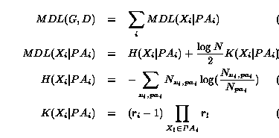
G:Graph , U = ( X₁ , .. , X_{n} ) ,
DL = DL(Data) + DL(Model)
DL(Model) : Penalty for complexity , # parameters to
represent each(i–j) state.
DL(Data|G) : for each case u, use - log P(u|G) as an optimal encoding length (Huffman code)
H term : N * conditional entropy(X|Pa)

Slide 5


Assume: X₁ < .. < X_{n} to reduce search complexity
MDL(G,D) is minimized iff each local score is minimized : Find a subset Pa for each X that
minimizes MDL(X|Pa) [here each Parent set can be independently selected.]
For each X_{i} , sets to search for the Parent set and total of sets.

Slide 6
Previous algorithms
K2: Cooper and Herskovits(1992), BD score
K3: K2 with MDL score
Branch-and-bound: Suzuki(1996)
MDL(X|Pa) = H + (log N /2)*K
(K= #parameters for parents, H= N*empirical entropy)
Adding a node to Pa : K increases by K(old)*(r-1),
while H decreases no more than H(old)
if H(old) < ΔK : positive MDL
and further search is unnecessary
Smaller H for the speed of pruning
lower bound of MDL: MDL >= (log N /2)*K

Slide 7
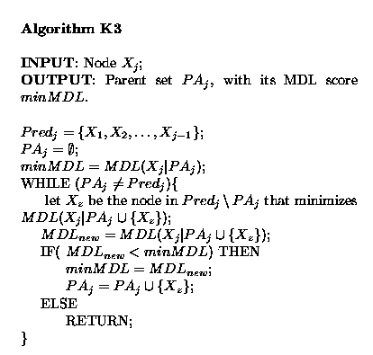

Slide 8
Search Space
Problem: Find a subset of U_{j} ={X₁ , .. , X_{j-1}} that minimize the MDL score.
Search space: states-operators set
State: a subset of U_{j} (node)
Operator: adding an X (edge)
In a search Tree, a state T with l variables is {X_{k1}, .. , X_{kl} } where X_{k1} < .. < X_{kl} are ordered. (Tree order).
A legal operator: Adding a single variable after X_{il .}

Slide 9
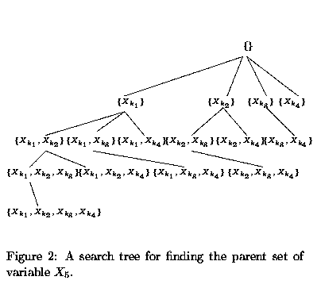
(A serach for the parents of X₅ )
The search tree for X_{j} has 2^{j-1} nodes and the tree depth is j-1

Slide 10
Branch-and-Bound Algorithm
In finding a parent of X_{j} , assume we are visiting a state T = {.., X_{kl}} and let W be the set of rest variables. We want to decide if we need to visit the branch below T’s child : T ∪ {X_{q}}, X_{q} ∈ W .
Pruning: Find initial minMDL from K3 (speedy) and compare with the lower bound
of MDL of that branch.

Slide 11



Lower bound (Suzuki):
Better lower bound:
Pruning:
If
, all branches below T ∪ {X_{q}} can be pruned.

Slide 12
In node ordering: X_{k1} < .. < X_{k(j-1)} ,
X_{k1} appears least, X_{k(j-1)} appears most.
Tree Order as:
H(X_{j}|X_{k1})<= H(X_{j}|X_{k2})<= .. <=H(X_{j}|X_{k(j-1)})
Result: Most of the lower bounds have larger
values.
Visiting of fewer states.

Slide 13
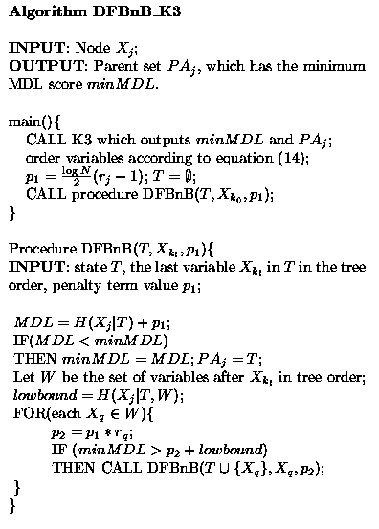

Slide 14
Empirical Results
ALARM(37 nodes, 46 edges)
Boerlage92(23 nodes, 36 edges)
Car-Diagnosis_2(18 nodes, 20 edges)
Hailfinder2.5(56 nodes, 66 edges)
A(54 nodes, dence edges)
B(18 nodes 39 edges)

Slide 15
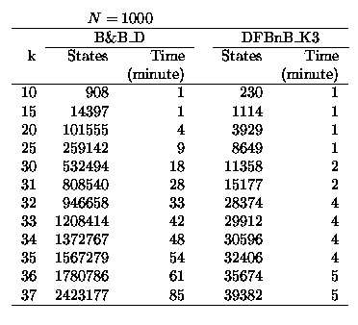

Slide 16
