Slide 1
Data Analysis with Bayesian Networks: A Bootstrap Approach
Nir Friedman, Moises Goldszmidt,
and Abraham Wyner, UAI99

Slide 2
Abstract
Confidence on learned Bayesian networks
  Edges
    How can we believe that the presence of an edge is true?
  Markov blankets
    The Markov blanket of a variable is true?
  Order relations
    The variable Y is ancestor of the variable X?
Especially for small datasets, this problem is so crucial.
Efron’s Bootstrap approach was used in this paper.

Slide 3
Sparse datasets
An application of Bayesian networks to molecular biology
Thousands of attributes and at most hundreds of samples
How can we separate the measurable “signal” from the “noise”?

Slide 4
Learning Bayesian networks
Given data D, find the network structure with high score.
  Bde score and MDL score
Search space is so large.
  Exponential order
Greedy hill-climbing with restart can be used.

Slide 5
Partially Directed Acyclic Graphs (PDAGs)
The network structure with directed and undirected edges.
  The undirected edge allows both directions.
    X – Y represents both X → Y and Y → X.
  In the case that both directions have the same score, we only have to allow both directions in the network.
    The accurate causal relationship can not be guaranteed by the dataset.

Slide 6

The Confidence Level of Features in the Network
Edges, Markov blankets, and order relations
  Above quantity can be regarded as the probability of the feature f’s presence in the Bayesian network induced from the samples of size N.

Slide 7


Non-Parametric Bootstrap
For i = 1, 2, …, m
  Re-sample, with replacement, N instances from D. Denote the resulting dataset by D_{i}.
  Apply the learning procedure on D_{i} to induce a network structure
For each feature of interest, define

Slide 8


Parametric Bootstrap
Induce a network B from D
For i = 1, 2, …, m
  Sample N instances from B. Denote the resulting dataset by D_{i}.
  Apply the learning procedure on D_{i} to induce a network structure
For each feature of interest, define

Slide 9
Empirical Evaluation
Synthetic datasets from alarm, gene, text networks were used.
N = 100, 250, 500, 1000
Bootstrap sampling size was 10 and the number of re-sampling, m was 100.

Slide 10
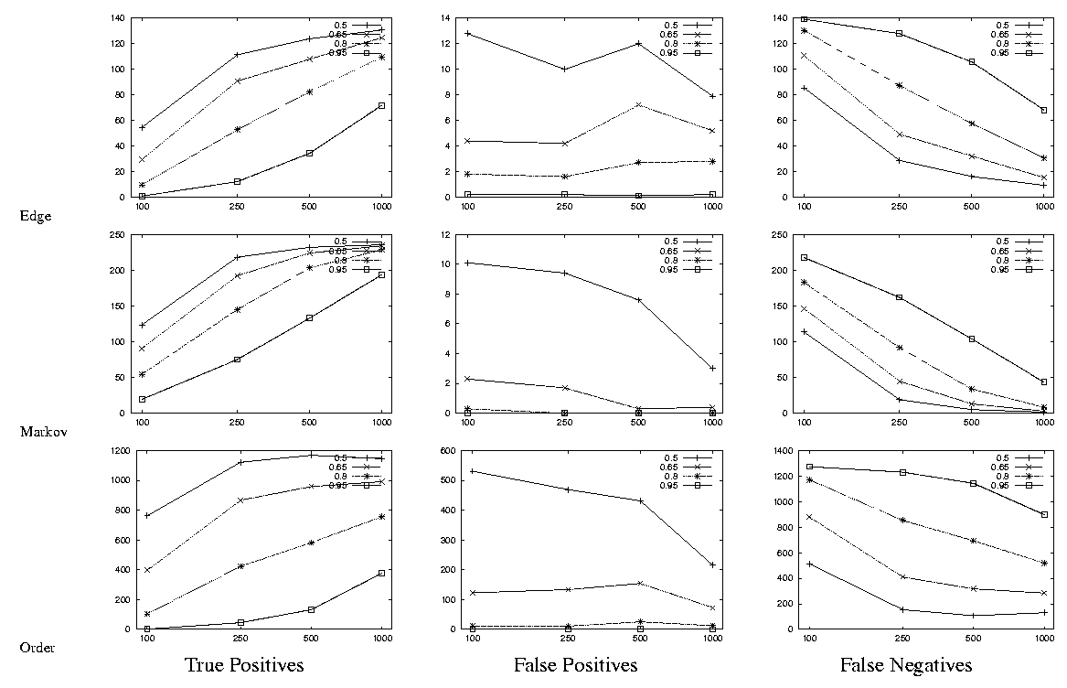
Results on the Alarm Network

Slide 11
Threshold Setting
The appropriate threshold setting is due to the problem domain.
  0.8 was best to the alarm network and 0.65 was best to the text network.

Slide 12
Robust features
Order relations and Markov blankets were robust to small dataset, but edges were sensitive to the sample size.

Slide 13
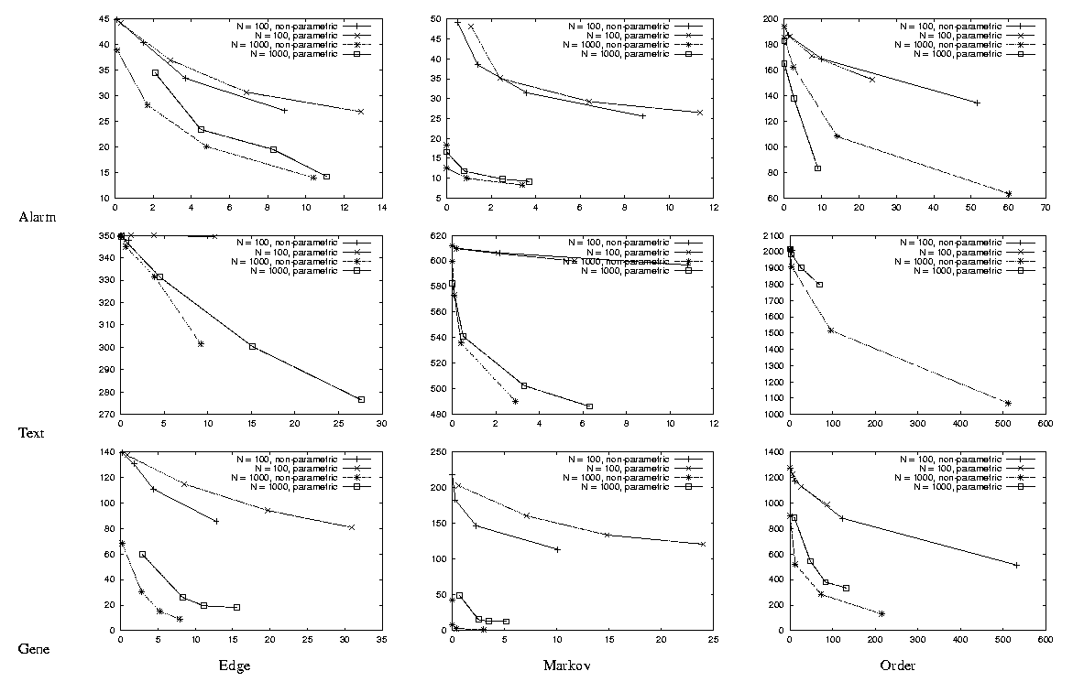
The Comparison of Parametric and Non-Parametric Bootstrap

Slide 14
Bootstrap for Network Induction
Some constraints according to the threshold values from bootstrapping.

Slide 15
Conclusions
The bootstrap estimates are quite cautious. Features induce with high confidence are rarely false positive.
The Markov blanket and partial ordering amongst variables are more robust than the existence of edges.

