Slide 1
Varieties of Helmholtz Machine
Peter Dayan and Geoffrey E. Hinton,
Neural Networks, Vol. 9, No. 8, pp.1385-1403, 1996.

Slide 2
Helmholtz Machines
Hierarchical compression schemes would reveal the true hidden causes of the sensory data and that this facilitate subsequent supervised learning.
  Easy to unsupervised learning via unlabelled data.

Slide 3
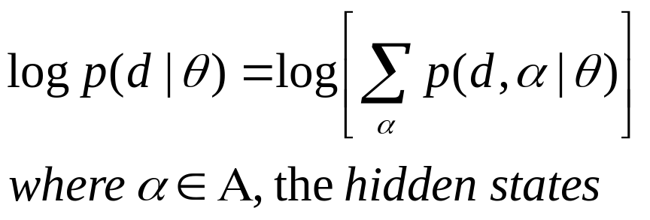
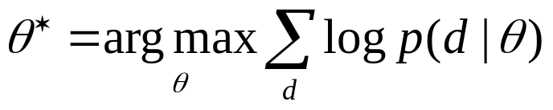
Density Estimation with Hidden States
log-likelihood of observed data vectors d
maximum likelihood estimation

Slide 4
The Helmholtz Machine
The top-down weights
  the parameter θ of the generative model
  unidirectional Bayesian network
  factorial within each layer
The bottom-up weights
  the parameter φ of the recognition model
  another unidirectional Bayesian network

Slide 5
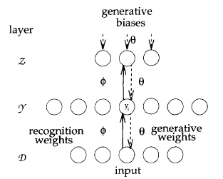

Slide 6
Another view of HM
Autoencoders
  the recognition model : the coding operation of turning inputs d into stochastic odes in the hidden layer
  the generative model : reconstructs its best guess of the input on the basis of the code that it sees
Maximizing the likelihood of the data can be interpreted as minimizing the total number of bits it takes to send the data from sender to receiver

Slide 7
The deterministic HM
- Dayan et al. 1995 (NC)
Approximation inspired by mean-field methods
replacing stochastic firing probabilities in the recognition model by their deterministic mean values.
Advantage
  powerful optimization method
disadvantage
  incorrect capturing of recognition distribution

Slide 8
The stochastic HM
- Hinton et al. 1995 (Science)
Capture the correlation between the activities in different hidden layers.
Wake-sleep algorithm

Slide 9
Variants of the HM
Unit activation function
reinforcement learning
alternative recognition models
supervised HM
modeling temporal structure

Slide 10
Unit Activation Function
The wake-sleep algorithm is particularly convenient for changing the activation functions.

Slide 11
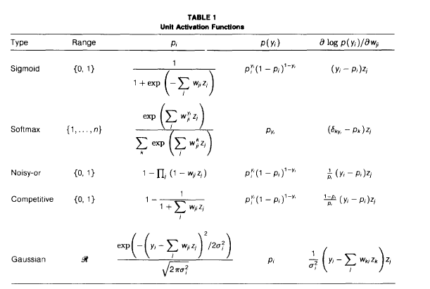

Slide 12
The Reinforcement
Learning HM
This methods only for correctly optimizing recognition weights.
can makes learning very slow.

Slide 13
Alternative Recognition Models
Recurrent Recognition
  Sophisticated mean field methods
  Using E-M algorithm
  Only generative weights
  But poor results

Slide 14
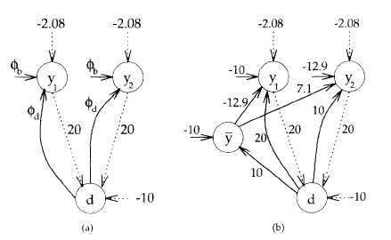
Alternative Recognition Models
Dangling Units
  For XOR problem (explanation away problem)
  No modification of wake-sleep algorithm

Slide 15
Alternative Recognition Models
Other sampling methods
  Gibbs sampling
  Metropolis algorithm

Slide 16
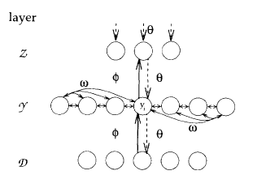
Alternative Recognition Models
The Lateral HM
  Recurrent weights within hidden layer.
  Only recognition model
  Recurrent connections into the generative pathway of HM → Boltzmann machine.

Slide 17
Alternative Recognition Models
The Lateral HM
  During wake phase
    Using stochastic Gibbs sampling
  During sleep phase
    Generative weights updated
    Samples is produced by generative weights and lateral weights

Slide 18
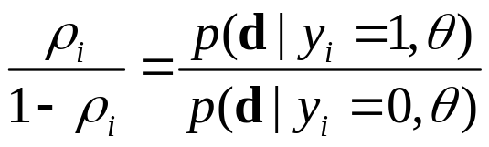

Alternative Recognition Models
The Lateral HM
  Boltzmann machine learning methods can be used.
  Recognition models
    Calculate
    Use Boltzmann machine methods
    For learning

Slide 19
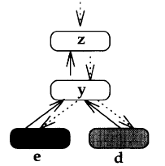
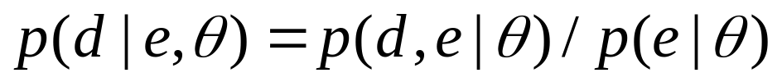
Supervised HMs
Supervised learning → p(d|e)
  e : input, d : output
First model
  Not good architecture

Slide 20
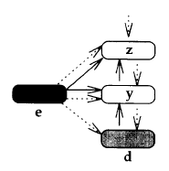
Supervised HMs
The Side-Information HM
  e as extra input to both recognition and generative pathway during learning
  Standard wake-sleep algorithm can be used.

Slide 21
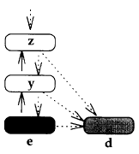
Supervised HMs
The Clipped HM
  To generate samples over d
  Standard wake-sleep algorithm is used to train the e pathway
  The extra generative connections to d are trained during wake-phases once the weights for e have converged

Slide 22

Supervised HMs
The Inverse HM
  Takes direct advantage of the capacity of the recognition model in the HM to learn inverse distributions
  After learning, the units above d can be discarded

Slide 23
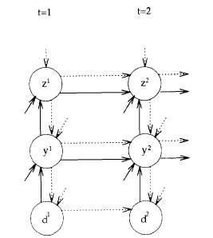
The Helmholtz Machine Through Time (HMTT)
Wake-sleep algorithm is used.

