Slide 1
On-Line Probabilistic Classification with Particle Filters
Pedro Højen-Sørensen, Nando de Freitas, and Torgen Fog, Proceedings of the IEEE International Workshop on Neural Networks for Signal Processing (NNSP2000), 2000 (to appear)
Cho, Dong-Yeon

Slide 2
Introduction
Sequential Classification Problems
  Condition monitoring and real-time decision systems
    Monitoring patients, fault detection problem
  Particle filter provide an efficient and elegant probabilistic solution to this problem.
    It becomes possible to compute the probabilities of class membership when the classes overlap and evolve with time.
    This classification framework applied to any type of classifier, but for demonstration purposes, multi-layer perceptrons (MLPs) are used.

Slide 3
Model Specification
Markov, Nonlinear, State Space Representation
  Transition model: p(θ_{t}|θ_{t–1})
    θ_{t} ∈R^{nθ} corresponds to the parameters (weights) of a neural network f(x_{t}, θ_{t})
    The parameters are assumed to follow a random walk θ_{t} = θ_{t–1} + u_{t}.
    The process noise could be Gaussian u_{t} ~ N(0, δ_{t}²I_{nθ})
  Observation model: p(y_{t}|x_{t},θ_{t})
    x_{t} ∈R^{nx} denotes the input data at time t.
    y_{t} ∈{0,1}^{ny} represents the output class labels.
    The likelihood of the observations should be given by the following binomial (Bernoulli) distribution

Slide 4
Estimation Objectives
  Our goal will be to approximate the posterior distribution p(θ_{0: t}|d_{1: t}) and one of its marginals, the filtering density p(θ_{t}|d_{1: t}), where d_{1: t} = {x_{1:t}, y_{1:t}}
    By computing the filtering density recursively, we do not need to keep track of the complete history of the parameters.

Slide 5
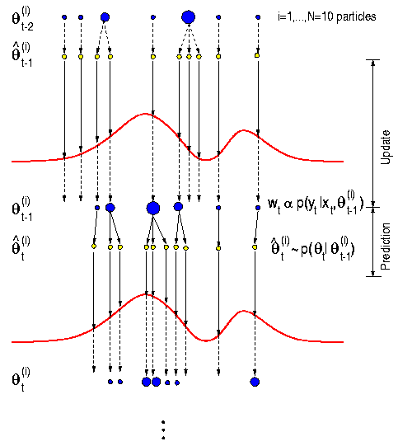
Particle Filtering

Slide 6
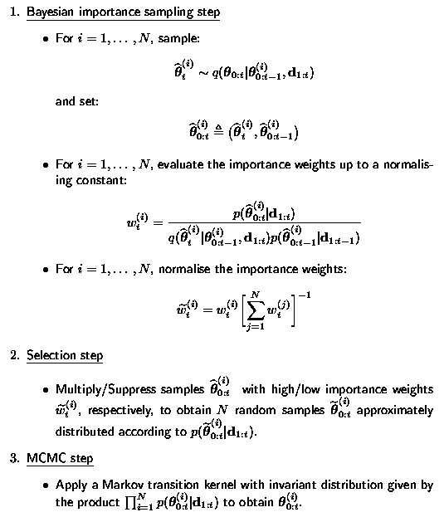
Generic Particle Filter for Classification

Slide 7
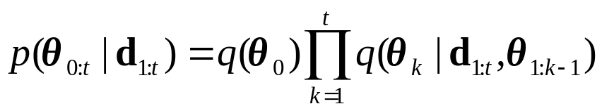
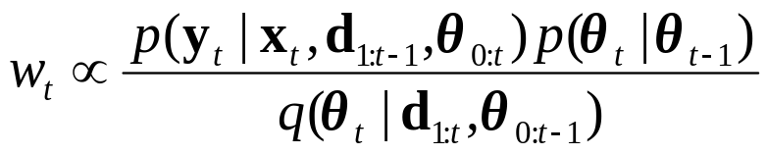

Bayesian Importance Sampling Step
  Importance functions
  Recursive formulas
  Transition prior p(θ_{t}|θ_{t–1}) is used as importance distribution for the MLPs.

Slide 8
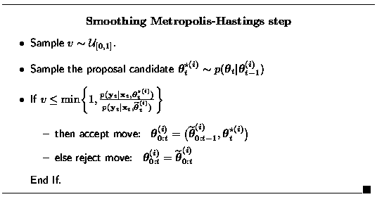
Selection Step
  E(N_{i}) = Nw_{t}^{(i)}
MCMC step
  A skewed importance weights distribution
    Many particles have no children, whereas others have a large number of children.

Slide 9
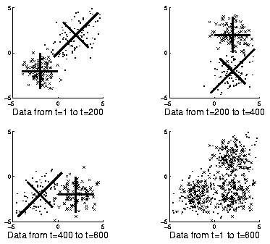
A Simple Classification Example
Experimental Setup
  An MLP with 4 hidden logistic functions and an output logistic function
  N = 200, δ_{t} = 0.2 (δ₀ = 10)

Slide 10
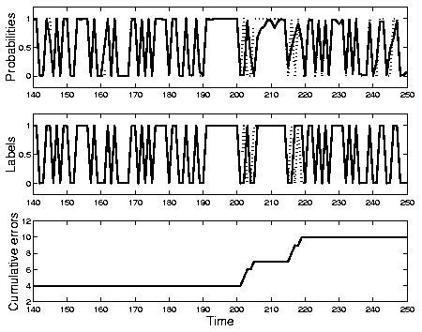
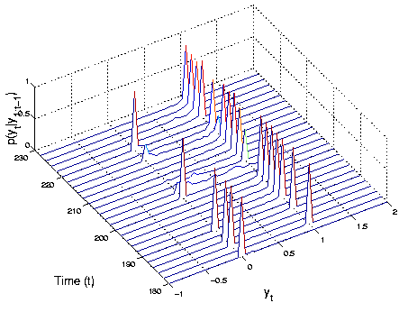
Results

Slide 11
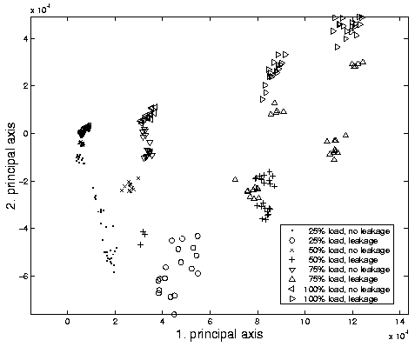
An Application to Fault Detection
Monitoring the exhaust valve condition in a marine diesel engine
  The main goal
    Detection of the leakage before the engine performance becomes unacceptable or irreversible damage occurs.

Slide 12
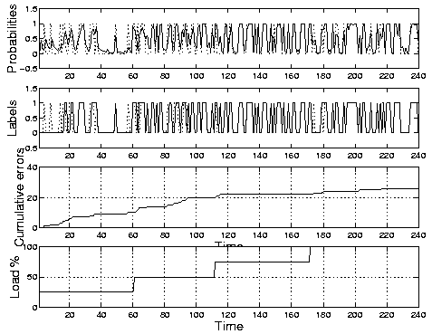
Experimental Setup and Results
  An MLP with 2 hidden unit and 5 input nodes (PCA is used for dimensionality reduction.)
  500 particles

Slide 13
Conclusions
We presented a novel on-line classification scheme and demonstrated it on two problems.
  We believe this strategy has great potential and that it needs to be further tested on other types of parametric classifiers and classification domains.

