Slide 1
Maximum a posteriori sequence estimation using Monte Carlo particle filters
S. J. Godsill, A. Doucet, and M. West
Annals of the Institute of Statistical Mathematics Vol. 52, No. 1, 2001.
조 동 연

Slide 2
Abstract
Performing maximum a posteriori (MAP) sequence estimation in non-linear non-Gaussian dynamic models
  A particle cloud representation of the filtering distribution which evolve through time using importance sampling and resampling ideas
  MAP sequence estimation is then performed using a classical dynamic programming technique applied to the discretised version of the state space.

Slide 3
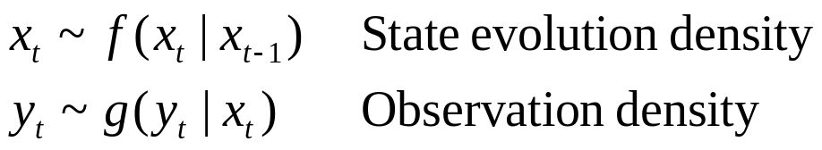
Introduction
Standard Markovian state-space model
  x_{t} ∈ R^{nx}: unobserved states of the systems
  y_{t} ∈ R^{ny}: observations made over some time interval
  f(.|.) and g(.|.): pre-specified densities which may be non-Gaussian and involve non-linearity
  f(x₁| x₀) ≡ f(x₀)
  x_{1:t}, y_{1:t}: collections of observations and states

Slide 4
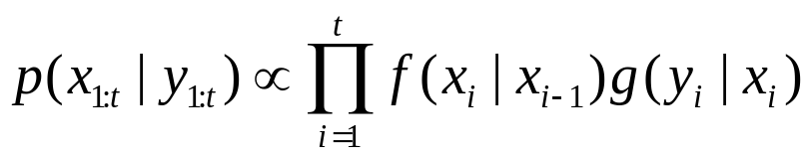
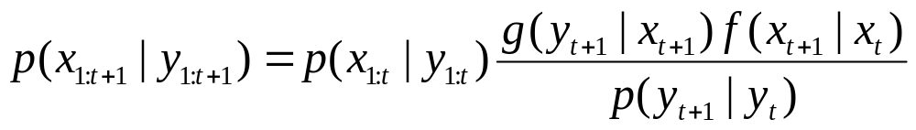
Joint distribution of states and observations
  Markov assumptions
  Recursion for this joint distribution
    Computing this can only be performed in closed form for linear Gaussian models using the Kalman filer-smoother and for finite state space hidden Markov models.
    Approximate numerical techniques

Slide 5
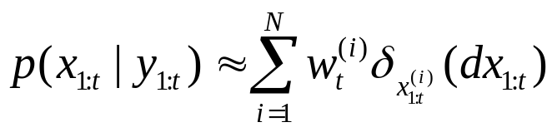
Monte Carlo particle filters
  Randomized adaptive grid approximation where the particles evolve randomly in time according to a simulation-based rule
    δ_{x0}(dx): the Dirac delta function located at x₀
    w_{t}^{(i)}: the weight attached to particle x^{(i)}_{1:t}, w_{t}^{(i)} ≥ 0 and ∑ w_{t}^{(i)} =1
    Particles at time t can be updated efficiently to particles at time t+1 using sequential importance sampling and resampling.
  Severe depletion of samples over time
    There are only a few distinct paths.

Slide 6
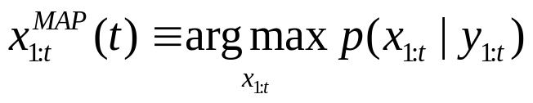
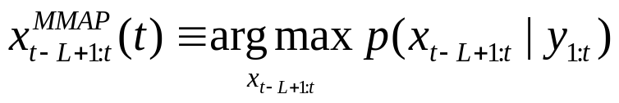
MAP estimation
  Estimation of the MAP sequence
  Marginal fixed-lag MAP sequence
  For many applications, it is important to capture the sequence-specific interactions of the states over time in order to make successful inferences.

Slide 7
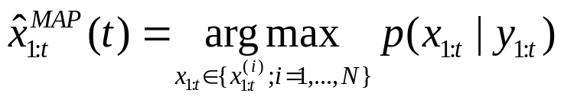
Maximum a Posteriori sequence estimation
Standard methods
  Simple sequential optimization method
    Sampling (sequentially in time) some paths according to a distribution q(x_{1:t})
    The choice of q(x_{1:t}) will have a huge influence on the performance of the algorithm and the construction of an “optimal” distribution q(x_{1:t}) is clearly very difficult.
    A reasonable choice for q(x_{1:t}) is the posterior distribution p(x_{1:t}| y_{1:t}) or any distribution that has the same global maxima.

Slide 8
  A clear advantage of this method
    It is very easy to implement and has computational complexity and storage requirements of order O(NT).
  A severe drawback
    Because of the degeneracy phenomenon, the performance of this estimate will get worse as time t increase.
    A huge number of trajectories is required for reasonable performance, especially for large datasets.

Slide 9
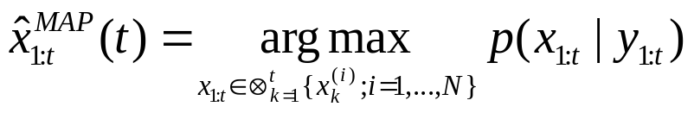
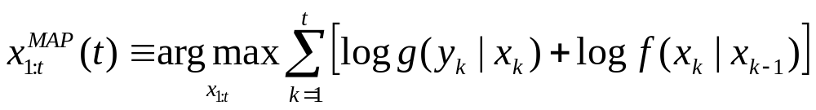
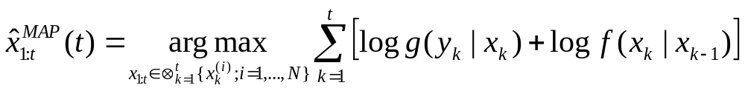
Optimization via dynamic programming
  Maximization of p(x_{1:t}|y_{1:t})
    The function to maximize is additive.

Slide 10

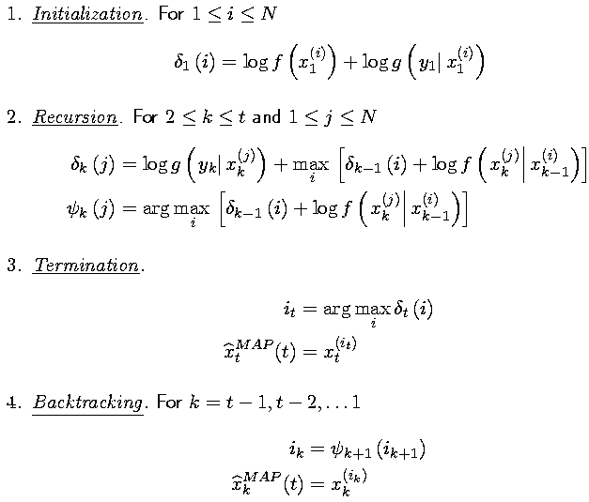
    Viterbi algorithm

Slide 11
  Maximization of p(x_{x-L+1:t}|y_{1:t})
    The algorithm proceeds exactly as before, but starting a time t-L+1 and replacing the initial state distribution with p(x_{x-L+1:t}|y_{1:t-L}).
    Computational complexity: O(N²(L+1))
    Memory requirements: O(N(L+1))

Slide 12
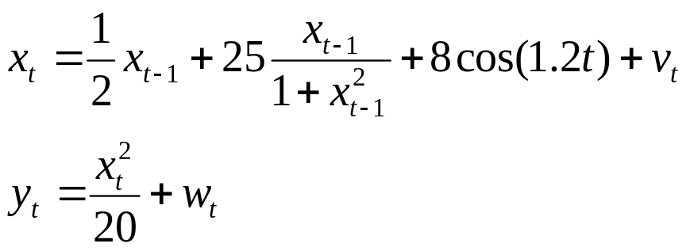

Examples
A non-linear time series

Slide 13
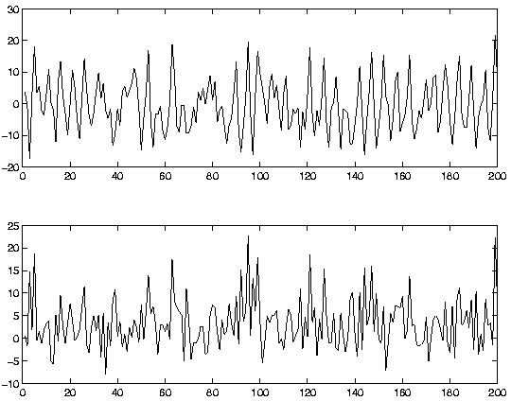
Simulated state sequence
Observations

Slide 14
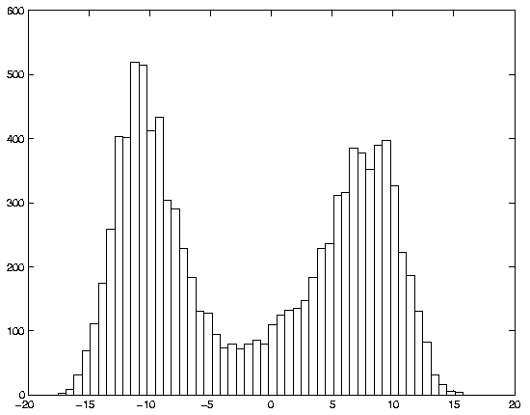
Filtering distribution p(x_{t}|y_{1:t}) at time t=14

Slide 15
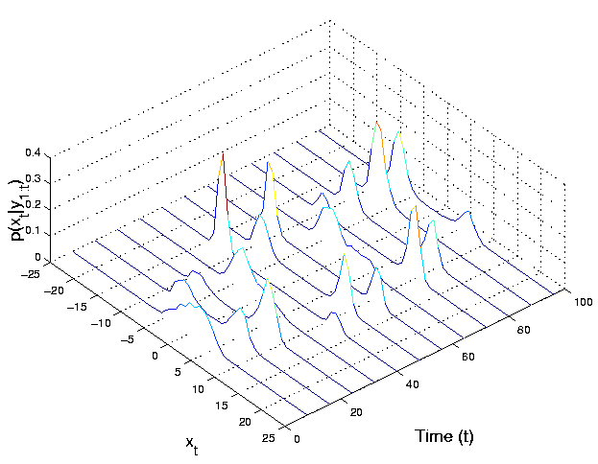
Evolution of the filtering distribution p(x_{t}|y_{1:t}) over time t

Slide 16
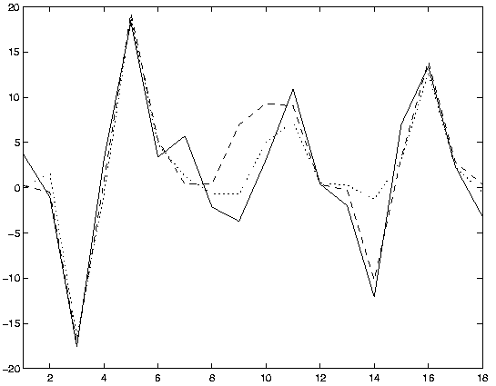
Simulated sequence (solid)
MMSE estimate (dotted)
MAP sequence estimate (dashed)

Slide 17
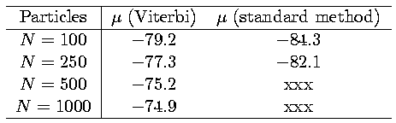
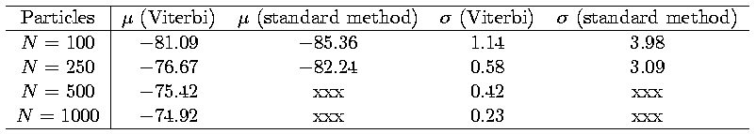
  Comparisons
    Mean log-posterior values of the MAP estimate over 10 data realization
    Sample mean log-posterior values and standard deviation over 25 simulations with the same data

Slide 18
    Viterbi algorithm outperforms the standard method and that the robustness in terms of sample variability improves as the number of particles increases.
    Because of the degeneracy phenomenon inherent in the standard method, this improvement over the standard methods will get larger and larger as t increases.

