Slide 1
Dynamic Modeling of Genetic Networks Using Genetic Algorithm and S-system
S. Kikuchi, D. Tominaga, M. Arita,
K. Takahashi, and M. Tomita
Bioinformatics,
vol. 19, no. 5, pp. 643-650, March 2003.
Cho, Dong-Yeon

Slide 2
Abstract
Motivation
  The modeling of system dynamics of genetic networks or signal transduction cascades from time-course data
    The estimation of only network structures
    Ineffective in inferring a network structure with feedback loops
  S-system formalism
  Genetic algorithm
    An additional term in its evaluation function that aims at eliminating futile parameters
    Simplex Crossover (SPX) to improve its optimization ability
    A gradual optimization strategy
Results
  PEACE1 (Predictor by EAs and Canonical Equations 1)

Slide 3
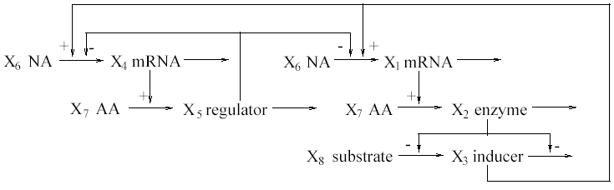
A Genetic Network (1/2)
A Typical Gene Interaction System
  Two genes

Slide 4
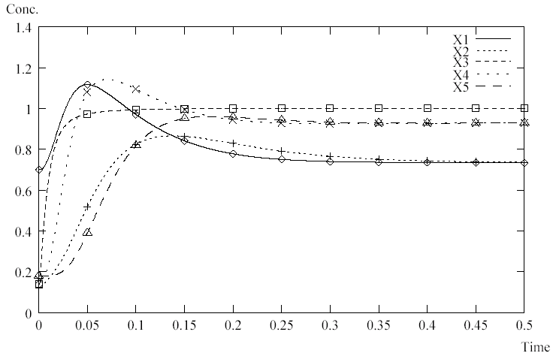
A Genetic Network (2/2)
Applied Time-Courses
  Initial concentration
    X₁ = 0.7, X₂ = 0.12, X₃ = 0.14, X₄ = 0.16, X₅ = 0.18

Slide 5
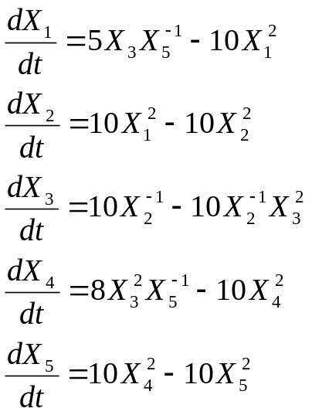
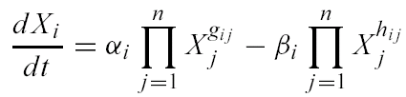
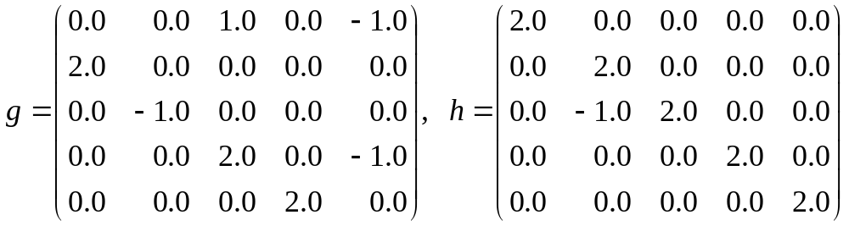
S-system Formalism
A Type of Power-Law Formalism
  2n(n+1) real-value parameters
  Previous example
    α = (5.0, 10.0, 10.0, 8.0, 10.0), β = (10.0, 10.0, 10.0, 10.0, 10.0)

Slide 6
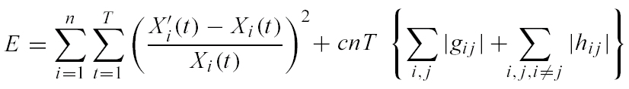
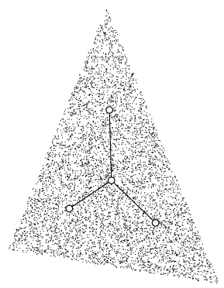
Optimization of S-system Parameters (1/2)
Real-Coded Genetic Algorithm
  Pruning method
  Simplex crossover

Slide 7
Optimization of S-system Parameters (2/2)
  Gradual optimization strategy
    (P1) Obtain skeletal structures by trails with different initial values using the GA for the S-system.
      Correct the higher-rank individuals that may have essential and common links.
    (P2) Use the higher-rank individuals as the subsequent initial individual groups. Apply the GA for the S-system to them.
      This detects common parameters from the multiple local minima.
    (P3) From the result of (P2), fix parameters judged unnecessary to 0, and return to (P1).
      The optimization procedure gradually becomes simpler.

Slide 8
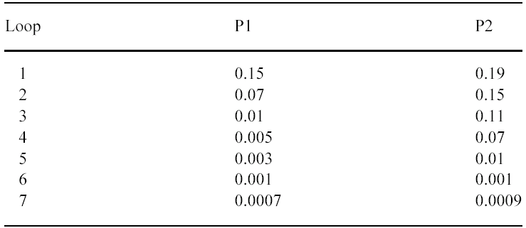
Experimental Results (1/2)
Data and Environments
  50 time-course data
  AIST CBRC Magi Cluster with 1040 CPUs and Pentium III 933MHz
    The time required for one loop was approximately 10 h.
  Applied values of c

Slide 9
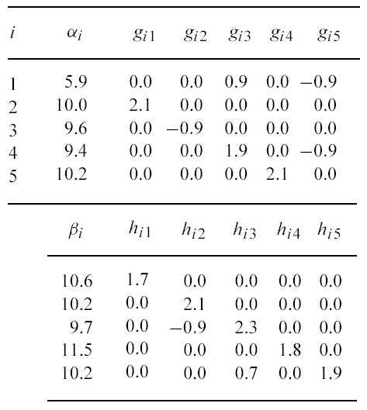
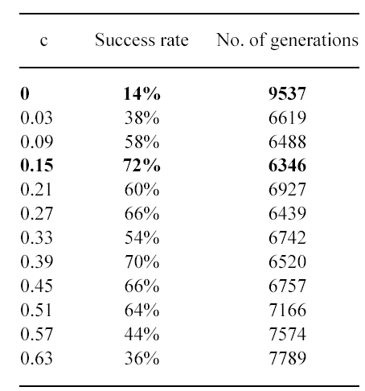
Experimental Results (2/2)
Results
  Parameters estimated by PEACE1
  Convergence rate

Slide 10
Discussion
Concluding Remarks
  The convergence rate increased about 5-fold.
  The optimization speed was raised about 1.5-fold.
  The number of predictable parameters was increased about 5-fold.
Weak points
  Optimization speed
  Learning structures and optimization parameters
  Coefficient of the complexity term

Slide 11
S-Tree
R
X₁
X₂
X₃
X₄
X₅
5
10
10
10
10
10
8
10
10
10
g_{1·}
h_{1·}
g_{2·}
h_{2·}
g_{3·}
h_{3·}
g_{4·}
h_{4·}
g_{5·}
h_{5·}
1
-1
2
2
2
-1
-1
2
2
-1
2
2
2
3
5
1
1
2
2
2
3
3
5
4
4
5

