Slide 1
Multi-criterion Optimization for Genetic Network Modeling
E. P. van Someren et al.,
Signal Processing, vol. 83, no. 4,
pp. 763-775, April 2003
Cho, Dong-Yeon

Slide 2
Abstract
Dimensionality Problem
  A major problem associated with the reverse engineering of genetic networks from micro-array data
    How to reliably find genetic interactions when faced with a relatively small number of arrays compared to the number of genes
  Additional knowledge about real genetic networks to sensibly constrain the modeling process
    Limited connectivity, redundancy, stability and robustness
  How multiple constraints can be combined by formulating genetic network modeling as a multi-criterion optimization problem

Slide 3
Introduction
Functional Genomic
  To infer regulatory interactions between genes from time-course micro-array data
  Dimensionality problem
    Data sets contain relatively few time-points (micro-arrays) compared to the number of genes
  Constraints
    Enforcing robustness
    Explicitly searching for limited connectivity

Slide 4
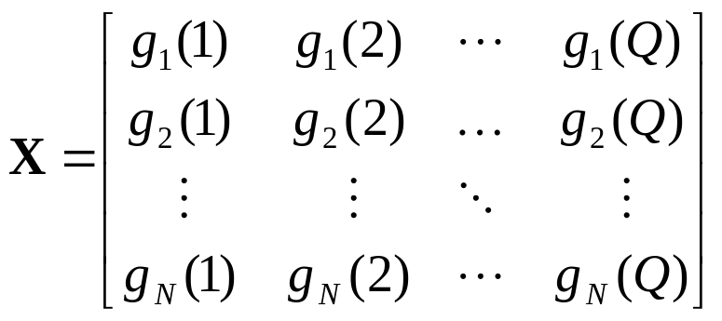
Learning Genetic Network Models (1/3)
Data
  A consecutive state of gene expression X = [x¹, x², …, x^{Q}]
    x^{q} = [g₁(q), g₂(q), …, g_{N}(q)]^{T}
    Pairs are constructed such that each input state x^{q} directly precedes the target (output) state x^{q+1}.

Slide 5

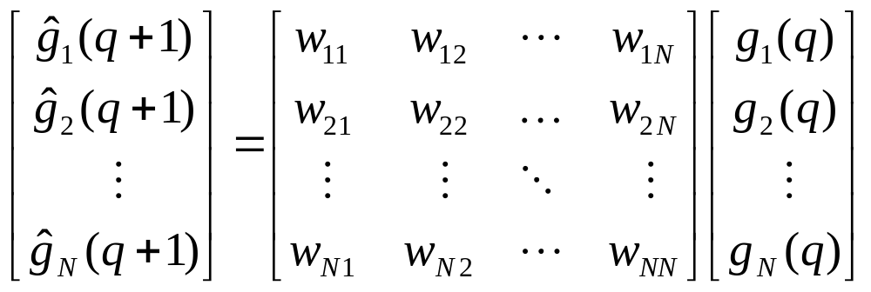
Learning Genetic Network Models (2/3)
Genetic Network model
  Representation of the genetic interactions
    It can predict (output) the consecutive states for a given state of gene expression.
  Linear genetic network model
    W: gene regulation matrix
    Consider only the estimation of weights in the ith row of W

Slide 6
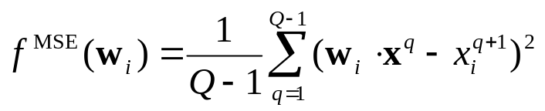
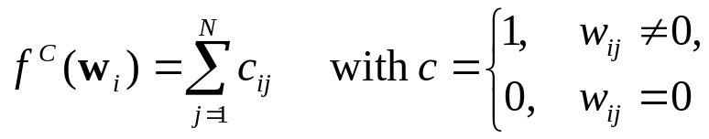
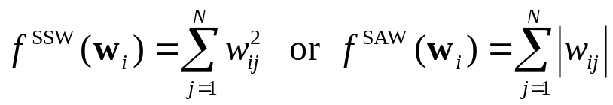
Learning Genetic Network Models (3/3)
Multi-criterion
  Mean squared error (MSE)
  Connectivity
  Sum of the squared (or absolute) weight (SSW or SAW)

Slide 7
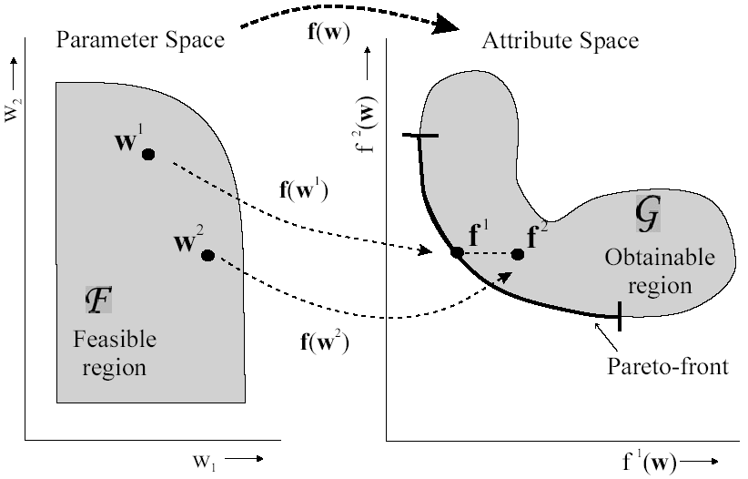
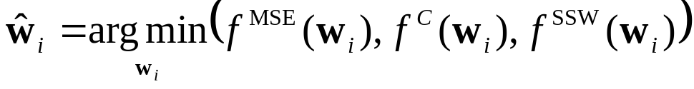
Solving the Multi-Criterion Optimization Problem (1/2)

Slide 8
Solving the Multi-Criterion Optimization Problem (2/2)
4 methods to estimate the Pareto-front in 3D space
  Random sparse solutions (RSS_K)
    A set of K random sparse solutions
  Exhaustive ridge (ER)
    25 ridge regression solutions for all possible structures of all possible connectivity levels
  Greedy ridge (GR)
    Starting at zero connectivity and stopping at full connectivity
    Add those connections to an intermediate solution that reduce the MSE the most
  Forward-TopK ridge (FTKR)
    It keeps track and expands a set of K intermediate solutions rather than a single solution

Slide 9
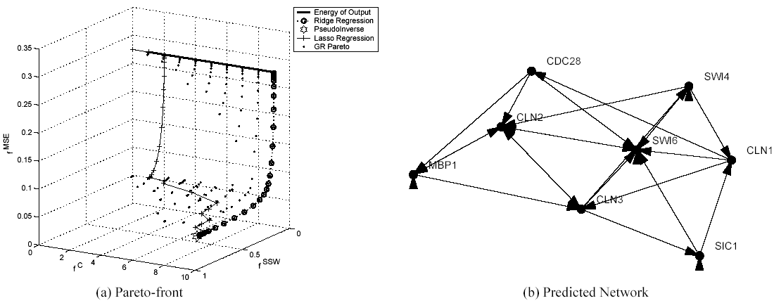
Experiments (1/3)
Real data
  A small sub-set of 8 cell-cycle related genes
    S. Cerevisiae
    18 time-points from the Alpha dataset [Spellman et al., 1998]

Slide 10
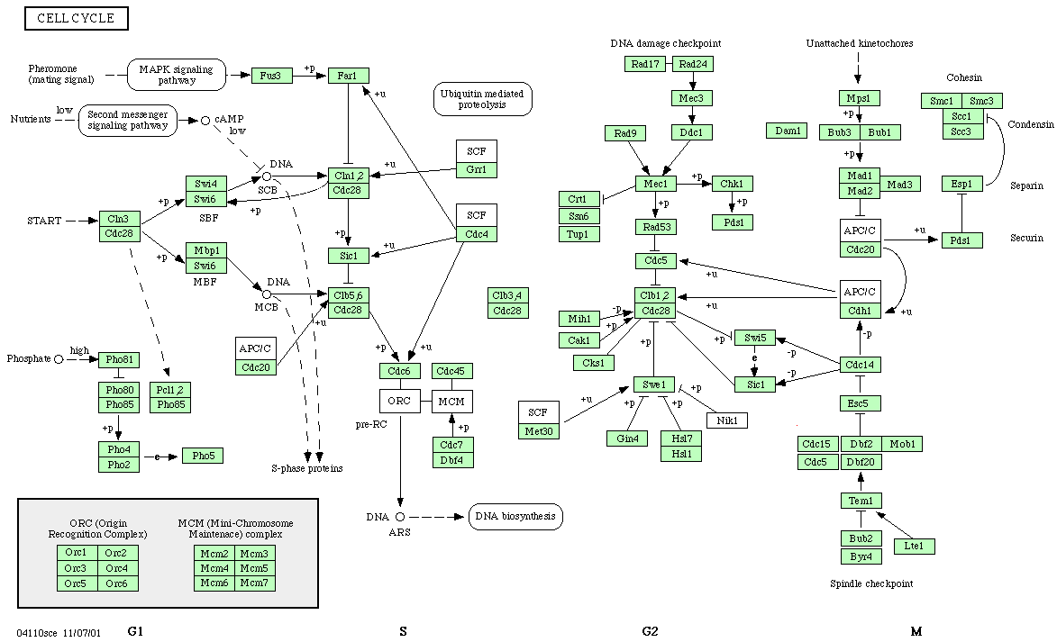
Experiments (2/3)
  KEGG database

Slide 11
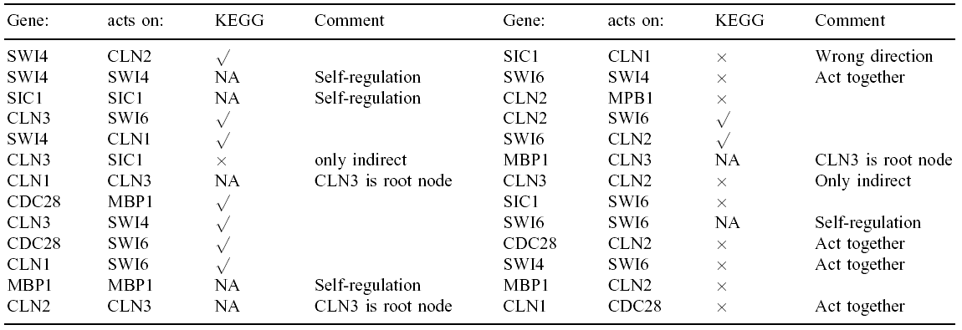
Experiments (3/3)
  Predicted interactions sorted on weight-strength

Slide 12
Discussion
Genetic Network Modeling
  Multi-criterion optimization problem
    Pareto-optimal solutions
    Choosing a single solution on the Pareto-front is far from trivial.
  A limited set of micro-array experiments
    Is it possible to make the meaningful inference of genetic interactions?

