Slide 1
Stochastic Fluctuations of the Synaptic Function
Francesco Ventriglia, Vito Di Maio
BioSystems, vol. 67, pp.287-294, 2002
Chung, Ho-Jin
Mar. 5, 2003

Slide 2
Introduction
The communication between neurons occurs at specialized junction called synapses.
Synaptic activity is necessary for computation of neural brain structures or neural coding.
The quantal Excitatory Postsynaptic Currents (EPSCs) produced by stimuli arriving to a single synapse had peak amplitudes in experimental procedure.
Stochastic variability of the synaptic response to quantal release of neurotransmitters is due to three factors.

Slide 3
Synaptic transmission
http://www.sumanasinc.com/webcontent/anisamples/neurobiology/synaptictransmission.html

Slide 4
Model (1/4)
Modeling synaptic fluctuations considering three factors; the concentration value of Glutamate within a vesicle, the volume and the position of the vesicle in presynapse.
Assumed that
  Each vesicle is filled with a predetermined number of neurotransmitters distributed uniformly.
  A presynaptic spike arrives at a time t=o, starting the activation of a fusion pore.
  AMPA receptors and NMDA receptors are randomly disposed on the Post Synaptic Density (PSD).
  Tiles encompassed by the PSD perimeter contained receptors (one receptor per tile).

Slide 5
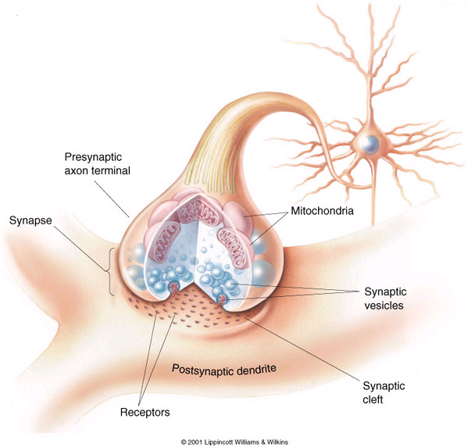
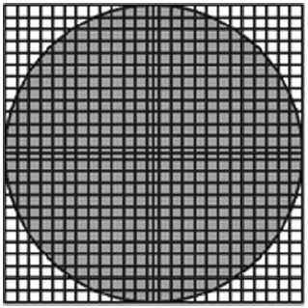
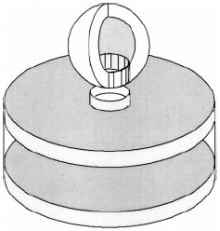
Tile
presynapse
postsynapse

Slide 6
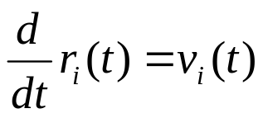
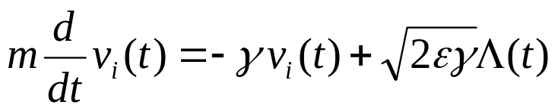


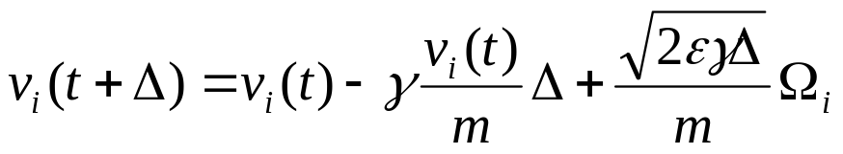


Model (2/4)
Brownian motion of glutamate: Langevin equation
  r_{i}: position of glutamate v_{i}: velocity of glutamate
  m: mass i: ith of the N_{m} molecules contained in a vesicle
  γ: friction parameter
  white Gaussian noise
Time discretized Langevin equation:
  Ω_{i}: random vector with three components, each following N~(0, 1)

Slide 7
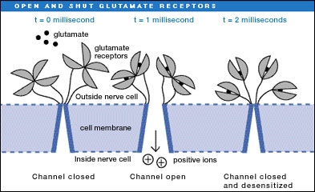
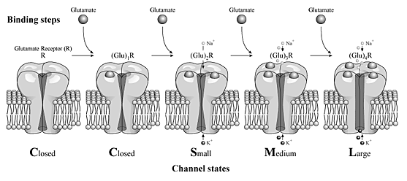
Model (3/4)
Assumed that
  Only AMPA receptors could contribute to the EPSC formation.
  Each receptor had two binding sites for glutamate.
    Four channel states: Basal (B)-closed, Active (A)-open, Inactivable (I)-closed, Desensitized (D)-closed
    B₀ B₁ B₂  A₂  I₂  D₂
    (0: unbound, 1: single-bound, 2: double-bound)

Slide 8
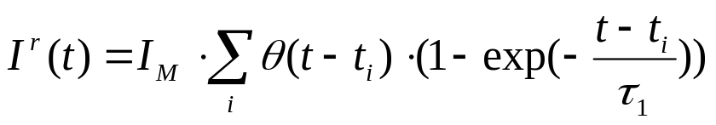
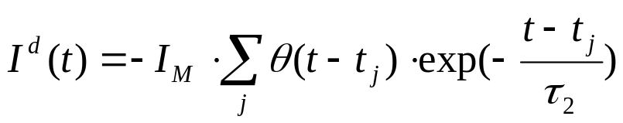

Model (4/4)
Transition states B₂  A₂
  Opening time τ_{o} and closing time τ_{c}
Changes induced on the postsynaptic response: quantal EPSC
  I^{r}(t): incremental contribution to the postsynaptic current produced by the channels in the active open state
  I^{d}(t): decremental contribution to the postsynaptic current of the channels in inactivated states
  t_{i}: opening time of the ith channel t_{j}: closing time of the jth channel
  I_{M}: peak current conveyed by a single opened AMPA channel
  τ_{I}: rise constant τ_{j}: decay constant
  θ(·): step function (θ(x)=0 for x<0, θ(x)=1 for x≥0)

Slide 9
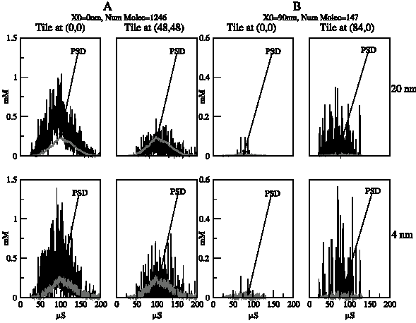
Simulations & Results
Fig.1 Concentration time course of glutamate in the synaptic cleft.
A: effect of a vesicle centered on the Active Zone (AZ), releasing 1246 glutamate
B: effect of a vesicle positioned at a distance of 90nm from the center of AZ, releasing 147 glutamate

Slide 10
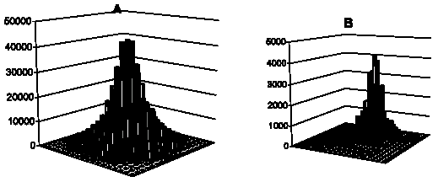
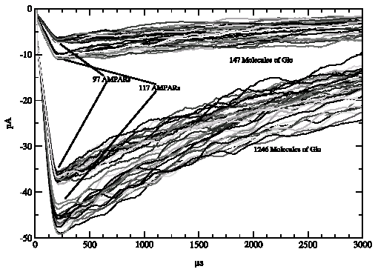
Simulations & Results
Fig. 2. Number of glutamate hits for each tile of the PSD grid during a complete vesicle release. A: 1246, B: 147 molecules
Fig. 3. EPSC ranges
Upper: 147 molecules in a vesicle positioned at 90nm from the center of AZ Lower: 1246 molecules Superior: tile side of 14nm Inferior: tile side of 12nm

Slide 11
Conclusion
The important presynaptic sources of variability such as the stochastic variation of glutamate concentration, volume and position of vesicles were considered in this paper.
The parameters used in simulation were based on empirically-derived data from literature.
The variability has importance in the understanding of neural coding.

