Slide 1
Calcium Sensitivity of Glutamate Release in a Calyx-Type Terminal
Science, vol. 289, no. 11, pp. 953-957, 2000.
Johann H. Bollmann et al.
2003. 6. 10.
Presented by Ho-Jin Chung

Slide 2
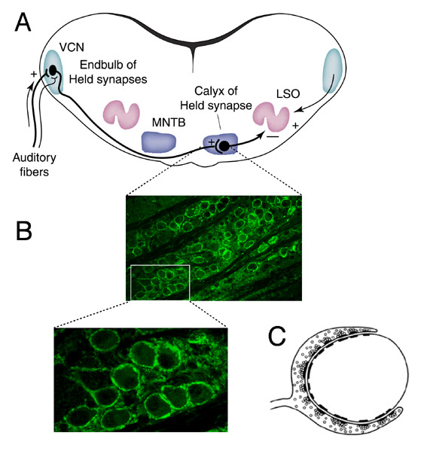
Calyx of Held
Fig. 2 The calyx of Held synapse.
  A: The calyx of Held is an excitatory, glutamatergic connection between presynaptic cells in the ventral cochlear nucleus (VCN) and postsynaptic neurons in the medial nucleus of the trapezoid body (MNTB).
  B: The immunocytochemical staining with an antibody against a presynaptic marker protein, Rab-3A, shows that the soma of each principal cell in the MNTB is surrounded by a large calyceal nerve terminal.
  C: The antibody was kindly provided by Prof. Jahn (Department of Neurobiology). The calyx of Held covers about 60 % of the somatic surface of the postsynaptic neuron, and contains hundreds of active zones. Its large size allows us, and other groups to make whole-cell patch-clamp recordings of this presynaptic terminal.

Slide 3
Phasic Release of Ca²⁺
In response to an action potential, the presynaptic release probability is strongly increased.
  This phasic release is thought to be triggered by a brief, localized increase in [Ca²⁺]_{i}.
  Two different assumptions have been suggested;
    A low-affinity Ca²⁺ sensor which is activated by local increase of [Ca²⁺]_{i} triggers phasic release.
    A high-affinity Ca²⁺ sensor triggers phasic release during more prolonged, delayed release period.
In this paper, they compared spatially uniform rise in presynaptic [Ca²⁺]_{i} with release triggered by action potential, during which changes in [Ca²⁺]_{i} are transient and highly localized.
  The measure of the releasable pool of vesicle is EPSC.

Slide 4
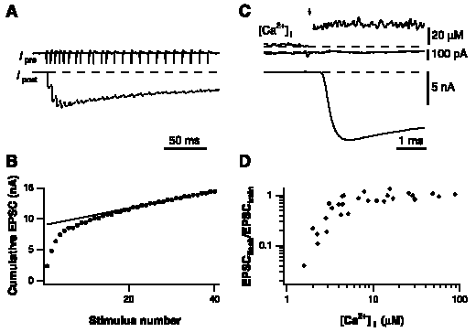
Rapid Depletion of the Release Vesicles by [Ca²⁺]_{i} Jumps
A: During the train, the size of the EPSCs evoked by action potential simultaneously recorded (a measure of the size of the releasable pool).
B: The peak-to-peak amplitudes of the individual EPSCs shown in (A) were summed to estimate the releasable pool size in the intact terminal.
C: UV laser pulse (arrow) evoked a rapid and sustained [Ca²⁺]_{i} increase. This increase in [Ca²⁺]_{i} resulted in a rapid, large EPSC.
D: Relative size of the EPSC evoked by the UV flash compared with the cumulative EPSC amplitude evoked by trains in the same terminals.

Slide 5
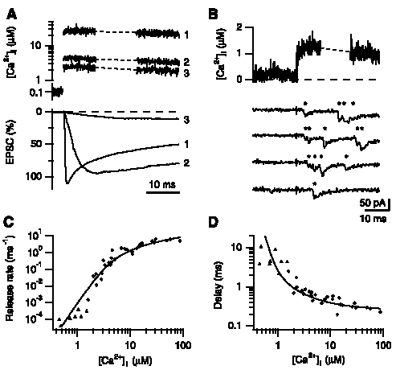
Relation Between [Ca²⁺]_{i} and the Rate of exocytosis in the Calyx of Held
A: Photodiode trace of [Ca²⁺]_{i} jumps
  Larger increases in [Ca²⁺]_{i} evoked EPSCs with a smaller delay and a shorter rise time.
B: A uniform increase of the [Ca²⁺]_{i} resulted in a increase in the frequency of small EPSCs.
C: Relation between peak release rates and [Ca²⁺]_{i}
D: [Ca²⁺]_{i} dependence of the delays between the [Ca²⁺]_{i} jump and the onset of release
→Ca²⁺ sensor binds Ca²⁺ rapidly before it triggers the final steps of transmitter release.

Slide 6
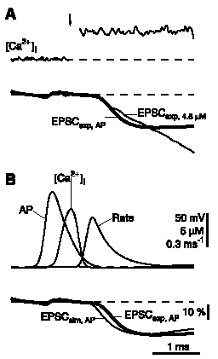
Comparison of Release Rates after Action Potentials and [Ca²⁺]_{i} jumps
A: A sustained increase of [Ca²⁺]_{i} to 5μM gave release rates similar to the ones observed during action potential.
B: Simulation of EPSCs evoked by a brief increase in [Ca²⁺]_{i}.

Slide 7
Conclusions
The transmitter release from the calyx of Held exhibited a high Ca²⁺ sensitivity compared with previous estimates.
The results suggest that binding of Ca²⁺ sensor to syntaxin is unlikely to be involved in the final steps before fusion at the calyx of the Held since it requires very high [Ca²⁺]_{i}.
The pahsic-release Ca²⁺ sensor equilibrated rapidly to changes in [Ca²⁺]_{I} and triggered release with a high maximal speed.

