Slide 1
Stochastic Context-Free Grammars for Modeling RNA
Y. Sakakibara, M. Brown, R. C. Underwood,
I. S. Mian, and D. Haussler
Proceedings of the 27th Hawaii International Conference on System Sciences
Jang HaYoung

Slide 2


Introduction
Phylogenetic analysis for homologous RNA molecules
  Alignment and subsequent folding of man sequences into similar structures.
Energy minimization
  Thermodynamic parameters and computer algorithms to evaluate the optimal and suboptimal free energy folding of an RNA species.

Slide 3
Introduction
HMM approach
  Two positions base-paired in the typical RNA are treated as having independent distributions.
Formal grammar
  Base pairing in RNA can be described by a context-free grammar

Slide 4
Base Pair Nesting
RNA base pairs are usually nested:
A G U G U C G G C U C A C U
Unnested RNA base pairs also occur
  Called pseudoknots
  Many algorithms ignore pseudoknots
A G U G U C A C U U C A C U G G A U G U

Slide 5
Context-free grammars for RNA
SCFG
  Generalization from HMM
  Learn the parameters from a set f unaligned primary sequences with a novel generalization of the forward-backward algorithm commonly used to train HMM
  Modularity: two separate grammars can be combined into a single grammar

Slide 6
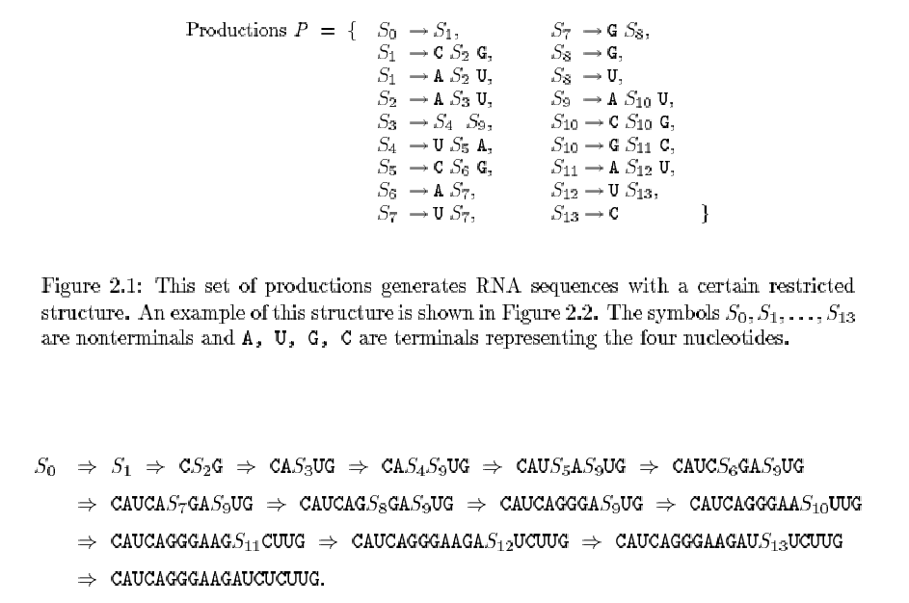
Context-free grammars for RNA

Slide 7
Context-free grammars for RNA
S→SS, S→aSa, S→aS, S→S, S→a
S→aSa: base pairings in RNA
S→aS, S→Sa: unpaired bases
S→SS: branched secondary structures
S→S: used in the context of multiple alignments

Slide 8
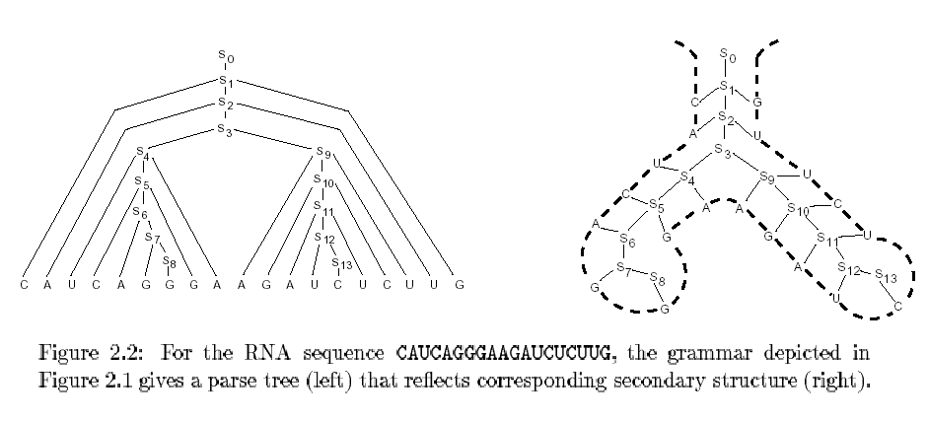
Context-free grammars for RNA

Slide 9
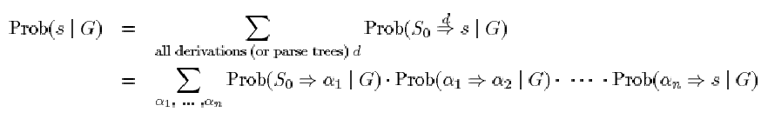

Stochastic context-free grammars
Stochastic context-free grammar G
The probability distribution of a parse tree can be calculated as the product of the probabilities of the production instances in the tree.
The probability of a sequence s is the sum of probabilities over all possible parse trees or derivations that could generate s

Slide 10
Estimating SCFG from sequences
Estimation Maximization training algorithm
  Theory of stochastic tree grammars
  Tree grammars are used to derive labeled trees instead of strings
  EM part readjust the production probabilities to maximize the probability of these parses.

Slide 11
Estimating SCFG from sequences
Design a rough initial grammar which might represent only a portion of the base pairing interaction.
Estimate a new SCFG using the partially folded sequences and our EM training algorithm.
Obtain more accurately folded training sequences and reestimate the SCFG

Slide 12
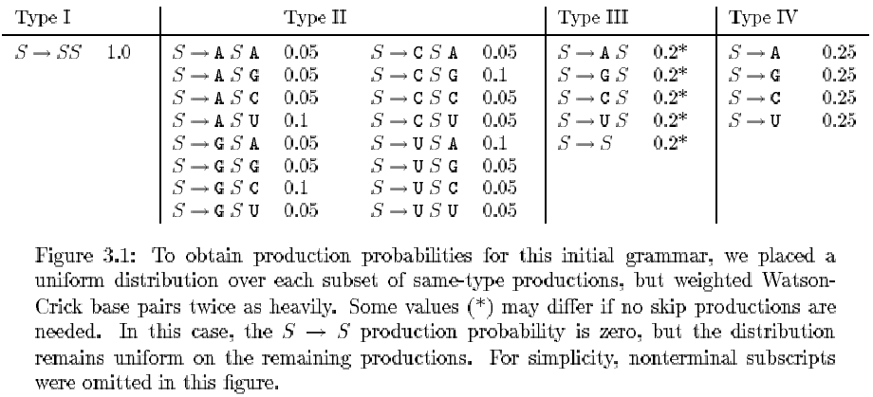
Experimental Result
A training set of unfolded and unaligned RNA sequences

Slide 13
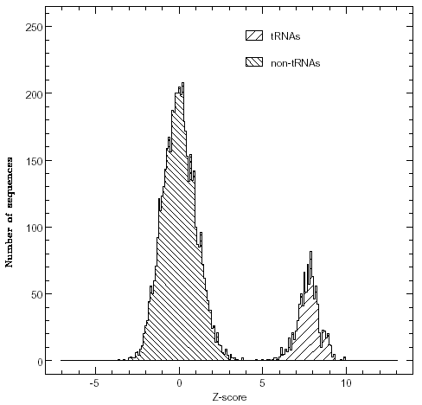
Experimental Result
Discriminating tRNAs
Multiple sequence alighments
Prediction of secondary structure
Introns

Slide 14
Discussion
SCFGs may provide a flexible and highly effective statistical method in a number of problems for RNA sequences.
How much prior knowledge about the structure of the RNA class being modeled is necessary

