Slide 1
RNAsoft: a suite of RNA secondary structure prediction and design software tools
Mirela Andronescu, Rosalía Aguirre-Hernández, Anne Condon and Holger H. Hoos
Nucleic Acids Research, 2003, Vol. 31, No. 13

Slide 2

RNAsoft
PairFold predicts the minimum free energy secondary structure formed by two input DNA or RNA molecules.
CombFold predicts which strand, out of a combinatorial set formed from DNA or RNA input strands, folds to a secondary structure with the lowest minimum free energy.
RNA Designer designs an RNA sequence that folds to a given input secondary structure. The tool is intended for designers of RNA molecules with particular structural or functional properties.
http://www.RNAsoft.ca

Slide 3
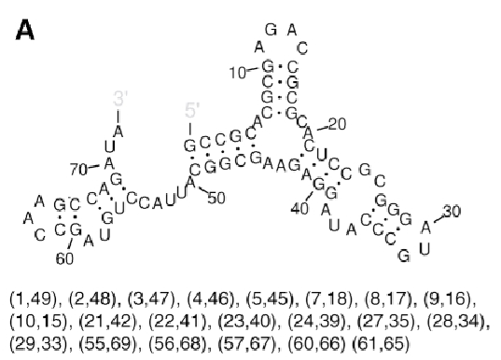

Pseudoknot Free Structure
If there are no base pairs (i, j) and (i’, j’) with i<i’<j<j’.

Slide 4
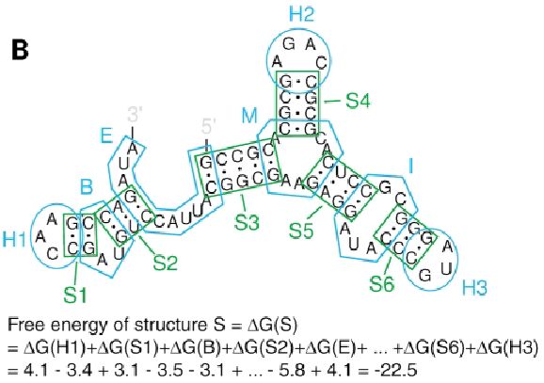
Free Energy Calculation For Structure

Slide 5

PAIRFOLD
Takes two RNA or two DNA sequences, R₁ and R₂, plus a temperature value in the range 0–100℃.
For RNA, the thermodynamics parameters from the Turner Group.
For DNA, the thermodynamic parameters from the laboratory of John SantaLucia Jr..
The algorithm uses dynamic programming and runs in time bounded by the cube of the lengths of the input strands.

Slide 6
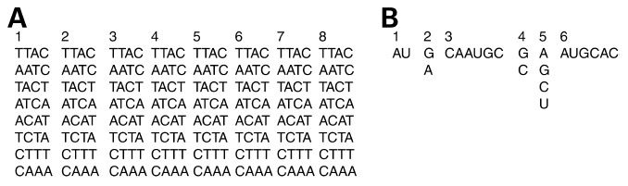
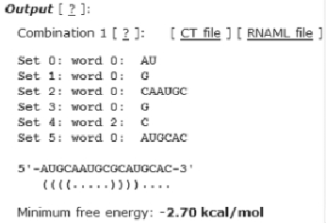
COMBFOLD
Predicts which strand from a combinatorial set of strands has the lowest minimum free energy secondary structure.

Slide 7
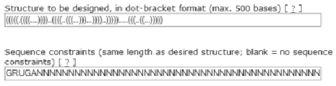
RNA DESIGNER
Takes as input a secondary structure description and outputs an RNA strand that is predicted to fold to that secondary structure.
Uses a stochastic local search algorithm, which decomposes the input structure in a hierarchical fashion.
Uses the fold routine from the Vienna RNA Package.

Slide 8
Extension
CombFold and an extended version of PairFold will be combined to determine the minimum strands taken over all of the possible orderings of the individual strands.
RNA Designer will support the design of complexes consisting of two or more RNA strands.

Slide 9
Compared With NACST/Sim
Thermodynamic model, but not nearest-neighbor model.
Multiple ordering, but not chain reaction.
Only two strands can be hybridized in PairFold.
Show the secondary structure explicitly.
Inverse folding as a objective function of the NACST/Seq.

