Slide 1
Phylogenetic Profile Analysis Using Matrix Factorization Methods
Jeong-Ho Chang
2003. 7. 10 (Thursday)

Slide 2
Phylogenetic Profile
Definition: a bit pattern that encodes the presence or absence of conserved genes in a set of organisms.
Application:
  Functional prediction of genes: when two genes share similar phylogenetic profiles, it is assumed that these genes are functionally correlated.
  Construction of genome trees: stems from the assumption that gene losses or acquisitions are major evolution phenomena.
O₁
O₂
O₃
O₄
O_{N}
O₁
O₂
O₃
O₄
O_{N}
…
…
G1:
1
0
0
1
1
G2:
1
0
1
0
0

Slide 3


Data Analysis by Matrix Factorization
residual
sample 1
sample 2
sample M
pattern 1
pattern K
pattern 2
attr 1
attr 1
attr 2
attr 2
sample 1
attr 3
attr 3
sample 2
sample M
pattern 1
×
pattern 2
pattern K
attr N-1
attr N-1
attr N
attr N

Slide 4
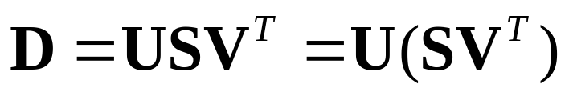
SVD
  U: columns contain the eigenvectors of DD^{T}.
  V: columns contain the eigenvectors of D^{T}D.
  S: the diagonal elements are square roots of eigenvalues of DD^{T} and D^{T}D.
If mean(D) = 0, this technique is closely related with principal component analysis.

Slide 5
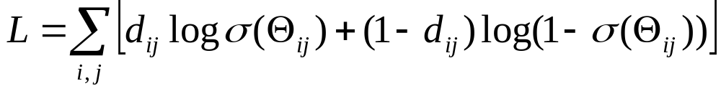

Logistic PCA (Schein, et al. 2003)
Dimensionality reduction technique for binary data, based on multivariate generalization of the Bernoulli distribution.
Formulation

Slide 6
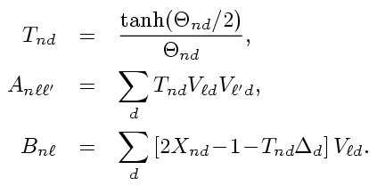

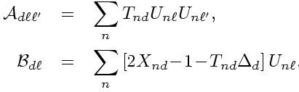



Logistic PCA: ALS Update
U update
V update
Δ update

Slide 7

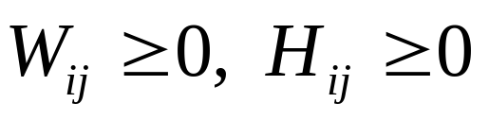
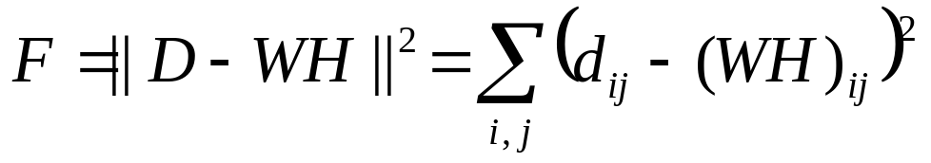
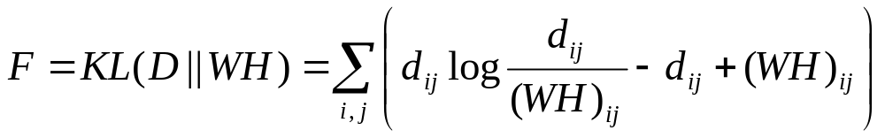
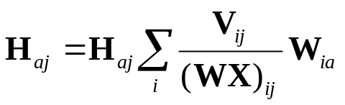
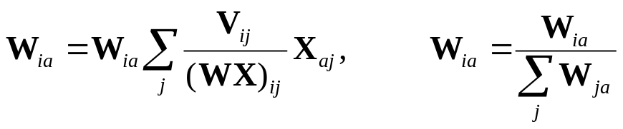
NMF (Lee & Seung, 1999)
Two objective functions
(1)
(2)
Parameter Update: (2)

Slide 8
Experimental Results

Slide 9
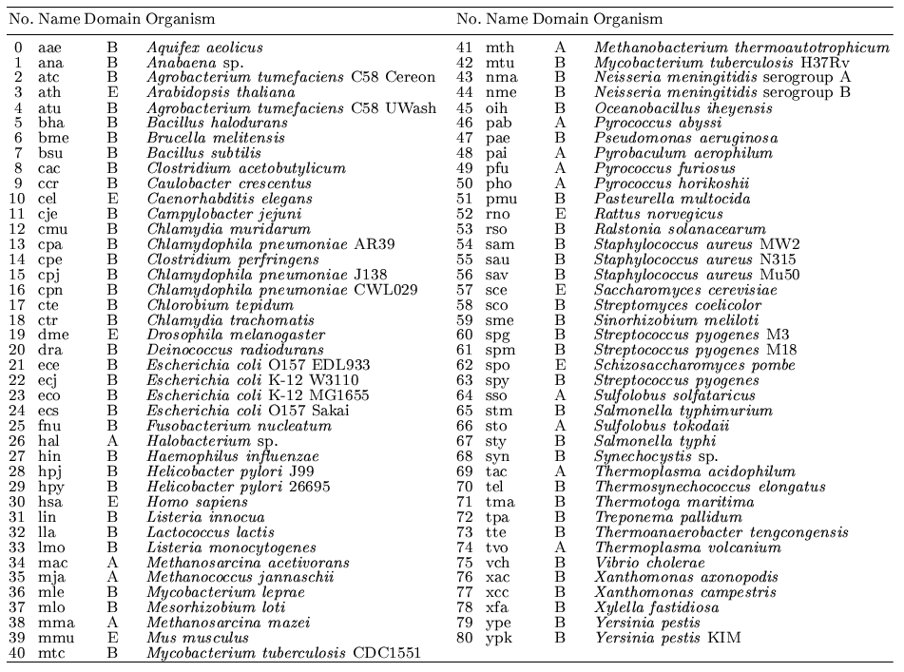
Data set
81 organisms included in the phylogenetic analysis

Slide 10
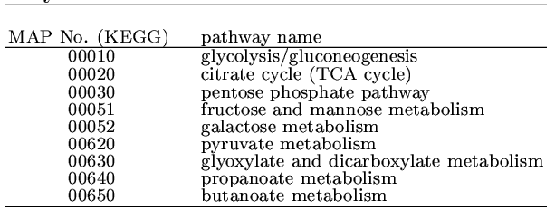
Data set (2)
9 reference pathways used in the analysis
Number of Enzymes: 350

Slide 11
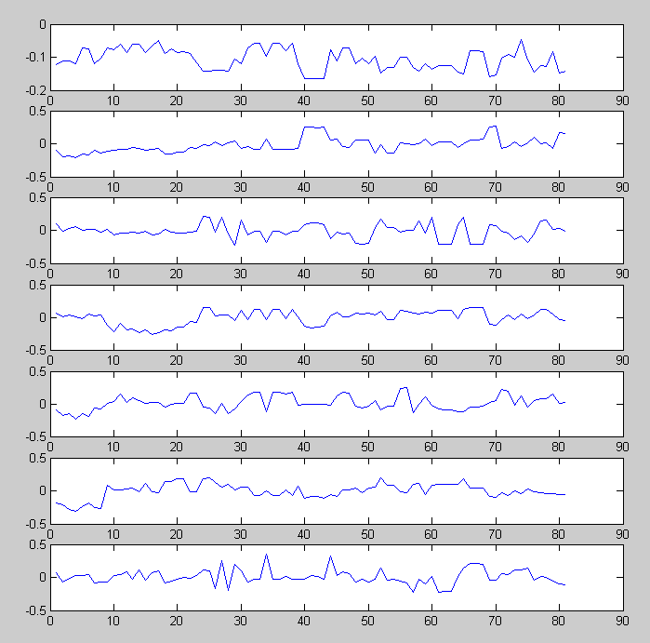
SVD

Slide 12
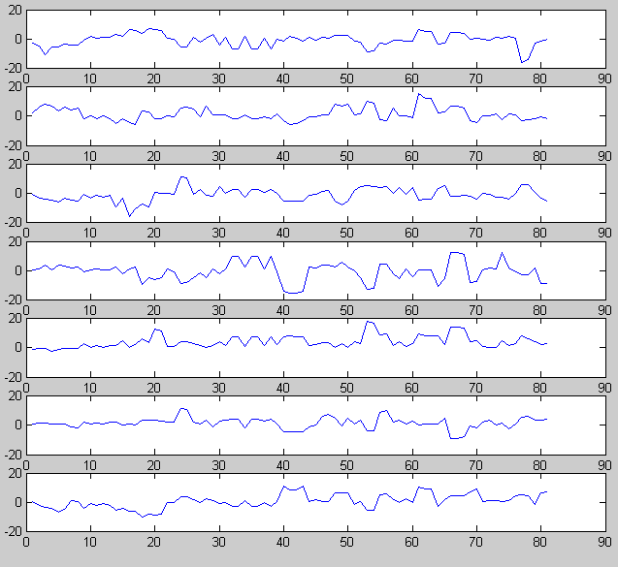
Logistic PCA

Slide 13
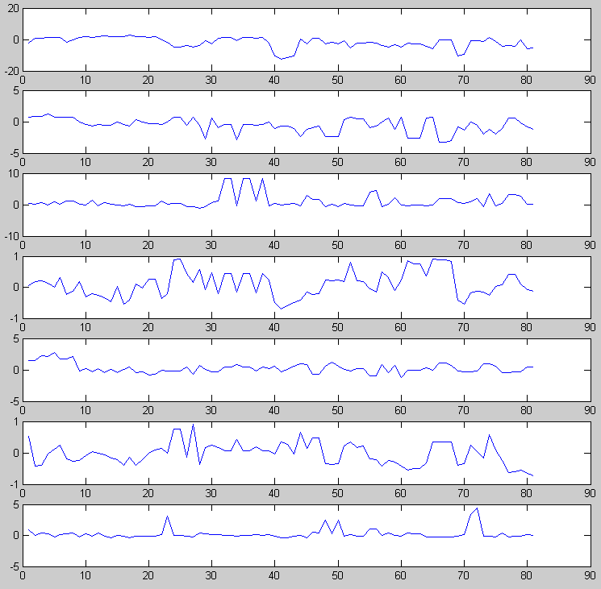
Logistic PCA (deflation version)

Slide 14
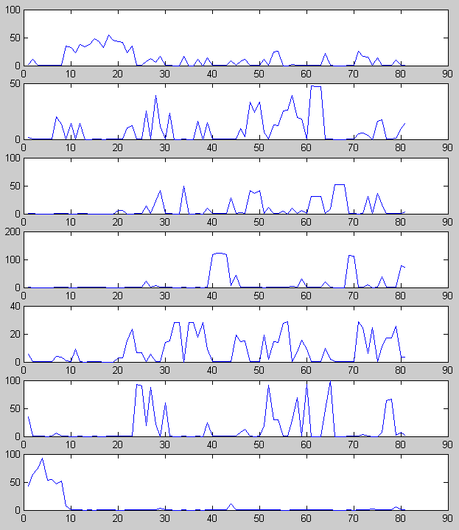
NMF

Slide 15
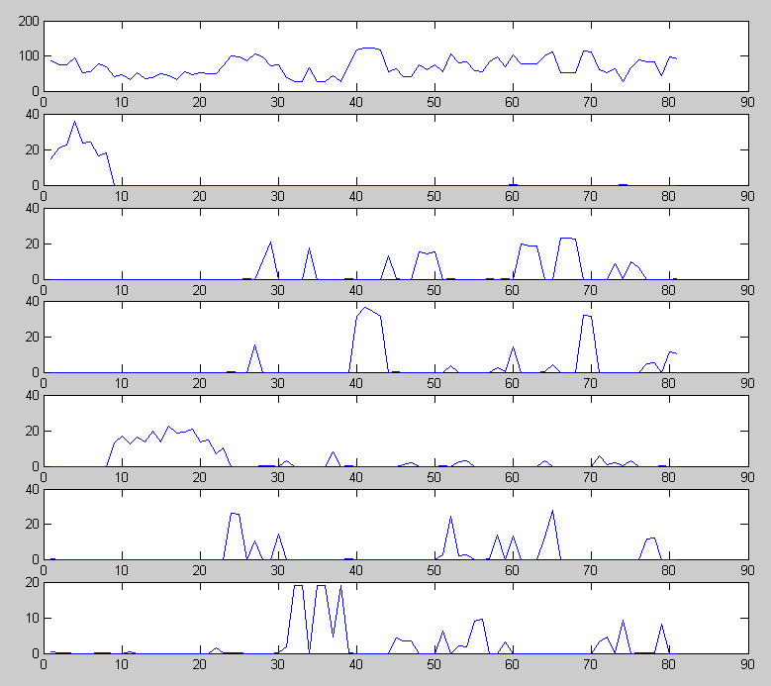
NMF (deflation version)

Slide 16
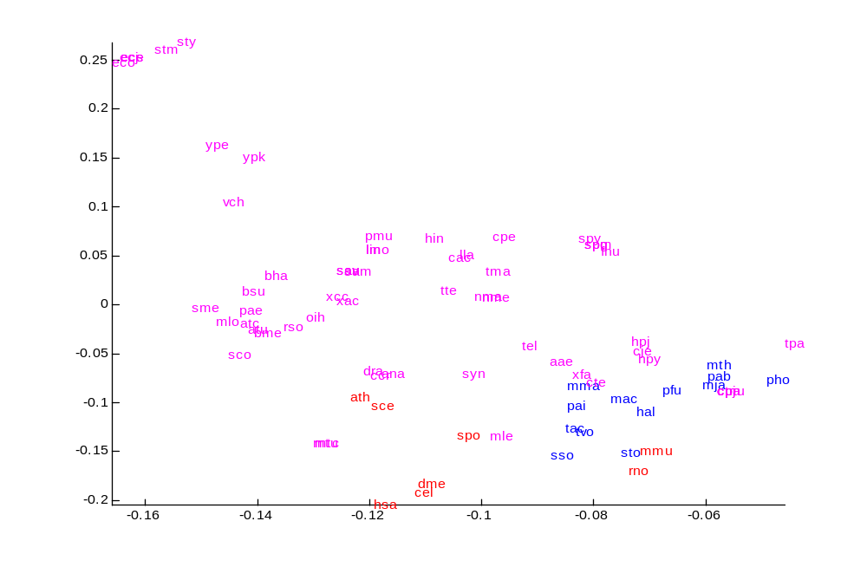
SVD vs. logistic PCA (1)
SVD

Slide 17
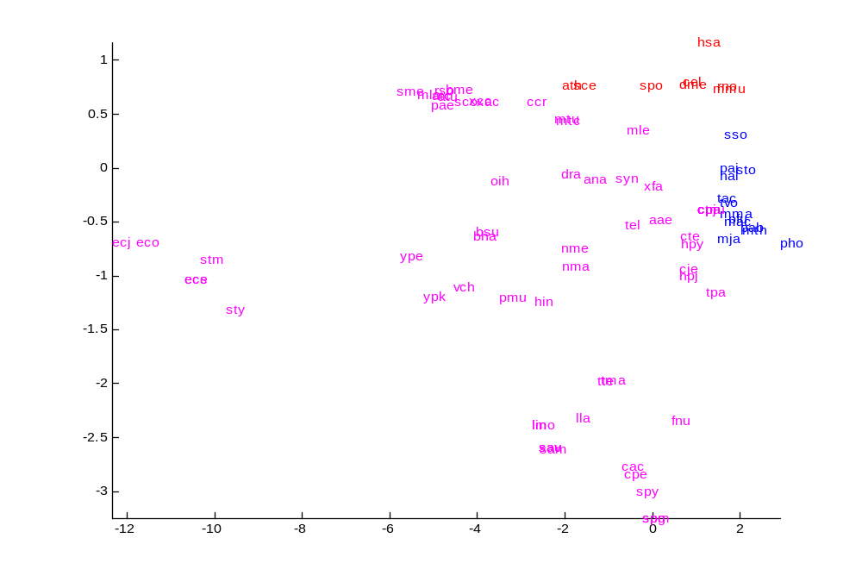
SVD vs. logistic PCA (2)
Logistic PCA

Slide 18
To Do
Functional prediction of genes: when two genes share similar phylogenetic profiles, it is assumed that these genes are functionally correlated.
Construction of genome trees: stems from the assumption that gene losses or acquisitions are major evolution phenomena.

