Slide 1
Gene Selection for Microarray-based Cancer Classification Using Genetic Algorithm
이 정문
2003/04/01
BI Lab

Slide 2
Introduction
Microarray can be used for cancer classification based on gene expression.
Selection of informative genes for sample discrimination can improve the cancer classification.
I use the genetic algorithm (GA) and k-nearest neighbor to find informative genes in multi-class microarray cancer data .

Slide 3
Gene Expression Data
samples
sample1 sample2 sample3 sample4 sample5 …
1 0.46 0.30 0.80 1.51 0.90 ...
2 -0.10 0.49 0.24 0.06 0.46 ...
3 0.15 0.74 0.04 0.10 0.20 ...
4 -0.45 -1.03 -0.79 -0.56 -0.32 ...
5 -0.06 1.06 1.35 1.09 -1.09 ...
Genes
Gene expression level of gene i in mRNA sample j
Tens or hundreds of samples Vs. Thousands of genes
=> Need to select informative genes
Notes:
3

Slide 4
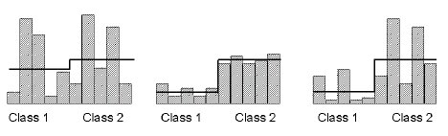

Rank-based selection methods
For each gene,
  Signal-to-noise = (μ₁ - μ₂) / (σ ₁ + σ ₂)
  BSS/WSS =
Are good at identifying genes which are strongly correlated with the target phenotype class distinction but ignore the interaction between genes

Slide 5
GA/kNN method(Leping Li,2001)
Initial chromosomes consisting of d genes (In this case d = 5)
G1
G35
G7
G21
G3
G35
G3
G32
G5
G7
G1
G21
G10
G6
G3
For each chromosome, assign fitness (the number of samples correctly classified by kNN)
Replacement
Selection
G1
G35
G7
G21
G3
G1
G21
G10
G6
G3
Mutation
G35
G3
G32
G5
G7
G1
G23
G10
G6
G3
G1
G23
G10
G6
G3
Is termination criterion met?
no
yes
Save the chromosome

Slide 6
Datasets
GCM
  Ramaswamy et al, 2001
  14 classes
  190 samples (144 training set + 46 test set)
  16,063 genes
NCI60
  Ross et al, 2000
  9 classes
  60 cancer cell lines
  9,703 genes

Slide 7
Issues
Choice of termination criterion
Computationally intensive
  One-Vs-All classification : build n classifier for each n class
Whether to use crossover
Lamarckian GA (?)

