Slide 1
Learning Bayesian Networks with Local Structure
by Nir Friedman and Moises Goldszmidt

Slide 2
Object: To represent and learn the local
structure in the CPDs.
Table of Contents
Introduction
Learning Bayesian Networks(MDL/BDe Score)
(MDL:Minimal Description Length score)
Learning Local Structure(MDL/BDe Scores for Default Tables/Decision Trees; Algorithms)
Experimental Results

Slide 3
1. Introduction
Bayesian network :
DAG(global) + CPDs(local)
- local structures for CPDs: table, decision tree, noisy-or gate, etc.
(DAG: Directed Acyclic Graph, CPD: Conditional Probability Distribution)
e.g.) a CPD is encoded by a table that is locally exponential in the number of parents of X.
A: alarm armed, B: burglary, E: earthquake,
S: loud alarm sound (all variables are binary).

Slide 4
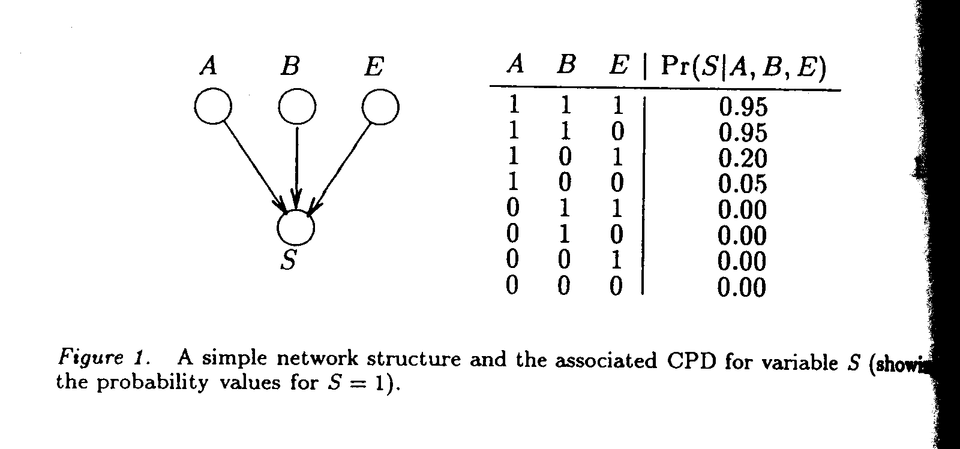

Slide 5
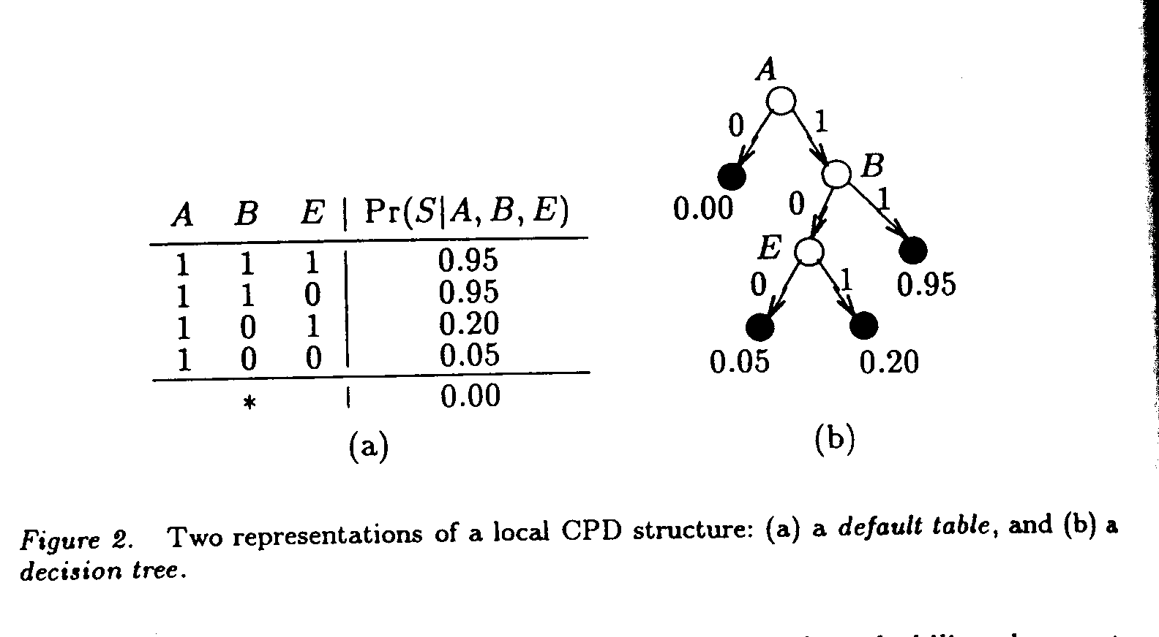

Slide 6
The learning of local structures motivated by CSI (Boutilier et al, 1996):
(CSI: Context-Specific Independence)
default table
decision tree (Quinlan and Rivest, 1989)
Improvements:
1. The induced parameters are more reliable.
2. The global structure induced is a better approximation to the real dependencies by considering networks with exponential penalty.

Slide 7


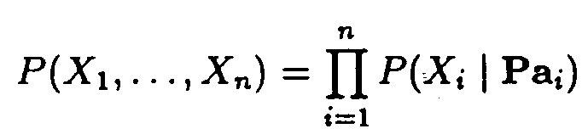
2. Learning Bayesian Networks
A Bayesian network for :
B = < G, L> where G: DAG, L: a set of CPDs,
each is independent of its nondescendants and
Problem: Given a training set D = { u₁, ... , u_{n}} of instances U, find a network B = < G, L > that best matches D.

Slide 8
2.1. MDL Score (Rissanen, 1989)
code length(data) = code length (model)
+ code length(data | model)
(data: D , model: B, P_{B} )
- Balance between complexity and accuracy
total description length:
DL(B, D) = DL(G) + DL(L) + DL(D | B)

Slide 9
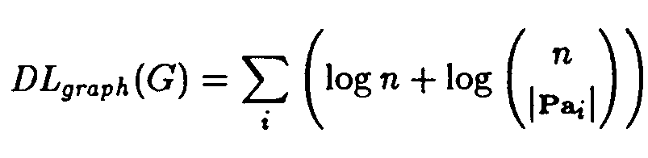
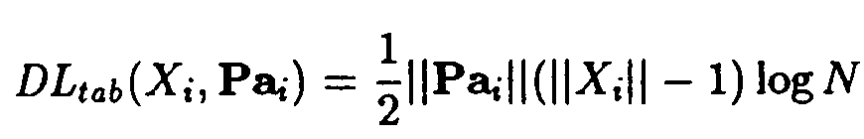
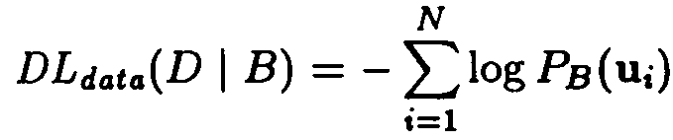
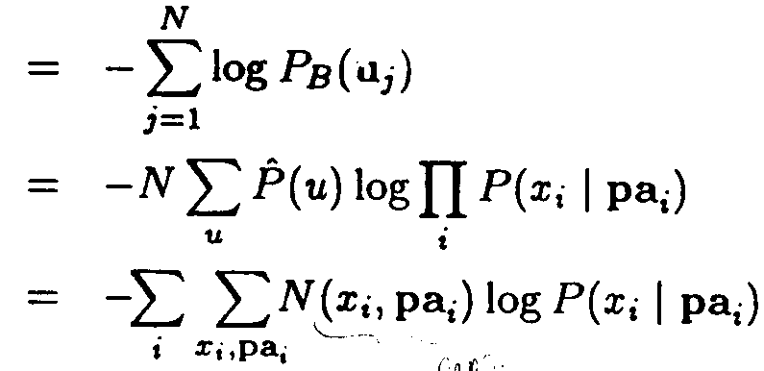

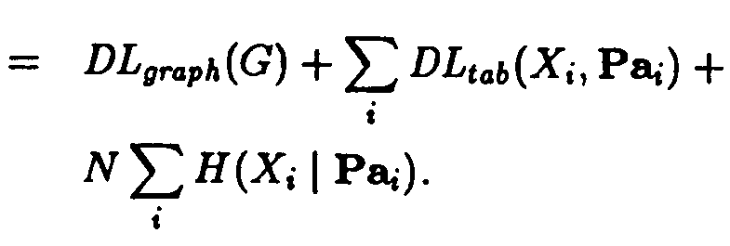
(Cover and Thomas, 1991)

Slide 10

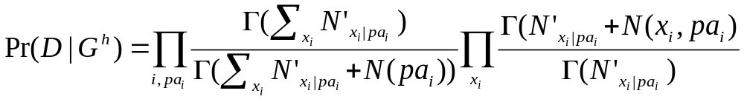
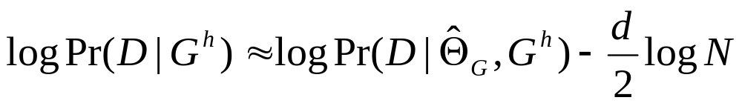


2.2. BDe Score
Bayes Rule:
Under a Dirichlet Prior:
Equivalence of MDL and BDe scores (Schwarz , 1978):
( : Hyperparameters of Dirichlet , : vector of parameters for the CPDs quantifying G. )

Slide 11



3. Learning Local Structure
3.1. Scoring functions
S_{L} - the structure of local representation
- the parameterization of L
Rows(DT): partition of Pa_{i}
: Mapping of Pa_{i} to the partition that
contains it
L = (S_{L ,} )

Slide 12
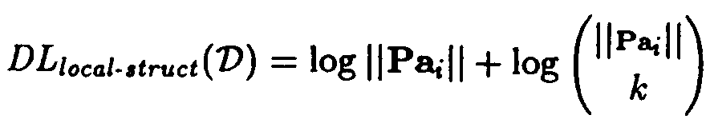

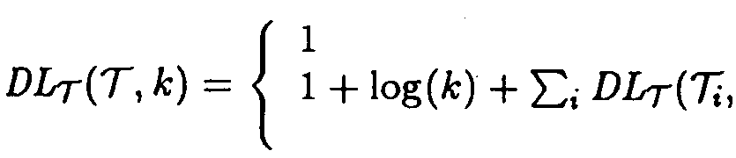
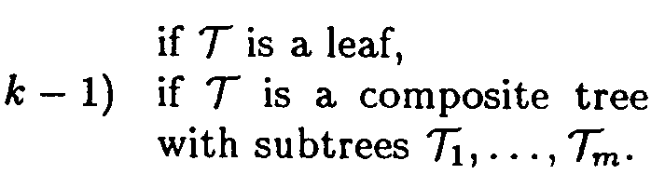


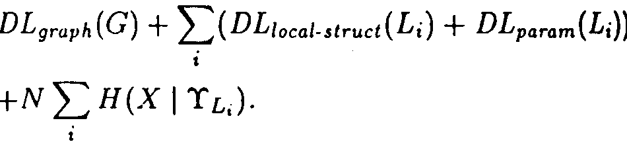
3.1.1. MDL score for local structure :
encoding of S_{L}
for a default table:
for a tree: ( k=|Rows(D)| )
(encoding a bit set to value 1 followed by the description of test variable
and trees)
encoding of :
MDL score

Slide 13

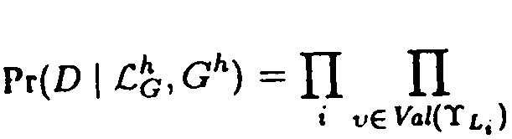
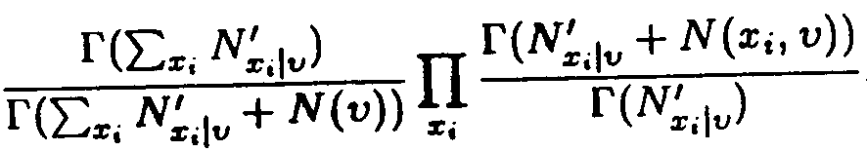
3.1.2. BDe score for local structure :
Bayes rule:
a natural prior over local structures:
Under Dirichlet prior of parameters:

Slide 14
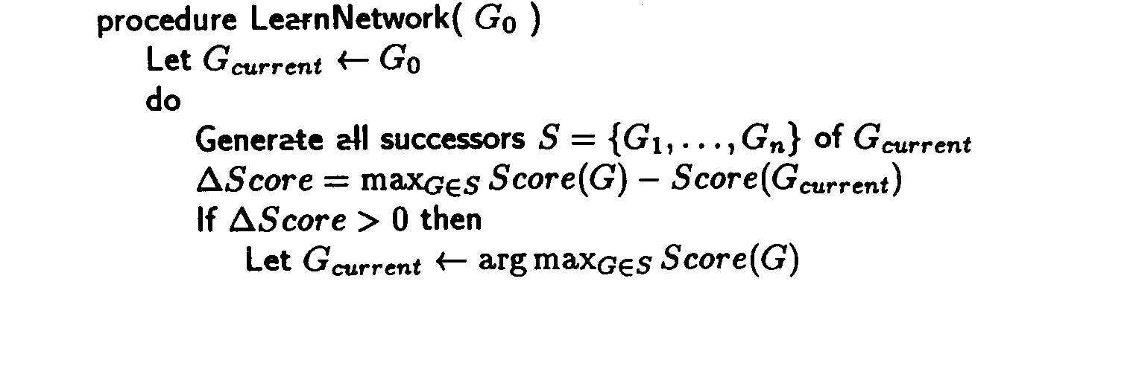

3.2. Learning Procedures
greedy hillclimbing: for network structure

Slide 15
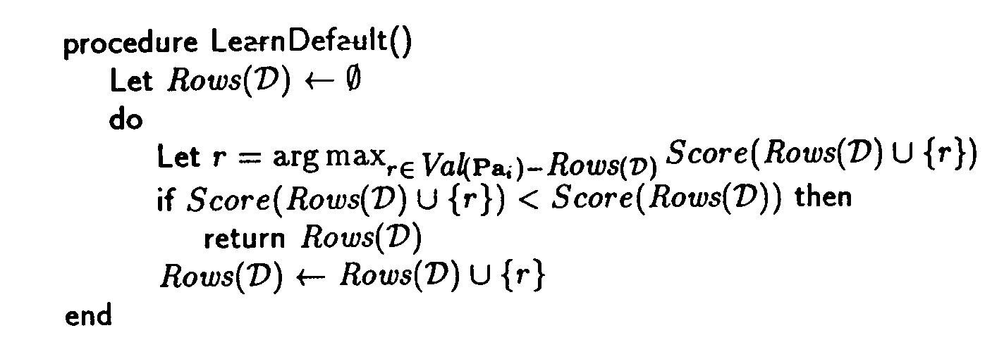
Default Table:

Slide 16
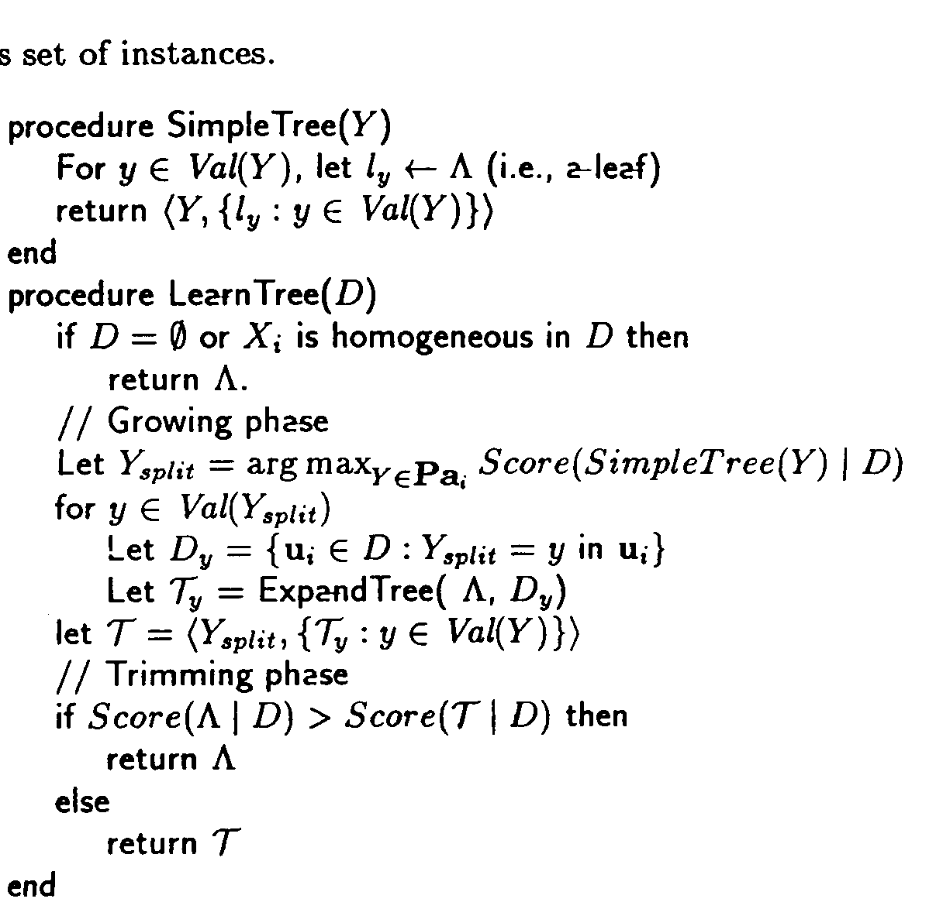
Decision Tree: Quinlan and Rivest(1989)

Slide 17
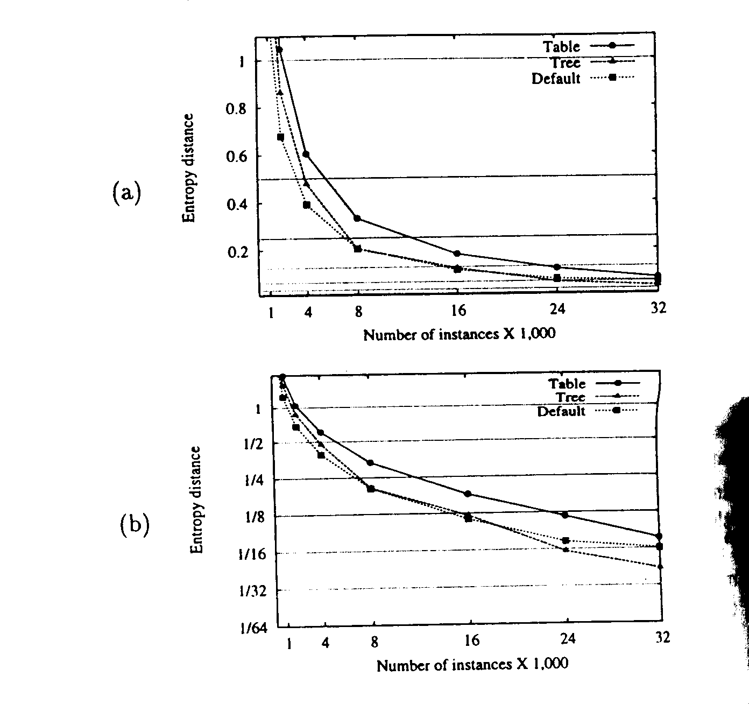
4. Experimental Results

Slide 18






DESCRIPTIONS OF THE NETWORK USED IN THE EXPERIMENTS
Alarm : for monitoring patients in intensive care
n=37, |U|= ,
Hailfinder : for monitoring summer hail in NE Coloraro
n=56, |U|= ,
Insurance : classifying insurance applications
n=27, |U|= ,
* |U| = val (U) : the set of values U can attain.(fig.1)

