Slide 1
Hierarchical Bayesian-Kalman Models for Regularization and ARD in Sequential Learning
JFG de Freitas, M Niranjan and AH Gee
CUED/F-INFENG/TR 307
Nov 10, 1998

Slide 2
Abstract
Sequential Learning
Hierarchical bayesian modelling : model selection, noise estimation, parameter estimation
Parameter estimation : Extended Kalman Filtering
  Minimum variance framework
Noise estimation : adaptive regularization, ARD
Adaptive noise estimation = Adaptive learning rate = smoothing regularization

Slide 3
Introduction
Sequential Learning :
  Non-stationary or expensive to get before training
Smoothing constraint :
  A priori knowledge
Contribution :
  Adaptive filtering = Regularized error function = Adaptive Learning rates

Slide 4
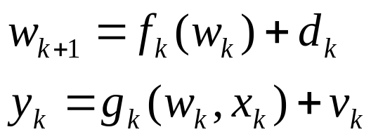
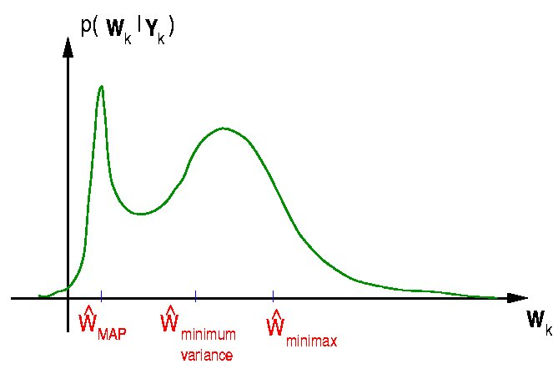
State Space Models, Regularization and Bayesian Inference
State space mode
Bayesian Framework : p(w_{k}|Y_{k})
  From uncertainty in model parameter and measurement
Regularization scheme for sequential learning
First order Markov Process :
w_{k+1}=w_{k}+d_{k}
Minimum variance estimation

Slide 5
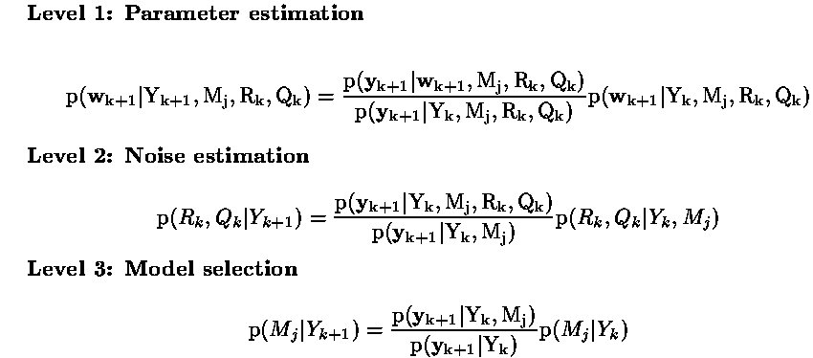
Hierarchical Bayesian Sequential Modeling
Parameter estimation can be done with EKF in slowly changing non-stationary environments.

Slide 6
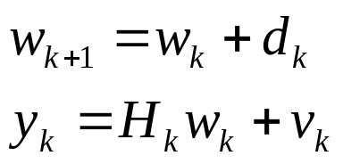
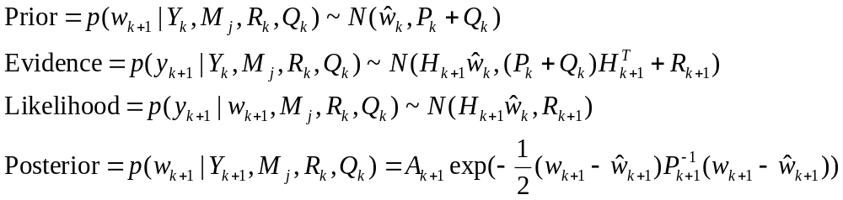
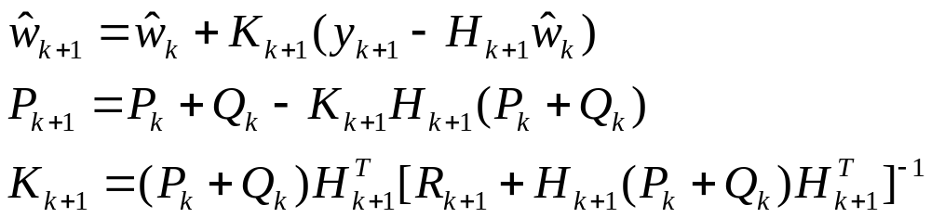
Kalman Filter for Param. Estimation
Linear Gauss-Markov process (Linear Dynamic System)
Covriance Matrix: Q, R, P
Bayesian Formulation
Kalman equation :based on minimum variance of P

Slide 7
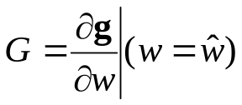
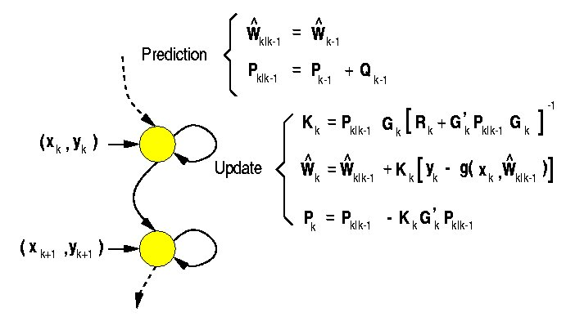
Extended Kalman Filter
Linear estimation with Taylor series expansion

Slide 8
Noise Estimation and Regularization
Limitation of Kalman filter
  Fixed a priori on Process Noise Q
  Large Q → Large K → more sensitive to noise or outlier
3 methods of updating noise covariance
  Adaptive Distributed Learning rates (multiple back propagation)
  Sequential evidence maximization with weight decay priors
  Sequential evidence maximization with updated priors
Descending on a landscape with numerous peaks and throughs
  Varying speed, smoothing landscape, jumping while descending

Slide 9

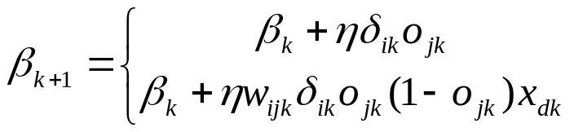

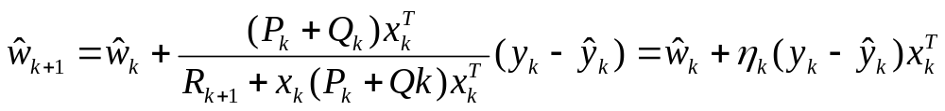
Adaptive Distributed Learning Rates and Kalman Filtering
Get speed, lose precision
  Assumption: UNCORRELATED model parameters.
  Update by back-propagation: (Sutton 1992b)
  Kalman Filter Equation
Why Adaptive Learning rates?

Slide 10
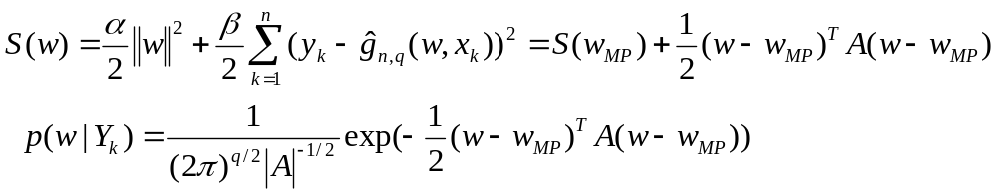
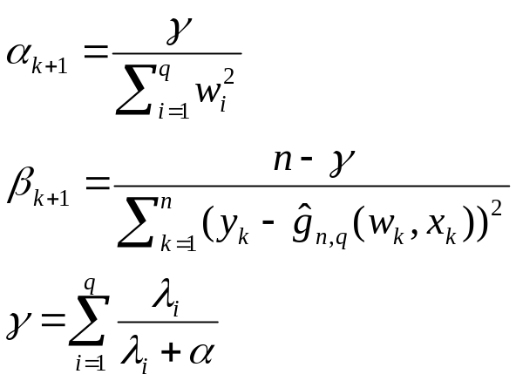
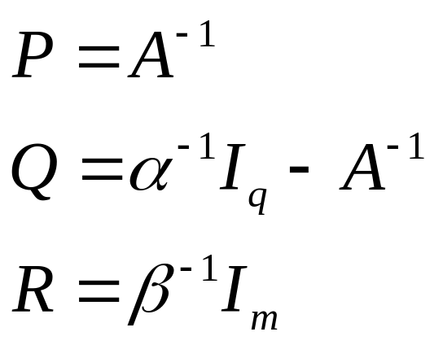
Sequential Bayesian Regularization with Weight Decay Priors
(Mackay 1992, 1994b)’s gaussian approximation
  By taylor series approximation
  Iteratively update of α,β Update of covariance

Slide 11
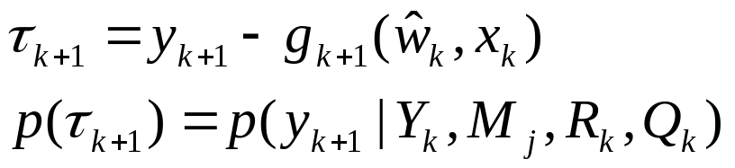
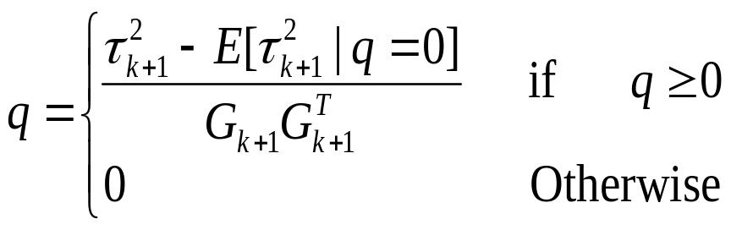
Sequential Evidence Maximization with Sequentially Updated Priors
Maximizing evidence:
  Prob. of residuals = evidence function
  Maximizing evidence leads to τ_{k+1}²=E[τ_{k+1}²]
  Update equation Q=qI_{q}.

Slide 12
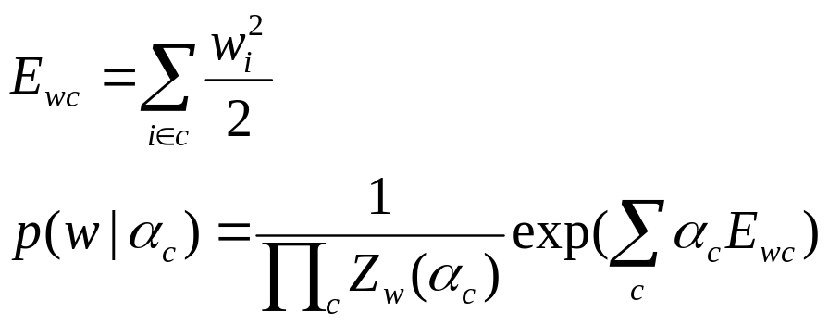
Automatic Relevance Determination
(Mackay 1995)
  Random correlation in finite data.
ARDI
  (Mackay 1994a, 1995)
  Large α_{c} in case of irrelevant input
Multiple learning rates = regularization coefficients = process noise hyper-parameters

Slide 13
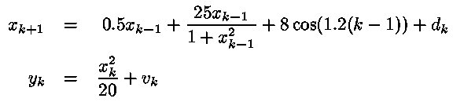
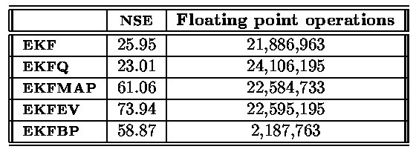
Experiment1
Problem:
Results:
EKFEV, EKFMAP are not good in sequential environment.
  LIMITATION: Weight must be converged before noise covariance can be updated

Slide 14
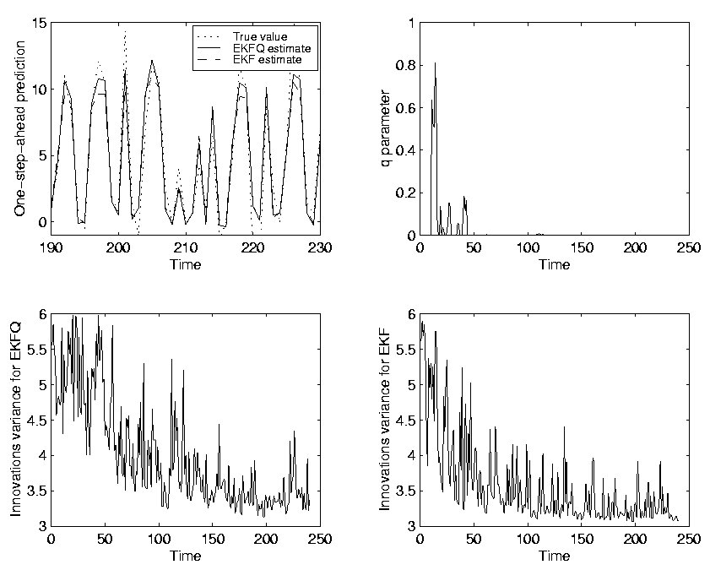

Slide 15

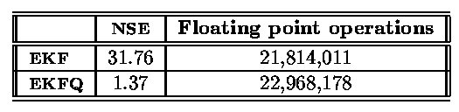
Experiment 2: (time-varying, chaotic)
Problem:
Results:
Tradeoff between regularization and tracking: EKFQ can do this well.

Slide 16
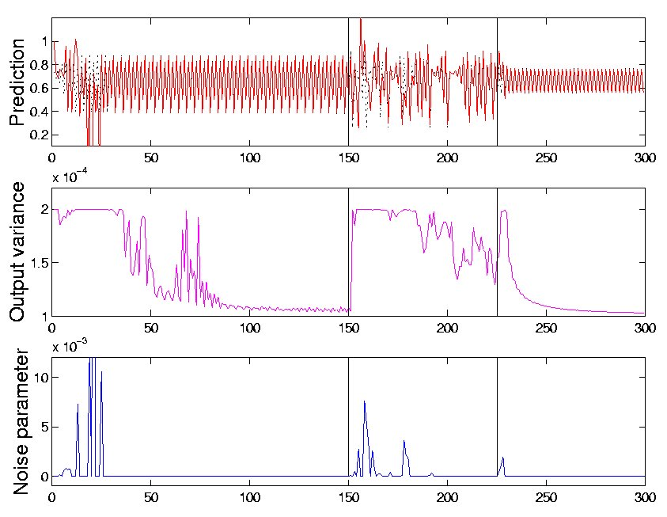

Slide 17
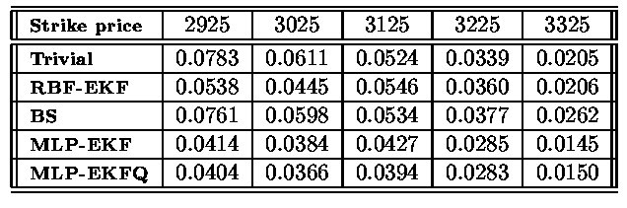
Experiment 4: Pricing Financial Options
Problem: five pairs of call and put option contracts on the FTSE100 index(1994/2 ~ 1994/12)
Results:

Slide 18
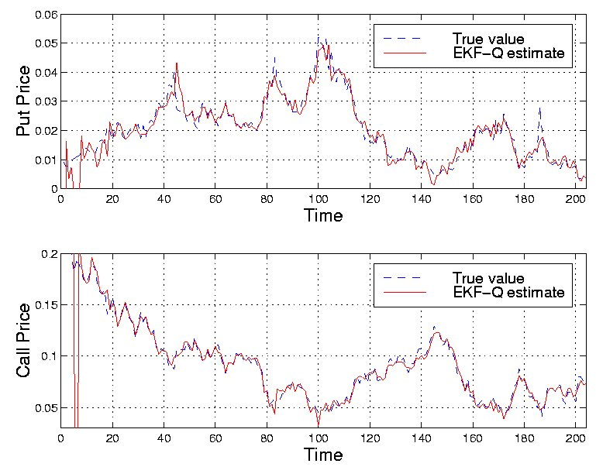

Slide 19
Conclusions
Bayesian view of Kalman filtering
Bayesian inference framework
Estimating Drift function?
Distributed learning rates = adaptive smoothing regularizer = adaptive noise parameter
Mixture of Kalman filters?

