Slide 1
What is DNA Computing?
Shin, Soo-Yong
Artificial Intelligence Lab.
Dept. of Computer Eng.
Seoul National University

Slide 2
Outline
Introduction
The Technology for DNA Computing
The Operators of DNA Computing
The Merits of DNA Computing
Applications
The Difficulties of DNA Computing
Our Project on DNA Computing
Conclusion

Slide 3
The First DNA Computing Approach
In 1994 Leonard Adleman demonstrated the potential of using interactions between DNA molecules to carry out “massive parallelism” in a test tube to solve hard combinatorial problems(Hamiltonian Path Problem)
4
3
1
0
6
2
5

Slide 4
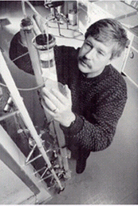
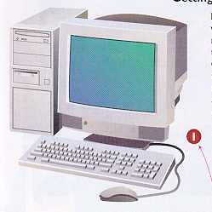
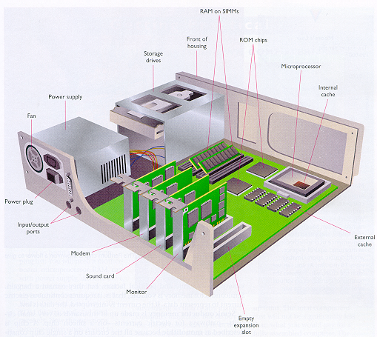
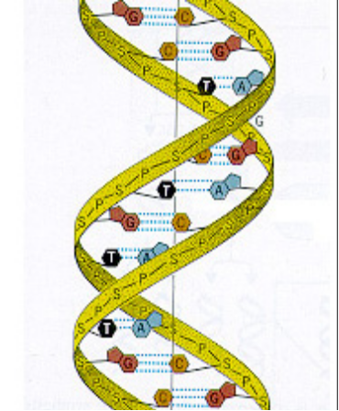
DNA Computing
011001101010001
ATGCTCGAAGCT

Slide 5
DNA Computing takes advantage of ..
Our ability to produce massive numbers of DNA molecules with specific properties (size, sequence)
The natural proclivity of specific DNA molecules to chemically interact according to defined rules to produce new molecules
Laboratory techniques that allow the isolation/identification of product molecules with specific properties
  PCR, Ligation, Gel Electrophoresis, etc.

Slide 6
The Operators of DNA Computing
DNA Structure
  4 characters
    A (Adenine), C (Cytosine), G (Guanine), T (Thymine)
  Watson-Crick base-pairing
    A = T, G ≡ C
Lab Techniques
  Hybridization (Annealing)
    base-pairing between two complementary single-strand molecules to form a double stranded DNA molecule
5’-AGCATCCATTA-3’
5’- AGCATCCATTA -3’
3’- TCGTAGGTAAT -5’
3’-TCGTAGGTAAT-5’

Slide 7

The Operators of DNA Computing (2)
  Ligation
    Joining DNA molecules together
  Enzymes used in DNA
    Ligase enzyme
    restriction enzyme

Slide 8
The Operators of DNA Computing (3)
  Gel Electrophoresis
    molecular size fraction technique
  Polymerase Chain Reaction (PCR)
    amplifies (produces identical copies of) selected dsDNA molecules
  Affinity Column

Slide 9

Why DNA Computing?
6.022 × 10²³ molecules / mole
Immense, Brute Force Search of All Possibilities
  Desktop : 10⁶ operations / second
  Supercomputer : 10¹² operations / second
  1 μmol of DNA : 10²⁶
Favorable Energetics: Gibb’s Free Energy
1 J for 2 × 10¹⁹ operations
Storage Capacity: 1 bit per cubic nanometer

Slide 10
Applications
Associative Memory
Satisfiability and Boolean Operations
DNA Adder
Finite State Machines
Road Coloring
DNA Chip
Solving NP-hard problems
Turing Machine
Boolean Circuits

Slide 11
The Problems of DNA Computing
It takes TOO long times
  hybridization/ligation operation over 4 hours
  In Adleman’s experiments : 7 days!
Not Perfect Operation
  Hybridization Mismatches
    Mismatched Hybridization
    Hairpin Hybridization
    Shifted Hybridization
  Extraction Errors
  Volume and Mass to solve a problem
False Negatives
False Positives

Slide 12
The Problems of DNA Computing (2)
Encoding Problems
  encoding problem is mapping the problem instance onto a set of DNA molecules and molecular biology protocols so that the resulting products contain an answer to instance of the problem
  prevent errors
  enable extraction

Slide 13
Our Projects
NACST systems
  Nucleic Acid Computing Simulation Toolbox
  Efficiency and robustness of DNA computing
  Molecular Programming (MP): “Evolving” fitter DNA molecules, not just filtering out infeasible ones (as in conventional DNA computing).
  To reduce the operation times
Two New Molecular Algorithms
  Iterative Molecular Algorithm (iMA): an “evolutionary” version of simple DNA computing
  Molecular evolutionary algorithm with genetic code optimization: iMA + Genetic Algorithm
  To solve the Encoding Problems

Slide 14
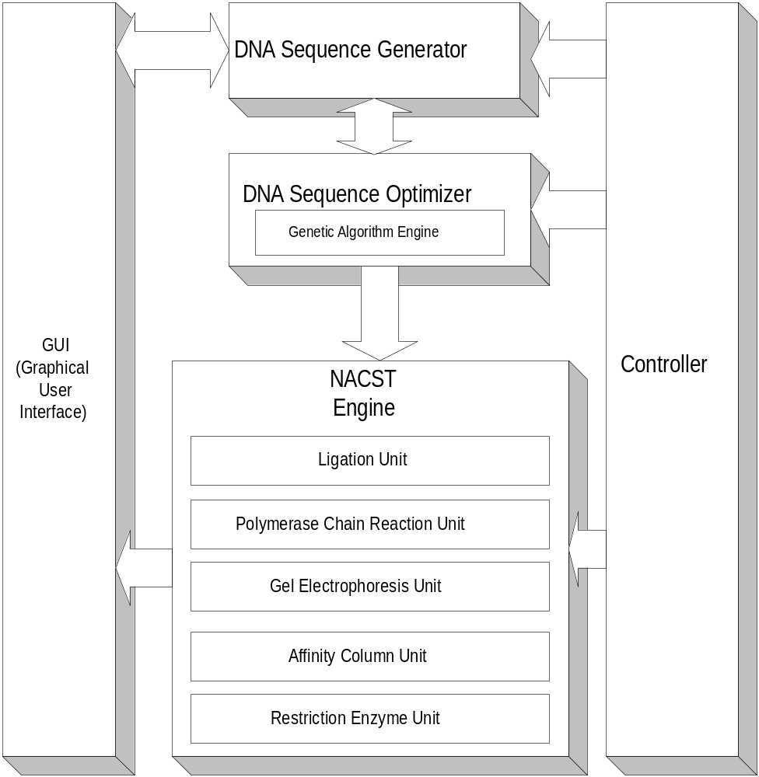
NACST sysmtes

Slide 15
Conclusion
DNA Computing uses DNA molecules to computing methods
DNA Computing is a Massive Parallel Computing because of DNA molecules
Someday, DNA Computer will replace the silicon-based electrical computer

