Slide 1
Intelligent Agents
Byoung-Tak Zhang
Computer Science and Engineering &
Cognitive Science
Seoul National University
E-mail: btzhang@cse.snu.ac.kr
This material is available at http://bi.snu.ac.kr./~btzhang/

Slide 2
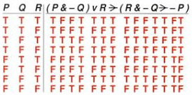
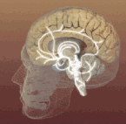
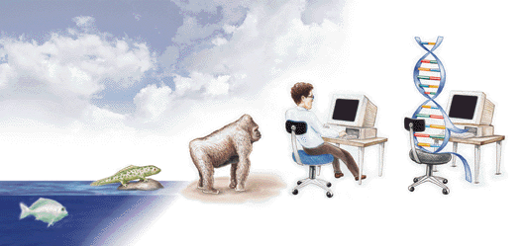


Artificial Intelligence (AI)
Symbolic AI
  Rule-Based Systems
Connectionist AI
  Neural Networks
Evolutionary AI
  Genetic Algorithms
Molecular AI:
  DNA Computing

Slide 3
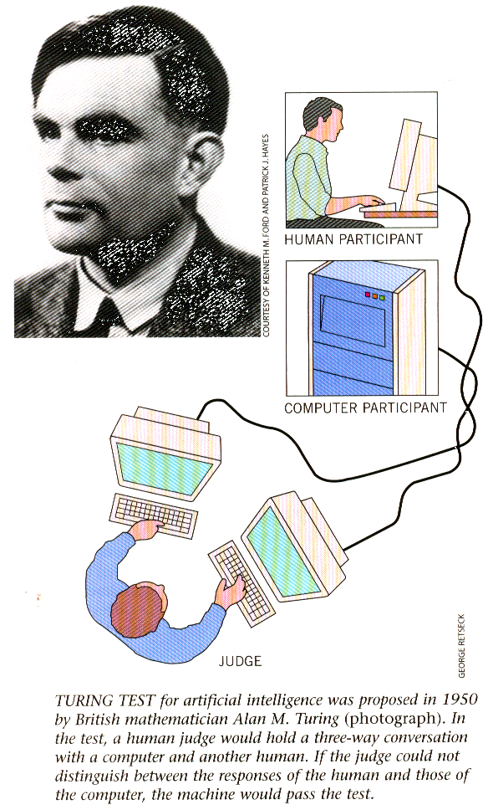
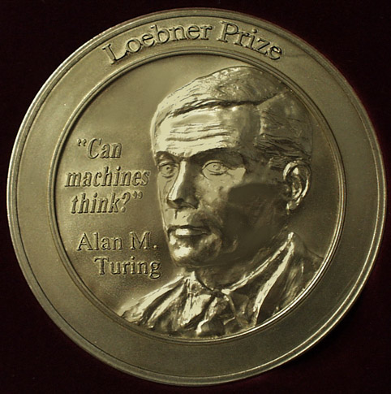
Can machines think?
The Turing Test

Slide 4
What is Artificial Intelligence?
AI is a collection of hard problems which can be solved by humans and other living things, but for which we don’t have good algorithms for solving.
  e. g., understanding spoken natural language, medical diagnosis, circuit design, learning, self-adaptation, reasoning, chess playing, proving math theories, etc.
Definition from R & N book: a program that
  Acts like human (Turing test)
  Thinks like human (human-like patterns of thinking steps)
  Acts or thinks rationally (logically, correctly)
Some problems used to be thought of as AI but are now considered not
  e. g., compiling Fortran in 1955, symbolic mathematics in 1965, pattern recognition in 1970

Slide 5
History of AI
The birth of AI (1943 – 1956)
  Turing test (1950)
Early enthusiasm (1952 – 1969)
  1956 Dartmouth conference
  Emphasize on intelligent general problem solving
Emphasis on knowledge (1966 – 1974)
  Domain specific knowledge
Knowledge-based systems (1969 – 1999)
  DENDRAL, MYCIN
AI became an industry (1980 – 1989)
  Wide applications in various domains
Current trends (1990 – present)
  Intelligent agents, neural networks and genetic algorithms

Slide 6
Symbolic AI
1943: Production rules
1956: “Artificial Intelligence”
1958: LISP AI language
1965: Resolution theorem
proving
1970: PROLOG language
1971: STRIPS planner
1973: MYCIN expert system
1982-92: Fifth generation computer systems project
1986: Society of mind
1994: Intelligent agents
Subsymbolic AI
1943: McCulloch-Pitt’s neurons
1959: Perceptron
1965: Cybernetics
1966: Simulated evolution
1966: Self-reproducing automata
1975: Genetic algorithm
1982: Neural networks
1986: Connectionism
1987: Artificial life
1992: Genetic programming
1994: DNA computing

Slide 7
Research Areas and Approaches
Learning Algorithms
Inference Mechanisms
Knowledge Representation
Intelligent System Architecture
Research
Intelligent Agents
Information Retrieval
Electronic Commerce
Data Mining
Bioinformatics
Natural Language Proc.
Expert Systems
Artificial
Intelligence
Application
Rationalism (Logical)
Empiricism (Statistical)
Connectionism (Neural)
Evolutionary (Genetic)
Biological (Molecular)
Paradigm

Slide 8
Intelligent Agents

Slide 9
Intelligent Agents
What are Intelligent Agents?
Properties of Intelligent Agents
Taxonomy of Intelligent Agents
Differences from Other Software
Reasons for Using Intelligent Agents
Applications of Intelligent Agents
Learning Methods for Agents

Slide 10
What are Intelligent Agents?
Some Definitions of Intelligent Agents
“Intelligent agents continuously perform three functions: perception of dynamic conditions in the environments; action to affect conditions in the environment; and reasoning to interpret perceptions, solve problems, draw inferences, and determine actions” [Hayes-Roth, 1995].

Slide 11
“An autonomous agent is a system situated within and a part of an environment that senses that environment and acts on it, over time, in pursuit of its own agenda and so as to effect what it senses in the future” [Franklin and Graesser, 1995].
“A hardware or (more usually) software-based computer system that enjoys the following properties: autonomy, social ability, reactivity, pro-activeness” [Wooldridge and Jennings, 1995]

Slide 12
“Autonomous agents are computational systems that inhabit some complex dynamic environment, sense and act autonomously in this environment, and by doing so realize a set of goals or tasks for which they are designed” [Maes, 1995].
“Intelligent agents are software entities that carry out some set of operations on behalf of a user or another program with some degree of independence or autonomy, and in so doing, employ some knowledge or representation of the user’s goals or desires” [IBM].

Slide 13
Properties of Intelligent Agents
Reactivity
Autonomy
Inferential capability
Temporal continuity
Personality
Adaptivity
Learnability
Collaborative behavior
Communication ability
Mobility

Slide 14
Agency
Service interactivity
Application interactivity
Data interactivity
Representation of user
Asynchrony
Intelligent
Agents
Fixed-Function
Agents
Expert
Systems
Mobility
Static
Mobile scripts
Mobile objects
Preferences
Reasoning
Planning
Learning
Intelligence
[Gilbert et al., 1995]

Slide 15
Smart
Agents
Collaborative
Learning
Agents
Learn
Cooperate
Autonomous
Collaborative
Agents
Interface
Agents
[Nwana, 1996]

Slide 16
Autonomous Agents
Biological Agents
Robotics Agents
Computational Agents
Software Agents
Artificial Life
Agents
Task-specific
Agents
Entertainment
Agents
Viruses
[Franklin and Graesser, 1996]

Slide 17
Agent
Task level
skills
Knowledge
Communications
Skills
Task
A priori
knowledge
Learning
with user
with other
agents
Information Retrieval
Information Filtering
Electronic Commerce
Coaching
Developer Specified
User Specified
System Specified
Interface
Speech
Social
Inter-agent
Communication
Language
Case-Based Learning
Decision Trees
Neural Networks
Evolutionary Algorithms
[Caglayan and Harrison, 1997]

Slide 18
Differences from other Software
How is an Agent different from other Software?
  personalized, customized
  pro-active, takes initiative
  long-lived, autonomous
  adaptive

Slide 19
Software Agents vs. Expert Systems
 | Software Agents | Expert Systems
Level of users | naive | expert
Tasks | Common | high-level task
Personalized | different actions | same actions
Active, autonomous | on their own | Passively
Adaptive | learn and change | remain fixed
[Maes, 1997]

Slide 20
Reasons for Using Intelligent Agents
Why do we need Software Agents?
  More everyday tasks are computer-based
  Vast amounts of dynamic, unstructured information
  More users, untrained
Change of Metaphor for HCI
  Direct manipulation
  Indirect manipulation

Slide 21
Applications of Intelligent Agents (1)
E-mail Agents
  Beyond Mail, Lotus Notes, Maxims
Scheduling Agents
  ContactFinder
Desktop Agents
  Office 2000 Help, Open Sesame
Web-Browsing Assistants
  WebWatcher, Letizia
Information Filtering Agents
  Amalthaea, Jester, InfoFinders, Remembrance agent, PHOAKS, SiteSeer

Slide 22
Applications of Intelligent Agents (2)
News-service Agents
  NewsHound, GroupLens, FireFly, Fab, ReferralWeb, NewT
Comparison Shopping Agents
  Mysimon, BargainFinder, Bazzar, Shopbor, Fido
Brokering Agents
  PersonalLogic, Barnes, Kasbah, Jango, Yenta
Auction Agents
  AuctionBot, AuctionWeb
Negotiation Agents
  DataDetector, T@T

Slide 23
Learning Methods for Agents
Learning agents: “Agents that change its behavior based on its previous experience.”
Learning Methods
  Decision Trees
    e.g.) InfoFinder
  Bayesian Learning
    e.g.) Syskill & Webert, NewsHound

Slide 24
  Neural Networks
    Neural Networks
    e.g.) Chaplin, STEALTH, Intruder Alert
  Reinforcement Learning
    e.g.) WAIR, LASER
  Evolutionary Algorithms
    e.g.) PAWS, ARACHNID

