Slide 1
neural networks

Slide 2
course layout
introduction
molecular biology
biotechnology
bioMEMS
bioinformatics
bio-modeling
cells and e-cells
transcription and regulation
cell communication
neural networks
dna computing
fractals and patterns
the birds and the bees ….. and ants

Slide 3
introduction

Slide 4
symbolic & sub-symbolic representation
AI
Symbolic
Subsymbolic
Rule-based
Artificial
Neural
Networks
Logic
Programming
Engineering approach: A set of elements with a set of processes or rules
Human modeling approach: About changing states of networks constructed of neurons

Slide 5
naïve symbolic representation
Rules representing behaviour of components
Referred to as Von Neumann machines
Follows explicit instructions
Sample program
  if (time < noon)
  print “Good morning”
  else
  print “Good afternoon”

Slide 6
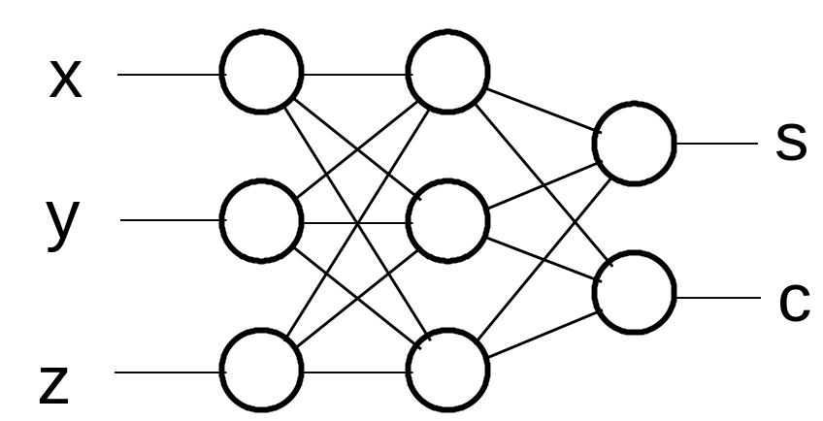
neural network alternative
representation is distributed or sub-symbolic
learns behaviour from examples.
no explicit representation of causal interactions

Slide 7
background
Neural Networks can be :
Biological models
Artificial models
Desire to produce artificial systems capable of sophisticated computations similar to the human brain

Slide 8
biological inspirations
Some numbers…
  The human brain contains about 10 billion nerve cells (neurons)
  Each neuron is connected to the others through 10,000 synapses
Properties of the brain
  It can learn, reorganize itself from experience
  It adapts to the environment
  It is robust and fault tolerant

Slide 9
computer verus brain
Computers require hundreds of cycles to simulate a firing of a neuron.
The brain can fire all the neurons in a single step.
→ Parallelism
-Serial computers require billions of cycles to perform some tasks but the brain takes less than a second.
e.g. Face Recognition

Slide 10
computer verus brain
a computer
our brain
Clock freq. - ~ Gigahertz (10⁹ per s)
Switching rate – 1000 per sec.
Memory - ~ Gigabytes (10¹⁰ bits)
Number of neurons - ~ 10¹³
Sync. and sharing problems
Connectivity - ~10⁴⁻⁵
Very strong with formal problems,
Very weak in informal problems
Image recognition - ~ 0.1 sec.
One ‘heart’ – the CPU
Very parallel

Slide 11
what are neural networks?
An interconnected assembly of simple processing elements, units, neurons or nodes, whose functionality is loosely based on the animal neuron
The processing ability of the network is stored in the inter-unit connection strengths, or weights, obtained by a process of adaptation to, or learning from, a set of training patterns.

Slide 12
why do we need to use NN ?
Determination of pertinent inputs
Collection of data for the learning and testing phase of the neural network
Finding the optimum number of hidden nodes
Estimate the parameters (Learning)
Evaluate the performances of the network
If performances are not satisfactory then review all the precedent points

Slide 13
what are neural networks?
Models of the brain and nervous system
Highly parallel
  Process information much more like the brain than a serial computer
Learning
Very simple principles
Very complex behaviours
Applications
  As powerful problem solvers
  As biological models

Slide 14
definition of neural network
A Neural Network is a system composed of many simple processing elements operating in parallel which can acquire, store, and utilize experiential knowledge.

Slide 15
types of problems
Classification determine to which of a discrete number of classes a given input case belongs
  equivalent to logistic regression
Regression predict the value of a (usually) continuous variable
  equivalent to least-squares linear regression
Times series predict the value of variables from earlier values of the same or other variables

Slide 16
characterization
Architecture: the pattern of nodes and connections between them
Learning algorithm, or training method: method for determining weights of the connections
Activation function: function that produces an output based on the input values received by node

Slide 17
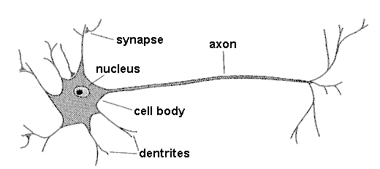
biological neuron
synapse
axon
nucleus
cell body
dendrites
A neuron has
  A branching input (dendrites)
  A branching output (the axon)
The information circulates from the dendrites to the axon via the cell body
Axon connects to dendrites via synapses
  Synapses vary in strength
  Synapses may be excitatory or inhibitory

Slide 18
neuron behavior
Signals travel between neurons through electrical pulses
Within neurons, communication is through chemical neurotransmitters
If the inputs to a neuron are greater than its threshold, the neuron fires, sending an electrical pulse to other neurons

Slide 19
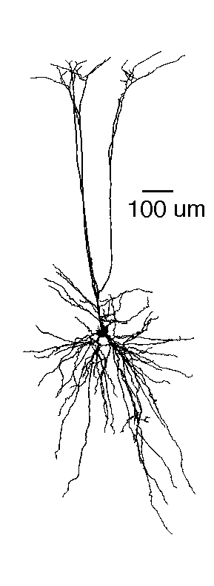
neuron
Pyramidal neuron

Slide 20
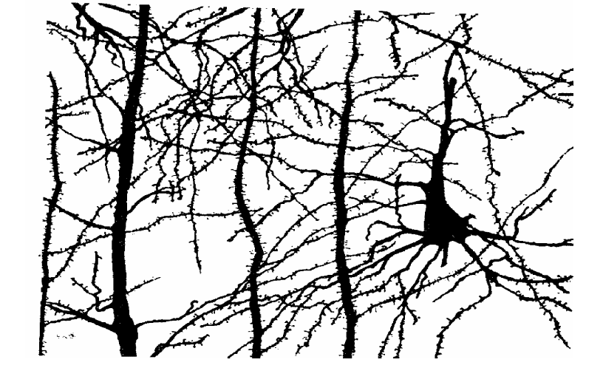
neuron in the brain

Slide 21
biological neural nets
Pigeons as art experts
Experiment
Pigeon in Skinner box
Present paintings of two different artists (e.g. Chagall / Van Gogh)
Reward for pecking when presented a particular artist (e.g. Van Gogh)
Watanabe et al. 1995

Slide 22
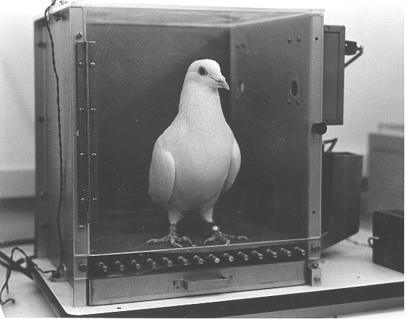
biological neural nets

Slide 23
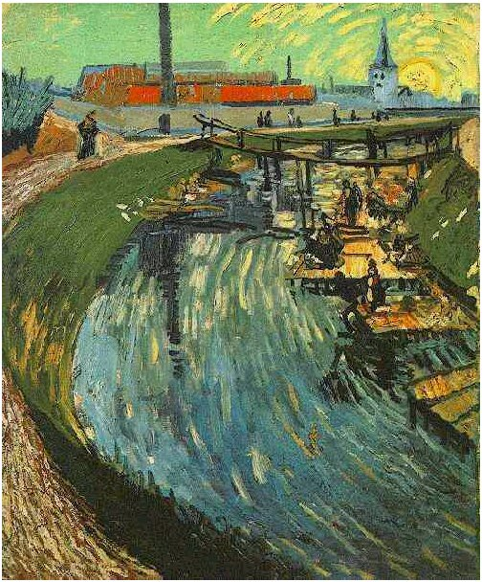
van Gogh
Notes:
Canal with Women Washing, 1888

Slide 24
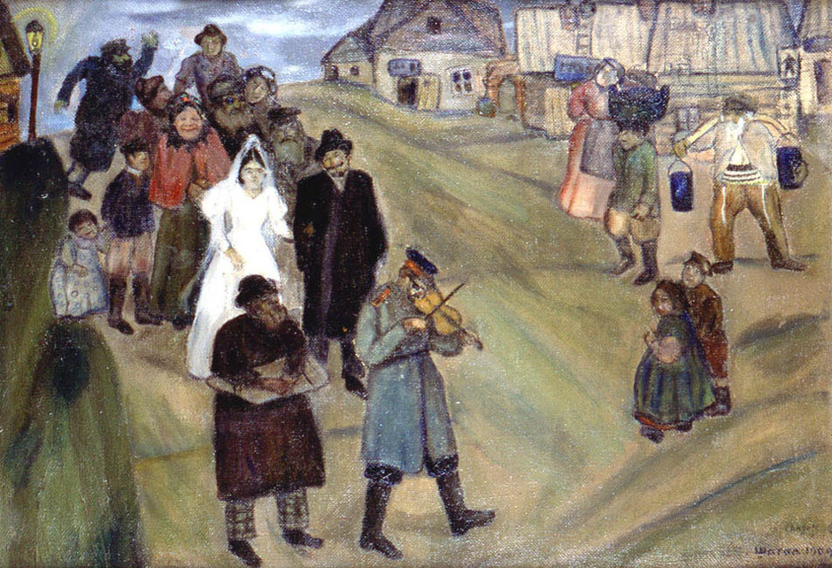
Chagall

Slide 25
pigeon neural nets
Pigeons were able to discriminate between Van Gogh and Chagall with 95% accuracy (when presented with pictures they had been trained on)
Discrimination still 85% successful for previously unseen paintings of the artists
Pigeons do not simply memorise the pictures
They can extract and recognise patterns (the ‘style’)
They generalise from the already seen to make predictions
This is what neural networks (biological and artificial) are good at (unlike conventional computer)

Slide 26
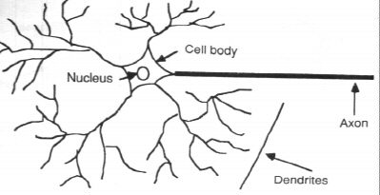
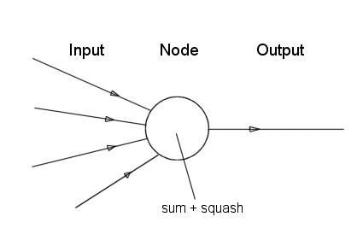
neurone vs. node

Slide 27
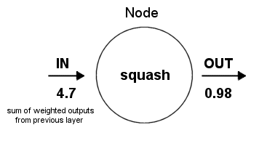
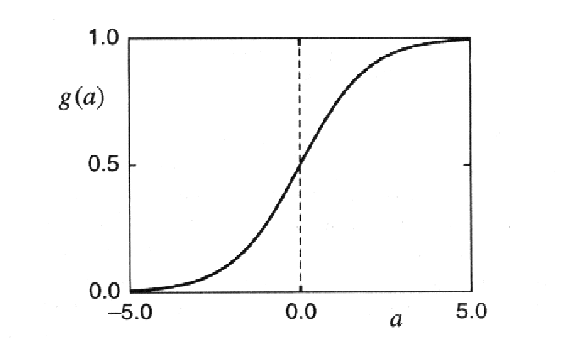
structure of the node
activation
Activation function limits node output:

Slide 28
basic artificial model
Consists of simple processing elements called neurons, units or nodes
Each neuron is connected to other nodes with an associated weight (strength) which typically multiplies the signal transmitted
Each neuron has a single threshold value
Weighted sum of all the inputs coming into the neuron is formed and the threshold is subtracted from this value = activation
Activation signal is passed through an activation function (a.k.a. transfer function) to produce the output of the neuron

Slide 29
processing at a node
weight 1
Activation Function
Output
weight 2
1.0
Sum
0.5
weight 3
Sum
weight 4

Slide 30
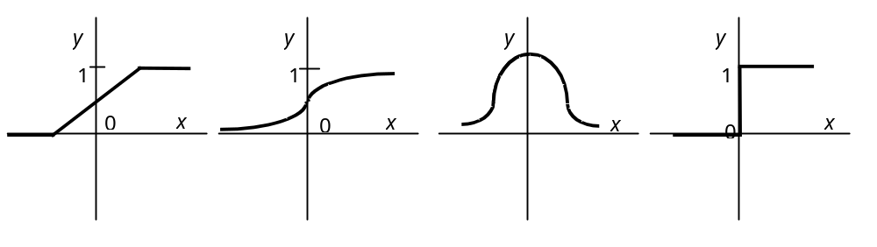
transfer functions
Determines how neuron scales its response to incoming signals
Hard-Limit Sigmoid Radial Basis Threshold Logic
Transfer function need not be sigmoidal but it must be differentiable

Slide 31
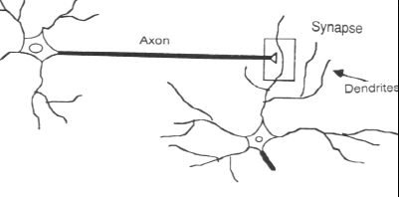
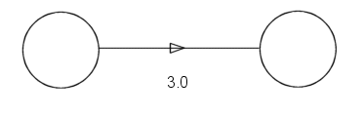
synapse vs. weight
synapse
axon
dendrite

Slide 32
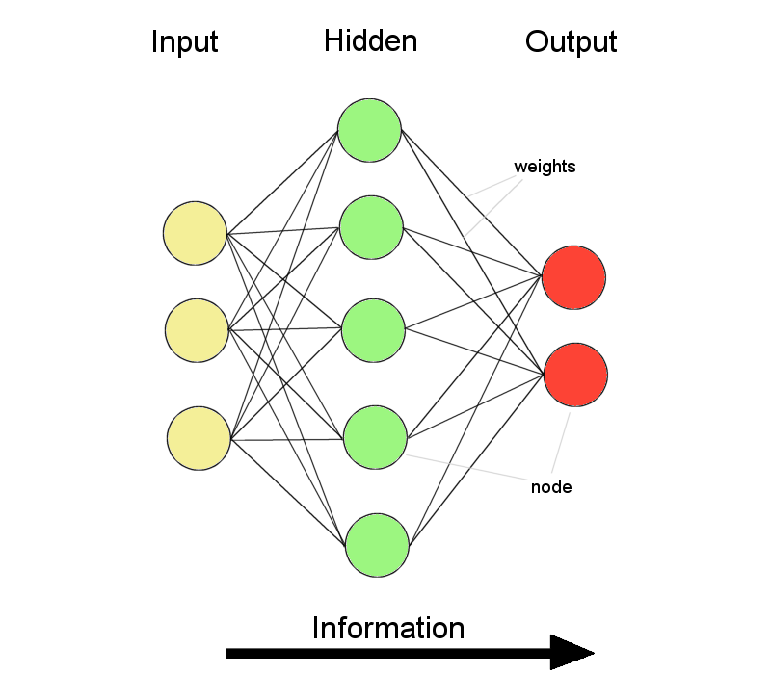
ANNs – the basics
ANNs incorporate the two fundamental components of biological neural nets:
Neurones (nodes)
Synapses (weights)

Slide 33
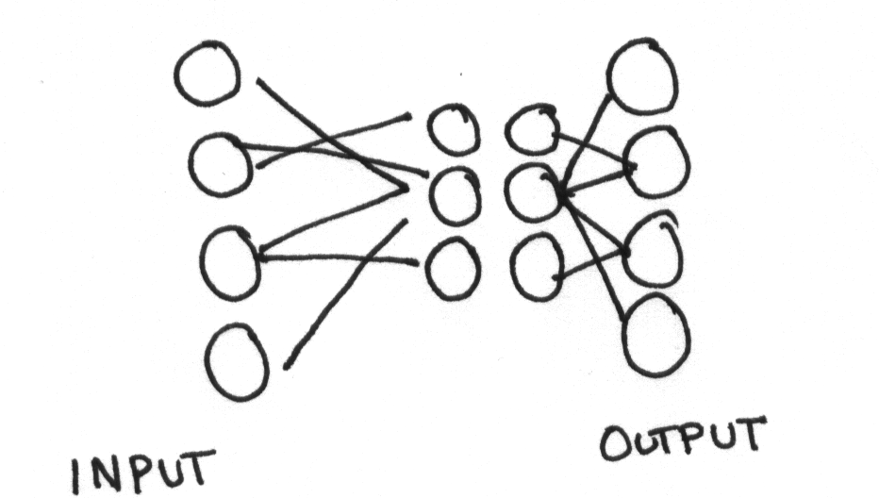
artificial neural networks
Yair Horesh, Bar-Ilan university, 2003

Slide 34
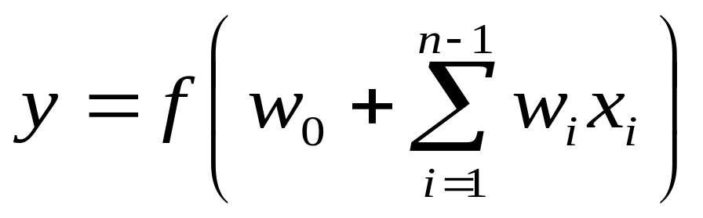
what is an artificial neuron ?
Definition : Non linear, parameterized function with restricted output range
y
w0
x1
x2
x3

Slide 35
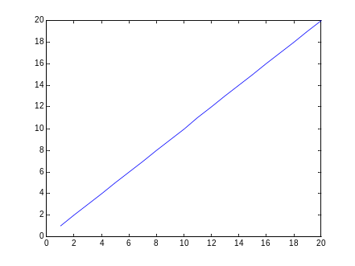

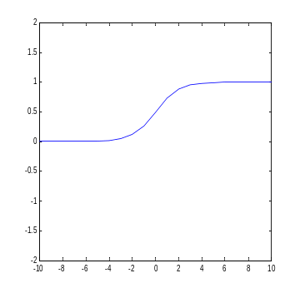
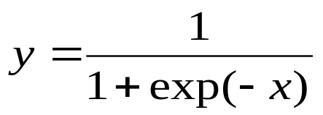
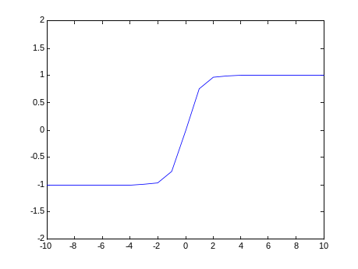
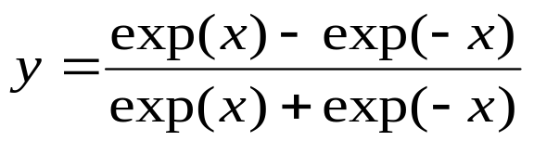
transfer functions
Linear
Logistic
Hyperbolic tangent

Slide 36
neural networks
A mathematical model to solve engineering problems
  Group of highly connected neurons to realize compositions of non linear functions
Tasks
  Classification
  Discrimination
  Estimation
2 types of networks
  Feed forward Neural Networks
  Recurrent Neural Networks

Slide 37
feed forward neural networks
The information is propagated from the inputs to the outputs
Computations of No non linear functions from n input variables by compositions of Nc algebraic functions
Time has no role (NO cycle between outputs and inputs)
Output layer
2nd hidden
layer
1st hidden
layer
x1
x2
…..
xn

Slide 38
recurrent neural networks
Can have arbitrary topologies
Can model systems with internal states (dynamic ones)
Delays are associated to a specific weight
Training is more difficult
Performance may be problematic
  Stable Outputs may be more difficult to evaluate
  Unexpected behavior (oscillation, chaos, …)
0
1
0
0
1
0
0
1
x1
x2

Slide 39
learning
The procedure that consists in estimating the parameters of neurons so that the whole network can perform a specific task
2 types of learning
  The supervised learning
  The unsupervised learning
The Learning process (supervised)
  Present the network a number of inputs and their corresponding outputs
  See how closely the actual outputs match the desired ones
  Modify the parameters to better approximate the desired outputs

Slide 40
supervised learning
The desired response of the neural network in function of particular inputs is well known.
A “Professor” may provide examples and teach the neural network how to fulfill a certain task

Slide 41
unsupervised learning
Idea : group typical input data in function of resemblance criteria un-known a priori
Data clustering
No need of a professor
  The network finds itself the correlations between the data
  Examples of such networks :
    Kohonen feature maps

Slide 42
properties of neural networks
Supervised networks are universal approximators (Non recurrent networks)
Theorem : Any limited function can be approximated by a neural network with a finite number of hidden neurons to an arbitrary precision
Type of Approximators
  Linear approximators : for a given precision, the number of parameters grows exponentially with the number of variables (polynomials)
  Non-linear approximators (NN), the number of parameters grows linearly with the number of variables

Slide 43
other properties
Adaptivity
  Adapt weights to environment and retrained easily
Generalization ability
  May provide against lack of data
Fault tolerance
  Graceful degradation of performances if damaged => The information is distributed within the entire net.

Slide 44
classification (discrimination)
Class objects in defined categories
Rough decision OR
Estimation of the probability for a certain object to belong to a specific class
Example : Data mining
Applications: Economy, speech and patterns recognition, sociology, etc.

Slide 45
examples

Slide 46
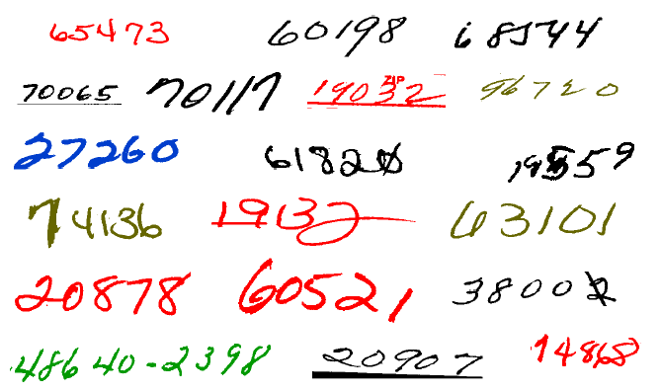
example
Examples of handwritten postal codes
drawn from a database available from the US Postal service

Slide 47
classical neural architectures
Perceptron
Multi-Layer Perceptron
Radial Basis Function (RBF)
Kohonen Features maps
Other architectures
  An example : Shared weights neural networks

Slide 48




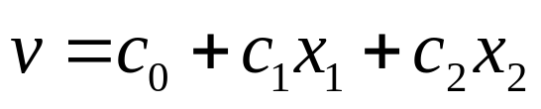

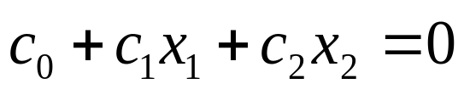





perceptron
Rosenblatt (1962)
Linear separation
Inputs :Vector of real values
Outputs :1 or -1
+
+
+
+
+
+
+
+
+
+
+
+
+
+
+
+
+
+
+
+
+
+
+
+
+
+
+
+
+
+
+
+
+
+
+
+

Slide 49
perceptron
inputs
weights
threshold
x
a
output
+
>10?
x
b

Slide 50
training
Inputs and outputs are 0 (no) or 1 (yes)
Initially, weights are random
Provide training input
Compare output of neural network to desired output
  If same, reinforce patterns
  If different, adjust weights

Slide 51
example
If both inputs are 1, output should be 1.
inputs
weights
threshold
x
2
output
+
>10?
x
3

Slide 52
example (1,1)
inputs
weights
threshold
1
x
2
output
+
>10?
1
x
3

Slide 53
example (1,1)
inputs
weights
2
threshold
1
x
2
output
+
>10?
1
x
3
3

Slide 54
example (1,1)
inputs
weights
2
threshold
1
x
2
output
5
+
>10?
1
x
3
3

Slide 55
example (1,1)
inputs
weights
2
threshold
1
x
2
output
5
+
>10?
0
1
x
3
3

Slide 56

example (1,1)
If both inputs are 1, output should be 1.
inputs
weights
2
threshold
1
x
2
output
5
+
>10?
0
1
x
3
3

Slide 57
example (1,1)
inputs
weights
Must increase weights!
2
threshold
1
x
2
output
5
+
>10?
0
1
x
3
3

Slide 58
example (1,1)
inputs
weights
threshold
1
x
output
+
>10?
1
x
Repeat for all inputs until weights stop changing.

Slide 59
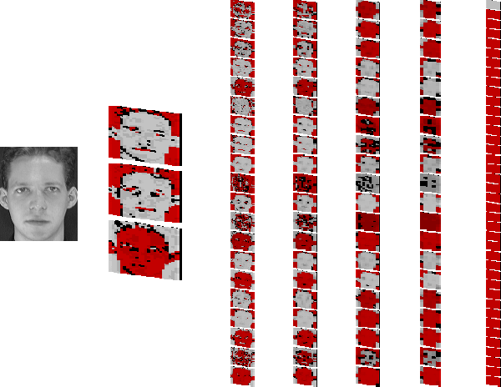
Face recognition
Steve Lawrence, C. Lee Giles, A.C. Tsoi and A.D. Back. Face Recognition: A Convolutional Neural Network Approach. IEEE Transactions on Neural Networks, Special Issue on Neural Networks and Pattern Recognition, Volume 8, Number 1, pp. 98-113, 1997.

Slide 60
learning
The perceptron algorithm converges if examples are linearly separable

Slide 61
multi-layer perceptron
One or more hidden layers
Sigmoid activations functions
Output layer
2nd hidden
layer
1st hidden
layer
Input data

Slide 62
feed-forward nets
Information flow is unidirectional
  Data is presented to Input layer
  Passed on to Hidden Layer
  Passed on to Output layer
Information is distributed
Information processing is parallel
Internal representation (interpretation) of data

Slide 63
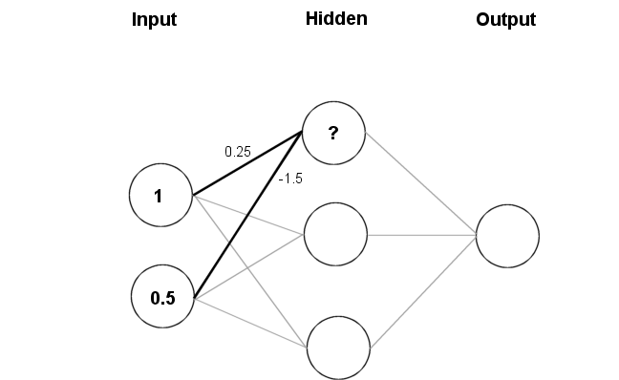
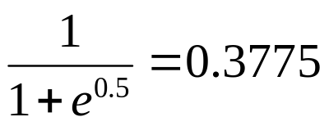
feeding data through the net
(1 × 0.25) + (0.5 × (-1.5)) = 0.25 + (-0.75) = - 0.5
activation

Slide 64
feeding data through the net
Data is presented to the network in the form of activations in the input layer
Examples
  Pixel intensity (for pictures)
  Molecule concentrations (for artificial nose)
  Share prices (for stock market prediction)
Data usually requires pre-processing
  Analogous to senses in biology
How to represent more abstract data, e.g. a name?
  Choose a pattern, e.g.
    0-0-1 for “Chris”
    0-1-0 for “Becky”

Slide 65
weights
Weight settings determine the behaviour of a network
→ How can we find the right weights?

Slide 66
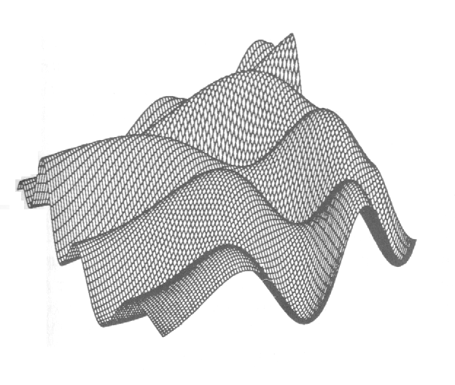
training the network - learning
Backpropagation
Requires training set (input / output pairs)
Starts with small random weights
Error is used to adjust weights (supervised learning)
→ Gradient descent on error landscape

Slide 67
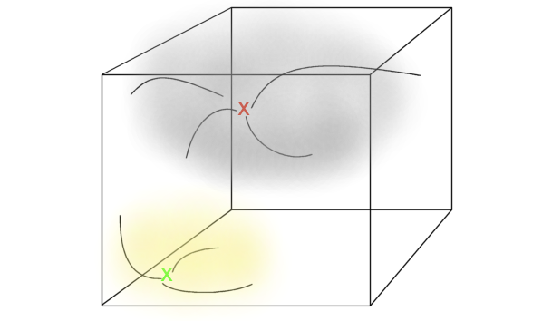
memories are attractors in state space

Slide 68
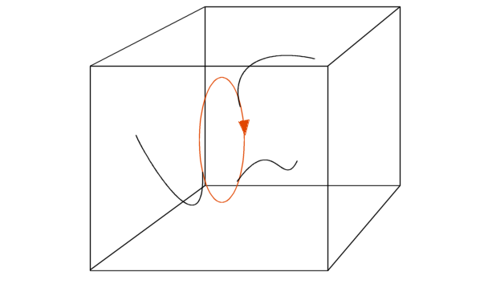
cyclic attractors in state space

Slide 69
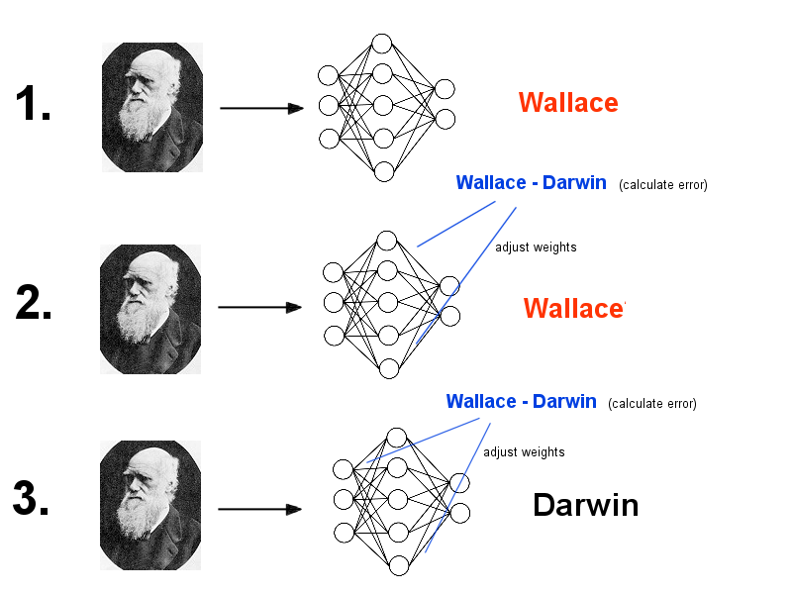
backpropagation

Slide 70
backpropagation
Advantages
  It works!
  Relatively fast
Downsides
  Requires a training set
  Can be slow
  Probably not biologically realistic
Alternatives to Backpropagation
  Hebbian learning
    Not successful in feed-forward nets
  Reinforcement learning
    Only limited success
  Artificial evolution
    More general, but can be even slower than backprop

Slide 71
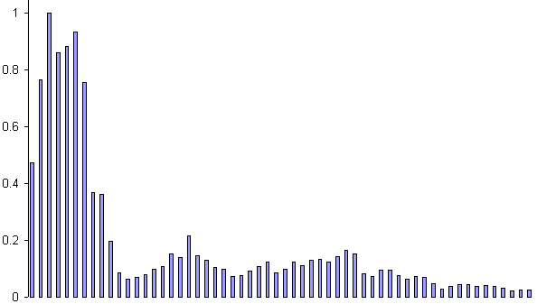
example: voice recognition
Task: Learn to discriminate between two different voices saying “Hello”
Data
  Sources
    Steve Simpson
    David Raubenheimer
  Format
    Frequency distribution (60 bins)
    Analogy: cochlea

Slide 72
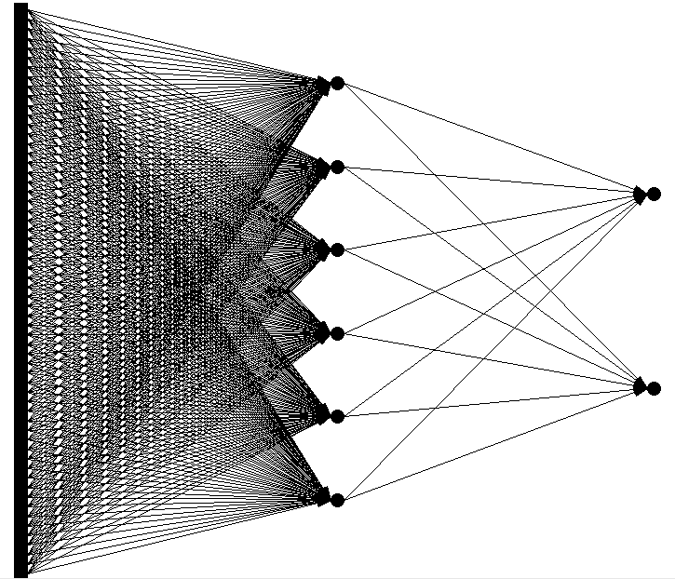
example: voice recognition
Network architecture: Feed forward network
60 inputs (one for each frequency bin)
6 hidden nodes
2 outputs (0-1 for “Steve”, 1-0 for “David”)

Slide 73
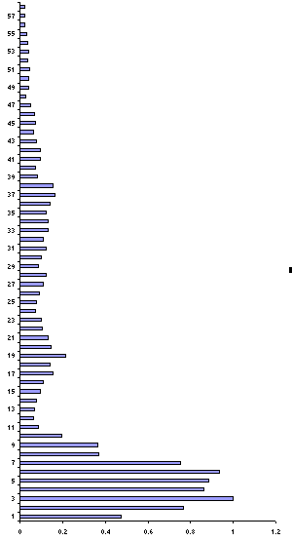
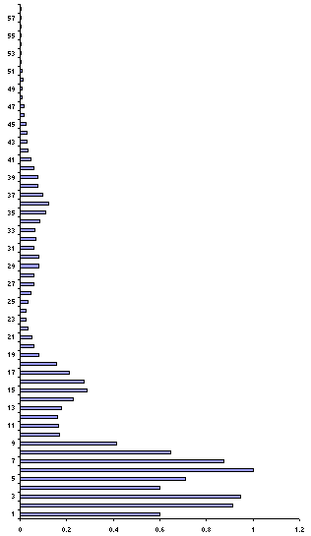
presenting the data
Steve
David

Slide 74
presenting the data
Steve
0.43
0.26
David
0.73
0.55
untrained network

Slide 75
calculate error
Steve
|0.43 - 0 |= 0.43
|0.26 – 1| = 0.74
David
|0.73 – 1| = 0.27
|0.55 – 0| = 0.55

Slide 76
backprop error and adjust weights
Steve
|0.43 - 0 |= 0.43
|0.26 – 1| = 0.74
1.17
David
|0.73 – 1| = 0.27
|0.55 – 0| = 0.55
0.82

Slide 77
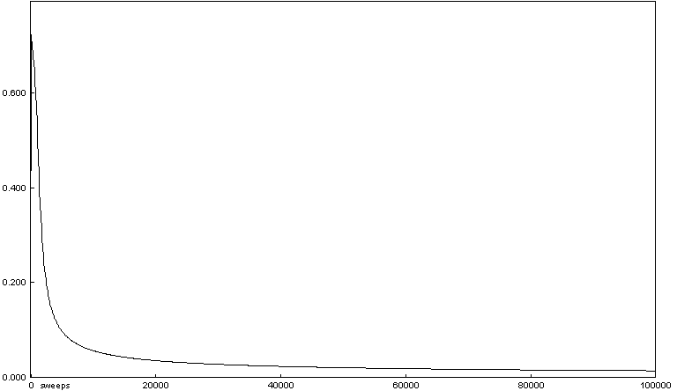
example: voice recognition
Repeat process (sweep) for all training pairs
  Present data
  Calculate error
  Backpropagate error
  Adjust weights
Repeat process multiple times

Slide 78
presenting the data
Steve
0.01
0.99
David
0.99
0.01
trained network

Slide 79
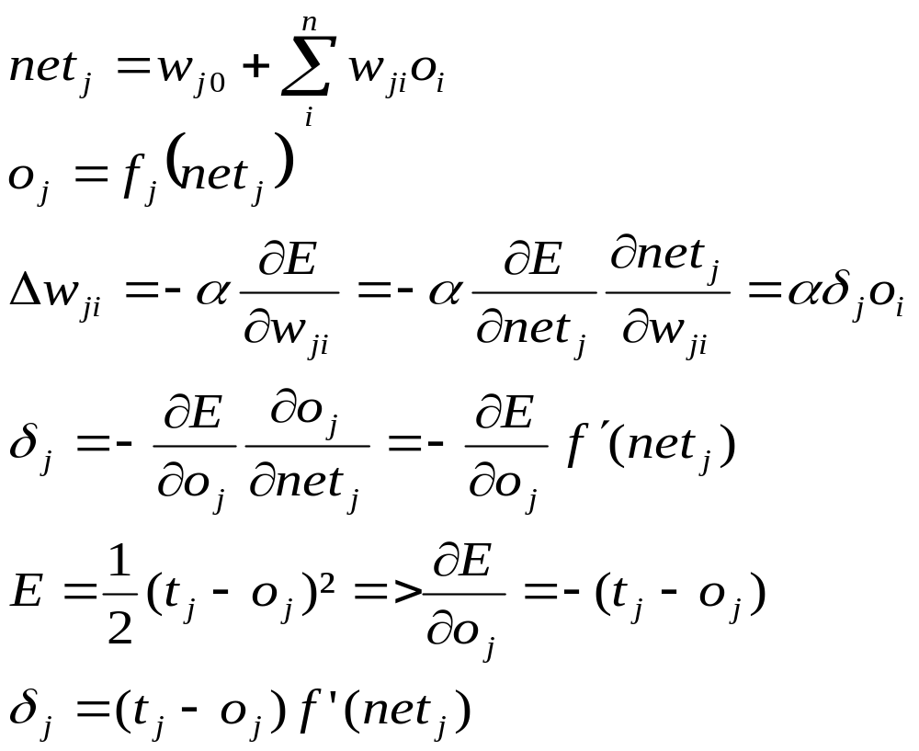
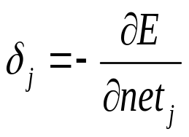
learning
Credit assignment
If the jth node is an output unit
Back-propagation algorithm

Slide 80
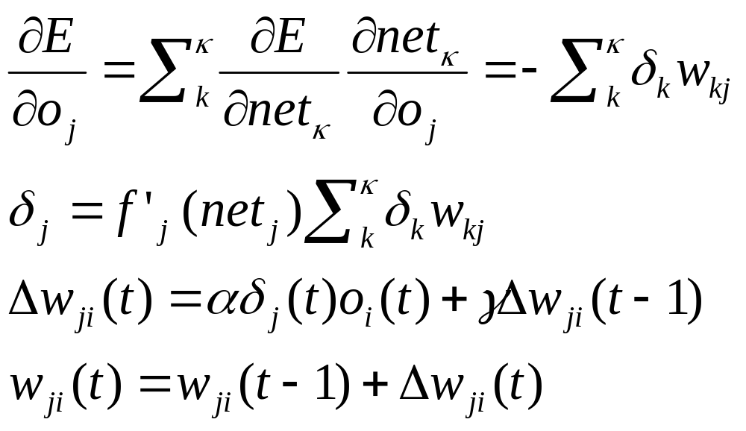
learning
Momentum term to smooth
The weight changes over time

Slide 81
different non linearly separable problems
Types of
Decision Regions
Exclusive-OR
Problem
Classes with
Meshed regions
Most General
Region Shapes
Structure
Single-Layer
Half Plane
Bounded By
Hyperplane
A
B
B
A
B
A
Two-Layer
Convex Open
Or
Closed Regions
A
B
B
A
B
A
Three-Layer
Abitrary
(Complexity
Limited by No.
of Nodes)
A
B
B
A
B
A

Slide 82
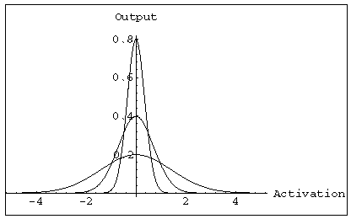
radial basis functions (RBFs)
Features
One hidden layer
The activation of a hidden unit is determined by the distance between the input vector and a prototype vector
Outputs
Radial units
Inputs

Slide 83
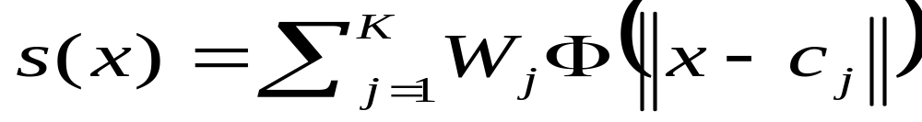
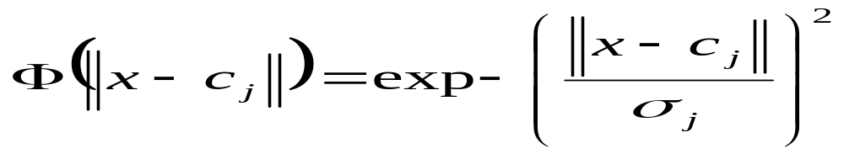
radial basis functions (RBFs)
RBF hidden layer units have a receptive field which has a centre
Generally, the hidden unit function is Gaussian
The output Layer is linear
Realized function

Slide 84
learning
The training is performed by deciding on
  How many hidden nodes there should be
  The centers and the sharpness of the Gaussians
2 steps
  In the 1st stage, the input data set is used to determine the parameters of the basis functions
  In the 2nd stage, functions are kept fixed while the second layer weights are estimated ( Simple BP algorithm like for MLPs)

Slide 85
MLPs versus RBFs
Classification
  MLPs separate classes via hyperplanes
  RBFs separate classes via hyperspheres
Learning
  MLPs use distributed learning
  RBFs use localized learning
  RBFs train faster
Structure
  MLPs have one or more hidden layers
  RBFs have only one layer
  RBFs require more hidden neurons => curse of dimensionality
X₂
MLP
X₁
X₂
RBF
X₁

Slide 86
self organizing maps
The purpose of SOM is to map a multidimensional input space onto a topology preserving map of neurons
  Preserve a topological so that neighboring neurons respond to « similar »input patterns
  The topological structure is often a 2 or 3 dimensional space
Each neuron is assigned a weight vector with the same dimensionality of the input space
Input patterns are compared to each weight vector and the closest wins (Euclidean Distance)

Slide 87
self organizing maps
The activation of the neuron is spread in its direct neighborhood =>neighbors become sensitive to the same input patterns
Block distance
The size of the neighborhood is initially large but reduce over time => Specialization of the network
2nd neighborhood
First neighborhood

Slide 88
adaptation
During training, the “winner” neuron and its neighborhood adapts to make their weight vector more similar to the input pattern that caused the activation
The neurons are moved closer to the input pattern
The magnitude of the adaptation is controlled via a learning parameter which decays over time

Slide 89
time delay neural networks (TDNNs)
Introduced by Waibel in 1989
Properties
  Local, shift invariant feature extraction
  Notion of receptive fields combining local information into more abstract patterns at a higher level
  Weight sharing concept (All neurons in a feature share the same weights)
    All neurons detect the same feature but in different position
Principal Applications
  Speech recognition
  Image analysis

Slide 90
TDNNs
Objects recognition in an image
Each hidden unit receive inputs only from a small region of the input space : receptive field
Shared weights for all receptive fields => translation invariance in the response of the network
Hidden
Layer 2
Hidden
Layer 1
Inputs

Slide 91
TDNNs
Advantages
Reduced number of weights
  Require fewer examples in the training set
  Faster learning
Invariance under time or space translation
  Faster execution of the net (in comparison of full connected MLP)

Slide 92
Hopfield networks
Sub-type of recurrent neural nets
  Fully recurrent
  Weights are symmetric
  Nodes can only be on or off
  Random updating
Learning: Hebb rule (cells that fire together wire together)
  Biological equivalent to LTP and LTD
Can recall a memory, if presented with a corrupt or incomplete version
→ auto-associative or
content-addressable memory

Slide 93
Hopfield networks
Task store images with resolution of 20x20 pixels
→ Hopfield net with 400 nodes
Memorise
  Present image
  Apply Hebb rule (Increase weight between two nodes if both have same activity, otherwise decrease)
  Go to 1
Recall
  Present incomplete pattern
  Pick random node, update
  Go to 2 until settled

Slide 94
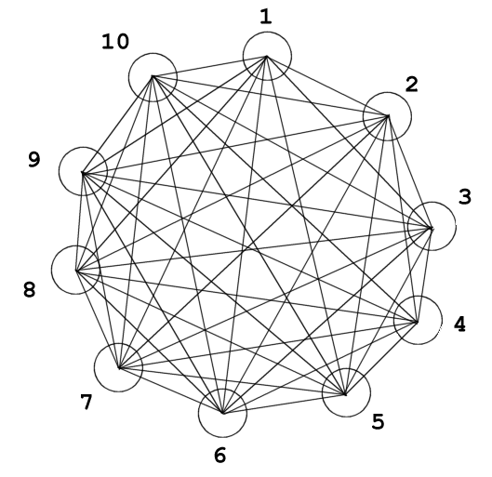
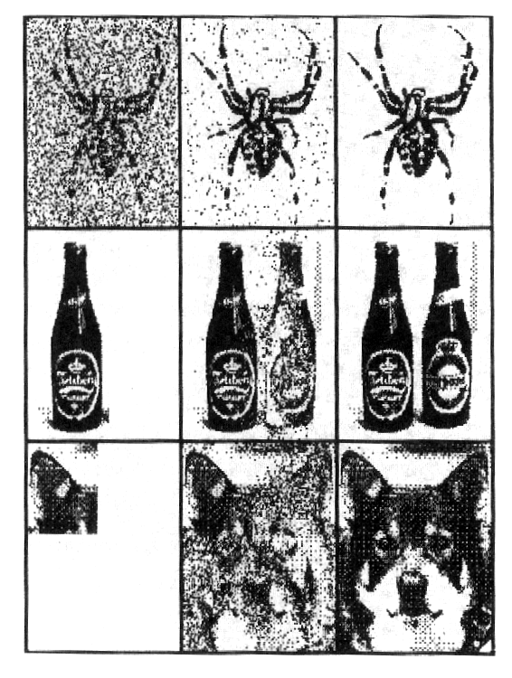
Hopfield networks

Slide 95
applications
Face recognition
Time series prediction
Process identification
Process control
Optical character recognition
Adaptative filtering
Etc…

Slide 96
conclusion on neural networks
Neural networks are utilized as statistical tools
  Adjust non linear functions to fulfill a task
  Need of multiple and representative examples but fewer than in other methods
Neural networks enable to model complex static phenomena (FF) as well as dynamic ones (RNN)
NN are good classifiers BUT
  Good representations of data have to be formulated
  Training vectors must be statistically representative of the entire input space
  Unsupervised techniques can help
The use of NN needs a good comprehension of the problem

Slide 97
recap – neural networks
Components – biological plausibility
  Neurone / node
  Synapse / weight
Feed forward networks
  Unidirectional flow of information
  Good at extracting patterns, generalisation and prediction
  Distributed representation of data
  Parallel processing of data
  Training: Backpropagation
  Not exact models, but good at demonstrating principles
Recurrent networks
  Multidirectional flow of information
  Memory / sense of time
  Complex temporal dynamics (e.g. CPGs)
  Various training methods (Hebbian, evolution)
  Often better biological models than FFNs

Slide 98
pre-processing

Slide 99
why preprocessing?
The curse of Dimensionality
The quantity of training data grows exponentially with the dimension of the input space
In practice, we only have limited quantity of input data
  Increasing the dimensionality of the problem leads to give a poor representation of the mapping

Slide 100
preprocessing methods
Normalization
Translate input values so that they can be exploitable by the neural network
Component reduction
Build new input variables in order to reduce their number
No Lost of information about their distribution

Slide 101

character recognition example
Image 256x256 pixels
8 bits pixels values (grey level)
Necessary to extract features

Slide 102
normalization
Inputs of the neural net are often of different types with different orders of magnitude (E.g. Pressure, Temperature, etc.)
It is necessary to normalize the data so that they have the same impact on the model
Center and reduce the variables

Slide 103
components reduction
Sometimes, the number of inputs is too large to be exploited
The reduction of the input number simplifies the construction of the model
Goal : Better representation of the data in order to get a more synthetic view without losing relevant information
Reduction methods (PCA, CCA, etc.)

Slide 104
principal components analysis (PCA)
Principle
Linear projection method to reduce the number of parameters
Transfer a set of correlated variables into a new set of uncorrelated variables
Map the data into a space of lower dimensionality
Form of unsupervised learning
Properties
It can be viewed as a rotation of the existing axes to new positions in the space defined by original variables
New axes are orthogonal and represent the directions with maximum variability

Slide 105
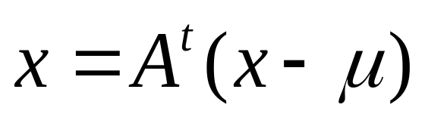
PCA
Compute d dimensional mean
Compute d*d covariance matrix
Compute eigenvectors and Eigenvalues
Choose k largest Eigenvalues
  K is the inherent dimensionality of the subspace governing the signal
Form a d*d matrix A with k columns of eigenvectors
The representation of data consists of projecting data into a k dimensional subspace by

Slide 106
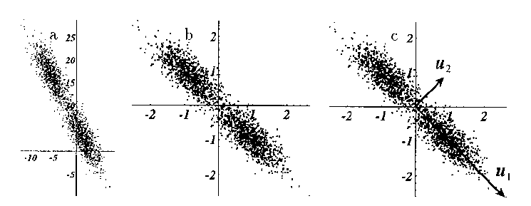
example of data representation using PCA

Slide 107
limitations of PCA
The reduction of dimensions for complex distributions may need non linear processing

Slide 108
curvilinear components analysis
Non linear extension of the PCA
Can be seen as a self organizing neural network
Preserves the proximity between the points in the input space i.e. local topology of the distribution
Enables to unfold some varieties in the input data
Keep the local topology

Slide 109
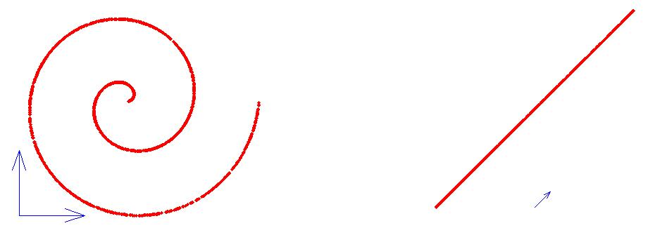
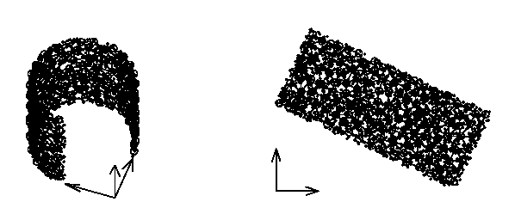
example of data representation using CCA
Non linear projection of a spiral
Non linear projection of a horseshoe

Slide 110
other methods
Neural pre-processing
Use a neural network to reduce the dimensionality of the input space
Overcomes the limitation of PCA
Auto-associative mapping => form of unsupervised training

Slide 111
neural pre-processing
D dimensional output space
Transformation of a D dimensional input space into a M dimensional output space
Non linear component analysis
The dimensionality of the sub-space must be decided in advance
x1
x2
….
xd
M dimensional sub-space
z1
zM
x1
x2
….
xd
D dimensional input space

Slide 112
intelligent preprocessing
Use an “a priori” knowledge of the problem to help the neural network in performing its task
Reduce manually the dimension of the problem by extracting the relevant features
More or less complex algorithms to process the input data

Slide 113
conclusion on the preprocessing
The preprocessing has a huge impact on performances of neural networks
The distinction between the preprocessing and the neural net is not always clear
The goal of preprocessing is to reduce the number of parameters to face the challenge of “curse of dimensionality”
It exists a lot of preprocessing algorithms and methods
  Preprocessing with prior knowledge
  Preprocessing without

Slide 114
bio-inspired computing

Slide 115
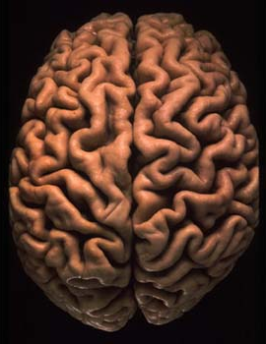
bioinspired computing

Slide 116
questions
Big questions
What is learning?
How does the brain learn?
Is it possible to think about learning in cortical cells/networks outside the body?
More big questions
What are bio-inspired computing applications?

Slide 117
learning
definition of learning
Learning is typically defined as the process by which a mode of behaviour/action is acquired in response to some experience (e.g., an event or series of events).
types of learning
Non-associative learning: habituation,
sensitisation
Associative learning: conditioning (Pavlov’s experiments)
contextual learning
and more…

Slide 118
learning
According to the above (top-down) definition, we can only recognise learning in the form of altered behaviour.
Is it possible for a system to learn without manifesting it in its “behaviour”? Is there a more fundamental definition of learning that is not behaviour-based?
Conversely, is learning always necessary for altered behaviour?

Slide 119
brain cells in a dish
Sensory
input
Neural
stimuli
Neural
response
Motor/other
output

Slide 120

brain cells in a dish

Slide 121

brain cells in a dish
http://neuro.gatech.edu/groups/potter/movies.html

Slide 122

training protocol
Select a pair of electrodes
A,B such that B does not
respond to a stimulus at A
Repeatedly stimulate at A
until the desired response
is obtained in B; register
how long this took.
Wait 5 minutes

Slide 123
stopping
Stimulation STOPS following desired response

Slide 124
set-up
“By providing a cultured network with a body to behave with and an environment to behave in, it is now possible to view changes in network activity as learning.”

Slide 125

set-up

Slide 126

set-up
Potter et al. (2003)

Slide 127
hardware

Slide 128
motivations and questions
Which architectures utilizing to implement Neural Networks in real-time ?
  What are the type and complexity of the network ?
  What are the timing constraints (latency, clock frequency, etc.)
  Do we need additional features (on-line learning, etc.)?
  Must the Neural network be implemented in a particular environment ( near sensors, embedded applications requiring less consumption etc.) ?
  When do we need the circuit ?
Solutions
  Generic architectures
  Specific Neuro-Hardware
  Dedicated circuits

Slide 129
generic hardware architectures
Conventional microprocessors
Intel Pentium, Power PC, etc …
Advantages
  High performances (clock frequency, etc)
  Cheap
  Software environment available (NN tools, etc)
Drawbacks
  Too generic, not optimized for very fast neural computations

Slide 130
specific neuro-hardware circuits
Commercial chips CNAPS, Synapse, etc.
Advantages
  Closer to the neural applications
  High performances in terms of speed
Drawbacks
  Not optimized to specific applications
  Availability
  Development tools
Remark
  These commercials chips tend to be out of production

Slide 131

example :CNAPS chip
CNAPS 1064 chip
Adaptive Solutions,
Oregon
64 x 64 x 1 in 8 µs
(8 bit inputs, 16 bit weights)

Slide 132
dedicated circuits
A system where the functionality is once and for all tied up into the hard and soft-ware.
Advantages
  Optimized for a specific application
  Higher performances than the other systems
Drawbacks
  High development costs in terms of time and money

Slide 133
dedicated circuits
Custom circuits
  ASIC
  Necessity to have good knowledge of the hardware design
  Fixed architecture, hardly changeable
  Often expensive
Programmable logic
  Valuable to implement real time systems
  Flexibility
  Low development costs
  Fewer performances than an ASIC (Frequency, etc.)

Slide 134
programmable logic
Field Programmable Gate Arrays (FPGAs)
Matrix of logic cells
Programmable interconnection
Additional features (internal memories + embedded resources like multipliers, etc.)
Reconfigurability
  We can change the configurations as many times as desired

Slide 135

FPGA architecture
cout
y
I/O Ports
G4
G3
G2
G1
Carry &
Control
D
Q
yq
LUT
xb
Block Rams
x
F4
F3
F2
F1
Carry &
Control
D
Q
xq
DLL
LUT
bx
Programmable
Logic
Blocks
Programmable
connections
cin
Xilinx Virtex slice

Slide 136
neural network architecture
4
64
……..
128
……..

Slide 137
very fast architecture
Matrix of n*m matrix elements
Control unit
I/O module
TanH are stored in LUTs
1 matrix row computes a neuron
The results is back-propagated to calculate the output layer
PE
PE
PE
PE
ACC
TanH
PE
PE
PE
PE
ACC
TanH
PE
PE
PE
PE
ACC
TanH
PE
PE
PE
PE
ACC
TanH

Slide 138
clustering
Idea : Combine performances of different processors to perform massive parallel computations
High speed
connection

Slide 139
clustering
Advantages
Take advantage of the intrinsic parallelism of neural networks
Utilization of systems already available (university, Labs, offices, etc.)
High performances : Faster training of a neural net
Very cheap compare to dedicated hardware

Slide 140
clustering
Drawbacks
Communications load : Need of very fast links between computers
Software environment for parallel processing
Not possible for embedded applications

Slide 142

physical AND gate
Electrical AND gate: open = 0 closed = 1
Block: Primitive Processes

Slide 143

biological AND gate
Cat and Mouse AND Gate: hungry mouse = 0 mouse fed = 1
Block: Primitive Processes

