Slide 1
An Essay on
“The Chemical Basis of Morphogenesis” written by A. Turing
Yongjin Park (99328-162),
Dept. of Biological Sciences

Slide 2
Agenda
Morphogenetic model
A critique on the article
Conclusion regarding complexity

Slide 3
Morphogenetic Model
Morphogenesis := morphology (shape) + genesis (development)
Chemical reagent (I.e., hormones) matters
  Enzyme kinetics: velocity ∝ concentration
  Osmotic pressure as driving force
Cell as a single system
Morphogen as a single unit
Units ∈ System

Slide 4
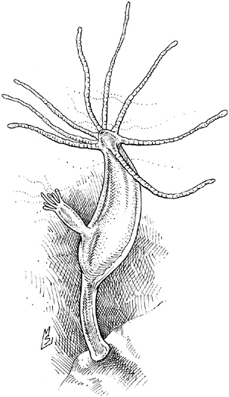
Morphogenetic Model cont.
Model organism (hydra)

Slide 5
Morphogenetic Model cont.
X
Y

Slide 6
A critique on Turing
Mathematically rigorous model but not biologically relevant.
Physical basis simultaneously contributes to the morphogenesis in more fundamental aspects.
  Skeletal structures (both extra and intra)
  Almost not permeable (or highly selective) cell membrane
  Tightly controlled cell division cycle
  Membrane tension
  Cell migration (neural navigation)
A single cell is far more complex.

Slide 7
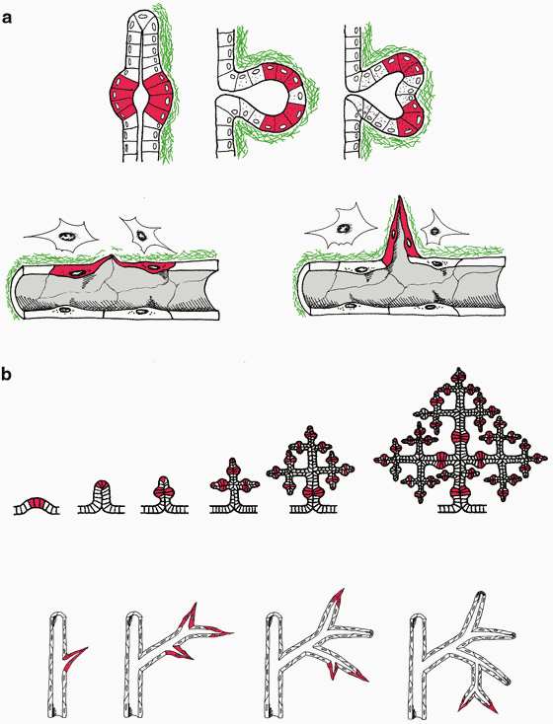
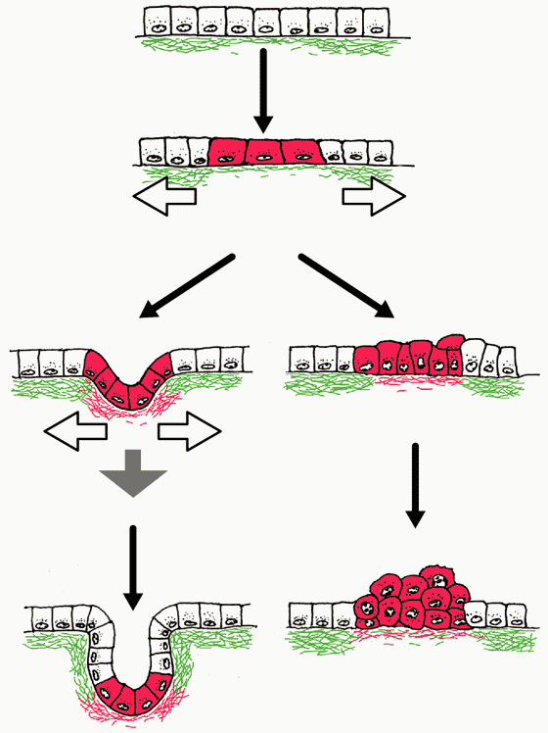
Sui Huang & Donald E. Ingber,
Nature Cell Biology 1, E131 - E138 (1999)

Slide 8
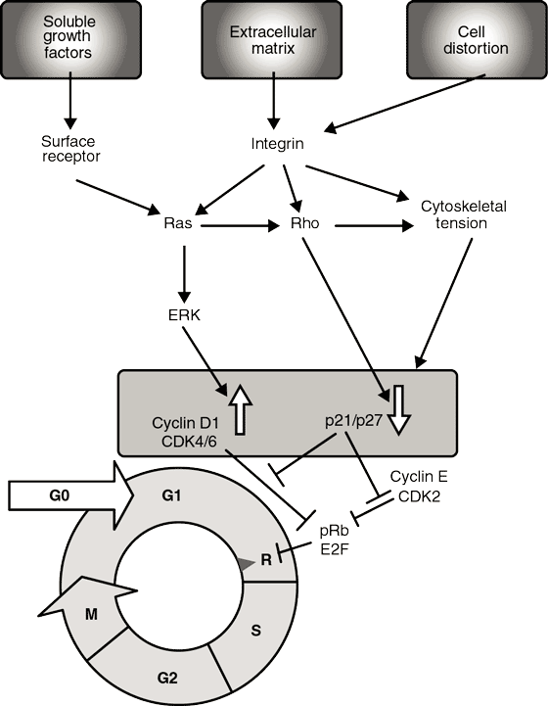
Sui Huang & Donald E. Ingber,
Nature Cell Biology 1, E131 - E138 (1999)

Slide 9
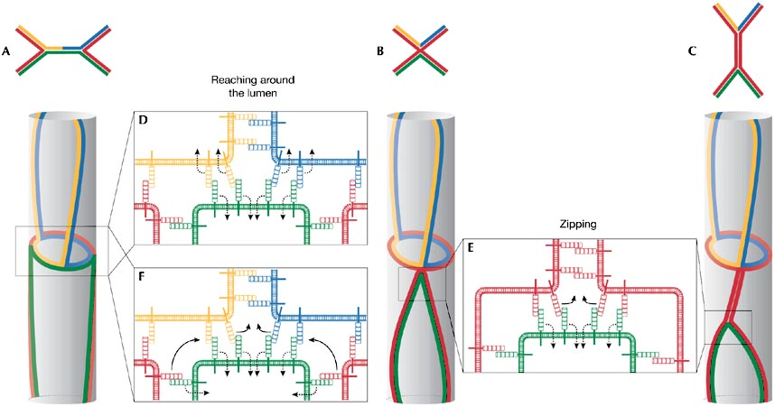
Marc Neumann & Markus Affolter, EMBO reports 7, 1, 36–40 (2006)

Slide 10
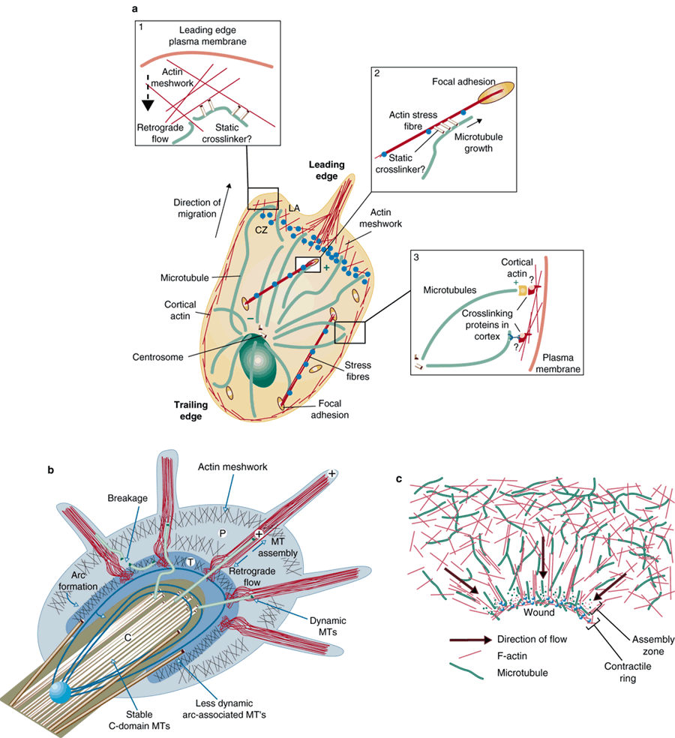
Olga C. Rodriguez et al.,
Nature Cell Biology 5, 599 - 609 (2003)

Slide 11
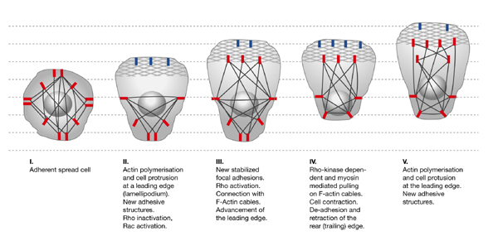
Luca Tamagnone & Paolo M. Comoglio, EMBO reports 5, 4, 356–361 (2004)

Slide 12
Cellular network model
X
Y

Slide 13
Conclusion
Simplicity within complexity
  Oscillating chemical gradient is at the heart of biological homeostasis.
Morphogenesis or chemical computing
  Chicken or egg problem
Physical complexity leads to computing structure
Network model of state machines
But even central dogma is not devised in 1950’s.
Biological state machine → DNA computing.

