Slide 1
Artificial Intelligence
Chapter 5
State Machines
Biointelligence Lab
School of Computer Sci. & Eng.
Seoul National University

Slide 2
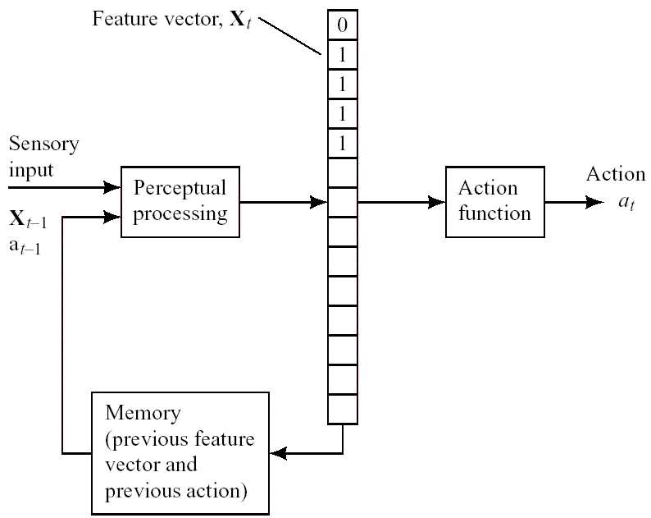
A State Machine
Figure 5.1 A State Machine

Slide 3
The State Machine
The feature vector represents the state of the environment.
The S-R agent computes an action appropriate for that environmental state.
Sensory limitations of the agent preclude completely accurate representation of environmental state by feature vectors.
The accuracy can be improved by taking into account previous history.
  The representation of environmental state at the previous time step
  The action taken at the previous time step
The state machine must have memory.

Slide 4
The Boundary-Following Robot
The sensory-impaired version
  This robot can sense only the cells immediately to its north, east, south, and west.
  The sensory inputs are only (s₂, s₄, s₆, s₈).
Even with this impairment, this robot can still perform boundary-following behavior if it computes the needed feature vector from its immediate sensory inputs, the previous feature vector, and the just-performed action.

Slide 5
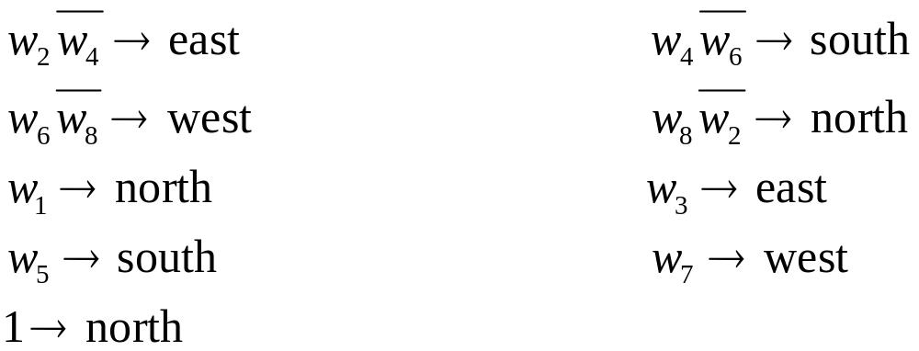
The Sensory-Impaired Boundary-Following Robot
The features
  w_{i} = s_{i}, for i = 2, 4, 6, 8
  w₁ has value 1 if and only if at the previous time step w₂ had value 1 and the robot moved east.
  Similar for w₃, w₅, w₇
The production system gives wall-following behavior.

Slide 6
An Elman Network
An Elman network
  A special type of recurrent neural network
The Elman network can learn how to compute a feature vector and an action from a previous feature vector and sensory inputs.
For the boundary-following robot
  Inputs: (s₂, s₄, s₆, s₈) + the values of the eight hidden units one time step earlier
  Hidden units: eight hidden units, one for each feature
  Outputs: four output units, one for each action

Slide 7
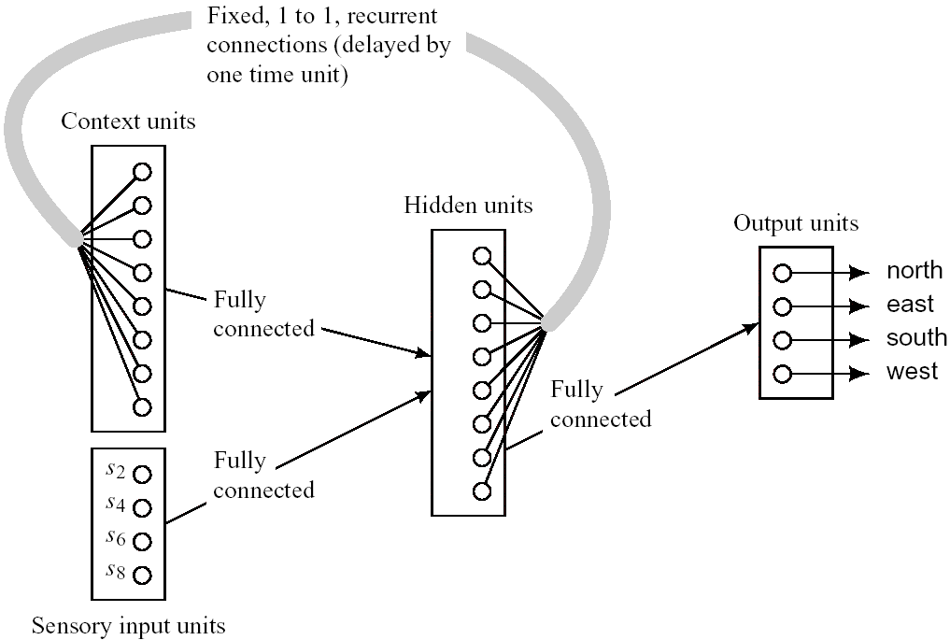
The Elman Network
This Elman network can be trained by ordinary backpropagation.
Figure 5.2 An Elman Network

Slide 8
Iconic Representations
Representing the world
  By features
  By data structures – iconic representation
The agent computes actions appropriate to its task and to the present modeled state of the environment.
  The sensory information is first used to update the iconic model as appropriate.
  Then, operations similar to perceptual processing are used to extract features needed by the action computation subsystem.
    The actions include those that change the iconic model as well as those that affect the actual environment.
    The features derived from the iconic model must represent the environment in a manner that is adequate for the kinds of actions the robot must take.

Slide 9
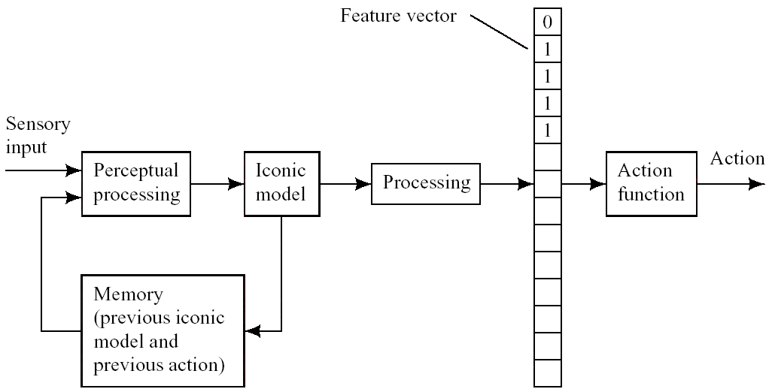
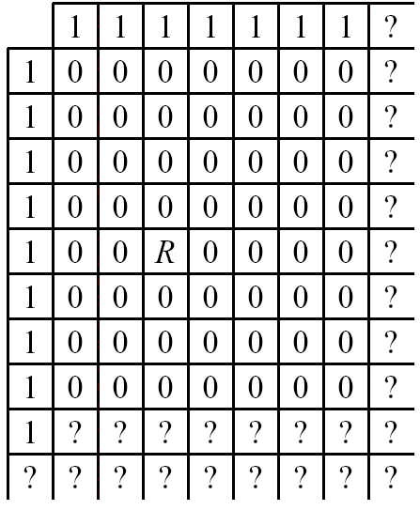
An Agent that Uses an Iconic Representation
Figure 5.3 An Agent That Computers Features from an Iconic Representation
Figure 5.4 A Maplike Iconic Representation

Slide 10

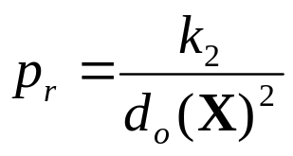
An Artificial Potential Field (1/2)
This technique is used extensively in controlling robot motion.
The robot’s environment is represented as a 2-dimensional potential field.
The potential field is the sum of an “attractive” and a “repulsive” component.
An attractive field
  Associated with the goal location
A repulsive field
  Associated with the obstacles

Slide 11
An Artificial Potential Field (2/2)
The artificial potential field
  p = p_{a} + p_{r}
Motion of the robot is directed along the gradient of the potential field.
Either the potential field can be precomputed and stored in memory or it can be computed at the robot’s location just before the use.

Slide 12
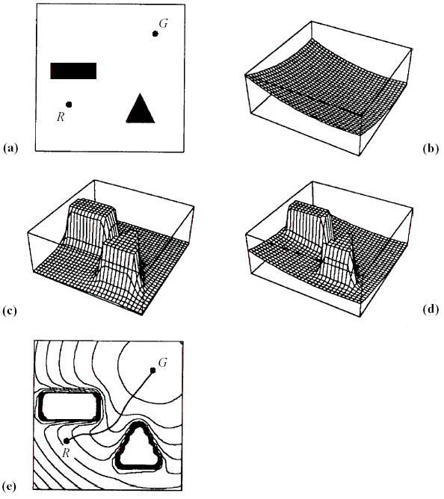
An Example Artificial Potential Field
(a)
  R: The robot position
  G: The goal location
(b) Attractive potential
(c) Repulsive potential
(d) Total potential
(e) Equipotential curves and the path to be followed
Figure 5.5 Equipotential Curves of an Artificial Potential Field

Slide 13
The Blackboard System
The blackboard architecture
  Knowledge sources (KSs) read and change the blackboard.
    A condition part computes the value of a feature from the blackboard data structure.
    An action part can be any program that changes the data structure or takes external action (or both).
  When two or more KSs evaluate to 1, a conflict resolution program decides which KSs should act.
  KS actions can have external effects and the blackboard might be changed by perceptual subsystems that process sensory data.
  The KSs are supposed to be “experts” about the part(s) of the blackboard that they watch.
Blackboard systems are designed so that as computation proceeds, the blackboard ultimately becomes a data structure that contains the solution to some particular problem.

Slide 14
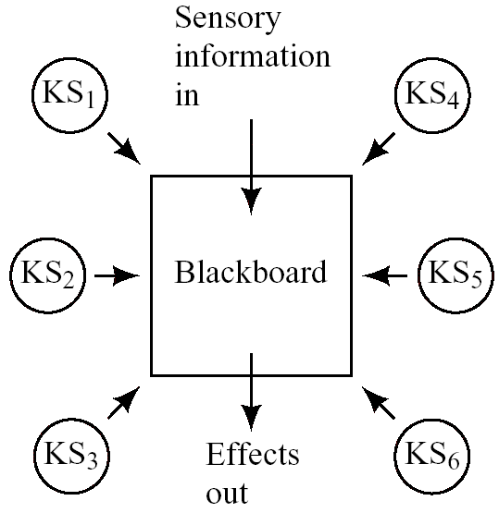
A Blackboard System
Figure 5.6 A Blackboard System

Slide 15
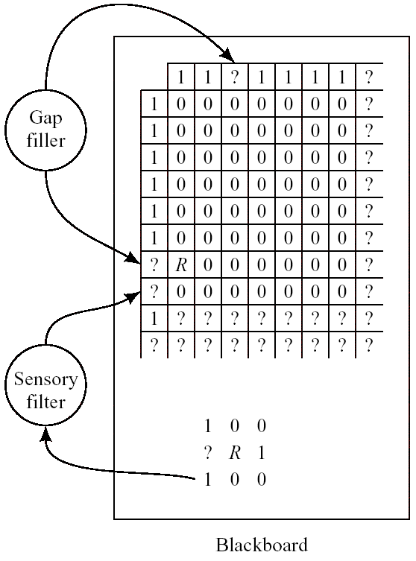
A Robot in Grid World (1/2)
The robot can sense all eight cells, but sensors are sometimes give erroneous information.
The data structure representing the map and the data structure containing sensory data compose the blackboard.
Figure 5.7 A Robot’s Blackboard and KSs

Slide 16
A Robot in Grid World (2/2)
A KS (gap filler)
  The gap filler looks for tight spaces in the map, and (knowing that there can be no tight spaces) either fills them in with 1’s or expands them with additional adjacent 0’s.
    For example, the gap filler decides to fill the tight space at the top of the map in Figure 5.7.
Another KS (sensory filter)
  The sensory filter looks at both the sensory data and the map and attempts to reconcile any discrepancies.
    In Figure 5.7, the sensory filter notes that s₇ is a strong “cell-occupied” signal but that the corresponding cell in the map was questionable.
    It decides to reconcile the difference by replacing that ? in the map with a 1.

Slide 17
Additional Readings and Discussion
State machines are even more ubiquitous than S-R agents, and the relationship between S-R agents and ethological models of animal behavior applies also to state machines.
Elman networks are one example of learning finite-state automata.
Many researchers have studied the problem of learning spatial maps, which are examples of iconic representations.

