Slide 1
Ch 5. Profile HMMs for sequence families
Biological sequence analysis: Probabilistic models of proteins and nucleic acids
Richard Durbin
Sean R. Eddy
Anders Krogh
Graeme Mitchison

Slide 2
Contents
Components of profile HMMs
HMMs from multiple alignments
Searching with profile HMMs
Variants for non-global alignments
More on estimation probabilities
Optimal model construction
Weighting training sequences

Slide 3
Introduction
Interest on sequence families
Profile HMMs
  Consensus modeling
Theory about inference, learning of profile HMMs

Slide 4
figure 5.1

Slide 5
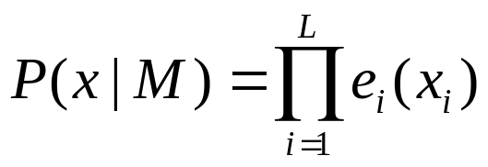
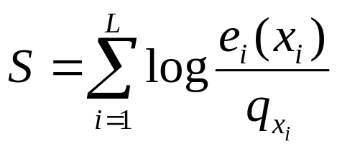
Ungapped score matrices
Only considering ungapped regions
  Probability model
PSSM (position specific score matrix)
  Log-odd ratio

Slide 6
Components of profile HMMs (1)
Consideration of gaps
  Henikoff & Henikoff [1991]
    Combining the multiple ungapped block models
  Allowing gaps at each position using the same gap scores γ(g) at each position
Profile HMMs
  Repetitive structure of states
  Different probabilities in each position
  Full probabilistic model for sequences in the sequence family

Slide 7
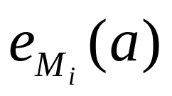
Components of profile HMMs (2)
Match states
  Emission probabilities
Begin
....
M_{j}
....
End

Slide 8
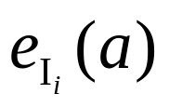

Components of profile HMMs (3)
Insert states
  Emission prob.
    Usually back ground distribution q_{a}.
  Transition prob.
    M_{i} to I_{i}, I_{i} to itself, I_{i} to M_{i+1}
  Log-odds score of a gap of length k (no logg-odds from emission)
I_{j}
Begin
M_{j}
End

Slide 9
Components of profile HMMs (4)
Delete states
  No emission prob.
  Cost of a deletion
    M→D, D→D, D→M
    Each D→D might be different
D_{j}
Begin
M_{j}
End

Slide 10
Components of profile HMMs (5)
Combining all parts
D_{j}
I_{j}
Begin
M_{j}
End
Figure 5.2 The transition structure of a profile HMM.

Slide 11
HMMs from multiple alignments (1)
Key idea behind profile HMMs
  Model representing the consensus for the family
  Not the sequence of any particular member
HBA_HUMAN ...VGA--HAGEY...
HBB_HUMAN ...V----NVDEV...
MYG_PHYCA ...VEA--DVAGH...
GLB3_CHITP ...VKG------D...
GLB5_PETMA ...VYS--TYETS...
LGB2_LUPLU ...FNA--NIPKH...
GLB1_GLYDI ...IAGADNGAGV...
*** *****
Figure 5.3 Ten columns from the multiple alignment of seven globin protein sequences shown in Figure 5.1 The starred columns are ones that will be treated as ‘matches’ in the profile HMM.

Slide 12
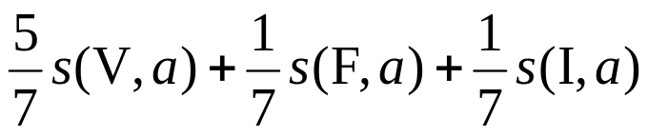
HMMs from multiple alignments (2)
Non-probabilistic profiles
  Gribskov, Mclachlan & Eisenberg [1987]
    Score for residue a in column 1
  Disadvantages
    More conserved region might be corrupted.
    Intuition about the likelihood can’t be maintained.
    The score for gaps do not behave as expected.

Slide 13
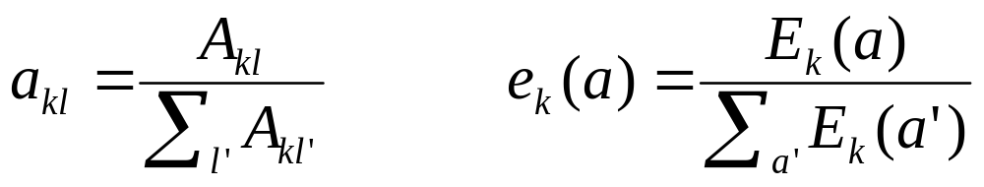
HMMs from multiple alignments (3)
Basic profile HMM parameterization
  Aim: making the distribution peak around members of the family
Parameters
  the probabilities values : trivial if many of independent alignment sequences are given.
  length of the model: heuristics or systematic way

Slide 14
HMMs from multiple alignments (4)
Figure 5.4

Slide 15
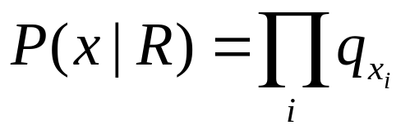
Searching with profile HMMs (1)
Main usage of profile HMMs
  Detecting potential membership in a family
  Matching a sequence to the profile HMMs
  Viterbi equations or forward equation
  Maintaining log-odd ratio compared with random model

Slide 16
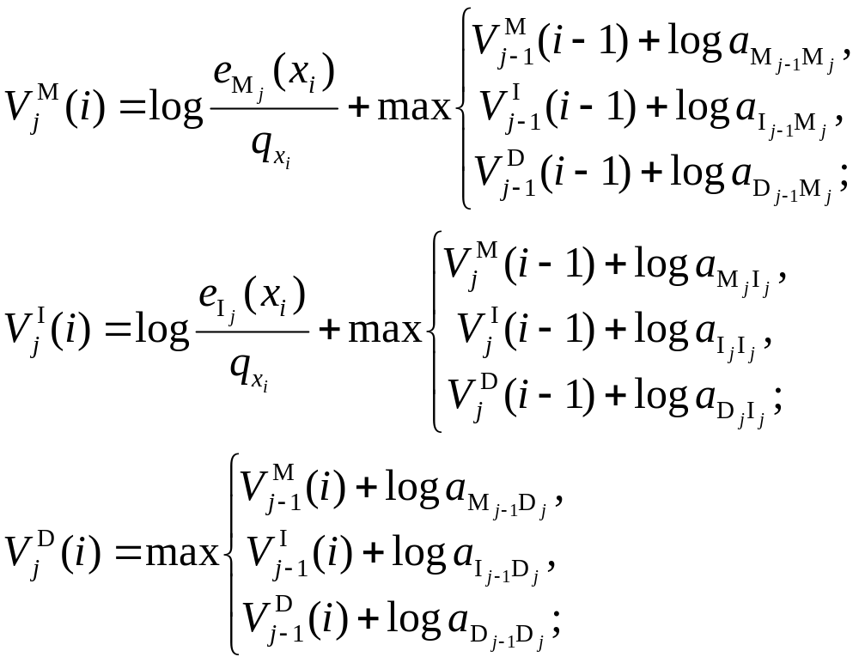
Searching with profile HMMs (2)
Viterbi equation

Slide 17
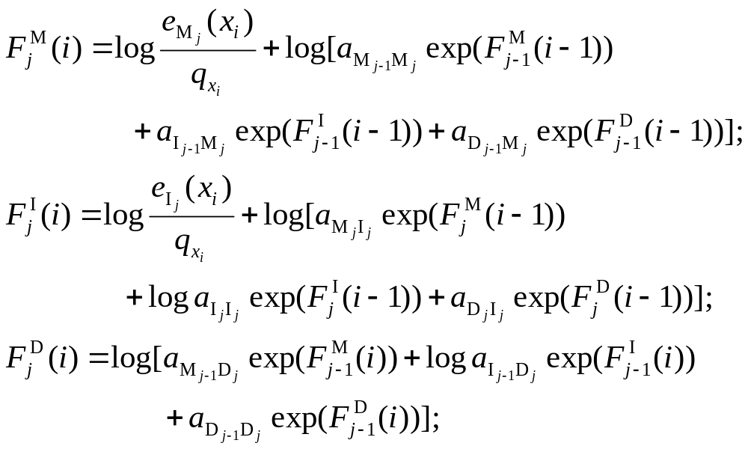
Searching with profile HMMs (3)
Forward algorithm

Slide 18
Variants for non-global alignments (1)
Local alignments (flanking model)
  Emission prob. in flanking states use background values q_{a}.
  Looping prob. close to 1, e.g. (1- η) for some small η.
D_{j}
I_{j}
M_{j}
Begin
End
Q
Q

Slide 19
Variants for non-global alignments (2)
Overlap alignments
  Only transitions to the first model state are allowed.
  When expecting to find either present as a whole or absent
  Transition to first delete state allows missing first residue
D_{j}
Q
I_{j}
Q
Begin
M_{j}
End

Slide 20
Variants for non-global alignments (3)
Repeat alignments
  Transition from right flanking state back to random model
  Can find multiple matching segments in query string
D_{j}
I_{j}
M_{j}
Begin
Q
End

Slide 21
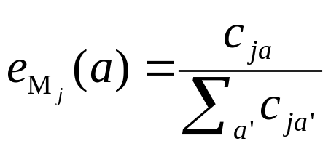
More on estimation of prob. (1)
Maximum likelihood (ML) estimation
  given observed freq. c_{ja} of residue a in position j.
Problem of ML estimation
  If observed cases are absent?
  Specially when observed examples are somewhat few.

Slide 22
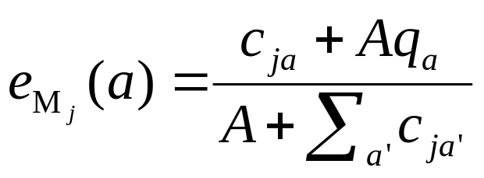
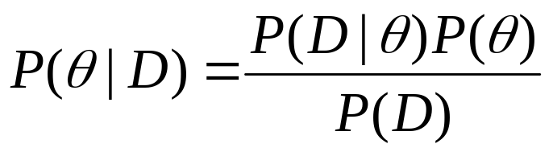
More on estimation of prob. (2)
Simple pseudocounts
  q_{a}: background distribution
  A: weight factor
  Laplace’s rule: Aq_{a} = 1
Bayesian framework
  Dirichlet prior

Slide 23
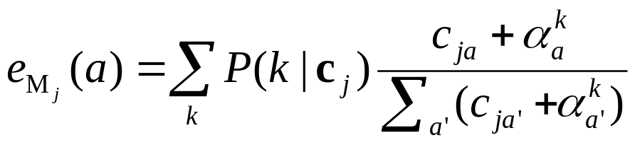
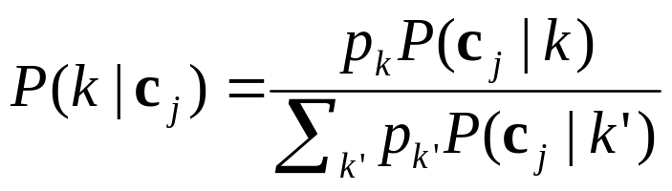
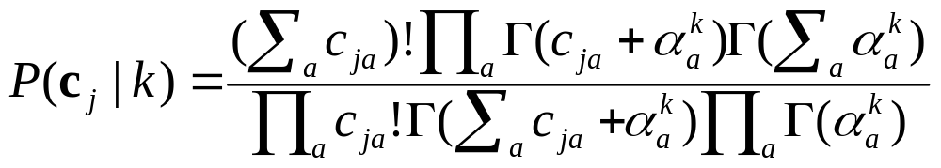
More on estimation of prob. (3)
Dirichlet mixtures
  Mixtures of dirichlet prior: better than single dirichlet prior
  With K pseudocount priors,

Slide 24
Optimal model construction (1)
Model construction
  Which columns to insert states or which to match states?
  If marked multiple alignments have no errors, the optimal model can be constructed.
  2^{L} combinations for markings of L columns
  Manual construction
  Maximum a posteriori (MAP) construction

Slide 25
Optimal model construction (2)
(a) Multiple alignment:
(c) Observed emission/transition counts
x x . . . x
bat A G - - - C
rat A - A G - C
cat A G - A A -
gnat - - A A A C
goat A G - - - C
1 2 . . . 3
0 1 2 3
A - 4 0 0
C - 0 0 4
G - 0 3 0
T - 0 0 0
A 0 0 6 0
C 0 0 0 0
G 0 0 1 0
T 0 0 0 0
M-M 4 3 2 4
M-D 1 1 0 0
M-I 0 0 1 0
I-M 0 0 2 0
I-D 0 0 1 0
I-I 0 0 4 0
D-M - 0 0 1
D-D - 1 0 0
D-I - 0 2 0
match
emissions
insert
emissions
(b) Profile-HMM architecture:
D
D
D
state
transitions
I
I
I
I
beg
M
M
M
end
0
1
2
3
4

Slide 26
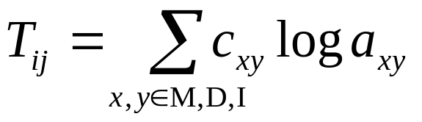
Optimal model construction (3)
MAP match-insert assignment
  Recursive calculation of a number S_{j}
    S_{j}: log prob. of the optimal model for alignment up to and including column j, assuming j is marked.
    S_{j} is calculated from S_{i} and summed log prob. between i and j.
    T_{ij}: summed log prob. of all the state transitions between marked i and j.
      c_{xy} are obtained from partial state paths implied by marking i and j.

Slide 27
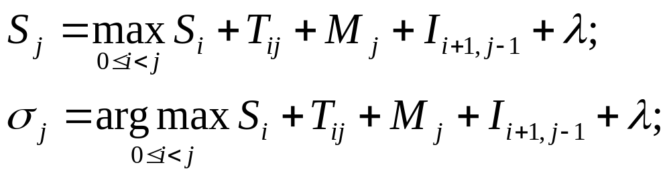
Optimal model construction (4)
Algorithm: MAP model construction
  Initialization:
    S₀ = 0, M_{L+1} = 0.
  Recurrence: for j = 1,..., L+1:
  Traceback: from j = σ_{L+1}, while σ_{j} > 0:
    Mark column j as a match column
    j = σ_{j}.

Slide 28
Weighting training sequences (1)
Good random sample do you have?
“Assumption : all examples are independent samples” might be incorrect
Solutions
  Weight sequences based on similarity

Slide 29
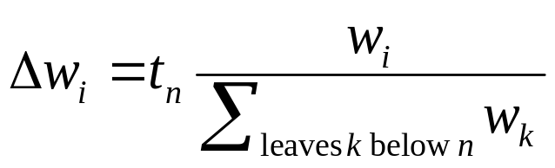
Weighting training sequences (2)
Simple weighting schemes derived from a tree
  Phylogenetic tree is given.
[Thompson, Higgins & Gibson 1994b]
  Kirchohoff’s law
[Gerstein, Sonnhammer & Chothia 1994]

Slide 30
Weighting training sequences (3)
7
V₇
t₆ = 3
I₁+I₂+I₃
6
V₆
t₅ = 3
t₄ = 8
I₁+I₂
I₄
t₃ = 5
V₅
5
t₁ = 2
t₂ = 2
I₃
I₁
I₂
1
2
3
4
w₁:w₂:w₃:w₄ = 35:35:50:64
I₁:I₂:I₃:I₄ = 20:20:32:47

Slide 31
Weighting training sequences (4)
Root weights from Gaussian parameters
  Influence of leaves on the root distr.
  Altchul-Carroll-Lipman wieghts
    Make gaussian distr.
    Mean μ: linearly combination of x_{i}.
    Combination weights represent the influences of leaves.

Slide 32
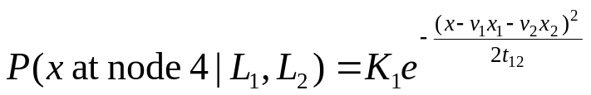
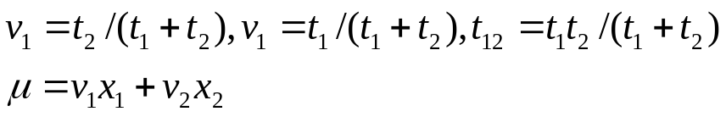
Weighting training sequences (5)
5
4
t₃
t₁
t₂
x₁
x₂
x₃

Slide 33
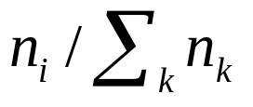
Weighting training sequences (6)
Voronoi weights
  Proportional to the volume of empty space
  Sequence family in sequence space
  Algorithm
    Random sample: choosing at kth position uniformly from the set of residues occurring kth position
    n_{i}: count of samples closest to the ith family
    ith weight

Slide 34
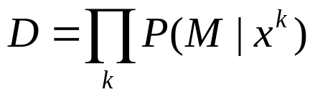
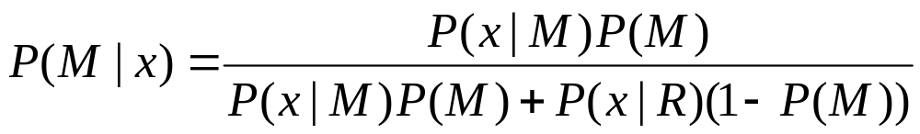
Weighting training sequences (7)
Maximum discrimination weights
  Focus: decision on whether sequences are members of the family or not
  discrimination
  weight: 1-P(M|x_{i})
  effect: difficult members are given big weight

Slide 35
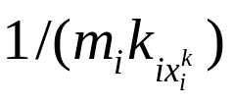
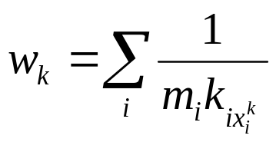
Weighting training sequences (8)
Maximum entropy weights (1)
  Intuition
    k_{ia}: number of residues of type a in column i of a multiple alignment
    m_{i}: number of different types of residues in column i
    As uniform as possible
      weight for sequence k:
      ML estimation under the weights: p_{ia} = 1/m_{i}
  Averaging over all columns [Henikoff 1994]

Slide 36
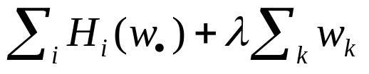
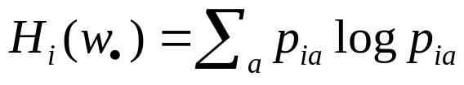
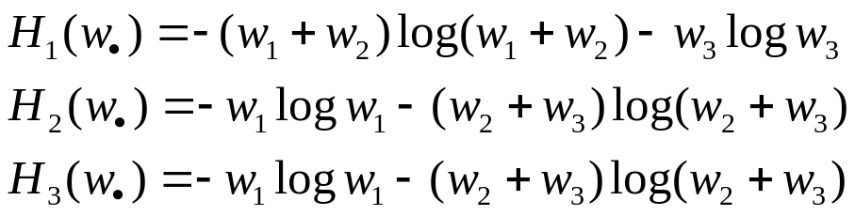
Weighting training sequences (9)
Maximum entropy weights (2)
  entropy: an measure of the ‘uniformity’ [Krogh & Mitchison 1995]
  maximize
  example
    x¹ = AFA, x² = AAC, x³ = DAC
    w₁ = w₃ =0.5, w₂ = 0
(sum to one constraints)

