Slide 1
Artificial Intelligence
Chapter 17
Knowledge-Based Systems
Biointelligence Lab
School of Computer Sci. & Eng.
Seoul National University

Slide 2
Outline
Confronting the Real World
Reasoning Using Horn Clauses
Maintenance in Dynamic Knowledge Bases
Rule-Based Expert Systems
Rule Learning
Additional Readings and Discussion

Slide 3
17.1 Confronting the Real World (1/3)
Knowledge-based systems
  Programs that reason over extensive knowledge bases.
  Do the methods scale up sufficiently well for practical applications?
Three major theoretical properties of logical reasoning systems
  Soundness
    To be confident that an inferred conclusion is true
  Completeness
    To be confident that inference will eventually produce any true conclusion
  Tractability
    To be confident that inference is feasible

Slide 4
17.1 Confronting the Real World (2/3)
Predicate calculus
  Resolution refutation is sound and complete, but semi-decidable.
    Semi-decidablility makes the predicate calculus inherently intractable.
    Even on problems for which resolution refutation terminates, the procedure is NP-hard.
    This fact has led many to despair of using formal, logical methods for large-scale reasoning problems.

Slide 5
17.1 Confronting the Real World (3/3)
To make reasoning more efficient
  We could use procedures that might occasionally prove an untrue formula.
  We could use procedures that might not be guaranteed to find proofs of true formulas.
  We could use a language that is less expressive than the full predicate calculus.
    Reasoning is typically more efficient with Horn clauses.

Slide 6



17.2 Reasoning Using Horn Clauses
Horn Clauses
  Clauses that have at most one positive literal.
  Rule:
    There is at least one negative literal and a single positive literal.
    The literal λ_{h} is called the head of the clause.
    The ordered list of literals, λ_{b1} ,…, λ_{bn}, is called body.
  Fact:
    There may be no negative literals in the clause.
  Goal:
    There may be no positive literal in the clause.
  Horn clauses form the basis of the programming language PROLOG.

Slide 7
Inference over PROLOG Clauses (1/2)
Resolution Operation
  A goal can resolve with a fact by unifying the fact with one of the literals in the goal.
    The resolvent is a new goal consisting of a list of all of the substitution instances of the other literals in the original goal.
  A goal can resolve with a rule by unifying the head of the rule with one of the literals in the goal.
    The resolvent is a new goal formed by appending the list of substitution instances of all of the literals in the body of the rule to the front of the list of substitution instances of all of the other (nonresolved-upon) literals in the goal.

Slide 8
Inference over PROLOG Clauses (2/2)
PROLOG programs
  The clauses are usually ordered in the following way: goal, facts, rules.
  Proof of a goal clause succeeds when the new goal produced by a resolution is empty.
  Depth-first, backtracking search procedure
    A goal clause fails if the interpreter has tried all resolutions for one of the goal literals and none results in new goals that can be proved.
    The interpreter backtracks to the previous goal clause and tries other resolutions on it.

Slide 9
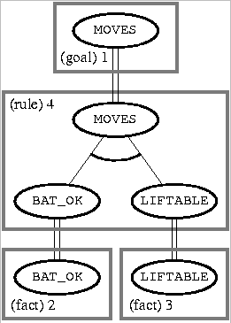
Example of an AND/OR Tree (1/2)
  Body nodes are called AND nodes because they must all be proved.
  If there had been alternative resolutions possible, the search for a proof tree could have generated additional nodes, called OR nodes.
:- MOVES
BAT_OK :-
LIFTABLE :-
MOVES :- BAT_OK, LIFTABLE

Slide 10
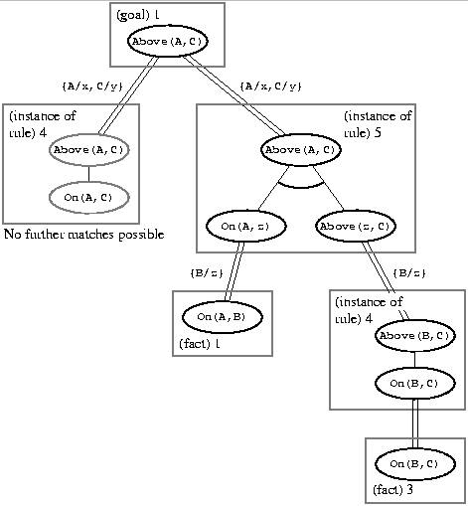
Example of an AND/OR Tree (2/2)
  Consistency requires that the same term be substituted for the variable throughout the proof tree.
:- Above(A,C)
On(A,B) :-
On(B,C) :-
Above(x,y) :- On(x,y)
Above(x,y) :- On(x,z), Above(z,y)

Slide 11
Forward Chaining
Forward chaining system (e.g., OPS5)
  Reasoning proceeds forward, beginning with facts, chaining through rules, and finally establishing the goal.
    A rule is applicable if each of the literals in its antecedent can be unified with a corresponding fact.
    When more than one rule is applicable, some sort of external conflict resolution scheme is used to decide which rule will be applied.
  Model of aspects of human cognitive processing
    Facts: working of short-term memory
    Rules: long-term memory

Slide 12
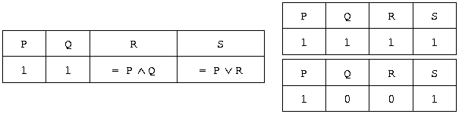
17.3 Maintenance in Dynamic Knowledge Bases (1/5)
Knowledge base of propositional calculus atoms
  The atoms are called premisses instead of facts.
  The rules are not restricted to being Horn rules.
  A spreadline reasoning system
    Any cell that has a formula in it gets its vale immediately calculated from the values of components.
    If the values of any components of a formula happen to change, the value of that formula is automatically changed.

Slide 13
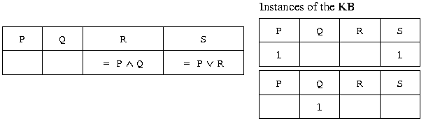
17.3 Maintenance in Dynamic Knowledge Bases (2/5)
Truth maintenance systems (TMSs)
  Dynamic knowledge base: the spreadline is extended to contain any number of premisses and rules.
    The formulas entered in the values of rule cells are called justifications.
  The values of certain premiss cells can be omitted.
    When a cell has a value of 1 or 0, it is called IN; otherwise, out.
    Allowing values of cells to be OUT permits an interesting generalization of rule types (e.g, U if R is True and S is Out).

Slide 14
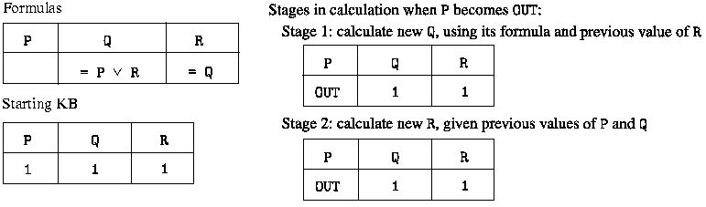
17.3 Maintenance in Dynamic Knowledge Bases (3/5)
  TMSs should be thought of as knowledge base maintenance systems that perform automatic updates when the truth values of certain atoms are changed.
    The use of IN’s and OUT’s permits an elementary sort of “monotonic” or defeasible inference not sanctioned by ordinary reasoning systems.
  Cycles among the rules present some difficulties.
    One is mutual justification.

Slide 15
17.3 Maintenance in Dynamic Knowledge Bases (4/5)
Assumption-based truth maintenance systems (ATMSs)
  The spreadline is used in a backward direction.
  We start with a particular cell’s formula and ask which premiss values will make the formula in that cell True.
    Other formulas called the background theory are considered together.
  Labels of the cells
    The values of the cells are taken to be formulas-expressed in DNF form in terms of the premiss atoms.
  ATMSs can be used for a variety of purposes.
    One is to perform diagnosis.

Slide 16
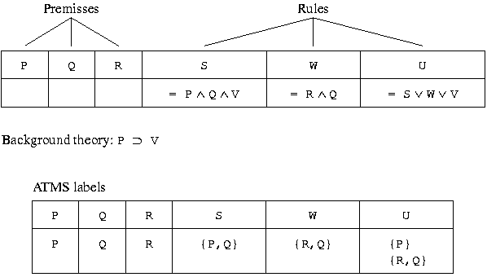
17.3 Maintenance in Dynamic Knowledge Bases (5/5)
  Conversion of a TMS to an ATMS

