Slide 1
Artificial Intelligence
Chapter 25
Agent Architectures
Biointelligence Lab
School of Computer Sci. & Eng.
Seoul National University

Slide 2
Outline
Three-Level Architectures
Goal Arbitration
The Triple-Tower Architecture
Bootstrapping
Additional Readings and Discussion

Slide 3
25.1 Three-Level Architecture
Shakey [Nilsson]
  One of the first integrated intelligent agent systems
  Hardware
    Mobile cart with touch-sensitive “feelers”
    Television camera, optical range-finder
  Software
    Push the boxes from one place to another
    Visual analysis : recognize boxes, doorways, room corners
    Planning : use STRIPS ( plan sequences of actions )
    Convert plans into intermediate-level and low-level

Slide 4
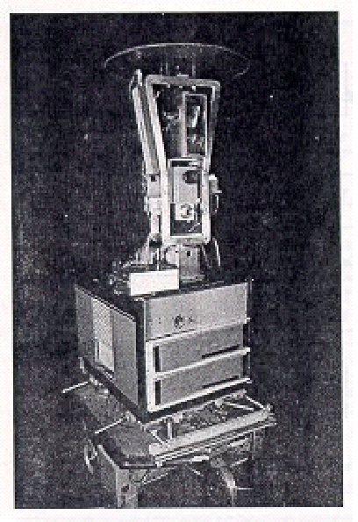
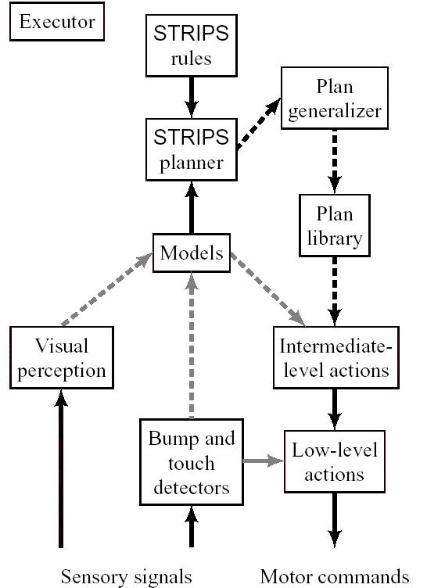
Figure 25.1 Shakey the Robot
Figure 25.2 Shakey Architecture

Slide 5
25.1 Three-Level Architecture (Cont’d)
Figure 25.2
  Low level : Gray arrow
    The low-level actions (LLAs) use a short and fast path from sensory signals to effectors.
    Important reflexes are handled by this pathway.
    Stop, Servo control of motors and so on
  Intermediate level : Broken gray arrow
    Combine the LLAs into more complex behaviors
    Intermediate-level action (ILA)
    Ex: A routine that gets Shakey through a named doorway.
  High level : Broken dark arrows
    Plan is expressed as a sequence of ILAs along with their preconditions and effects.

Slide 6
25.1 Three-Level Architecture (Cont’d)
More Recently, the three-level architecture has been used in a variety of robot systems
  AI subsystems are used at the intermediate and high levels
    Blackboard systems
    Dynamic Bayes belief networks
    Fuzzy logic
    Plan-space planners

Slide 7
25.2 Goal Arbitration
Need of Arbitration
  Agents will often have several goals that they are attempting to achieve.
  Goal urgency will change as the agent acts and finds itself in new, unexpected situations.
  The agent architecture must be able to arbitrate among competing ILAs and planning.
Urgency
  Depend on the priority of the goal at that time and on the relative cost of achieving goal from the present situation.

Slide 8
25.2 Goal Arbitration (Cont’d)
Figure 25.3
  Goals and their priorities are given to the system and remain active until rescinded by the user.
  ILAs stored as T-R programs and matched to specific goals stored in its Plan library.
  If any of the active goals can be accomplished by the T-R programs already stored in the Plan library, those T-R programs become Active ILAs.
  The actions actually performed by the agent are actions called for by one of Active ILAs.

Slide 9
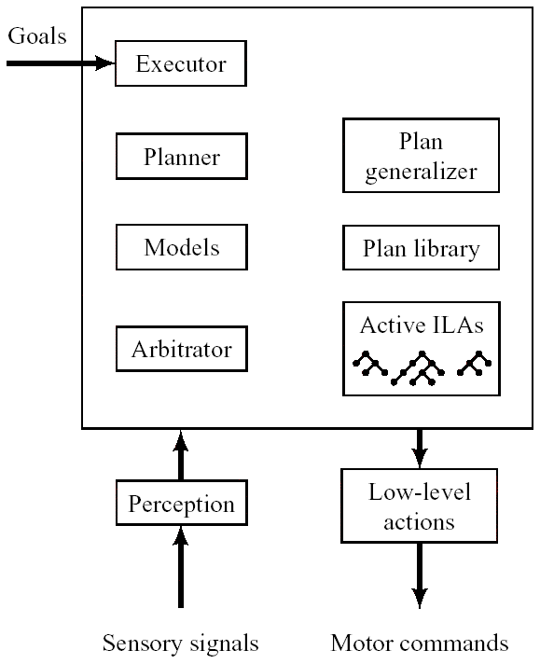
Figure 25.3 Combining Planning and Reacting

Slide 10
25.2 Goal Arbitration (Cont’d)
The task of the Arbitrator
  Select at each moment which T-R program is currently in charge of the agent.
  Calculate cost-benefit that takes into account the priority of the goals and the estimated cost of achieving them.
  Works concurrently with the Planner so that the agent can act while planning.

Slide 11
25.3 The Triple-Tower Architecture
The perceptual processing tower
  Start with the primitive sensory signals and proceed layer by layer to more refined abstract representations of what is being sensed.
The action tower
  Compose more and more complex sequences of primitive actions.
Connections between the perceptual tower and the action tower
  Can occur at all levels of the hierarchies.
  The lowest-level : correspond to simple reflexes
  The higher level : correspond to the evocation of complex actions

Slide 12
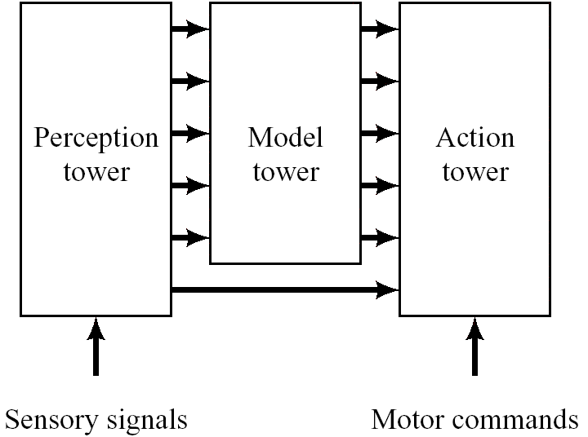
Figure 25.4 The Triple-Tower Architecture

Slide 13
25.3 The Triple-Tower Architecture (Cont’d)
The model tower
  Internal representations required by agents.
  At intermediate levels
    There are might be models appropriate for route planning.
  At higher levels
    Logical reasoning, planning and communication would require declarative representations such as those based on logic or semantic networks.

Slide 14
25.4 Bootstrapping
The limit of contemporary robots and agents
  The Lack of commonsense knowledge.
  No “bootstrapping”
    Bootstrapping is to learn much of the knowledge from previously obtained knowledge.
    Humans can bootsrap knowledge from previously acquired skills and concepts through practice, reading and communicating.
Bootstrapping process will be required by AI agent to be similar to human-level intelligence.

Slide 15
25.5 Discussion
A critical question is whether to refine a plan or to act on the plan in hand.
  Metalevel architectures can be used to make such a decision.
  Computational time-space tradeoff : Agent actions ought to be reactive with planning and learning used to extend the fringes of what an agent already knows how to do.

Slide 16
Additional Readings
Whitehead, S., Karlsson, J., and Tenenberg, J., “Learning Multiple Goal Behavior via Task Decomposition and Dynamic Policy Merging,” Robot Learning, Ch. 3, Boston: Kluwer Academic Publishers, 1993
Laird, J., Yager, E., Hucka, M., and Tuck, C., “Robo-Soar: An Integration of External Interaction, Planning, and Learning Using SOAR,” Robotics and Autonomous Systems, 8:113-129,1991.
Russell, S., and Wefald, E., Do the Right Thing, Cambridge, MA: MIT Press, 1991.

