Slide 1
Artificial Intelligence
Chapter 1
Introduction
Biointelligence Lab
School of Computer Sci. & Eng.
Seoul National University

Slide 2
1.1 What Is AI? (1)
Artificial Intelligence (AI)
  Intelligent behavior in artifacts
  “Designing computer programs to make computers smarter”
  “Study of how to make computers do things at which, at the meoment, people are better”
Intelligent behavior
  Perception, reasoning, learning, communicating, acting in complex environments
Long term goals of AI
  Develop machines that do things as well as humans can or possibly even better
  Understand behaviors

Slide 3
1.1 What Is AI? (2)
Can machines think?
  Depend on the definitions of “machine”, “think”, “can”
“Can”
  Can machines think now or someday?
  Might machines be able to think theoretically or actually?
“Machine”
  E6 Bacteriophage: Machine made of proteins
  Searle’s belief
    What we are made of is fundamental to our intelligence
    Thinking can occur only in very special machines – living ones made of proteins

Slide 4
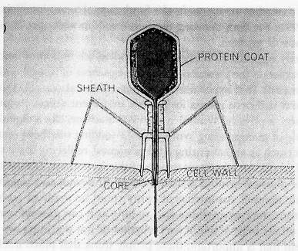
1.1 What Is AI? (3)
Figure 1.1 Schematic Illustration of E6 Bacteriophage

Slide 5
1.1 What Is AI? (4)
“Think”
  Turing test: Decide whether a machine is intelligent or not
    Interrogator (C): determine man/woman
    A: try and cause C to make the wrong identification
    B: help the interrogator
  Examples: ELIZA [Weizenbaum], JULIA [Mauldin]
Room1
Man (A), Woman (B)
Room2
Interrogator (C)
teletype

Slide 6
학습 알고리즘
추론 메커니즘
지식 표현 방식
지능 시스템 구조
[Zhang 98]
연구분야
지능형 에이전트
정보검색
데이터마이닝
전문가 시스템
지능형 로봇
자연언어 처리
인공지능
응용분야
합리론적(논리기호)
경험론적(확률통계)
연결론적(신경소자)
진화론적(유전 진화)
생물학적(인공생명)
접근방법

Slide 7
1.2 Approaches to AI (1)
Two main approaches: symbolic vs. subsymbolic
1. Symbolic
  Classical AI (“Good-Old-Fashioned AI” or GOFAI)
  Physical symbol system hypothesis
  Logical, top-down, designed behavior, knowledge-intensive
2. Subsymbolic
  Modern AI, neural networks, evolutionary machines
  Intelligent behavior is the result of subsymbolic processing
  Biological, bottom-up, emergent behavior, learning-based
Brain vs. Computer
  Brain: parallel processing, fuzzy logic
  Computer: serial processing, binary logic

Slide 8
1.2 Approaches to AI (1)
Symbolic processing approaches
  Physical symbol system hypothesis [Newell & Simon]
    “A physical symbol system has the necessary and sufficient means for general intelligence action”
    Physical symbol system: A machine (digital computer) that can manipulate symbolic data, rearrange lists of symbols, replace some symbols, and so on.
  Logical operations: McCarthy’s “advice-taker”
    Represent “knowledge” about a problem domain by declarative sentences based on sentences in first-order logic
    Logical reasoning to deduce consequences of knowledge
    applied to declarative knowledge bases

Slide 9
1.2 Approaches to AI (2)
  Top-down design method
    Knowledge level
      Top level
      The knowledge needed by the machine is specified
    Symbol level
      Represent knowledge in symbolic structures (lists)
      Specify operations on the structures
    Implementation level
      Actually implement symbol-processing operations

Slide 10
1.2 Approaches to AI (3)
Subsymbolic processing approaches
  Bottom-up style
    The concept of signal is appropriate at the lowest level
  Animat approach
    Human intelligence evolved only after a billion or more years of life on earth
    Many of the same evolutionary steps need to make intelligence machines
  Symbol grounding
    Agent’s behaviors interact with the environment to produce complex behavior
  Emergent behavior
    Functionality of an agent: emergent property of the intensive interaction of the system with its dynamic environment

Slide 11
1.2 Approaches to AI (4)
  Well-known examples of machines coming from the subsymbolic school
    Neural networks
      Inspired by biological models
      Ability to learn
    Evolution systems
      Crossover, mutation, fitness
    Situated automata
      Intermediate between the top-down and bottom-up approaches

Slide 12
1.3 Brief History of AI (1)
[Zhang 98]
Symbolic AI
1943: Production rules
1956: “Artificial Intelligence”
1958: LISP AI language
1965: Resolution theorem
proving
1970: PROLOG language
1971: STRIPS planner
1973: MYCIN expert system
1982-92: Fifth generation computer systems project
1986: Society of mind
1994: Intelligent agents
Biological AI
1943: McCulloch-Pitt’s neurons
1959: Perceptron
1965: Cybernetics
1966: Simulated evolution
1966: Self-reproducing automata
1975: Genetic algorithm
1982: Neural networks
1986: Connectionism
1987: Artificial life
1992: Genetic programming
1994: DNA computing

Slide 13
1.3 Brief History of AI (2)
1940~1950
  Programs that perform elementary reasoning tasks
  Alan Turing: First modern article dealing with the possibility of mechanizing human-style intelligence
  McCulloch and Pitts: Show that it is possible to compute any computable function by networks of artificial neurons.
1956
  Coined the name “Artificial Intelligence”
  Frege: Predicate calculus = Begriffsschrift = “concept writing”
  McCarthy: Predicate calculus: language for representing and using knowledge in a system called “advice taker”
  Perceptron for learning and for pattern recognition [Rosenblatt]

Slide 14
1.3 Brief History of AI (3)
1960~1970
  Problem representations, search techniques, and general heuristics
  Simple puzzle solving, game playing, and information retrieval
  Chess, Checkers, Theorem proving in plane geometry
  GPS (General Problem Solver)

Slide 15
1.3 Brief History of AI (4)
Late 1970 ~ early 1980
  Development of more capable programs that contained the knowledge required to mimic expert human performance
  Methods of representing problem-specific knowledge
  DENDRAL
    Input: chemical formula, mass spectrogram analyses
    Output: predicting the structure of organic molecules
  Expert Systems
    Medical diagnoses

Slide 16
1.3 Brief History of AI (5)
DEEP BLUE (1997/5/11)
  Chess game playing program
Human Intelligence
  Ability to perceive/analyze a visual scene
    Roberts
  Ability to understand and generate language
    Winograd: Natural Language understanding system
    LUNAR system: answer spoken English questions about rock samples collected from the moon

Slide 17
1.3 Brief History of AI (6)
Neural Networks
  Late 1950s: Rosenblatt
  1980s: important class of nonlinear modeling tools
AI research
  Neural networks + animat approach: problems of connecting symbolic processes to the sensors and efforts of robots in physical environments
Robots and Softbots (Agents)

Slide 18
1.4 Plan of the Book
Agent in grid-space world
Grid-space world
  3-dimensional space demarcated by a 2-dimensional grid of cells “floor”
Reactive agents
  Sense their worlds and act in them
  Ability to remember properties and to store internal models of the world
  Actions of reactive agents: f(current and past states of their worlds)

Slide 19
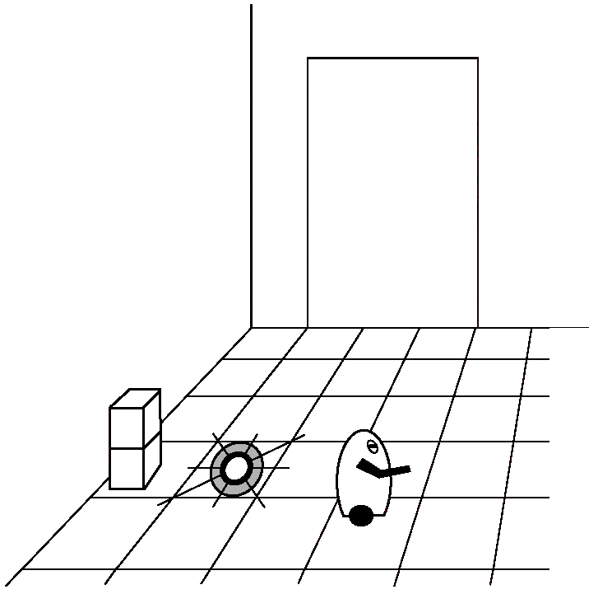
Figure 1.2 Grid-Space World

Slide 20
1.4 Plan of the Book
Model
  Symbolic structures and set of computations on the structures
  Iconic model
    Involve data structures, computations
    Iconic chess model: complete
    Feature based model
      Use declarative descriptions of the environment
      Incomplete

Slide 21
1.4 Plan of the Book
Agents can make plans
  Have the ability to anticipate the effects of their actions
  Take actions that are expected to lead toward their goals
Agents are able to reason
  Can deduce properties of their worlds
Agents co-exist with other agents
  Communication is an important action

Slide 22
1.4 Plan of the Book
Autonomy
  Learning is an important part of autonomy
  Extent of autonomy
    Extent that system’s behavior is determined by its immediate inputs and past experience, rather than by its designer’s.
  Truly autonomous system
    Should be able to operate successfully in any environment, given sufficient time to adapt

