Slide 1
Getting the MOST out of your Storage Hierarchy with Mirror-Optimized Storage Tiering
Kaiwei Tu, Kan Wu, Andrea C. Arpaci-Dusseau, Remzi H. Arpaci-Dusseau
University of Wisconsin–Madison · Google | FAST ’26
Presented by Keonwook Park & Yeonjin Park
Distributed Systems · Seoul National University

Slide 2
Outline
Keonwook
Motivation
What goes wrong in today’s hierarchy?
Background
Why can’t existing approaches fix it?
Design: reads
How does MOST balance reads?
Yeonjin
Design: writes
What changes with writes?
Evaluation
How much does it help?
Discussion
What is left open?

Slide 3
The storage hierarchy is no longer hierarchical
Motivation
Classic hierarchy
Modern devices: read bandwidth (GB/s)
DRAM
orders of
magnitude gap
HDD
1.5 : 1
1.25 : 1
2.2 : 1
Optane : PCIe3
16 KB reads
local : remote
NVMe
Optane : PCIe3
4 KB reads

Slide 4
Setting: a two-tier storage hierarchy
Motivation
Skewed access
a small hot set gets most requests
smaller · faster · pricier
e.g., Optane, NVMe
Roles are relative
Performance
one NVMe SSD can play either role
Capacity device
Two tiers only
larger · slower · cheaper
more tiers: future work
e.g., NVMe, SATA, remote NVMe

Slide 5
Under load, the capacity tier sits idle
Motivation
Low load
Application
~90%
~10%
bandwidth use
Perf.
Hot
Cap.
Cold

Slide 6
Under load, the capacity tier sits idle
Motivation
Low load
High load
Application
Application
~90%
~10%
~90%
~10%
bandwidth use
bandwidth use
Perf.
Perf.
saturated
Hot
Hot
latency ↑
Cap.
Cap.
idle
Cold
Cold

Slide 7
And the load keeps changing
Motivation
load
Burst
needs both tiers
fast tier
saturates
Low load
fast tier alone is best
time
The best split flips with every burst, both ways → adapt within seconds

Slide 8



What a multi-device storage manager should do
Motivation
Use all bandwidth
Save space
Adapt quickly
both tiers, once the fast tier saturates
no large duplicate copies
react in seconds to bursty load
… without prior knowledge of the devices or the workload

Slide 9
Existing approaches: one copy or several
Background
Single copy
Multiple copies
each block lives on one device
some blocks live on both devices
Perf.
Perf.
Cap.
Cap.
Tiering
Mirroring, caching
HeMem, Colloid
RAID-1, Orthus

Slide 10


Single copy: tiering moves load only by moving data
Background
Classic tiering
Load-balancing tiering
e.g., HeMem (SOSP ’21)
e.g., Colloid (SOSP ’24), BATMAN
Perf.
saturated
Perf.
demote on burst,
promote back after
Cap.
Cap.
no load balancing across tiers
every load change = data movement

Slide 11

Multiple copies: mirroring and caching
Background
Mirroring (RAID-1)
Caching (Orthus, FAST ’21)
every block on both devices
inclusive cache + read routing
Perf.
Perf.
Cap.
Cap.
2× space
fast tier holds only duplicates
writes hit the slower device
writes: dirty copies can’t be routed

Slide 12



No existing approach gets all of it
Background
Tiering
Mirroring / caching
MOST
HeMem, Colloid
RAID-1, Orthus
this paper
Use all bandwidth
only by migrating
reads only
?
Save space
one copy
full duplicates
?
Adapt quickly
migration is slow
reads only
?

Slide 13
No existing approach gets all of it
Background
Tiering
Mirroring / caching
MOST
HeMem, Colloid
RAID-1, Orthus
this paper
Use all bandwidth
only by migrating
reads only
reads and writes
Save space
one copy
full duplicates
small mirror
Adapt quickly
migration is slow
reads only
route, don’t migrate
Can we balance load without paying for migration?

Slide 14




Storage vs. memory: same problem, costlier migration
Background
Same as memory
Goals
Approaches
Load balancing
bandwidth · latency · capacity
striping · tiering · caching
react to observed performance
Different in storage
Larger datasets
Limited write bandwidth
But: software indirection is cheap
slower convergence
migration takes even longer
device 10–500 µs
vs. memory 50–100 ns
Read/write interference
Device endurance
→ selective mirroring is practical
slows foreground reads
wears out the SSD

Slide 15
So far
Keonwook
Motivation
Under load, the capacity tier’s bandwidth sits idle
Background
Migration is slow and costly; full copies waste space
Design: reads
How does MOST balance reads?
Yeonjin
Design: writes
What changes with writes?
Evaluation
How much does it help?
Discussion
What is left open?

Slide 16
MOST: mirroring’s load balancing + tiering’s capacity
Design: reads
Classic tiering
MOST
one copy per block
hottest data on both tiers
Perf.
Perf.
Hot
Warm
Cap.
Cap.
Cold
Hot
Cold
Mirrored
Tiered
≤ 20% of capacity

Slide 17
Architecture
Design: reads
Application
read / write
allocate
Optimizer
Class?
tuning
Load switch
offload ratio x
mirrored
tiered
tiered
x
1 − x
Performance device
Capacity device
Mirrored
Warm
Migrator
Mirrored
Cold

Slide 18
Read balancing with the offload ratio x
Design: reads
Application
load switch
x
optimizer
1 − x
goal: equalize latency
x
Performance tier
Warm
Capacity tier
Mirrored
Cold

Slide 19
Read balancing with the offload ratio x
Design: reads
Application
load switch
x
optimizer
Low load: x = 0
1.0
goal: equalize latency
0
Performance tier
Warm
Capacity tier
Mirrored
Cold

Slide 20
Read balancing with the offload ratio x
Design: reads
Application
load switch
x
optimizer
High load: x > 0
0.7
goal: equalize latency
0.3
Performance tier
Warm
latency ↑
Capacity tier
Mirrored
Cold

Slide 21
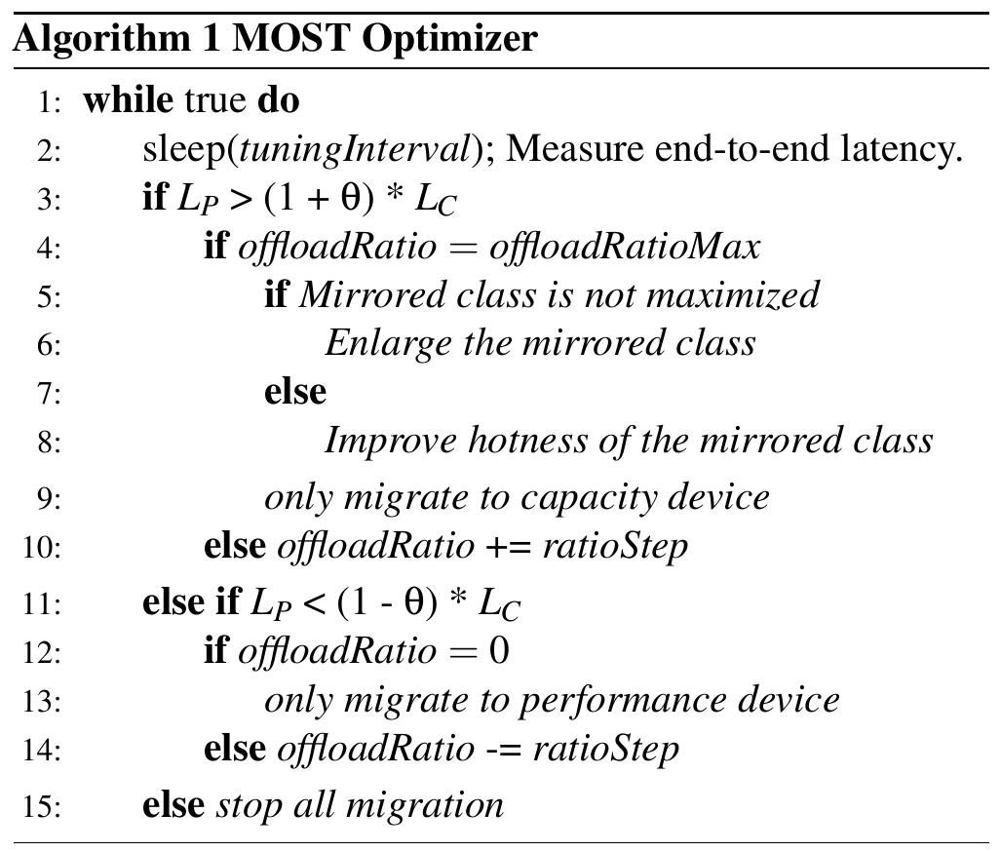
The optimizer: Algorithm 1
Design: reads
every 200 ms: compare L_{P} and L_{C}
Perf. slower
lines 3–10
x ↑
at max: Grow / Swap, migrate down only
Cap. slower
lines 11–14
x ↓
at 0: migrate up only
About equal
line 15
stop all migration

Slide 22
Managing the mirrored class
Design: reads
Before
After
new copy
copy dropped
Grow
Perf.
Perf.
when x is maxed out
Cap.
Cap.
Swap
Perf.
Perf.
mirror full (20%), hotter tiered data
Cap.
Cap.
Reclaim
Perf.
Perf.
free space drops below 2.5%
Cap.
Cap.
Regulate: move data only away from the slower device (Algorithm 1, lines 9 / 13 / 15)

Slide 23
So far
Keonwook
Motivation
Under load, the capacity tier’s bandwidth sits idle
Background
Migration is slow and costly; full copies waste space
Design: reads
Mirror a small hot set; route its reads with x
Yeonjin
Design: writes
What changes with writes?
Evaluation
How much does it help?
Discussion
What is left open?

Slide 24
Three kinds of writes
Design: writes
New block
Where to place it?
first write
write
Tiered block
Update it: nothing new
one copy
Mirrored block
Which copy to update?
two copies
then: which copy is valid? when to re-mirror?

Slide 25
New block: where to place it?
Design: writes
Classic tiering
MOST
new writes
new writes
1 − x
Perf.
Perf.
x
saturated
Cap.
Cap.
always the fast tier
capacity tier with probability x

Slide 26
Mirrored block: which copy to update?
Design: writes
Application
load switch
x
write-through: both copies
write
write
Performance tier
Warm
Capacity tier
just written
Mirrored
Cold
bottleneck

Slide 27
Mirrored block: which copy to update?
Design: writes
Application
load switch
x
optimizer
MOST: one copy, chosen by x
1 − x
x
Performance tier
Warm
×
Capacity tier
just written
Mirrored
Cold
×
stale copy

Slide 28
Mirrored block: which copy is valid?
Design: writes
4 KB write
4 KB
2 MB segment = unit of migration →
Perf. copy
…
Cap. copy
…
↑ one 4 KB write invalidates the whole 2 MB copy
→ later reads and small writes to this segment: Perf. only
4 KB segments instead? 512× more metadata

Slide 29
Mirrored block: which copy is valid?
Design: writes
4 KB write
4 KB
2 MB segment = unit of migration →
Perf. copy
×
…
Cap. copy
×
…
4 KB write (to capacity)
invalid
0
0
0
1
0
0
0
1
0
0
0
location
0
0
0
1
0
0
0
0
0
0
0
2 bits per 4 KB, kept in DRAM, only for mirrored segments

Slide 30
Mirrored block: when to re-mirror?
Design: writes
Read-heavy block
Write-heavy block
Perf.
Perf.
×
Cap.
×
Cap.
→ re-mirror in the background
→ leave it: the next write rebalances
Selective cleaning: only blocks with a large rewrite distance

Slide 31
MOST in one picture
Design: writes
Application
1
Hot data mirrored, the rest tiered
load switch
x
optimizer
2
Reads to mirrored data: routed by x
1 − x
x
Performance tier
3
New writes: placed by x
Warm
4
Writes to mirrored data: routed by x
Capacity tier
5
Optimizer: route first, migrate last
Mirrored
Cold

Slide 32
Implementation: Cerberus in CacheLib
Evaluation
Application
Baselines in the same layer
DRAM cache
Striping | even split | default
Orthus | caching | original
HeMem | classic tiering | re-impl.
BATMAN | load-balancing tiering | re-impl.
Colloid (+, ++) | load-balancing tiering | re-impl.
Flash cache
Small Object
Cache
Large Object
Cache
Cerberus (MOST)
Optane P4800X
Samsung 960 NVMe
MOST optimizer
every 200 ms, θ = 0.05, ratioStep = 0.02
latency: block-layer counters + EWMA

Slide 33
Evaluation setup
Evaluation
Hierarchy 1
Hierarchy 2
Perf.
Intel Optane P4800X · 750 GB
Perf.
Samsung 960 NVMe · 1 TB
Cap.
Samsung 960 NVMe · 1 TB
Cap.
Samsung 870 SATA · 1 TB
Micro-benchmarks
CacheBench
YCSB
storage layer only
CacheLib + Meta production traces
A–F (no E) on CacheLib
Server: 40-core Xeon Gold 5218R, 64 GB DRAM

Slide 34

What the evaluation asks
Evaluation
Static load
Better than the baselines at every load level and pattern?
Bursty load
How fast does it adapt, and how much does it write vs. tiering?
Mirrored class
How much mirroring? Subpages? Selective vs. full cleaning?
End-to-end
Does a real cache (CacheLib) get faster?

Slide 35
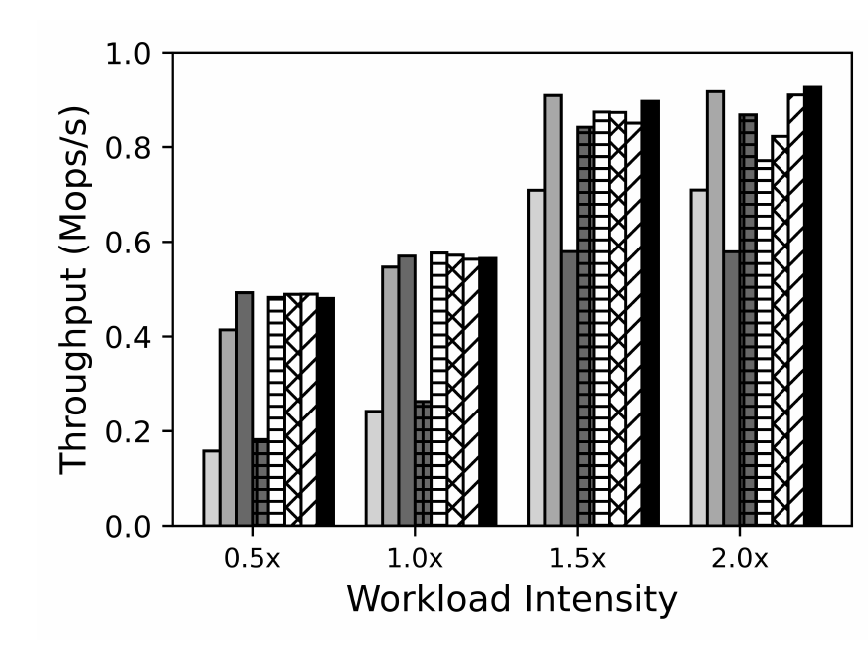
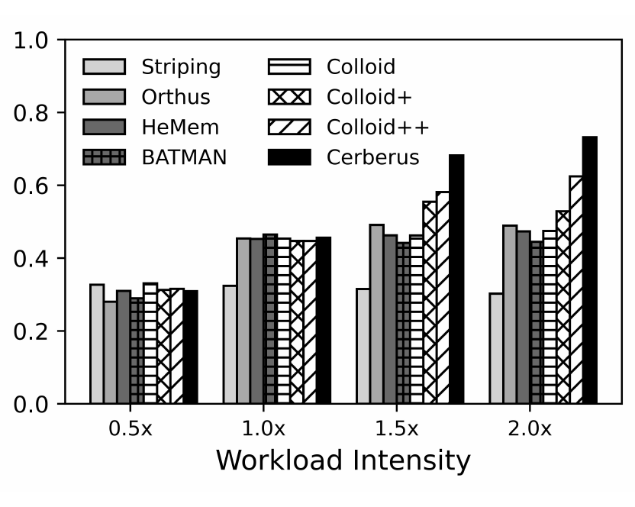
Static load: random reads and writes
Evaluation
Fig. 4(a) Random read-only
Fig. 4(b) Random write-only
HeMem flat after 1.0×, Colloid drops at 2.0×
Orthus mirrors 690 GB (Cerberus: 50 GB)
HeMem, Colloid, Orthus don’t balance writes
Colloid+, ++ still pay for migration
1.0× = load that just saturates the fast tier

Slide 36
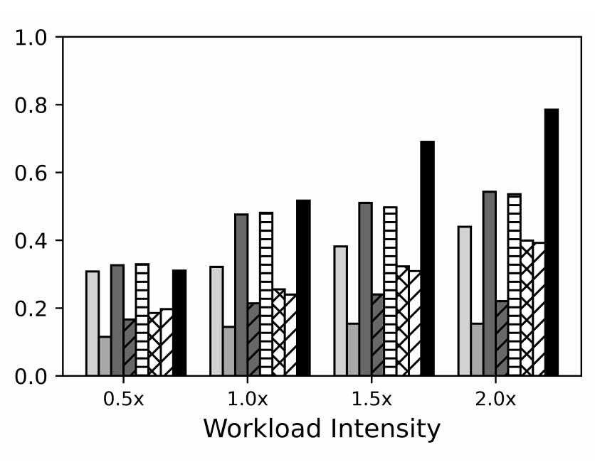
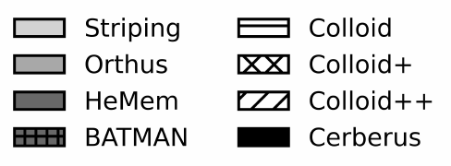
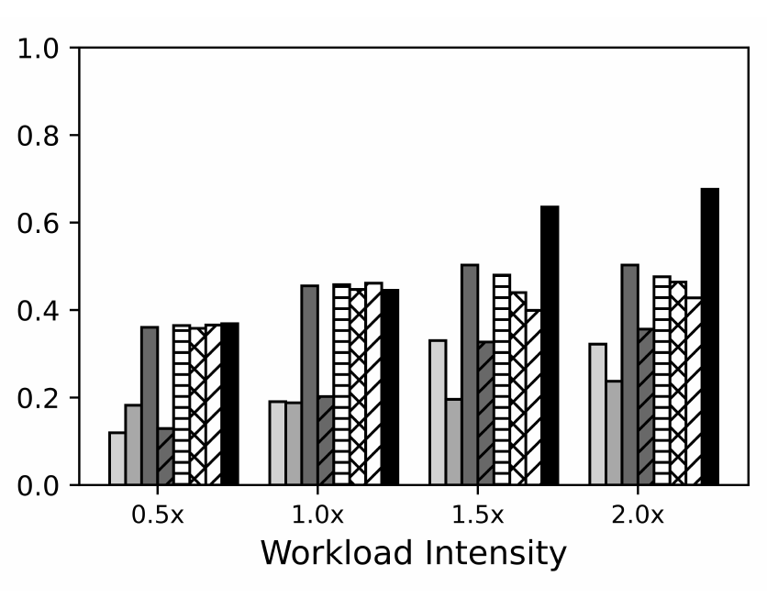
Static load: sequential writes and read-latest
Evaluation
Fig. 4(c) Sequential writes
Fig. 4(d) Read latest
Cerberus writes to both tiers
Colloid+, ++ worse: wasted migrations
Colloid migrates blocks that soon go cold
Cerberus places new writes by load

Slide 37
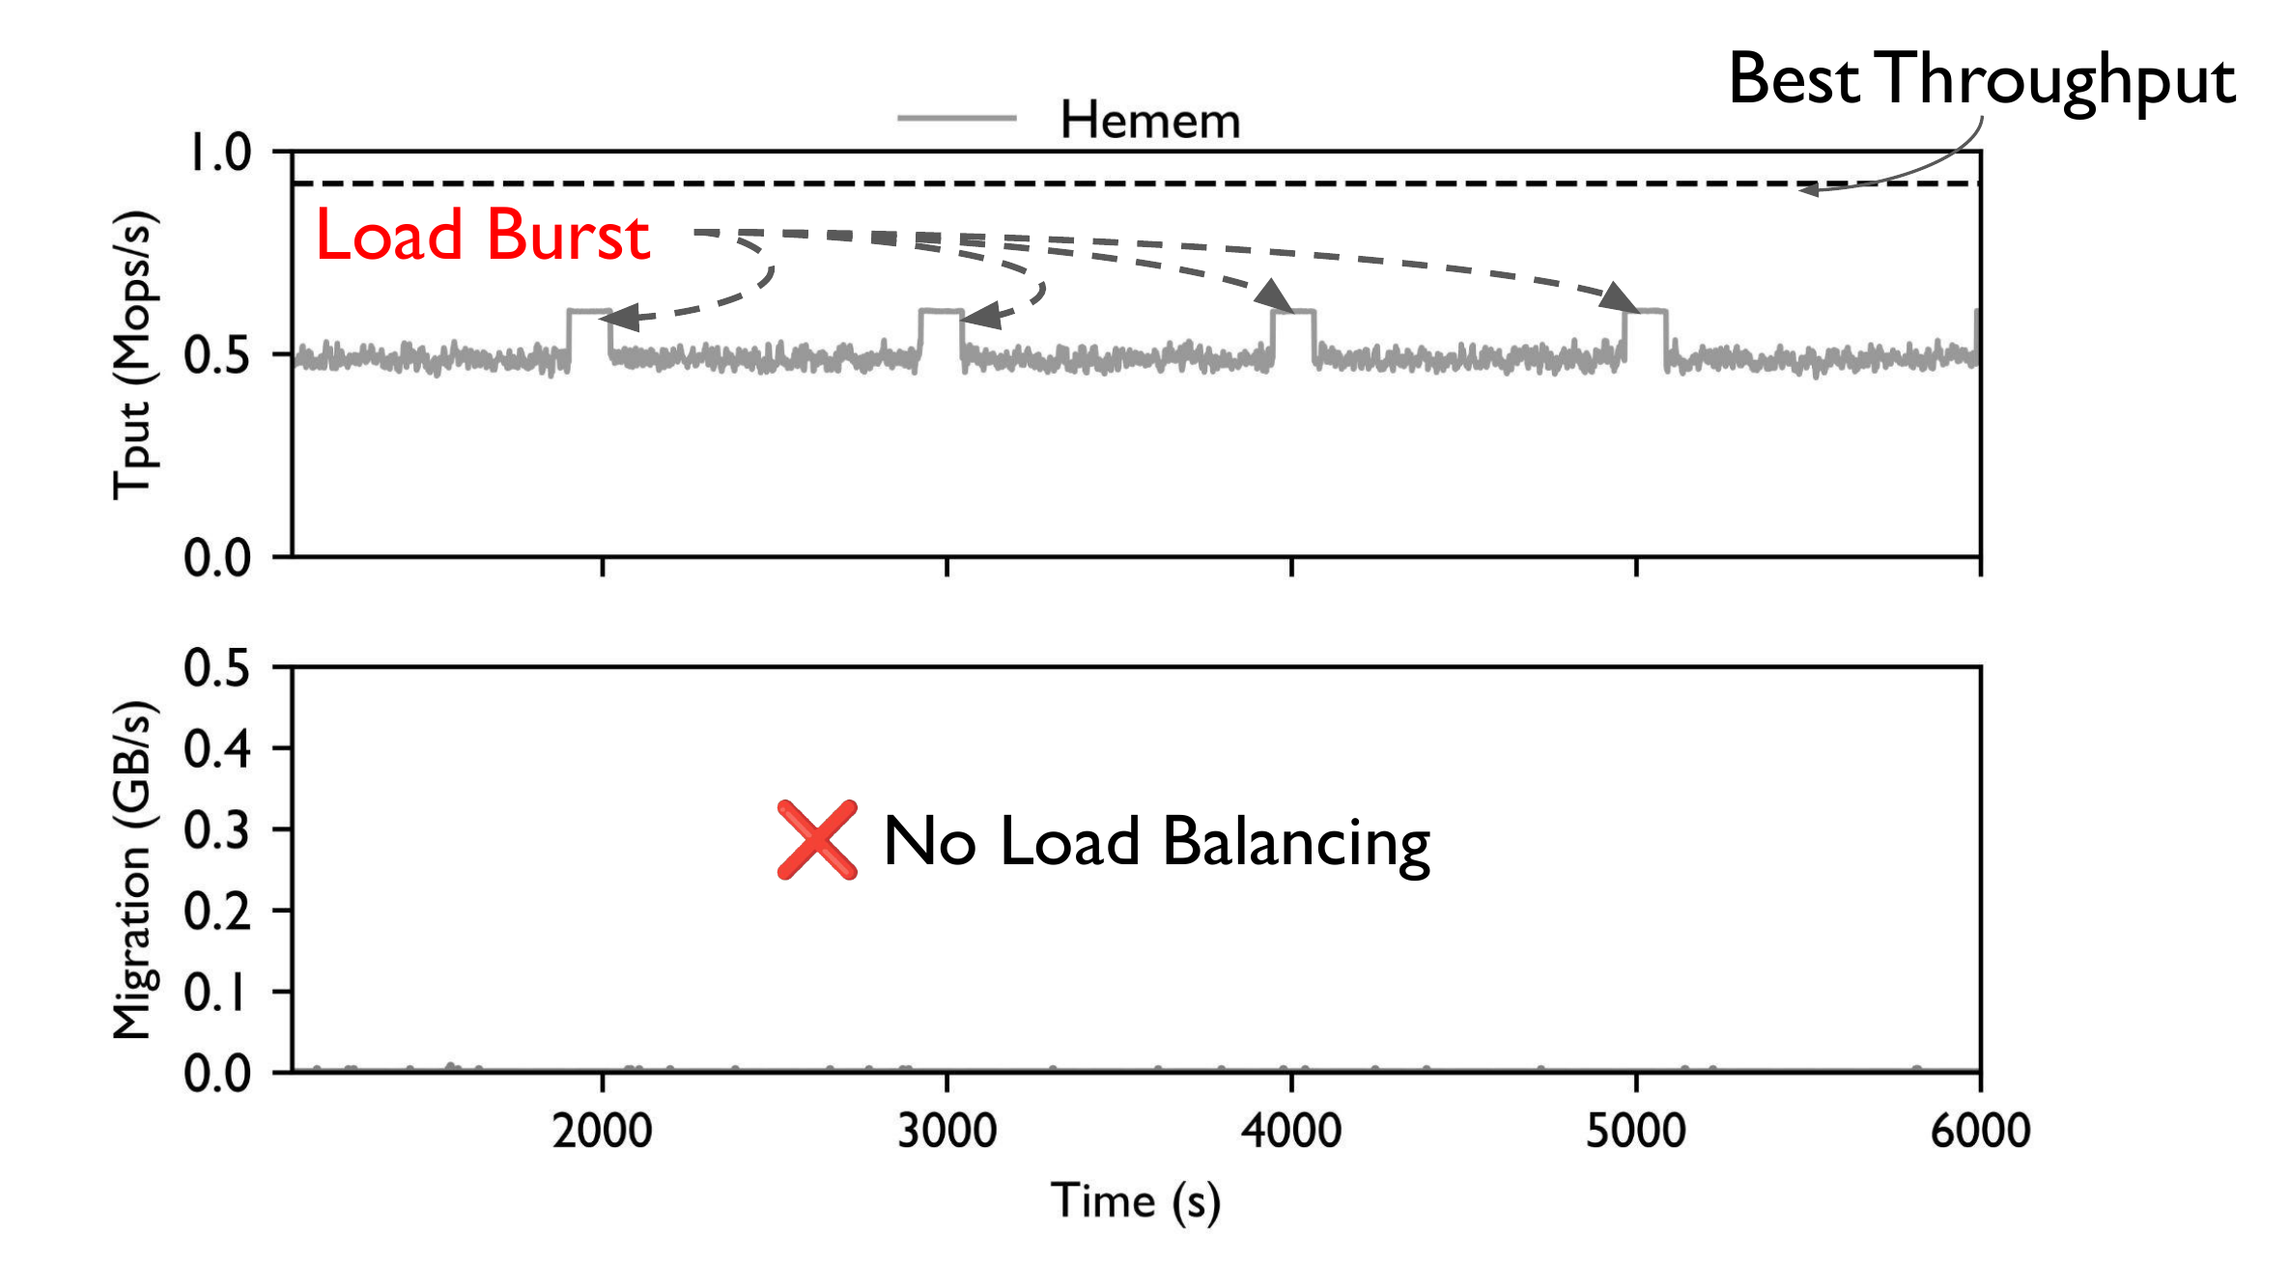
Bursty load: routing vs. migration
Evaluation
HeMem
no load balancing
Fig. 5(a) Read-only

Slide 38
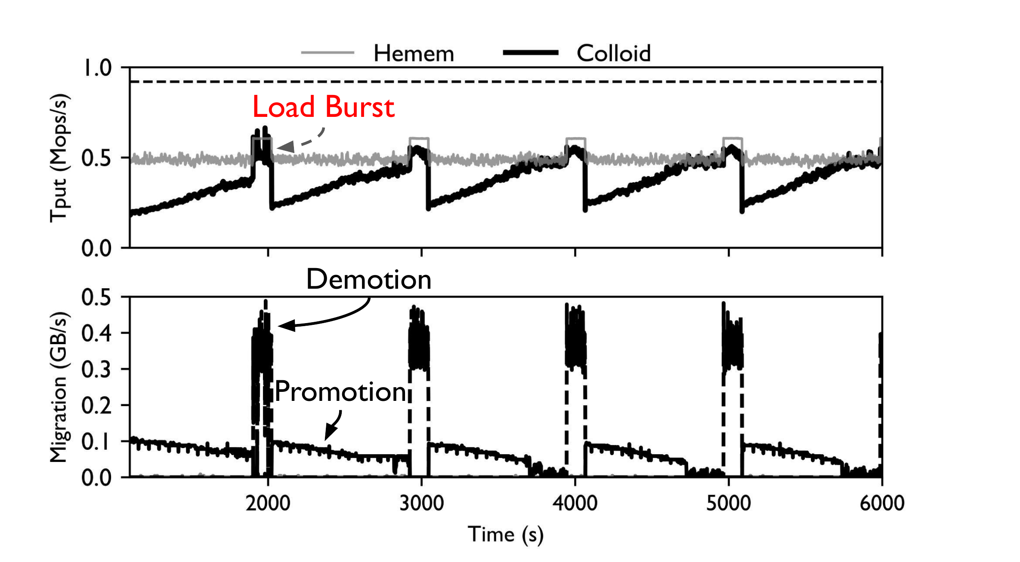
Bursty load: routing vs. migration
Evaluation
HeMem
no load balancing
Colloid
544 GB migrated
capacity SSD lifetime:
3.0 years → 129 days
Fig. 5(a) Read-only

Slide 39
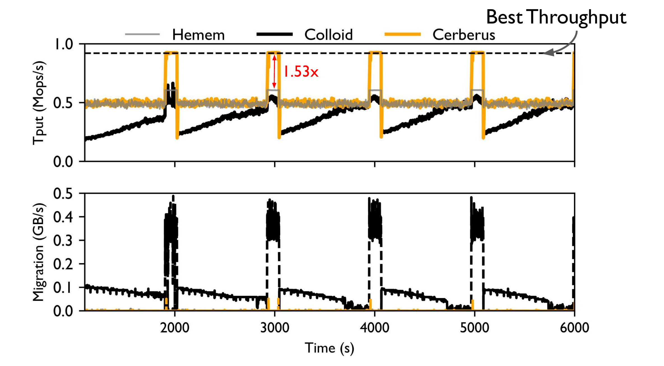
Bursty load: routing vs. migration
Evaluation
HeMem
no load balancing
Colloid
544 GB migrated
capacity SSD lifetime:
3.0 years → 129 days
Cerberus
1.53× HeMem in bursts
adapts in < 10 s
Fig. 5(a) Read-only

Slide 40
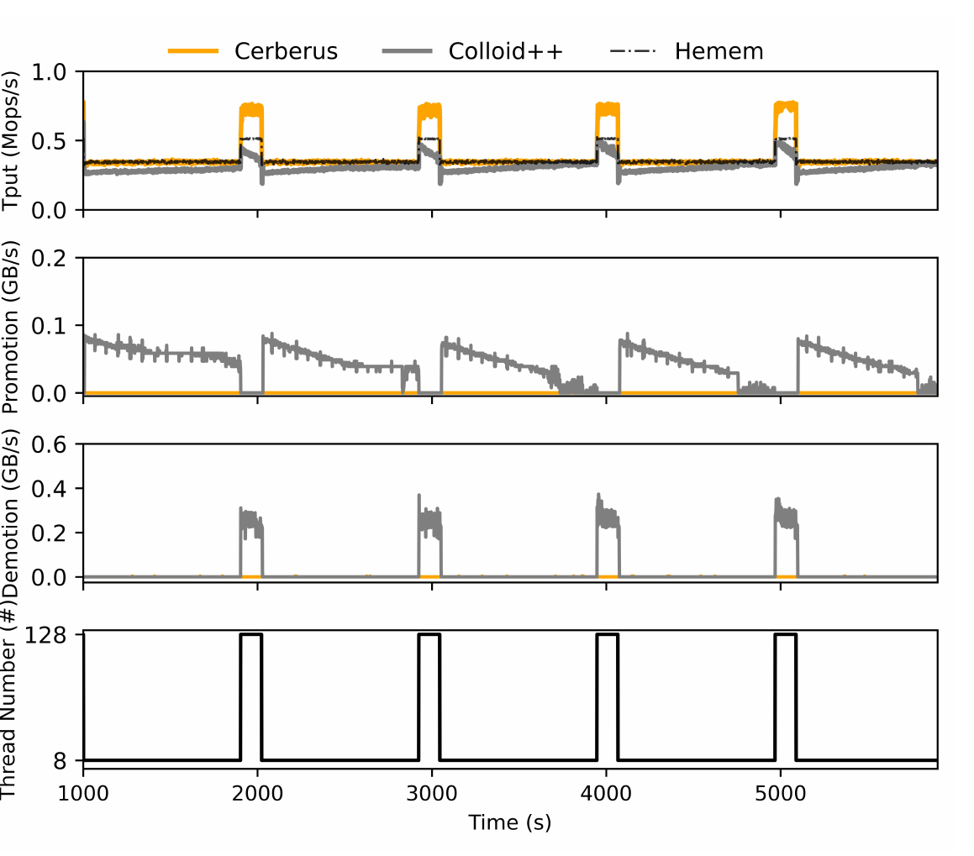
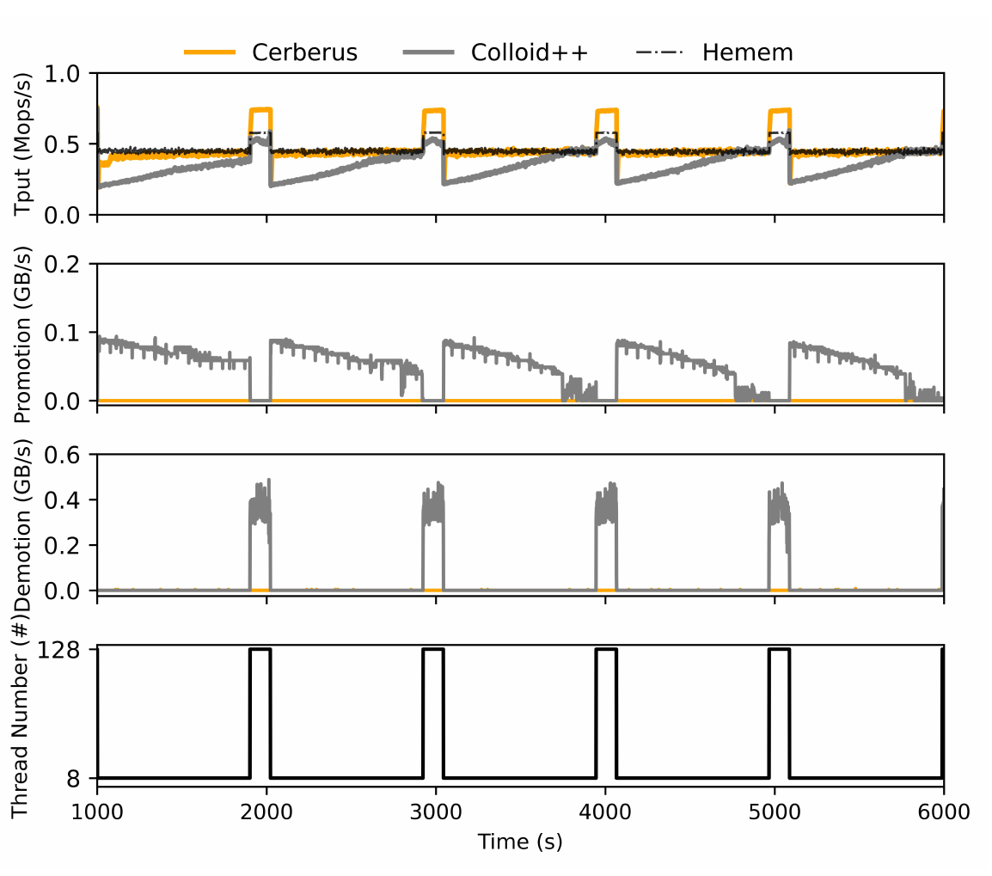
Bursty load: writes and mixed workloads
Evaluation
Fig. 5(b) Write-only
Fig. 5(c) Read/write mixed
1.48× HeMem in bursts
Moved: Colloid++ 400 GB, Cerberus 107 GB
Same pattern as read-only
Moved: Colloid++ 499 GB, Cerberus 64 GB

Slide 41
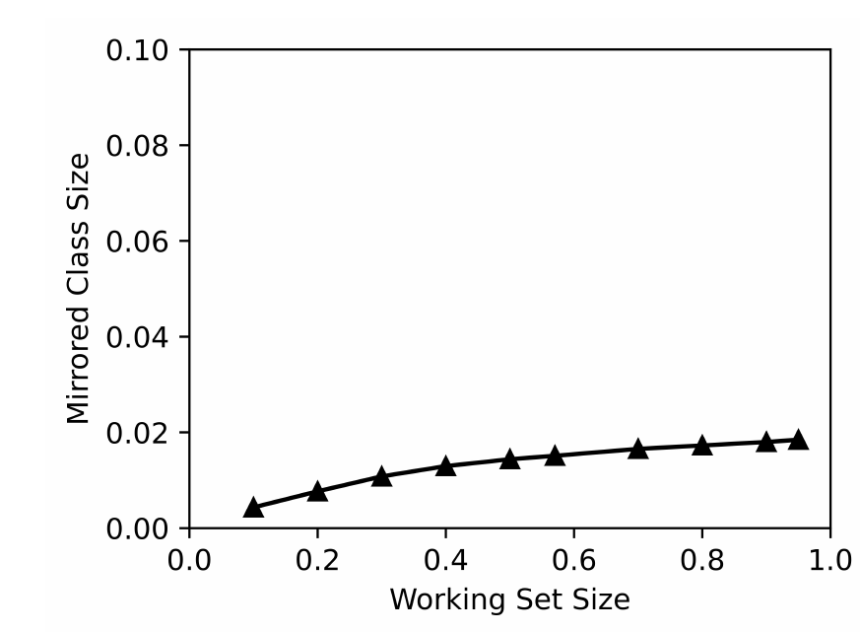
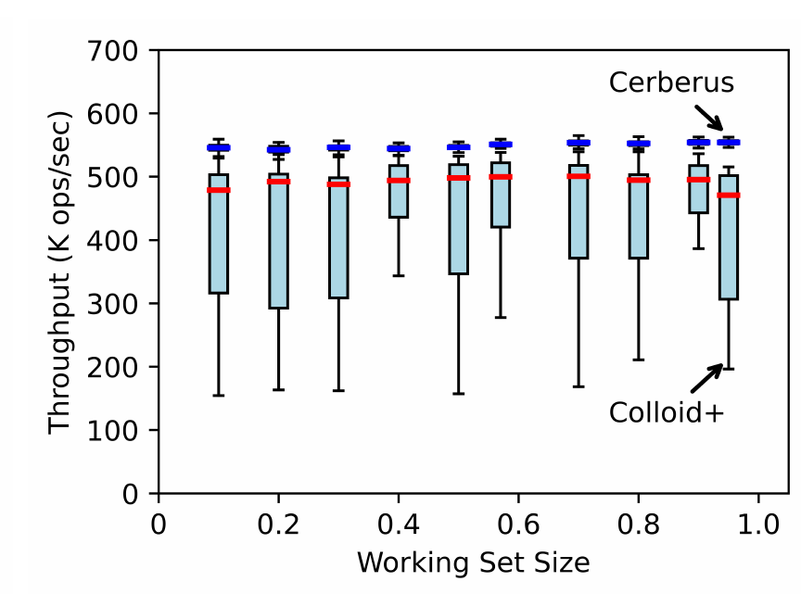
Mirrored class: how much is enough?
Evaluation
Fig. 7(a) Mirrored fraction
Fig. 7(b) Throughput
1.8% of all data mirrored, even at a 95% working set

Slide 42
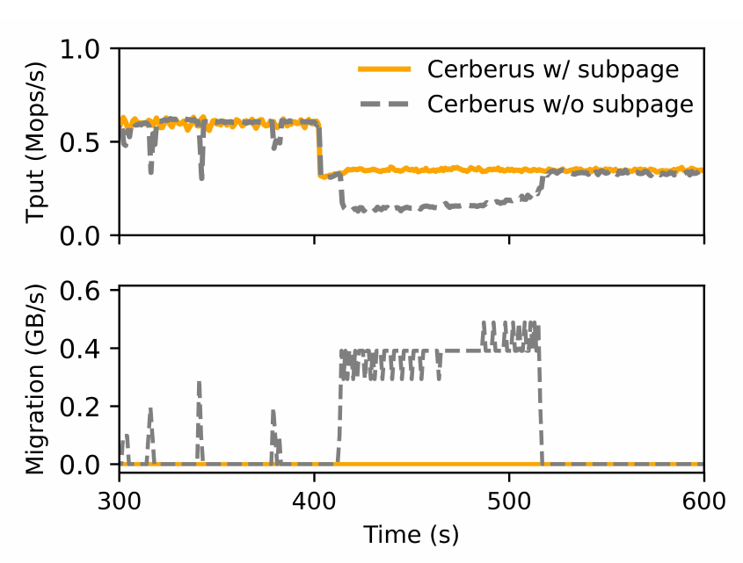
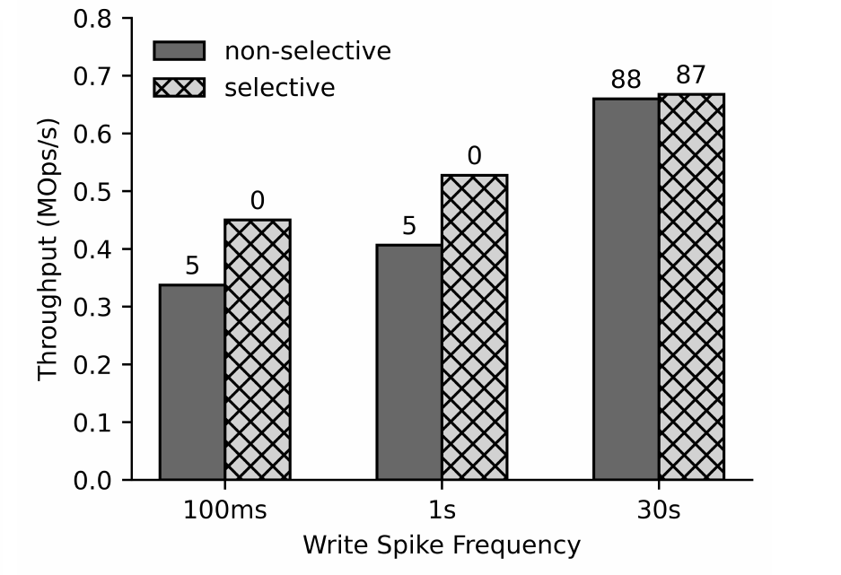
Mirrored class: subpages and selective cleaning
Evaluation
threads 128 → 8
Fig. 7(c) With vs. without subpages
Fig. 7(d) Selective vs. full (non-selective) cleaning
Without subpages: whole 2 MB segments migrate after a load drop
Full cleaning: −25% throughput for +5% clean blocks

Slide 43
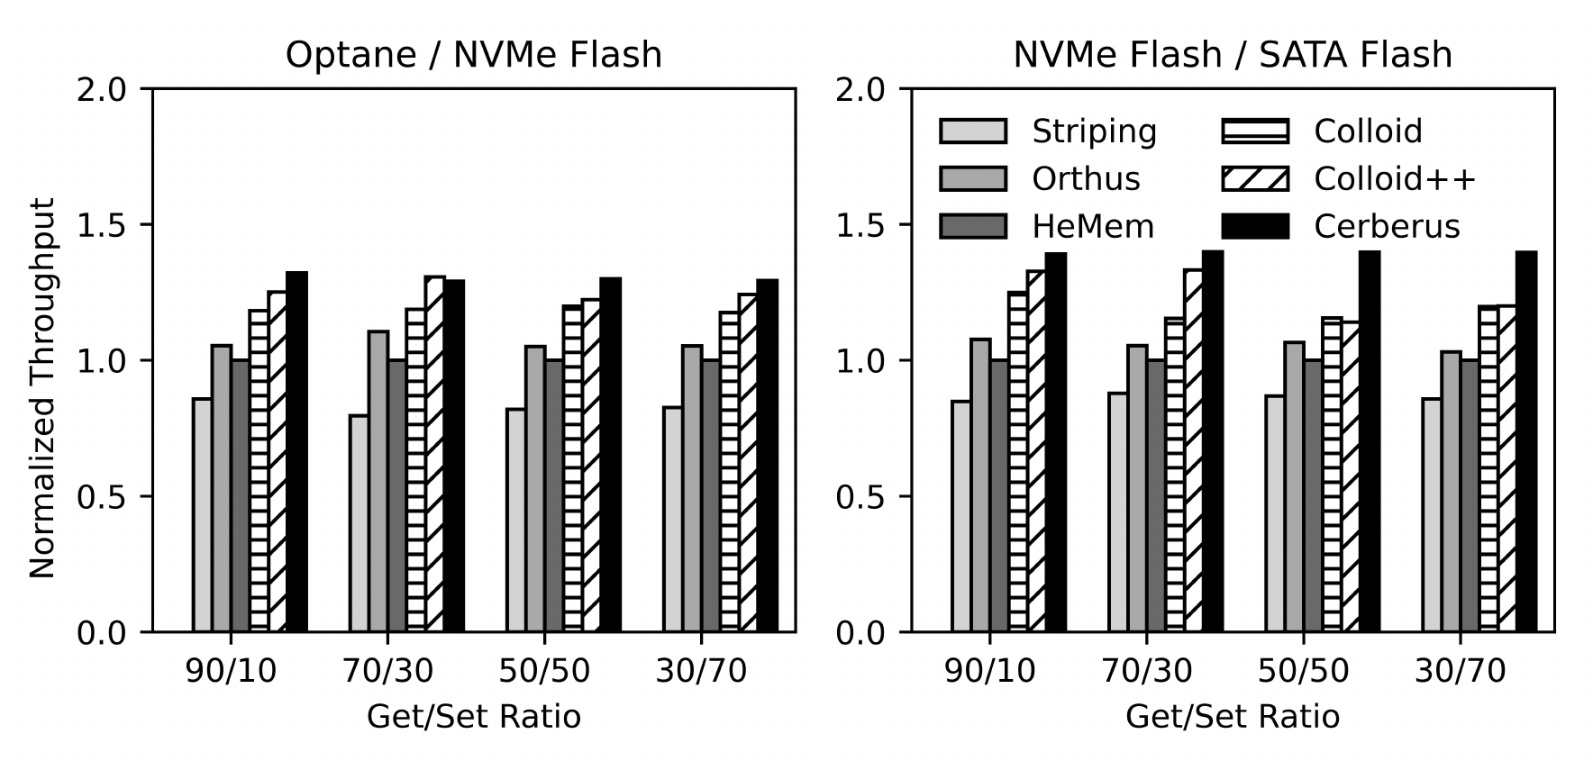
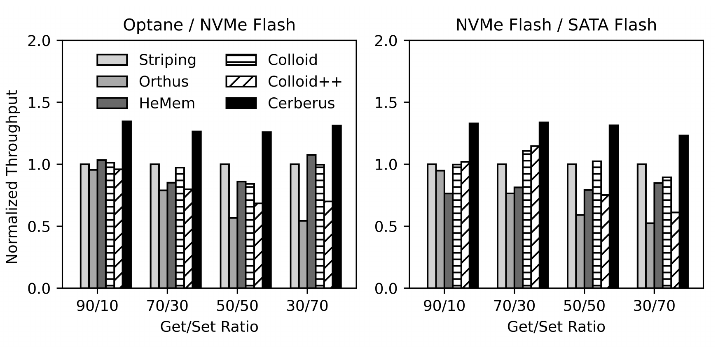
End-to-end: CacheLib lookaside workloads
Evaluation
Fig. 8(a) Small Object Cache, 1 KB values
Fig. 8(b) Large Object Cache, 16 KB values
Colloid, Colloid++ migrate on latency spikes
Gap largest on NVMe/SATA
up to 1.36× / 1.54×
Optane/NVMe, NVMe/SATA

Slide 44
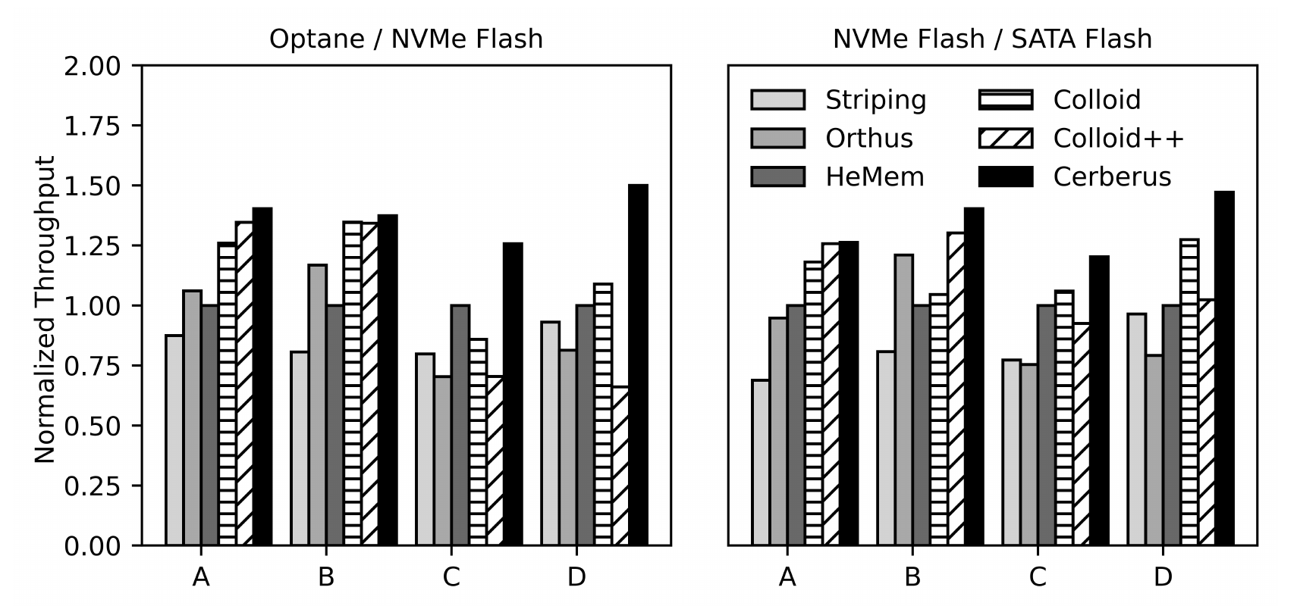
End-to-end: Meta production cache traces
Evaluation
Trace | Value | I/O
A | 335 B | random
B | 860 B | random
C | 33 KB | log
D | 92 KB | log
Fig. 9 Throughput, normalized to HeMem
1.24× / 1.17×
−19%
−90%
throughput vs. Colloid
P99 vs. best baseline
P99, trace D vs. Orthus

Slide 45
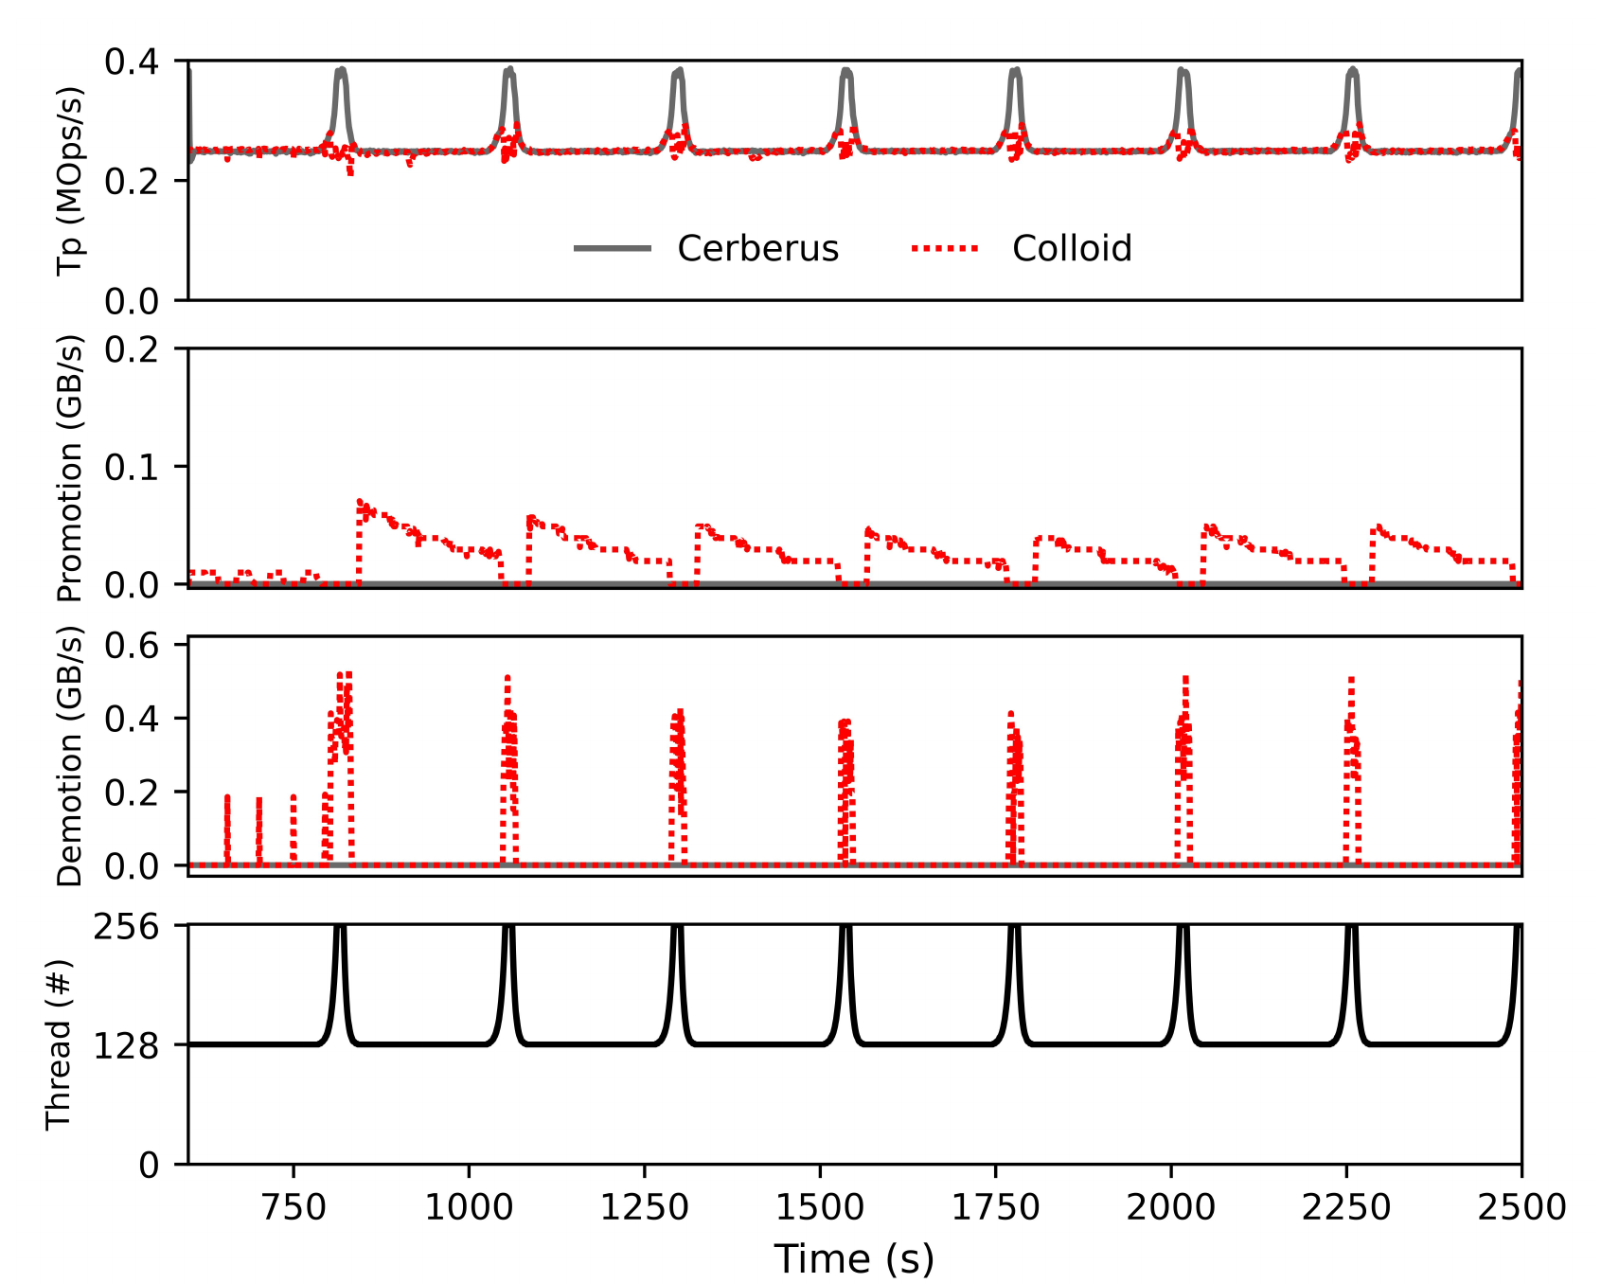
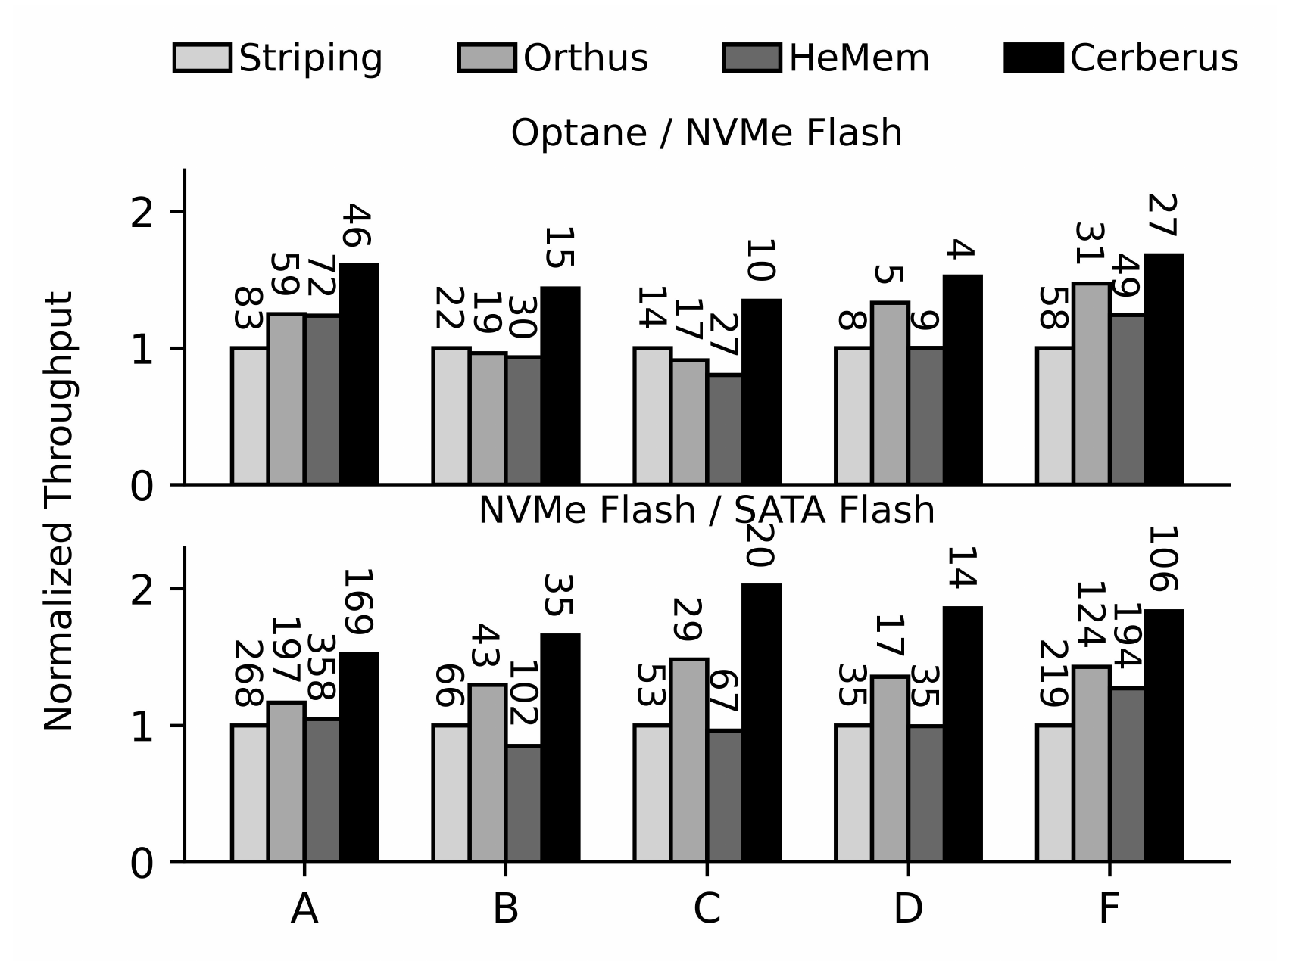
End-to-end: other results
Evaluation
Fig. 10 Dynamic cache load
Fig. 11 YCSB (labels: P99 µs)
Cerberus: no migration during bursts
up to 1.43× throughput, −30% P99

Slide 46




Limitations and open questions
Discussion
Evaluated only as a cache
Baselines are ports
crash consistency of in-memory metadata: future work
memory-tiering designs re-implemented by the authors
Hand-set knobs, two tiers
Hardware sensitivity
θ, step, 20% cap, 2 MB segments set by hand
smaller gains on NVMe/SATA; no local vs. remote NVMe test

Slide 47



Conclusion
Discussion
Migration-only balancing is slow and write-hungry in storage
MOST mirrors a small hot set and balances load by routing
Up to 2.34× throughput, −84% device writes, adapts in < 10 s
Authors’ outlook: caching + tiering + RAID → a “unified theory” of storage hierarchies

Slide 48
Questions?
slides
Keonwook
Motivation
3–8
Under load, the capacity tier’s bandwidth sits idle
Background
9–15
Migration is slow and costly; full copies waste space
Design: reads
16–22
Mirror a small hot set; route its reads with x
Yeonjin
Design: writes
23–31
Route writes with x too; track validity per 4 KB
Evaluation
32–45
Matches or beats every baseline; adapts in < 10 s
Discussion
46–47
Cache-only tests; no crash recovery; hand-set knobs

Slide 49
Backup: per-segment metadata (2 MB segment)
Member | Type | Bytes
id | uint64_t | 8
addr[2] | uint64_t[ ] | 16
invalid | bitset<512>* | 8
location | bitset<512>* | 8
clock | uint64_t | 8
readCounter | uint8_t | 1
writeCounter | uint8_t | 1
rewriteReadCounter | uint64_t | 8
rewriteCounter | uint64_t | 8
flags | uint8_t | 1
storageClass | enum class | 1
mutex | SharedMutex | 8
Total |  | 76
invalid / location: pointers to 512-bit bitsets (one bit per 4 KB subpage), used for subpage tracking in the mirrored class
4 KB segments would need 512× more metadata and get lower device bandwidth
Larger segments waste fast-tier space on cold subpages
2 MB matches HeMem, Colloid, Memtis

Slide 50
Backup: GET latency (ms), production traces
Hierarchy | Trace | Metric | Striping | Orthus | HeMem | Colloid | Colloid++ | Cerberus
Optane / NVMe | A | Avg | 0.81 | 0.67 | 0.71 | 0.56 | 0.52 | 0.50
 |  | P99 | 15.76 | 18.18 | 19.24 | 9.59 | 9.00 | 7.33
 | B | Avg | 0.73 | 0.61 | 0.59 | 0.45 | 0.44 | 0.43
 |  | P99 | 7.00 | 14.28 | 12.83 | 4.12 | 4.12 | 3.65
 | C | Avg | 0.76 | 0.86 | 0.59 | 0.67 | 0.88 | 0.47
 |  | P99 | 9.53 | 10.69 | 6.50 | 7.78 | 8.85 | 5.43
 | D | Avg | 9.67 | 12.38 | 8.26 | 7.15 | 8.32 | 3.16
 |  | P99 | 67.68 | 272.00 | 73.63 | 72.93 | 86.32 | 27.76
NVMe / SATA | A | Avg | 2.30 | 1.76 | 1.58 | 1.35 | 1.21 | 1.15
 |  | P99 | 46.43 | 27.96 | 22.98 | 25.98 | 21.31 | 20.40
 | B | Avg | 1.90 | 1.41 | 1.54 | 1.48 | 1.17 | 1.10
 |  | P99 | 23.40 | 16.84 | 11.59 | 14.15 | 9.34 | 8.54
 | C | Avg | 1.95 | 2.00 | 1.49 | 1.40 | 1.62 | 1.23
 |  | P99 | 18.18 | 18.42 | 12.35 | 16.50 | 18.50 | 12.31
 | D | Avg | 27.55 | 32.15 | 26.69 | 19.98 | 16.68 | 16.09
 |  | P99 | 239.86 | 364.20 | 160.10 | 158.07 | 170.29 | 101.85

Slide 51
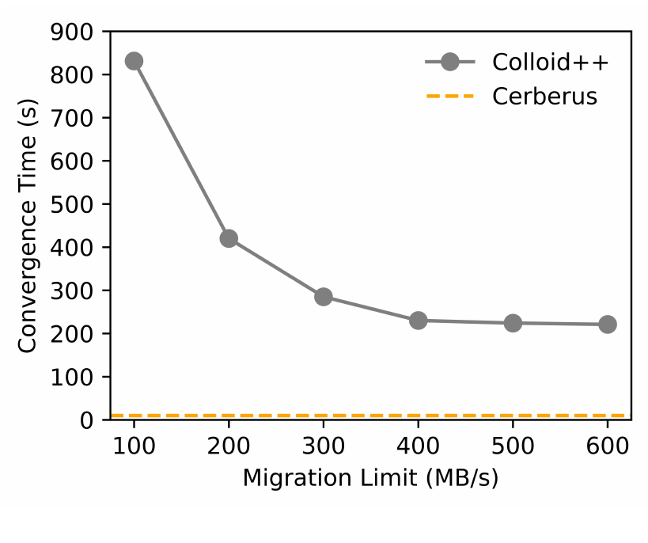
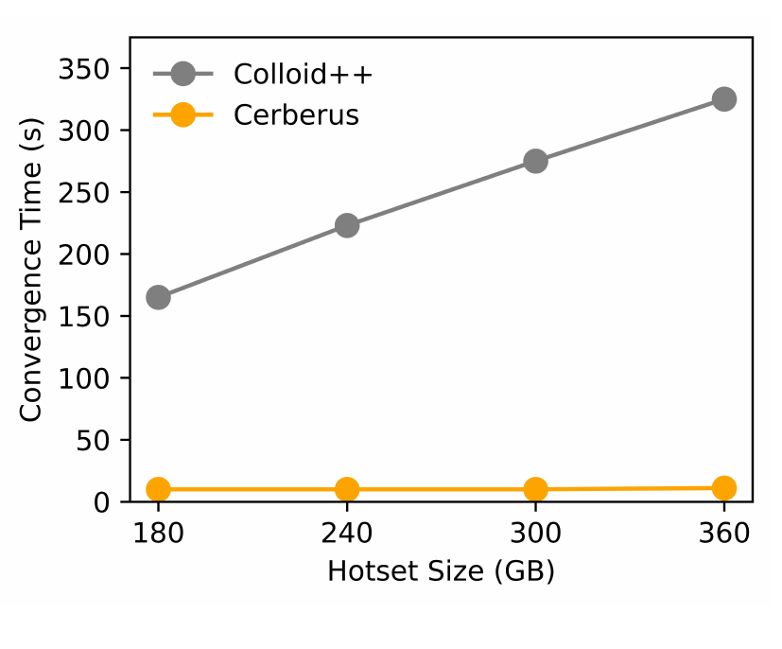
Backup: the cost of migration (Fig 6, SSD lifetime)
Projected SSD lifetime (years)
Fig. 6(a) vs. migration cap
Fig. 6(b) vs. hotset size
Colloid++ > 800 s at a 100 MB/s cap
Cerberus < 10 s
3.0 years → 129 days
capacity SSD under Colloid++ (−88%)

Slide 52
Backup: qualitative comparison (Table 2)
 | Single copy |  | Multiple copies
 | Tiering |  | Mirroring | Caching
 | HeMem | Colloid | RAID-1 | Orthus | MOST
Read bandwidth | Low | Med | High | High | High
Write bandwidth | Low | Low | Low | Low | High
Mixed R/W bandwidth | Low | Med | Med | Med | High
Seq. write bandwidth | Low | Low | Low | Low | High
Capacity use | High | High | Low | Low | High
Dynamic load | Low | Low | Med | Med | High
Low: no load balancing · Med: limited, for some workloads · High: effective across workloads

Slide 53
Backup: related work map
Area | Systems | Difference from MOST
Tiered memory | Thermostat, Nimble, HeterOS, vTMM | Access tracking, hot/cold identification, migration — orthogonal to load balancing
Load-balancing tiering | BATMAN, Colloid, AutoTiering, EDT-DTM | Balance only by migrating data → slow to react to load changes
Tiered / hybrid storage | AutoRAID (mirror + RAID-5, 1996), Strata, Ziggurat, Spitfire, hStorage-DB, PolyStore | Load-unaware, or no cross-tier duplication → slow to adapt
Storage-aware caching | Orthus, Wu & Reddy, SIB, LBICA | Migration-only (Wu & Reddy) or partial balancing (SIB, LBICA); like Orthus, don’t fully use the hierarchy
Distributed multi-tier caching | EC-Cache, ELECT, eMRC | Erasure coding or replication within a single tier; miss-ratio modeling
ML-based tiering | IDT, RLTiering, A3C, ArtMem | Learned placement on single-copy tiering — still migration-bound
Copies during migration | Nomad (OSDI ’24) | Temporary copy hides migration cost; does not maximize bandwidth in steady state

Slide 54
Backup: device performance (Table 1)
Device | Latency 4K (µs) | Latency 16K (µs) | Read 4K (GB/s) | Read 16K (GB/s) | Write 4K (GB/s) | Write 16K (GB/s)
Optane SSD | 11 | 18 | 2.2 | 2.4 | 2.2 | 2.2
PCIe 4.0 NVMe Flash SSD | 66 | 86 | 1.5 | 3.3 | 1.9 | 2.3
PCIe 3.0 NVMe Flash SSD | 82 | 90 | 1.0 | 1.6 | 1.5 | 1.6
PCIe 4.0 NVMe over RDMA | 88 | 114 | 1.2 | 2.7 | 1.7 | 2.3
SATA Flash SSD | 104 | 146 | 0.38 | 0.5 | 0.38 | 0.5
Latency: single-thread read. Bandwidth: 32 threads. Remote device over a 25 Gbps link.

