Slide 1

FineMem:
Breaking the Allocation Overhead vs. Memory Waste Dilemma in Fine-Grained Disaggregated Memory Management
Author: Xiaoyang Wang, Yongkun Li, Kan Wu, Wenzhe Zhu, Yuqi Li, Yinlong Xu
Presenter: 2026-37146 Seongjong Bae, 2025-28554 Yonghwan Chung

Slide 2




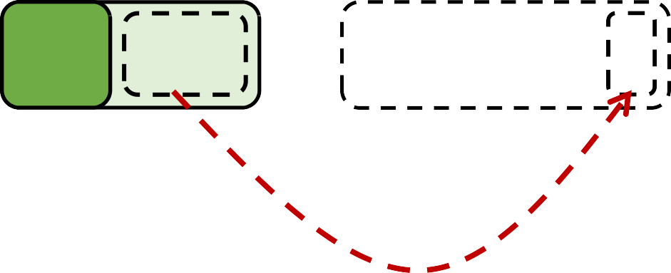




Memory Costs in Hyperscale Systems
Background & Motivation
Monolithic Servers: Coupled CPU and Memory
Memory-intensive applications → Require large per-node memory
Problem: Low utilization
Node1:
Low utilization
Node 2:
Out-of-Memory
…
Application 1
Application 2
…
Memory
Memory
Hyperscalers
Unsharable

Slide 3

































Memory Disaggregation
Background & Motivation
Memory Disaggregation: Decoupled Compute Nodes and Memory Nodes
Shared, large global memory pool
Utilization ↑
Compute Node 1 Compute Node n
…
Tiny Cache
…
Compute Pool
Network (e.g., RDMA, CXL)
Memory Pool
…
Basic Core
…
Monolithic
Memory Node 1
Memory Node n
Servers
Notes:
Memory Disaggregation 혹은 DM(Disaggregated Memory)

Slide 4








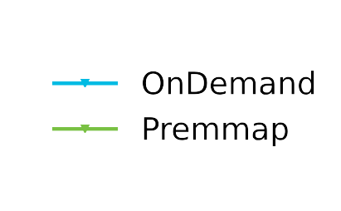



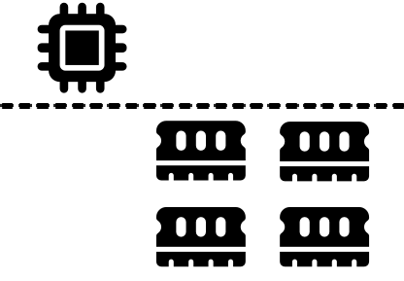



Memory Disaggregation - Allocation Overheads
Background & Motivation
RDMA-based disaggregated memory allocation: performance challenges
Memory region registration latency
RPC execution overheads
mmap() with pre-fault
+
on-chip registration
1GB registration ~ 100ms
1.5
1.0
Memory Region Registration
Throughput (Mops)
0.5
Weak CPU
busy
Allocation with RPC:
Memory node CPU execution
16
32
48
64
80
96
112
128
Client Number
DM KV-Store in a YCSB-A workload
Remote Allocations Over Network
Notes:
그래프: DM KV-Store FUSEE 이용, 4KB Chunk 사용
Registration 오버헤드: 낮은 throughput
RPC메모리 노드 오버헤드: Client증가에 따른 throughput 감소

Slide 5
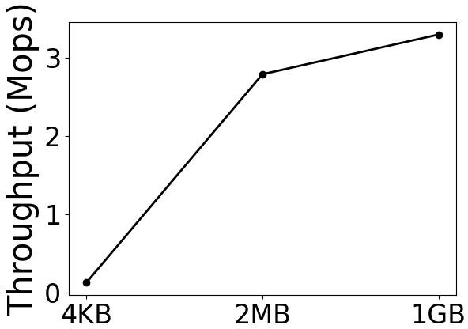
Trade-off: Coarse-grained Memory Management
Background & Motivation
Existing DM systems: Coarse-grained (MB-GB) Memory Management
Reduce allocation frequency → Lower allocation overheads
Performance ↑
Memory efficiency?
State-of-the-Art Works | Management Granularity
FaRM@NSDI’14 | 2GB
Fastswap@Furosys’20 | 32GB
FUSEE@FAST’23 | 16MB
CXL-SHM@SOSP’24 | 64MB
DM KV-Store with different
block allocation size (YCSB-A)

Slide 6




DM Dilemma: Performance vs Efficiency
Background & Motivation
Existing DM systems: Coarse-grained (MB-GB) Memory Management
Reduce allocation frequency → Causing significant memory waste
memory cost reduction
Memory Efficiency
3
Fine-grained management
100
2
Memory (GB)
Throughput (Mops)
50
1
0
4KB
2MB
1GB
0
Block Size
Coarse-grained management
DM KV-Store with different
block allocation size (YCSB-A)
Performance
DM Management Dilemma: Allocation Overheads vs. Memory Waste
Notes:
그래프: FUSEE 이용

Slide 7




Solving the DM Dilemma with Fine-grained Management
Overview
FineMem: A fine-grained remote memory management system in RDMA-based DM
Compute Pool
Memory Efficiency
Fine-grained management
App. 1
App. 2
App. 3
Our Goal
Fine-grained (4KB page), Shared and Recoverable
Coarse-grained management
Memory Pool
Performance
Key Challenges
MR Registration Latency
Fine-grained Allocations Over Network
Memory Recovery during Compute Node Failures

Slide 8
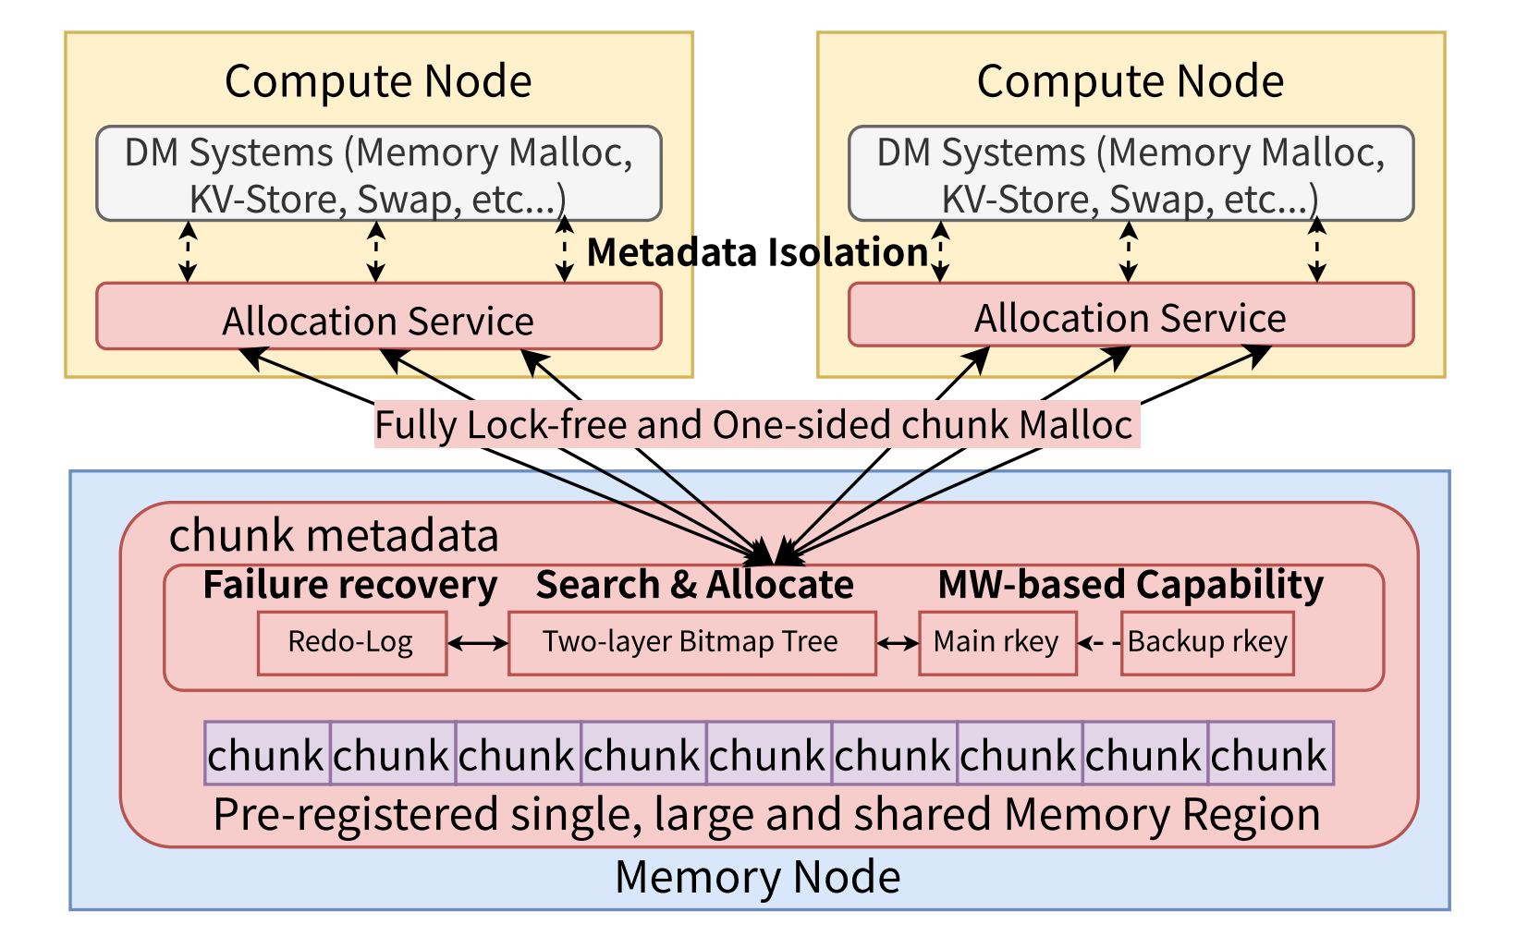
Key Design Elements of FineMem
Overview
FineMem: A fine-grained remote memory management system in RDMA-based DM
1. Global MR while Overcoming Isolation Challenges
2. One-sided, Efficient Remote Memory Chunk Allocation
3. Memory Metadata Consistency

Slide 9
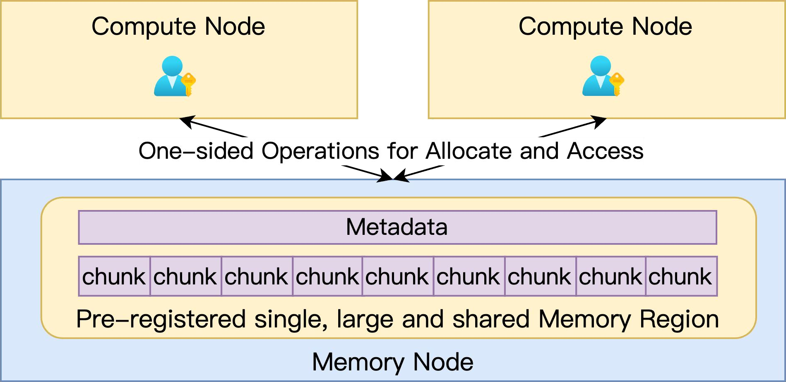
Memory Pool sharing a Single Memory Region
FineMem Design
Strawman Solution: Pre-registered single, large and shared memory region
Fine-grained memory chunks among multiple nodes
Allocation via directly modifying shared allocation metadata

Slide 10
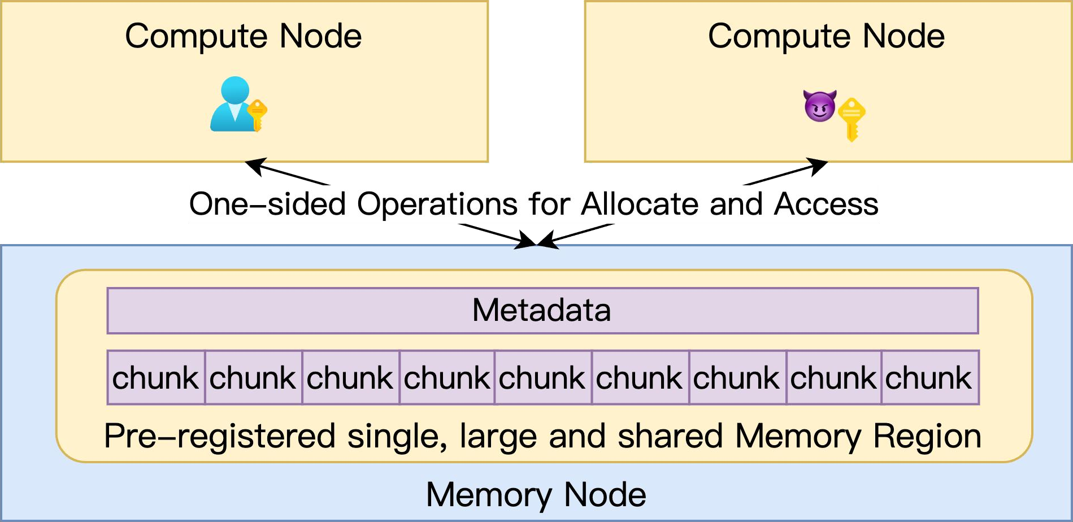
Memory Pool sharing a Single Memory Region
FineMem Design
Isolation Challenges:
Privacy and security risks among nodes
Memory chunks and memory allocation metadata unprotected (Shared rkey)

Slide 11
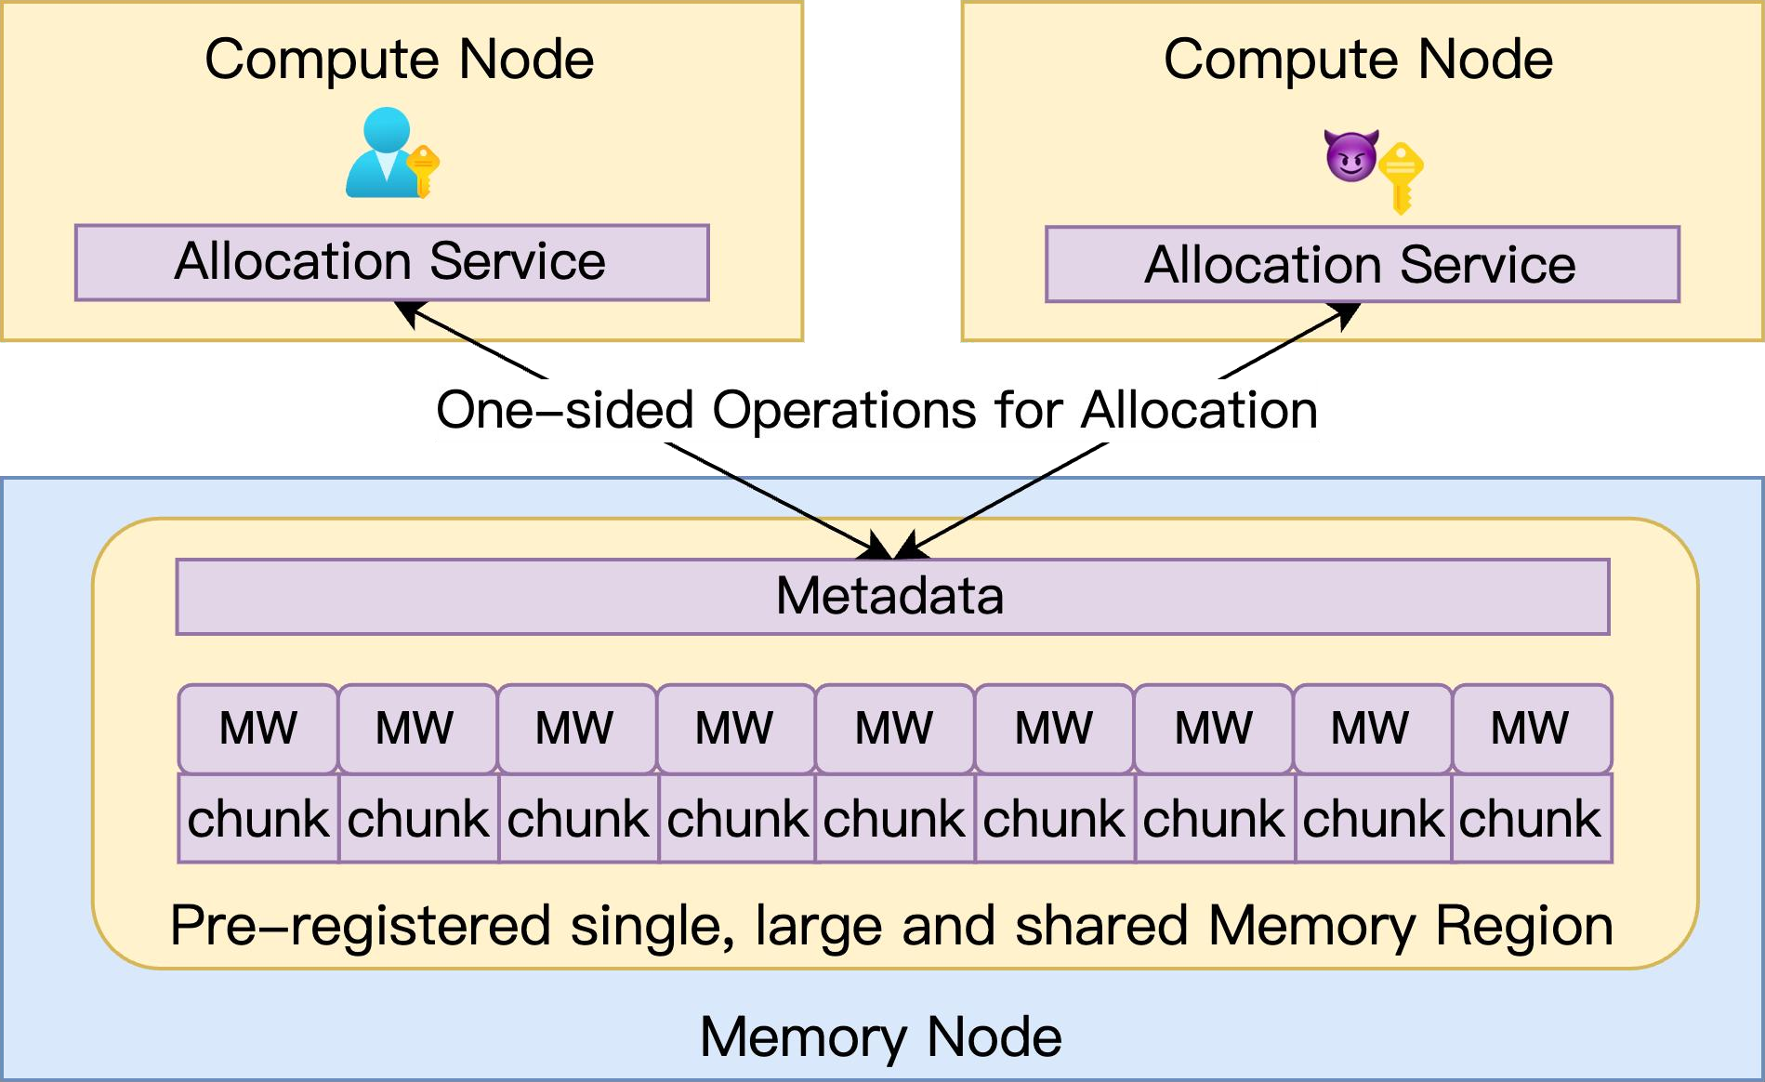
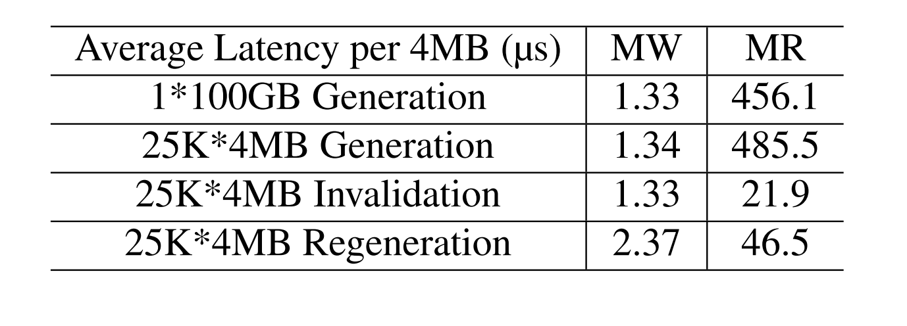
FineMem Design
FineMem: Global Shared Memory Pool
FineMem Solution: MW-based Chunk Isolation + Compute-Node Runtime Service
Chunk Isolation
Fine-grained Memory Window
Fast MW (re)generation
Each chunk has an MW rkey
Faster MW generation time than MR
Metadata Isolation
Per-Node Allocation Service
Trusted allocation service
Users call service via IPC

Slide 12
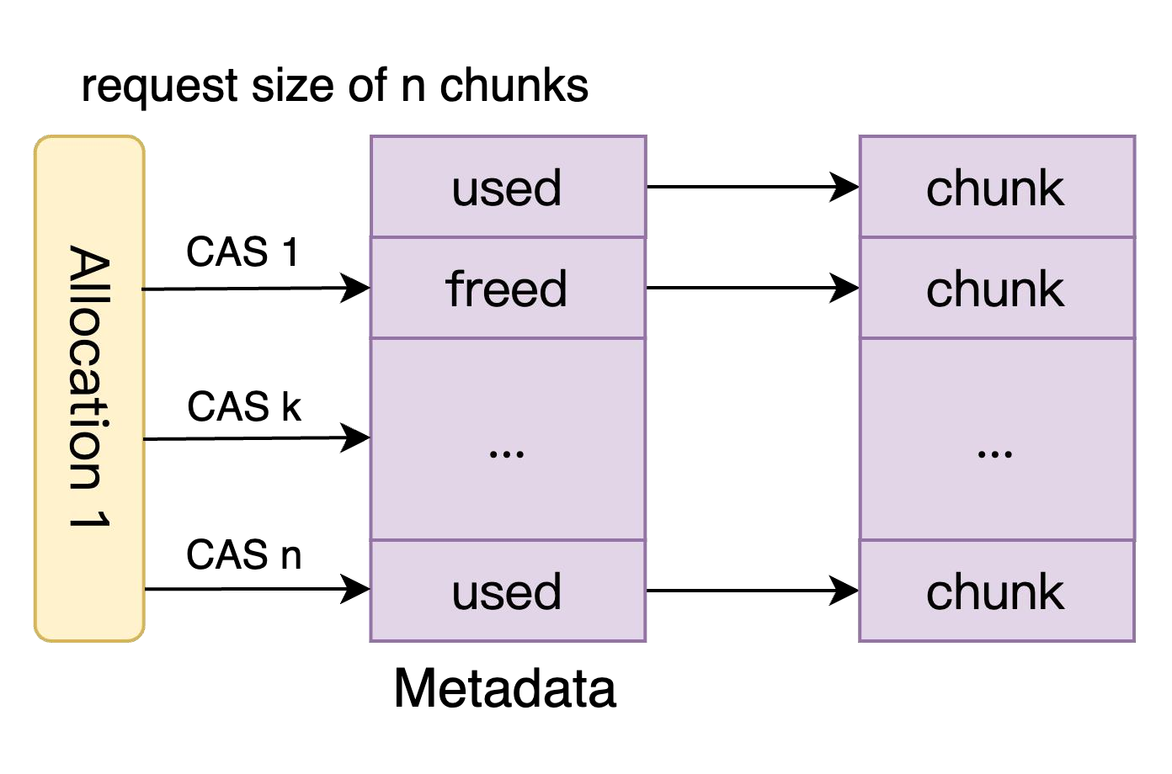
One-sided DM Allocation
FineMem Design
Strawman Solution: One Chunk per Entry (8B)
One RDMA Compare-And-Swap (CAS) update to occupy one chunk
Variant-size Allocation Challenge
  E.g., 4KB base chunk, 2MB allocation requires 512 CAS

Slide 13
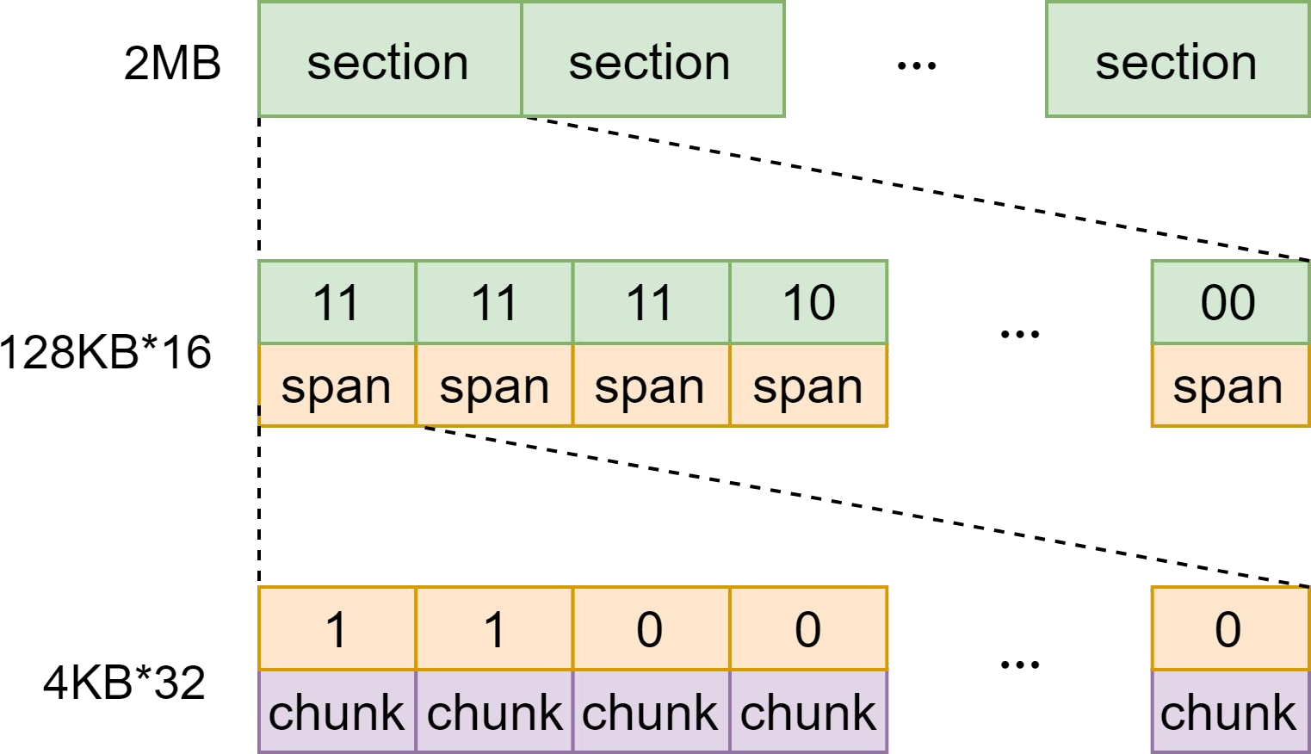
FineMem: One-sided DM Allocation With Two-Layer Bitmap
FineMem Design
FineMem Solution: Two-Layer Bitmap
[First-Layer] Section: 32-bit bitmap (16 spans, 2-bit per span) + 32-bit redo-log
[Second-Layer] Span: 32-bit bitmap (32 chunks, 1-bit per chunk) + 32-bit redo-log
[Base-Block] Chunk
One-layer bitmap: limited to 64 chunks
Two-layer bitmap:
  Search/allocate 512 (16*32) chunks with up to 2 RDMA request
Span bits | Span status
00 | Empty
01 | Partially Allocated
10 | Contended
11 | Full
Contention Threshold

Slide 14






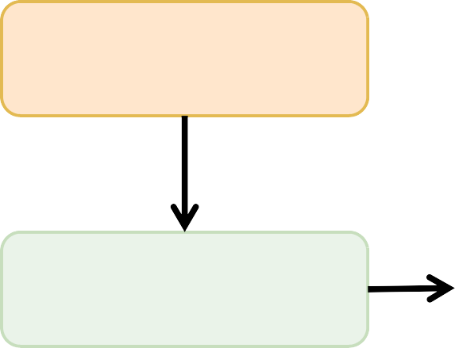
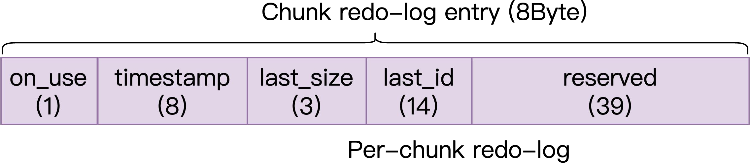
Compute Node Failure Recovery via Redo-Log
Challenges
Strawman Solution: Recovery Memory Chunks using Redo-Log
Redo logging on memory nodes, written by compute nodes via one-sided RDMA
Compute node failure
Write
redo-log
Set Chunk
bit as 1
Recovery
Write log
(malloc, ID, size,...)
Notes:
Compute node A가 청크 할당 받은 채로 죽으면 free() call X → 회수 불가
Redo log를 통해 메모리 누수 복구할 수 있음

Slide 15

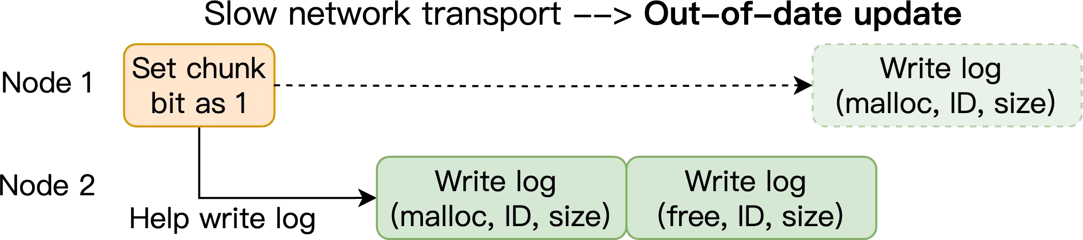
Metadata Consistency during Compute Node Failure
Challenges
Metadata Consistency Challenges:
Crash failure: chunk unrecoverable
Fail-slow failure: outdated log writing
Case 1:
Case 2:
Notes:
Case 1. CAS로 bitmap은 바꿨는데, redo log 쓰기 전에 죽음
Case 2. Case 1을 막으려 다른 스레드가 써줌 → 근데 compute node가 죽은 게 아니라 단지 느렸을 뿐이라 옛날 log가 최신 log를 덮어씀 → bitmap과 log 상태가 consistency가 맞지 않음

Slide 16
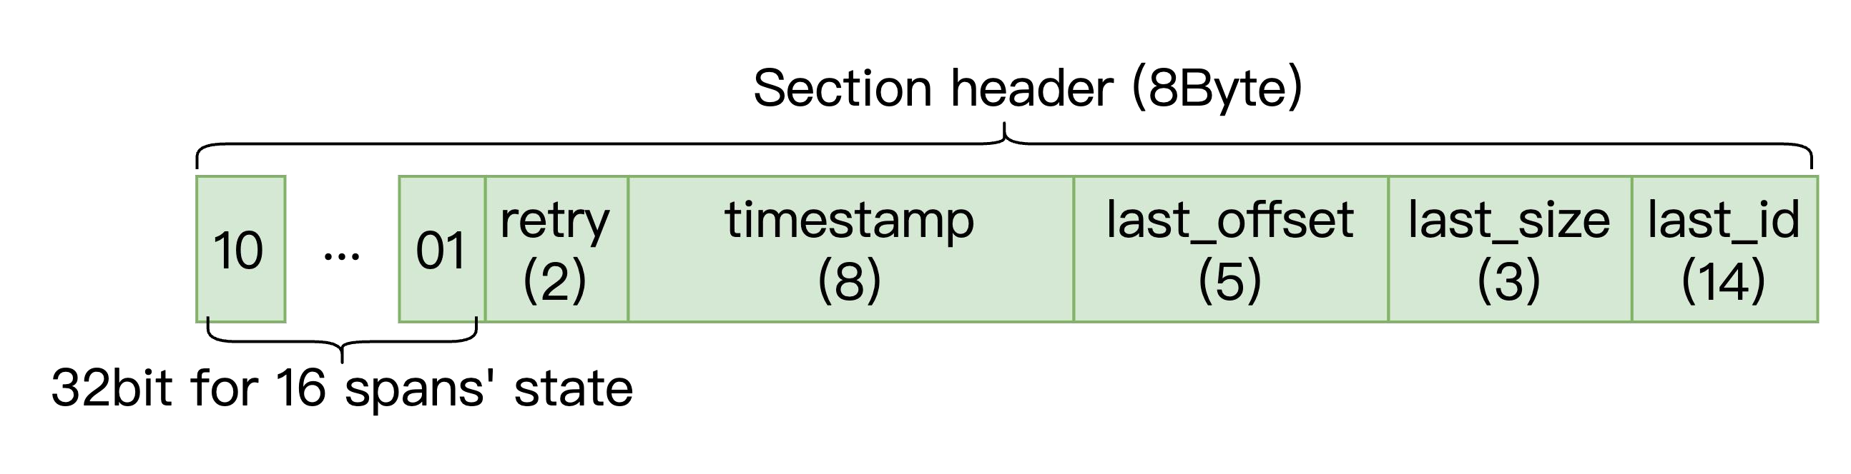
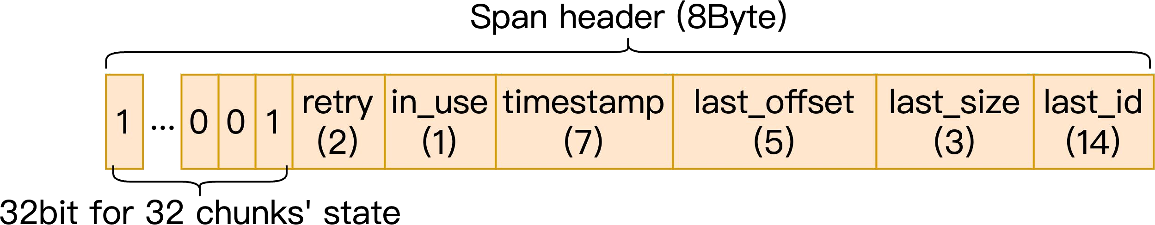
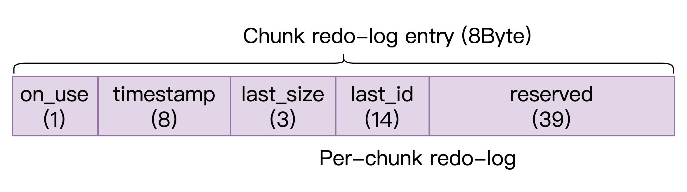
Metadata Consistency in FineMem
Challenges
FineMem Solution: Temporary log in the section/span headers
  size(Status bitmap) + size(temp_log) = 8B → 1 RDMA CAS
  Timestamp for out-of-date detection
  Flush to full log asynchronously (via any node)
Notes:
임시로그 쓰는 이유: 8B 연속적 memory region에 bitmap과 같이 RDMA CAS로 한번에 업데이트
Flush 이유: 로그 유효 기간 동안 permanently 유지하려고

Slide 17
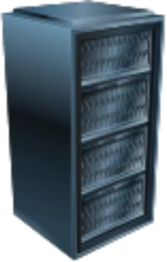
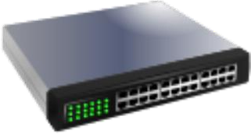
Evaluation Setup
Evaluation
Up to 16 CNodes (32 CPU cores each)
Baselines
OnDemand-RPC (CoRM [SIGMOD’21])
  On-demand MR registration
  RPC allocation
Premmap-RPC (FUSEE [FAST’23])
  Pre-registered MR
  RPC allocation
Premmap-One-sided (CXL-SHM [SOSP’24])
  Pre-registered MR
  Array-based one-sided allocation
100Gbps Ethernet Switch
ConnectX-6
100Gbps NICs
with RoCE
Up to 6 MNodes (256GB DRAM + 1 core each)
Notes:
RPC: 빈 청크 찾는 걸 memory node가 해서 memory node의 CPU 병목 가능
One-sided: 빈 청크 찾기를 compute node가 할 때, 혹은 CAS가 실패했을 때 할당 한 번이 n RTT 걸릴 수 있음

Slide 18
Evaluation Setups: DM Systems Working with FineMem
Evaluation
DM Systems Case Study:
DM Usage Cases | Based on | Workloads
Memory Malloc System | Mimalloc | Malloc benchmarks
Key-Value Store System | FUSEE | YCSB workloads
DM-Swap System | Fastswap | Unmodified applications
Memory
Malloc
System
Key-Value
Store
System
DM-Swap
System
FineMem
Disaggregated Memory
Notes:
Memory malloc system: mimalloc을 수정하여 local mmap() 호출을 FineMem 호출로 바꿔서 app이 remote memory 이용할 수 있게 함. Malloc bench 돌림.
Key-value store system: FUSEE에서 메모리 노드에 RPC로 블록을 요청하던 부분을 FineMem 호출로 바꿔서, 메모리 노드 CPU 없이 동작하는 완전 one-sided KV 스토어로 만듦. KV 스토어 성능 측정용 표준 벤치마크인 YCSB workloads 사용.
DM-swap system: swap-out할 때 FineMem을 이용하게 함. 수정되지 않은 일반 app 사용.

Slide 19
Microbenchmark
Evaluation
Different allocation granularity and scalability
FineMem
Premmap-RPC
(4KB allocation granularity)
Premmap-One-sided
OnDemand-RPC
16 threads in total
128 threads in total
10⁴
10⁴
10⁴
10³
10⁴
10³
10³
Avg. Alloc. Lat. (us)
Avg. Alloc. Lat. (us)
Avg. Alloc. Lat. (us)
Avg. Alloc. Lat. (us)
10³
10²
10²
10²
10²
10¹
2⁰
2¹
2²
2³
2⁴
2⁵
2⁶
2⁷
2⁸
2⁹
10¹
2⁰
2¹
2²
2³
2⁴
2⁵
2⁶
2⁷
2⁸
2⁹
10¹
16
32
48
64
80
96
112
128
10¹
1
2
3
4
5
6
Allocation size (4KB)
Allocation size (4KB)
Thread Number
Memory Node Number
Allocation Performance vs. Varying Request Size Varying Client Thread Varying Number of MNodes
FineMem outperforms across varying allocation granularities (4KB-2MB)
and levels of parallelism (~128 Client Threads and ~6 memory Nodes)
Reduces allocation latency by approximately 95%
Notes:
(1) Varying req size
OnDemand-RPC: 할당 크기만큼 MR을 그때그때 등록해서 할당 size 커질수록 MR 등록 비용이 커짐
Premmap-One-sided: 큰 할당은 chunk마다 CAS를 따로 해야 해서, 크기 커질수록 RDMA CAS 횟수가 많아짐
Premmap-RPC: 크기와 무관한 비용 구조. 할당을 memory node가 진행하여 threads 개수 적을 때는 allocation latency 낮지만, threads 수 늘어나면 CPU 병목와서 성능 나빠짐
FineMem은 가장 아래에서 거의 평평함 → 큰 할당을 section header CAS 한 번으로 처리하기 때문
(2) Varying client threads #
Thread 개수가 늘어날수록 RPC 방식은 지연 증가 (mem node CPU 병목)
FineMem은 one-sided라 128 threads에서도 거의 변화 없음
(3) Varying memory nodes #
Mem node 늘수록 CPU 병목 해소됨 → 근데 노드 6개로 늘려도 FineMem 못 따라잡음
두번째 불릿 수치 (로그 스케일 언급)

Slide 20
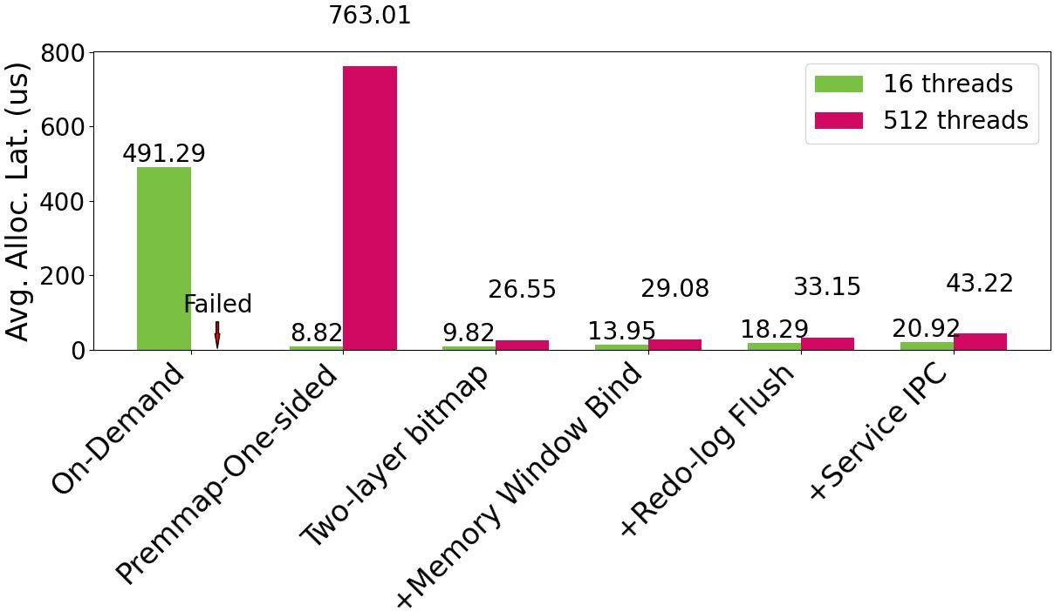
Factor Analysis of FineMem’s Design Mechanisms
Evaluation
Existing work
FineMem
FineMem overheads: MW bind + allocation service + redo-log write ~ 10-20us
Notes:
Client threads 수에 따라 경합 심할 때 latency 관찰
On-demand RPC는 16 th여도 lat 크고, cli th 많아지면 timeout
Premmap-one-sided는 적은 threads 수일 땐 좋지만 경합 심하면 CAS 실패로 인해 lat 급증
FineMem: Two layer bitmap으로 경합 관리 잘함
MW 격리 위해서 MR용 말고 chunk/span/section용 MW의 rkey를 받아오는 1 RTT overhead
Redo-log flush가 critical path에 더해져서 overhead 생김
Mem node의 meta data 접근하는 allocation service와 app간 IPC overhead
다 더해도 기존보다 매우 낮은 latency
수치 말하기

Slide 21


Case Study: Key-value Store System
Evaluation
FUSEE with FineMem as the memory block allocation backend
FineMem
Premmap-RPC
45% memory
cost reduction
Premmap-One-sided
OnDemand-RPC
4KB Block
2MB Block
4
3
3
100
2
3
2
Throughput (Mops)
Throughput (Mops)
Memory (GB)
Throughput (Mops)
2
50
1
1
0
1
0
4KB
2MB
1GB
0
16
32
48
64
80
96
112
128
16
32
48
64
80
96
112
128
Block Size
Client Number
Client Number
YCSB-A (Search:Update=50:50)
Reduces the allocation overheads in KV-update operations
  A bandwidth improvement of around 27% to 110%
Achieves 45% reduction in memory cost with 4KB fine-grained block
Notes:
Key-value store system에서 FUSEE의 블록 할당 부분을 FineMem으로 바꾸고, 검색:업데이트 비율이 1:1인 YCSB-A 워크로드 사용
(왼쪽) 블록 작음: per-block 할당 성능이 좋아야 함 → on-demand한테 불리, premmap-one-sided는 client 수 많아질수록 낮아지는 이유가 CAS 실패해서. Premmap-RPC는 mem node CPU 병목. FineMem은 클라이언트 수에 따라 계속 올라가는 경향.
(중간) 블록 큼: 큰 블록 써도 concurrency 높으면 할당 비용이 성능에 영향 줌 (64 clients 이상).
여기서 수치 말하기 (첫번째 불릿)
(오른쪽) 할당 성능과 MR 크기 사이의 기존 trade-off. 할당 크기가 크면 per-할당 overhead 적은 대신 fragmentation, 작으면 fragmentation 없는 대신 KV store의 ops가 작아짐 → FineMem은 미리 MR 등록을 하고, MW로 나뉜 작은 chunk를 client에게 전달하여 trade-off를 없앰 (여기서 수치 언급, 두번째 불릿)

Slide 22
Case Study: DM-Swap System
Evaluation
Fastswap with FineMem as the dynamic swap-out page allocation backend
150
1.0
200 jobs
125
0.8
10000 jobs
100
0.6
Remote Memory (GiB)
CDF
75
0.4
50
FastSwap
FineMem-Swap
Total Remote Memory
0.2
25
0.0
0
0
1000
2000
3000
4000
5000
6000
−0.05
0.00
0.05
0.10
0.15
0.20
Time(s)
Improvement
Dynamic swap system vs. Static premmap swap system
Higher memory utilization: 41% → 74%
More jobs running concurrently in DM: job throughput improvement 8-11%
Notes:
FastSwap: remote memory를 uniform하게 나눠줌.
(왼) 시간에 따른 remote mem 실제 사용량. 주황 점선이 160 GB.
FastSwap은 1500초 쯤 75GB로 떨어지고 쭉 유지 → fragmentation 때문에 큰 작업들이 할당이 안됨. 자기 몫 32GB보다 큰 작업을 진행하지 못함.
FineMem은 잘 수행해서 전체 작업이 더 빨리 끝나고, 평균 메모리 활용율이 41 → 74%로 오름
(오) 한 번 실행으로는 우연일 수 있어서 작업 구성 비율을 무작위로 한 workload를 많이 만들어서 반복 측정. 초록선은 작은 규모 작업 (160GB 짜리 워크로드 500개), 주황선은 큰 규모 작업 (1280GB 짜리 워크로드 500개). Improvement는 FastSwap 대비 처리량 향상률 (0.1 = 10%). 대체적으로 크고 작은 규모의 모든 작업에서 FineMem은 FastSwamp을 이기는 것을 볼 수 있음. 평균적으로 큰 규모 job에서 8-11%의 처리량 향상을 보임

Slide 23
Summary
Summary
Background
  Existing RDMA-based DM systems face a tough choice
  Either endure significant allocation overheads or accept substantial memory waste
FineMem: A distributed remote memory management system in RDMA-connected DM
To support fine-grained, high-performance memory allocation
  Removing MR registration while overcoming critical isolation challenges
  Enabling one-sided, efficient remote memory chunk allocation
  Maintaining metadata consistency during compute node failures
Evaluation
  FineMem reduces remote memory allocation latency by as much as 95%
  Enables DM systems to achieve low memory waste with minimal overhead
Notes:
Background: 기존 trade-off
FineMem: trade-off 없애겠다 → MR 등록 오버헤드 없애며 격리 문제 해결, one-sided로 효과적인 alloc 자료구조 제작, compute node failure에도 강건한 metadata consistency 유지
Eval: mem alloc latency를 95% 절감, remote memory fragmentation 제거

