Slide 1
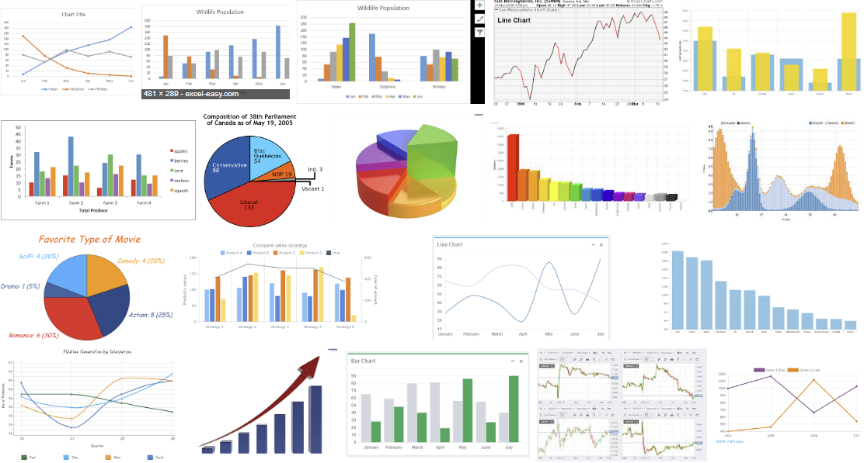


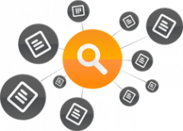
1
Analysis 수행
2
Logging
3
Log Pattern Analysis & Abstraction
4
Log Pattern Visualization을 통한
Recover & Reuse

