Slide 1
AD9910 Meeting
AD9910

Slide 2
DDS chip comparison
DDS Chip | AD9914 | AD9912 | AD9910
Frequency(bit) | 32 – 64 | 48 | 32
Phase(bit) | 16 | 14 | 16
Amplitude(bit) | 12 | X | 14
DAC(bit) | 12 | 14 | 14
Max Out Freq | 1.4 GHz | 400 MHz | 400 MHz
Max Sys Freq | 3.5 GHz | 1 GHz | 1 GHz
SYNC_IN | O | X | O
IO_UPDATE | Only pin | Pin and register write | Only pin
Multiple Profile | O | X | O
Parallel mode | O | X | O
Register data | Parallel(10ns) & Serial(SPI) | Serial(SPI) | Serial(SPI)
SPI speed | 80MHz | 70MHz | 50MHz
Price(Won) | 250,000 | 80,000 | 80,000
No Amplitude control
No internal synchronize functionality

Slide 3
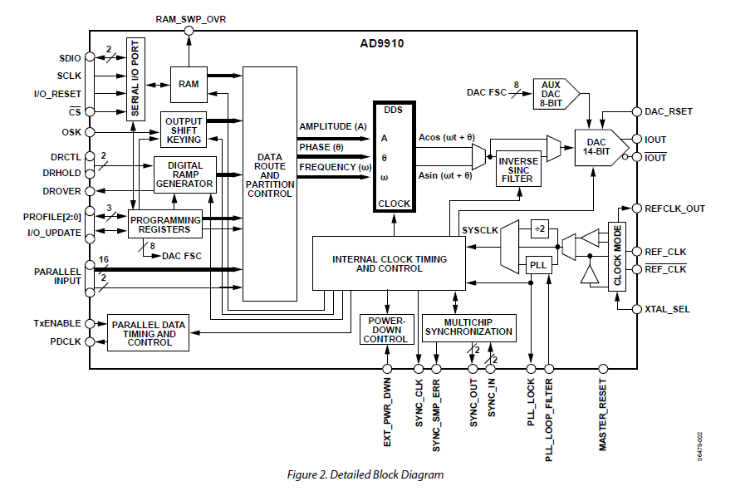
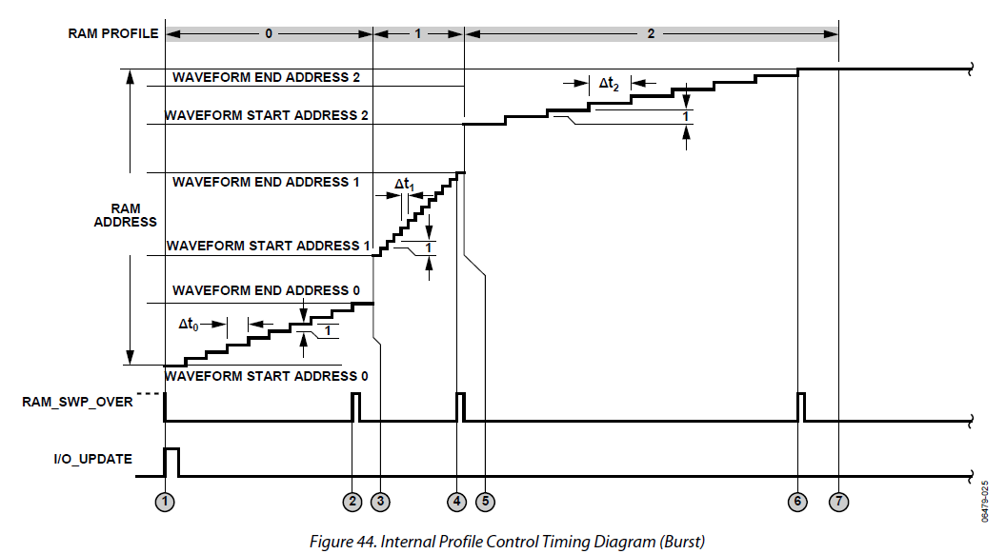
AD9910
4 mode available
Single ton mode (8 profile)
Ram mode (32 * 1024 RAM)
Parallel mode (real time parameter supply)
DRG mode

Slide 4
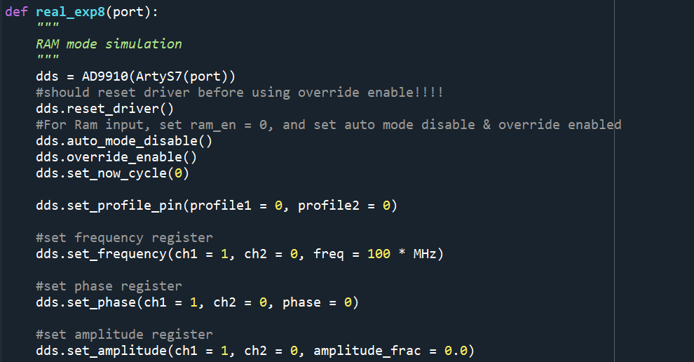
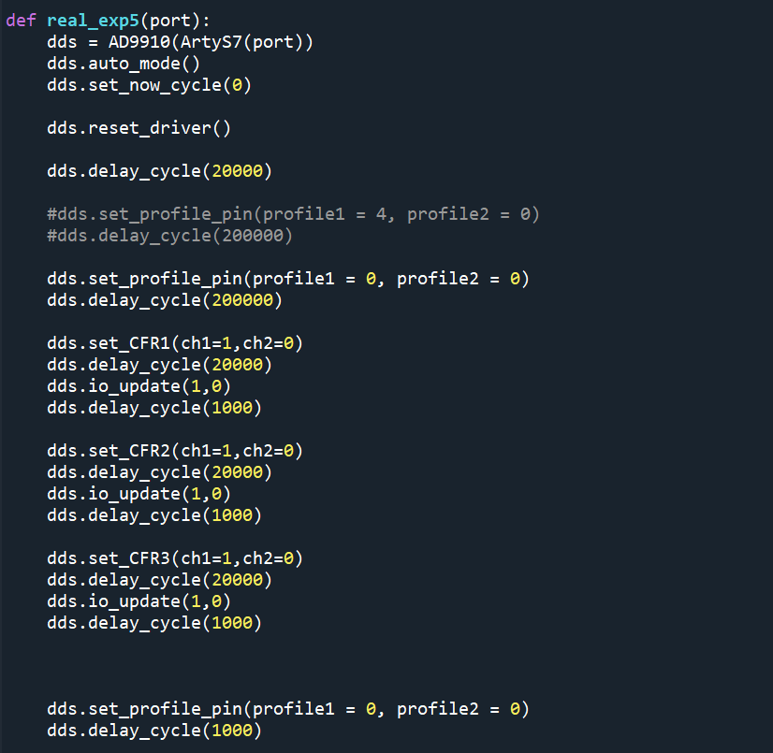
Mode
-Override
-Auto

Slide 5
RAM mode is possible
Profile Pin issue
-IO update -> 10ns uncertainty
-Gray Code -> Works well

Slide 6
Artiq Style Code
dds.delay_cycle(10000)
dds.set_frequency(ch1=1,ch2=0,freq=100*MHz)
dds.delay_cycle(10000)
dds.io_update(ch1 = 1,ch = 0)
dds.delay_cycle(1000)

Slide 7
Example Code (auto mode)
def exp1():
dds = AD9910(ArtyS7('COM12’), min_freq = 10 * MHz, max_freq = 400 * MHz, sys_clk = 1000 * MHz,
dest_val = 1, auto_en = False)
dds.reset_driver()
dds.auto_mode()
dds.set_profile_register(ch1 = 1, ch2 = 1, freq = 50 * MHz, phase = 0 * RAD,
amplitude = 1.0, profile = 0)
dds.delay_cycle(10000)
dds.set_profile_register(ch1 = 1, ch2 = 1, freq = 100 * MHz, phase = 0 * RAD,
amplitude = 1.0, profile = 1)
dds.delay_cycle(10000)
dds.set_profile_pin(profile1 = 1, profile2 = 0)
dds.auto_start()
UartRx
reset_driver
set_profile_register
set_profile_register
set_profile_pin
auto_start
counter
0
10000
20000
CSB
profile
0
1

Slide 8
RAM write functionality(1)
#set profile pin
dds.set_profile_pin(profile1 = 0, profile2 = 0)
#set ram profile to bidirectional ram mode with start address 0 to
#end address 16 with step rate 20
dds.set_ram_profile_register(ch1 = 1, ch2 = 0, addr_step_rate =2000,
end_addr= 10,
start_addr=0, no_dwell_high=0, zero_crossing=0,
ram_mode_ctrl=2, profile=0)
...
dds.set_ram_profile_register(ch1 = 1, ch2 = 0, addr_step_rate =2000,
end_addr= 87,
start_addr=77, no_dwell_high=0, zero_crossing=0,
ram_mode_ctrl=2, profile=7)

Slide 9
RAM write functionality(2)
freq_list = [ 100*MHz, 120*MHz, 140*MHz, 160*MHz, 180*MHz, 200*MHz, 220*MHz, 240*MHz,
260*MHz, 280*MHz, 300*MHz]
dds.set_profile_pin(profile1 = 0, profile2 = 0)
dds.io_update(1,0)
dds.ram_write_frequency(ch1 = 1, ch2 = 0, data_list = freq_list)
dds.io_update(1,0)
...
dds.set_profile_pin(profile1 = 7, profile2 = 0)
dds.io_update(1,0)
dds.ram_write_frequency(ch1 = 1, ch2 = 0, data_list = freq_list)
dds.io_update(1,0)

Slide 10
RAM write functionality(3)
###########################################################################
#set ram_en = 1
###########################################################################
dds.set_CFR1(ch1=1,ch2=0, ram_en = 1, ram_playback = 0, manual_OSK = 0,
inverse_sinc_filter = 0, internal_porfile = 0, sine = 1,
load_LRR = 0, autoclear_DRG = 0, autoclear_phase = 0,
clear_DRG = 0, clear_phase = 0, load_ARR = 0, OSK_en = 0,
auto_OSK = 0, digital_power_down = 0, DAC_power_down = 0,
REFCLK_powerdown = 0, aux_DAC_powerdown = 0,
external_power_down_ctrl = 0, SDIO_in_only = 0,
LSB_first = 0)
dds.io_update(1,0)

Slide 11
TTL Module?
-TTL module should be added to current ArtyS7 Verilog Code
(takes ~1-2week?)
-No CPU moduel in current AD9910 Verilog Code
(Only AD9910 Control)
Other Option : RFSoC?
-> TTL(1,8ns resolution), DDS(2GHz, x8) is possible
-> CPU can be utilized

Slide 12
