Slide 1
DDS Debugging3
AD9910 in real experiment

Slide 2
Ground Loop Problem1
2023/11/23 -> Profile signals are not maintained due to ground loop voltage?
PC PWR
multitap1 PWR
multitap2 PWR
Chassis
Sequencer
AD9910
Oscilloscope
PWR
Profile Signal
PWR
DDS output
PWR
GND
GND
GND
Chassis
ArtyS7
PWR
Large Ground Loop Voltage
GND
PC GND
multitap1 GND
multitap2 GND

Slide 3

Ground Problem
PC PWR
multitap1 PWR
2. Mechanical Impact
(Human walks makes
induced voltage ~ 10V[1])
Chassis
Sequencer
Device
PWR
PWR
GND
GND
Chassis
1. Large Current Change I
PC GND
multitap1 GND
V
[1]ICHIKAWA, N. (2016). Investigation of human body potential measured by a non-contact measuring system. Industrial Health, 54(6), 542–549. https://doi.org/10.2486/indhealth.2016-0008

Slide 4
Experiment condition
multitap1 PWR
PC PWR
Chassis
Sequencer
PWR
1
~1V
GND
IN
GND
OUT
2
~6V
Chassis
PC GND
ArtyS7
Not Connected ?
PWR
V
multitap1 GND
3
~1V
GND
IN
GND
OUT
Almost floating
N

Slide 5


Professors's Solution(e.g. Chassis)
Multitap PWR
COMMON PWR
PC
Sequencer
Device
PWR
PWR
PWR
Isolator
GND
GND
GND
Multitap GND
COMMON GND

Slide 6
For AD9910
파워 공급은 어떻게?
Multitap PWR
COMMON PWR
PC
Sequencer
AD9910
Oscilloscope
PWR
PWR
PWR
PWR
Isolator
GND
GND
GND
ArtyS7
PWR
Isolator
GND
GND
Multitap GND
COMMON GND
(e.g. Experiment Desk)
Is it dangerous?

Slide 7
For long signal lines
-Use isolator?

Slide 8
Artiq Power ground scheme
12V
GND
PWR
Kasli
AD9910
BNC
?

Slide 9
https://electronics.stackexchange.com/questions/149643/physically-how-does-connecting-a-pcb-to-chassis-ground-reduce-noise

Slide 10
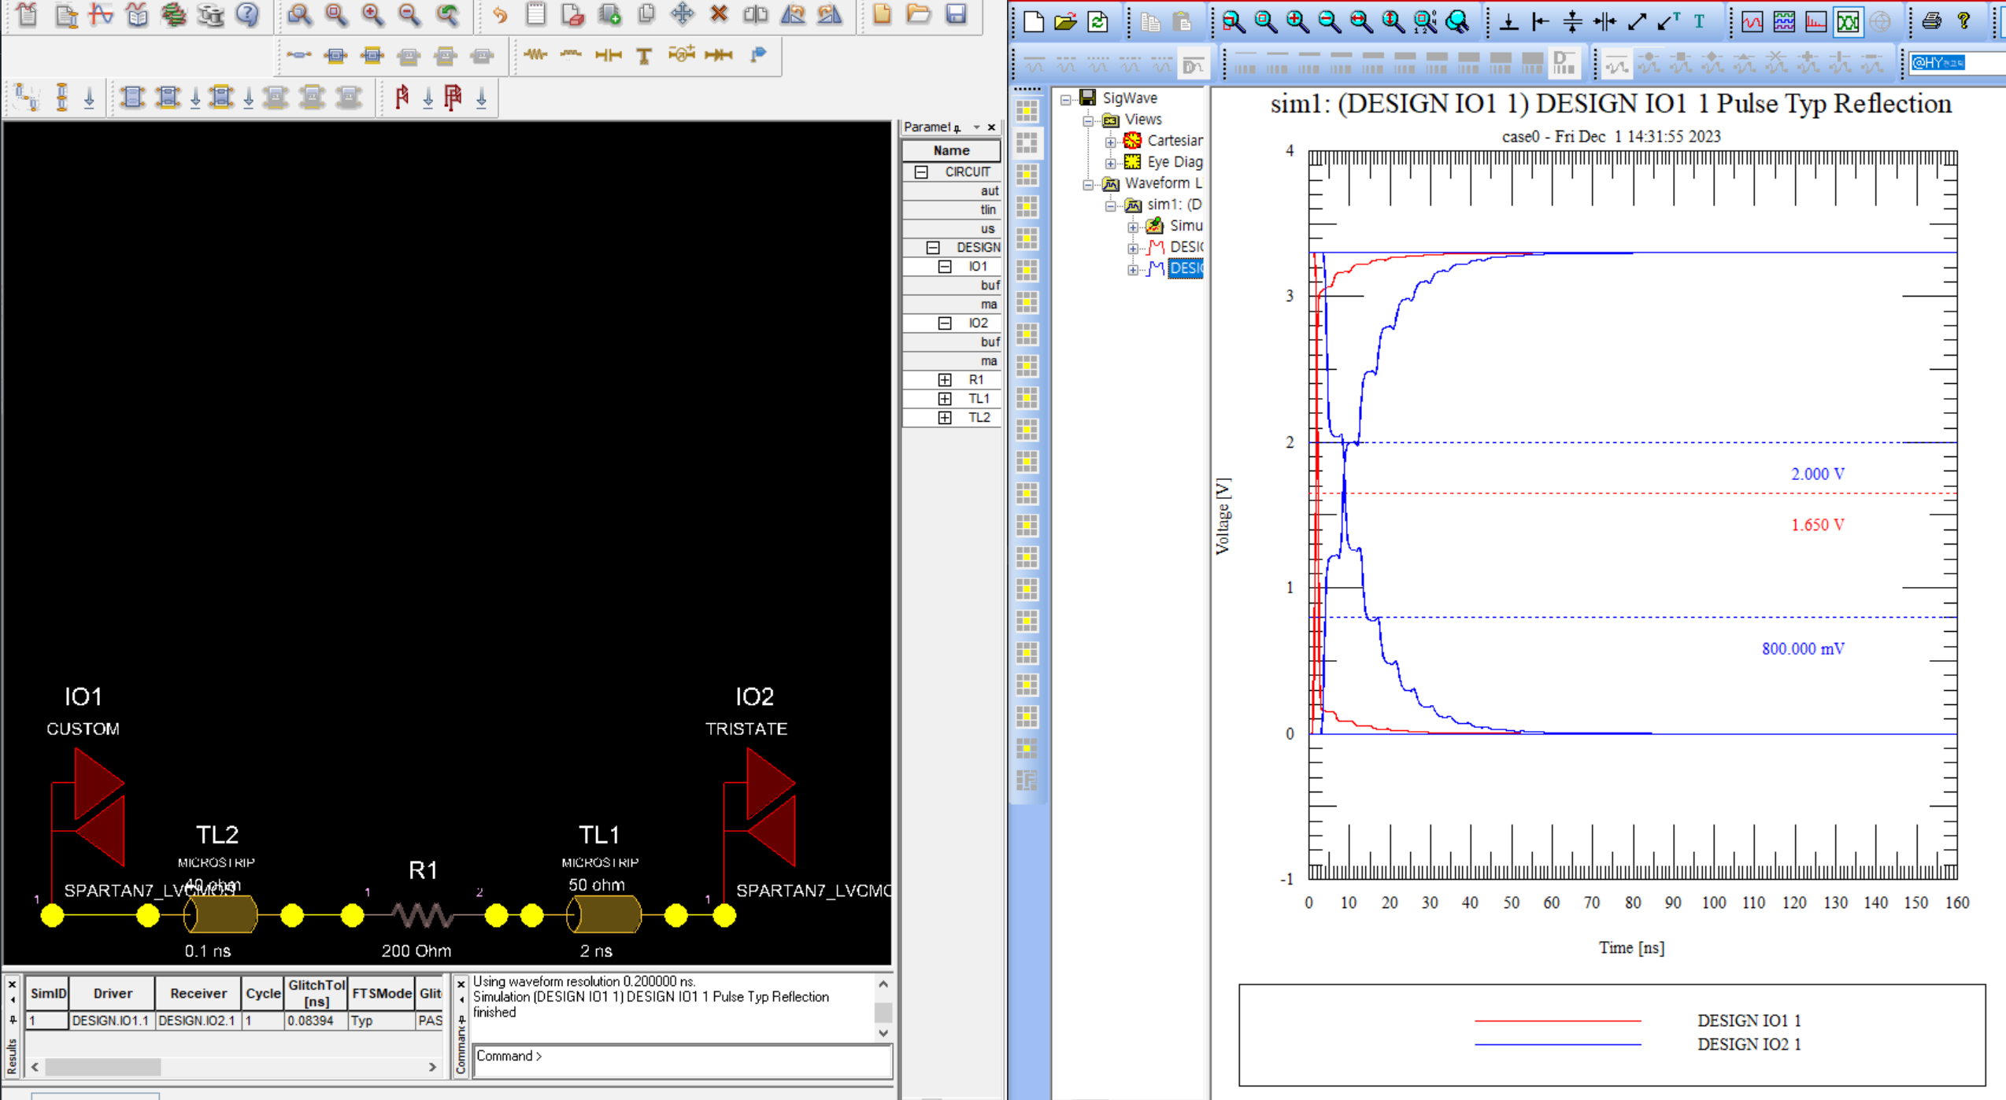
6.25MHz SPI Simulation

Slide 11
Pin
VCC | GND | ja_3 CSB2 | ja_2 T_STR | ja_1 T_STP | ja_0 GPI
VCC | GND | ja_7 SDIO1 | ja_6 SCK | ja_5 CSB1 | ja_4 SDIO2
GND | PROF1[2] jb_7
GND | PROF1[1] jb_6
GND | PROF1[0] jb_5
GND | IO_UPDATE1 ja_7
GND | IO_UPDATE2
GND | PROF2[0]
GND | PROF2[1]
GND | PROF2[2]
GND | RESET1
GND | SDIO1 ja_6
GND | SCLK1 ja_3
GND | CSB1 ja_5
GND | CSB2
GND | SCLK2
GND | SDIO2
GND | RESET2
VCC | GND | jb_3 IOUP2 | jb_2 P2[0] | jb_1 P2[1] | jb_0 P2[2]
VCC | GND | jb_7 P1[2] | jb_6 P1[1] | jb_5 P1[0] | jb_4 IOUP1

Slide 12
Trigger mode
Trigger ready
command
Trigger start
Trigger data write
command
BRAM
FIFO
Trigger data clear
command
Trigger stop

Slide 13
Trigger Mode
Start
Stop
profile
0
1
2
3
0
1
2
3
4
5
0
1
2
3
4
5
timestamp

