Slide 2
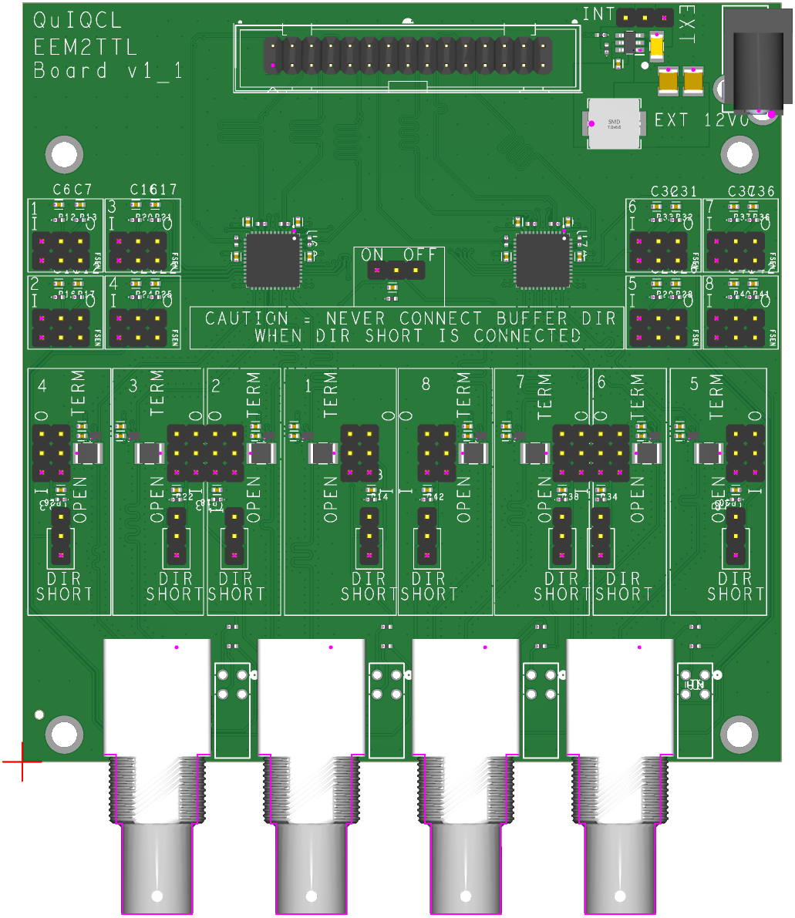
7
1
2
8
3
9
6
A
4
5

Slide 3
Callout Number | Function
1 | Power source selection
2 | External power pin
3 | Transciever direction selection
 | Transciever FSEN option selection
4 | Buffer direction selection
 | Buffer termination selection
5 | Transciever, buffer direction short selection
6 | Board power on/off
7 | EEM interface pins
8 | Buck Converter
9 | SN65MLVD040RGZ Transciever
A | SN74LXC1T45DRYR Buffer

