Slide 1
RFSoC Meeting
RFSoC Procedure

Slide 2
Summary of Procedure
Minimal RFSoC Latency ~100ns
DDS using Xilinx dds_compiler implemented
Automatic TCL creation
Automatic Verilog Code indexing

Slide 3
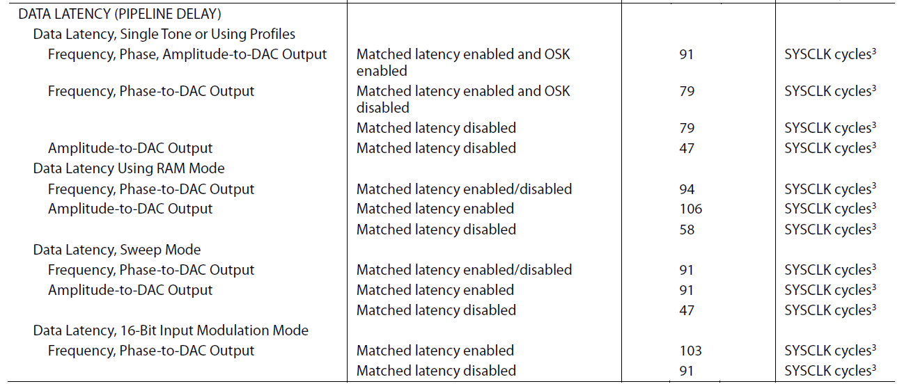
AD9910 Latency

Slide 4
Vivado Simulation for RFSoC...
i5-8400 (QuIQCL)
takes 90mins to start sim
i7-10700H
takes 30mins to start sim
-> Better CPU, faster simulation

Slide 5
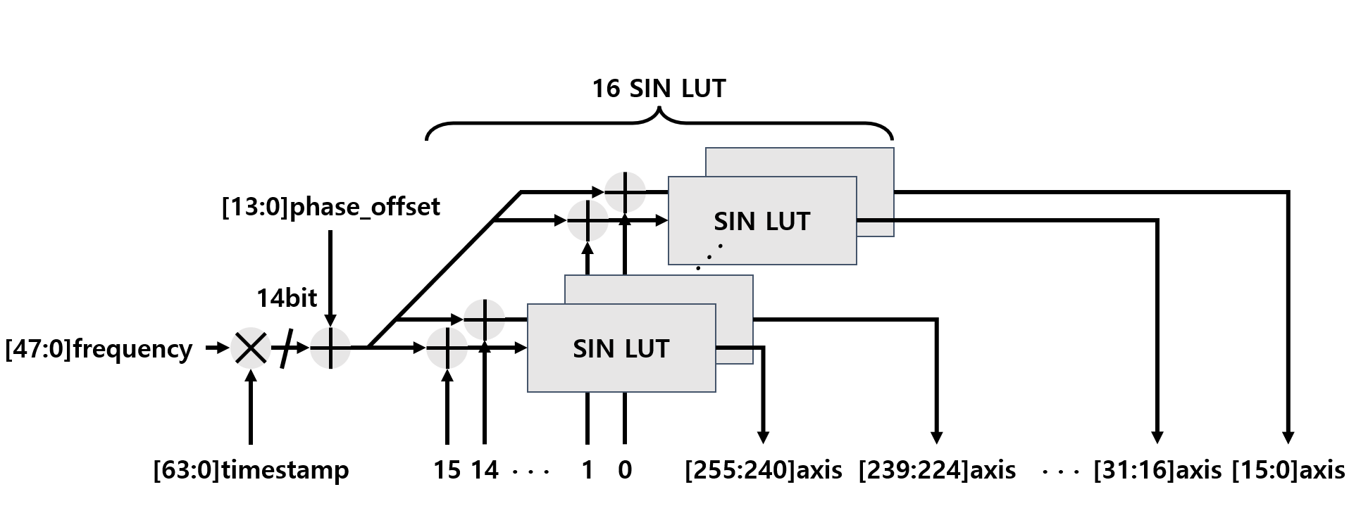
DDS Strucuture

Slide 6
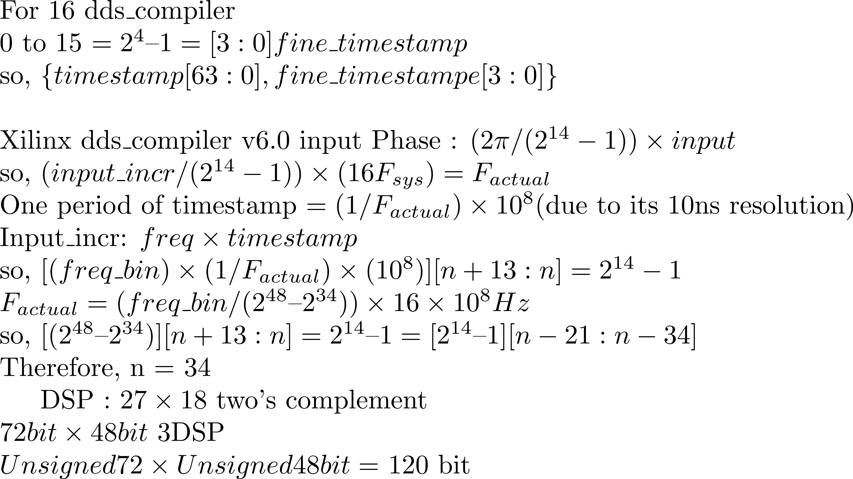
DDS in Verilog

Slide 7
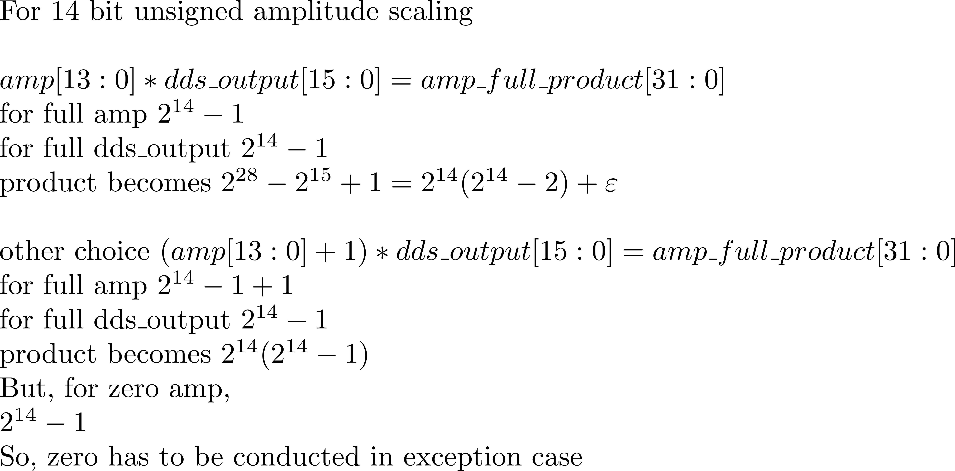
DDS in Verilog (2)

Slide 8
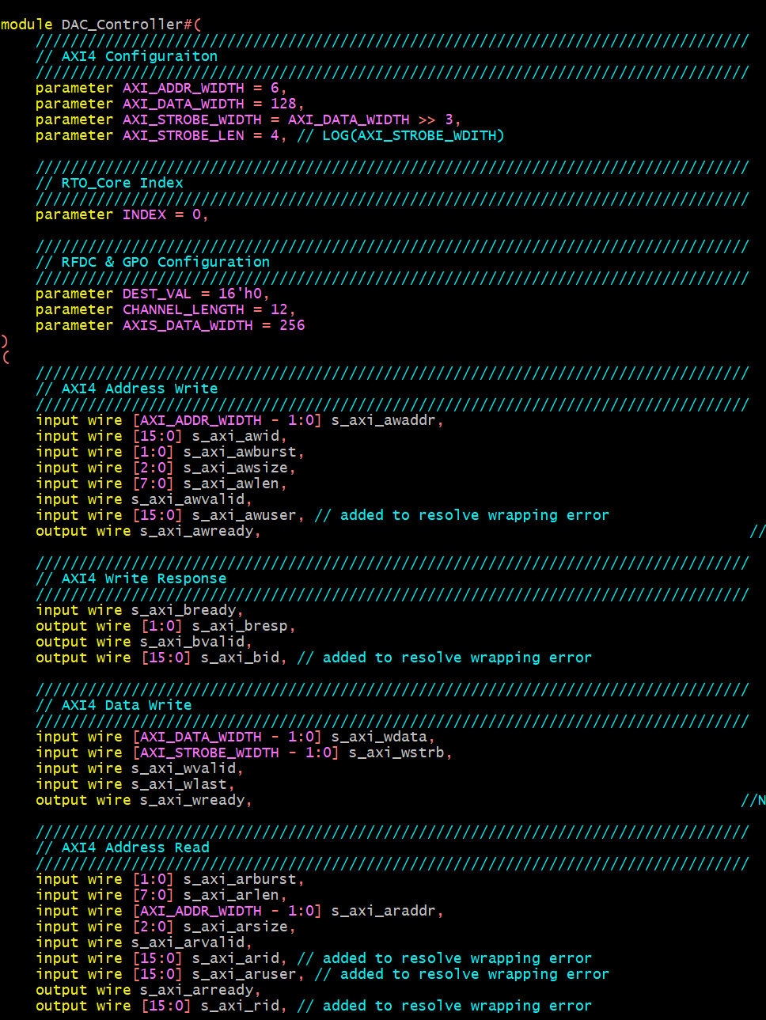
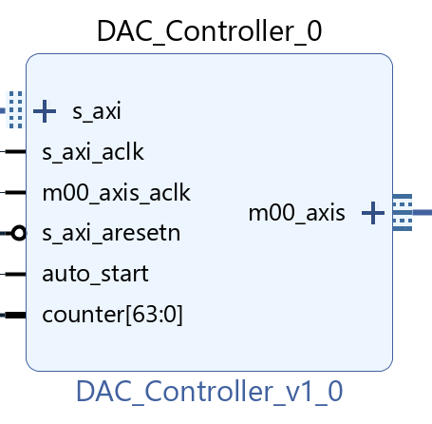
Vivado Custom IP

Slide 9
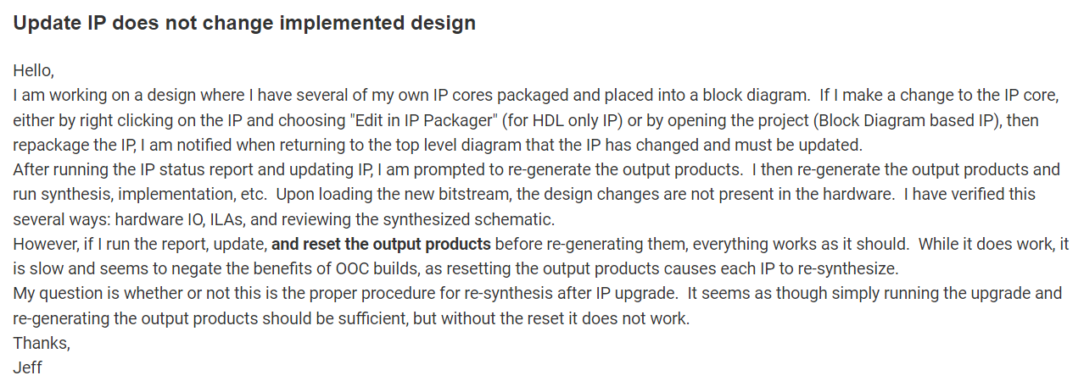
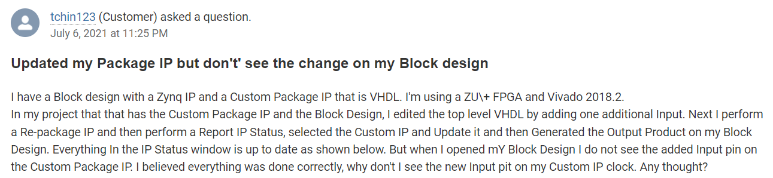
Vivado TCL
Custom IP update bug(?) in Vivado
https://support.xilinx.com/s/question/0D52E00006hpbx3SAA/update-ip-does-not-change-implemented-design?language=en_US
https://support.xilinx.com/s/question/0D52E00006hpRTFSA2/updated-my-package-ip-but-dont-see-the-change-on-my-block-design?language=en_US

Slide 10
Vivado TCL Control
/ip_src_dir
ip1.sv
ip2.sv
ip3.sv
/main_dir
ip.tcl
ip3.xdc
/prj_dir
/ip_out_dir
main.tcl
blk.bd
prj.xpr
ip.xic
ip.xml
ip.xpr

Slide 11
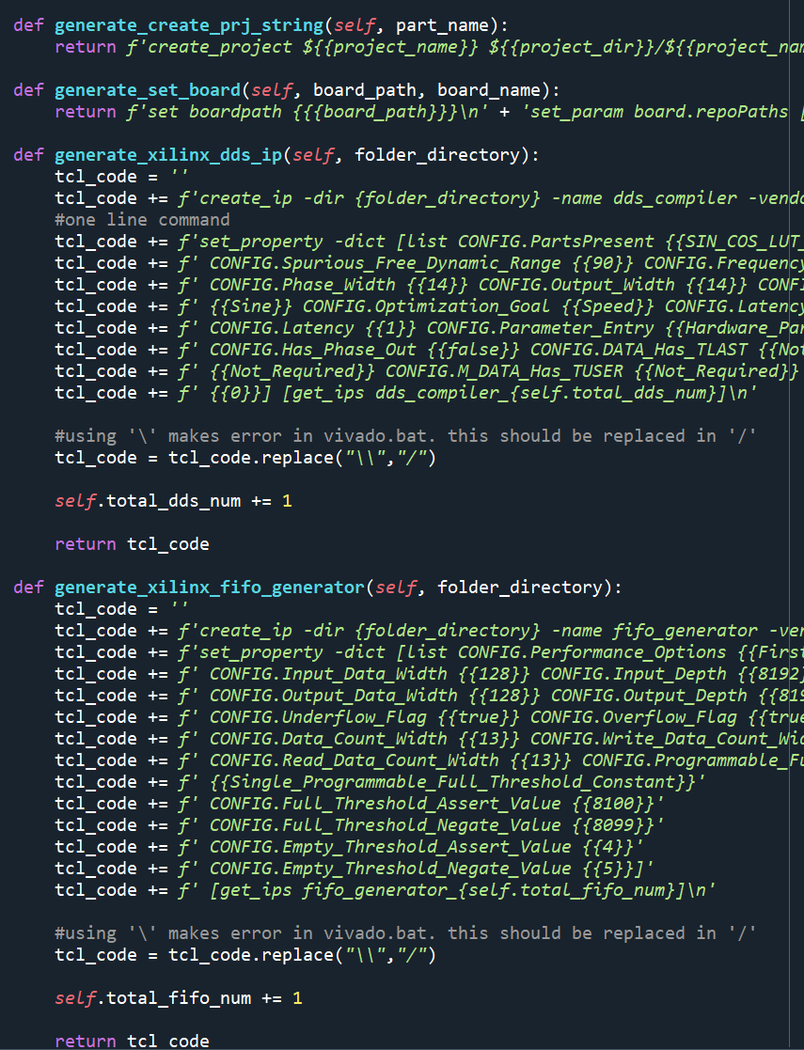

Custom IP Creation
/ip_src_dir
ip1.sv
ip2.sv
ip3.sv
ip.tcl
Call Vivado in python
/ip_out_dir
ip.xic
ip.xml
ip.xpr

Slide 12
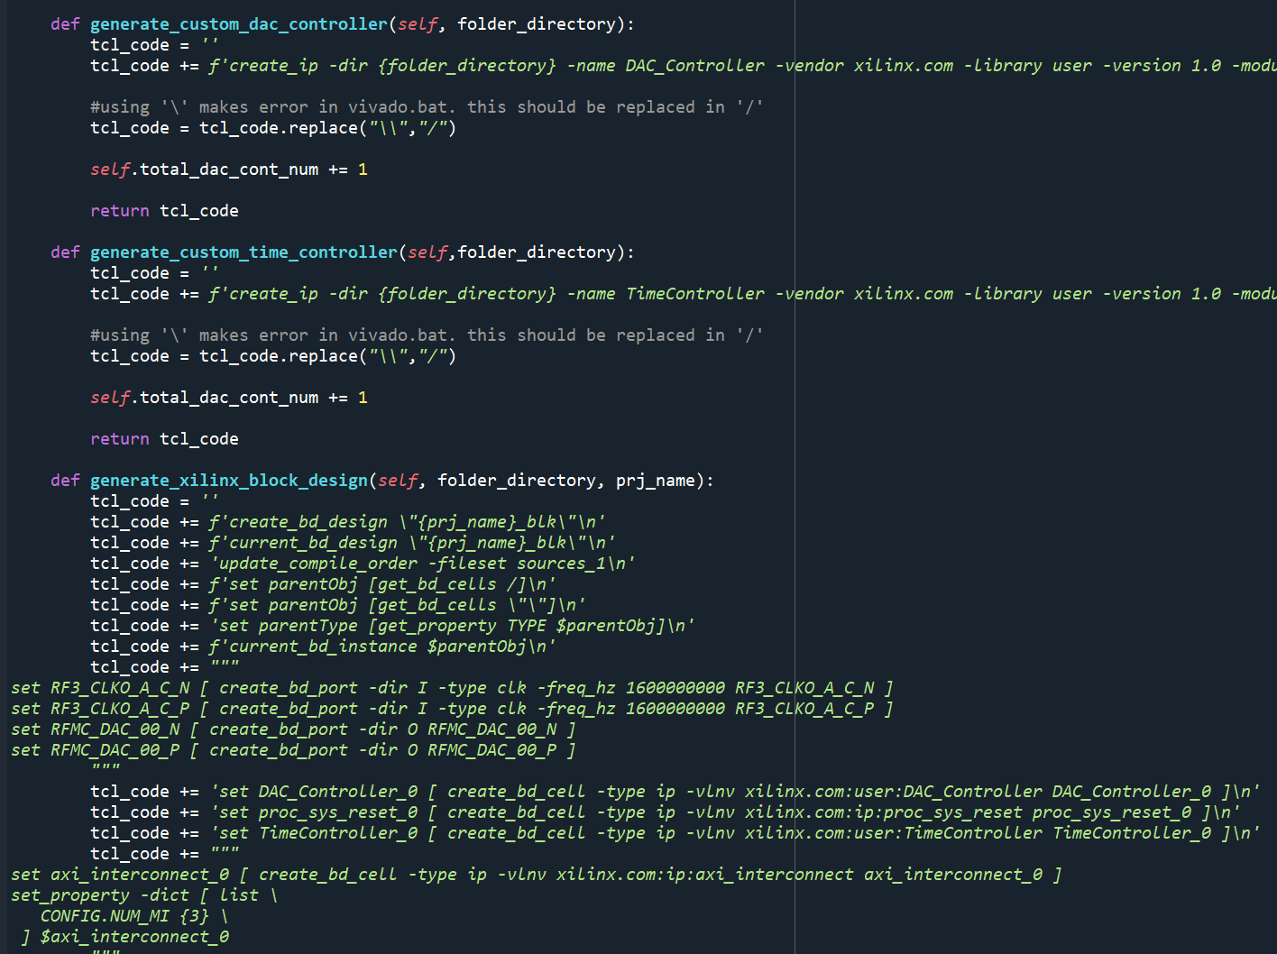
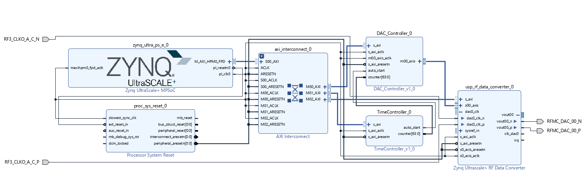
Block Design Creation
/main_dir
/ip_out_dir
ip3.xdc
ip.xic
ip.xml
ip.xpr
main.tcl
Call Vivado in python
/prj_dir
blk.bd
prj.xpr

Slide 13
Created Block Design Example

Slide 14
Xilinx IP Duplication Problem
/ip_src_dir
fifo0.xic
ip.sv
/ip_out_dir
ip.xic
ip.xml
ip.xpr

Slide 15
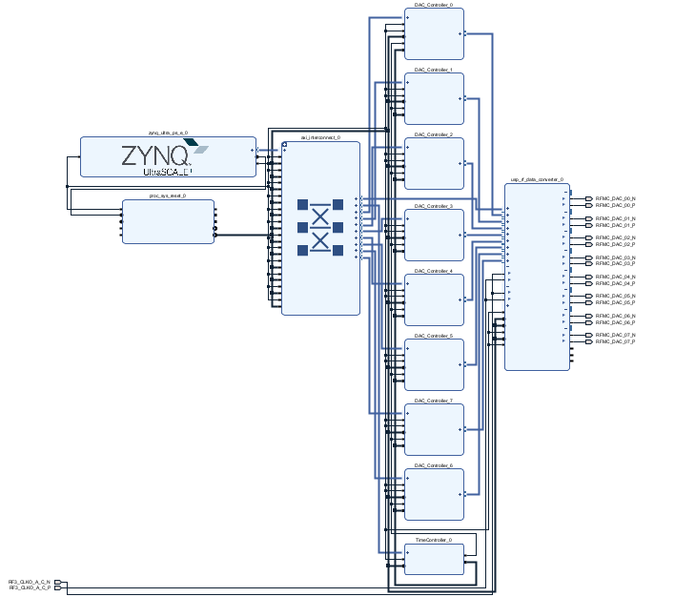
Automatic Verilog Indexing
/ip_src_dir
fifo.xic
ip.sv
/ip0_src_dir
/ip0_src_dir
fifo0.xic
ip0.sv
fifo1.xic
ip0.sv
. . .

Slide 16
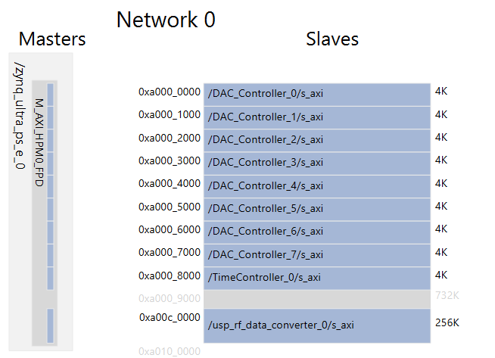
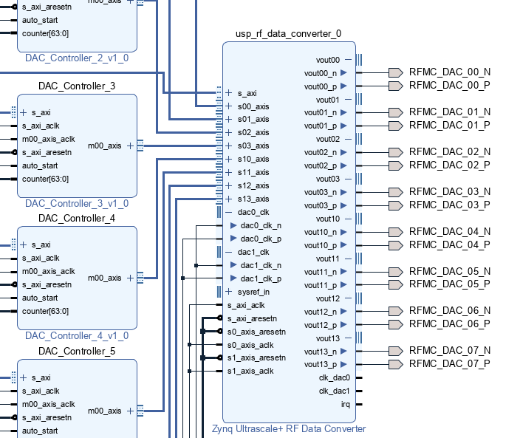
Created Design

Slide 17
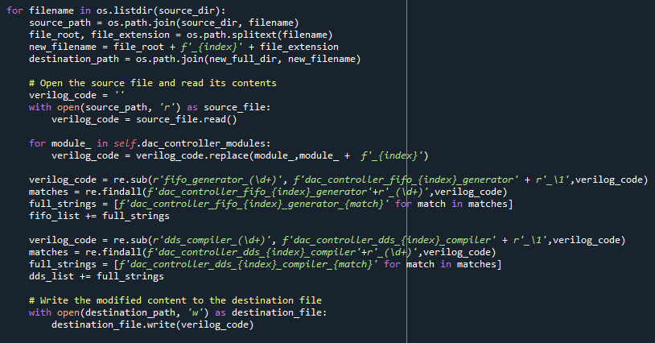
Automatic Verilog Indexing Code

Slide 18
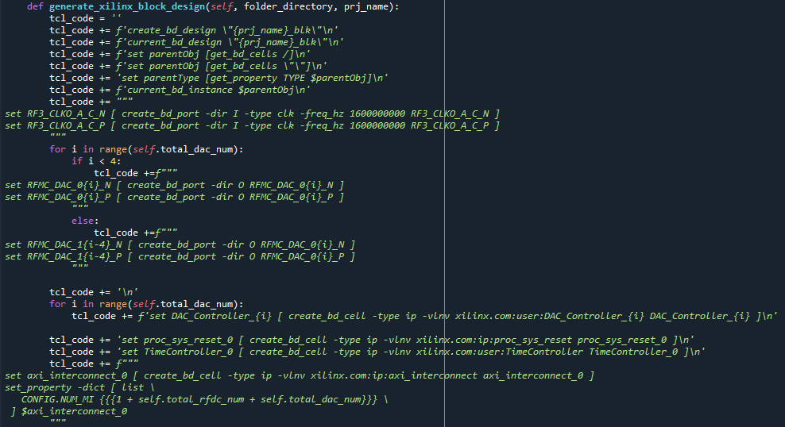
Making TCL based on created Verilog Code(1)

Slide 19
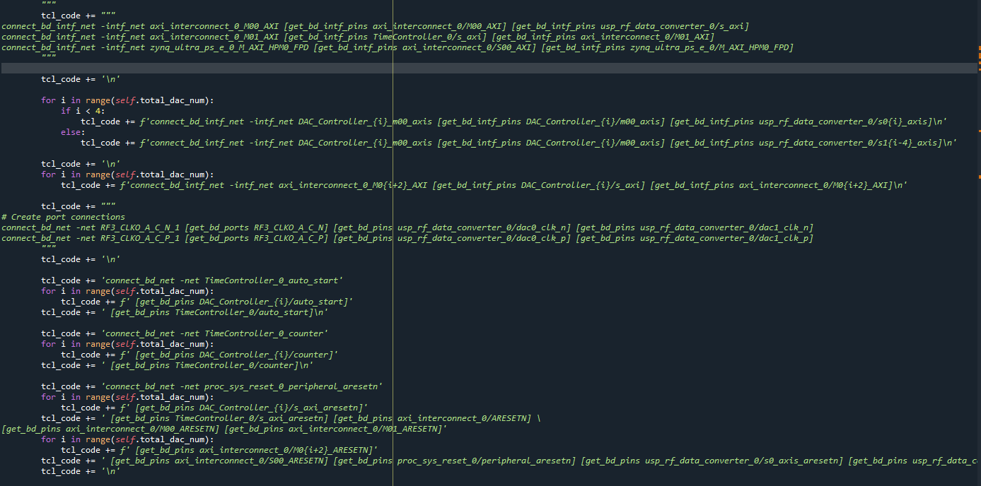
Making TCL based on created Verilog Code(2)

Slide 20
Making TCL based on created Verilog Code(3)

Slide 21
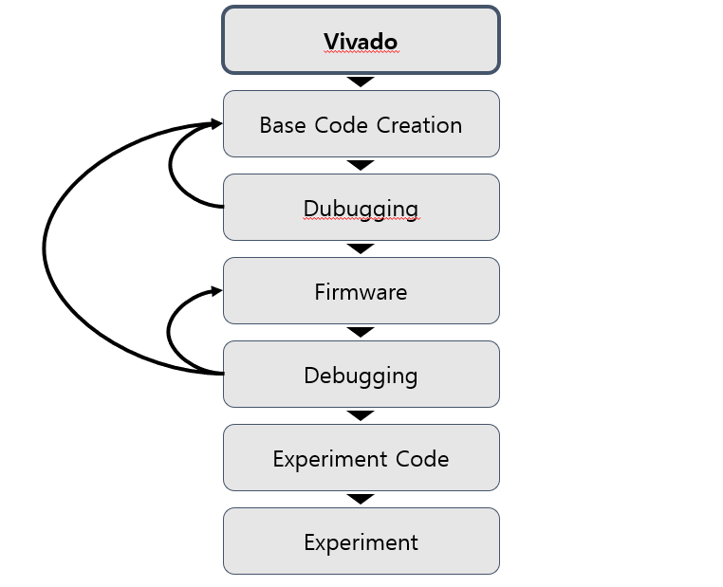
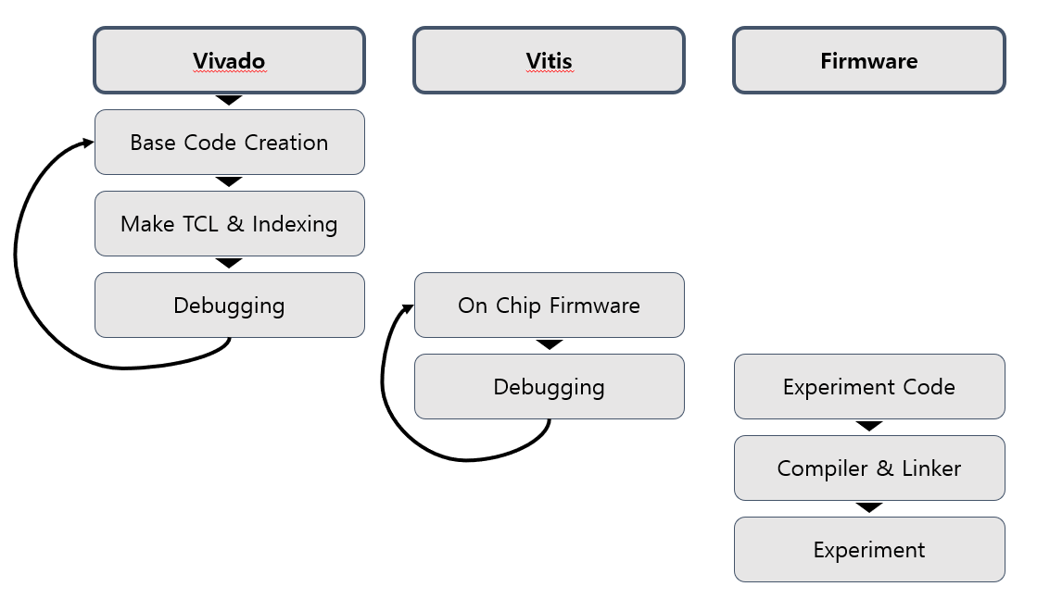
Experiment Device Creation Procedure
-Increased Scalability
-Reduced Dependency on Verilog Code in Experiment Code
-Thanks to MMIO based Zynq

