Slide 1
RFSoC Meeting
RFSoC Procedure

Slide 2
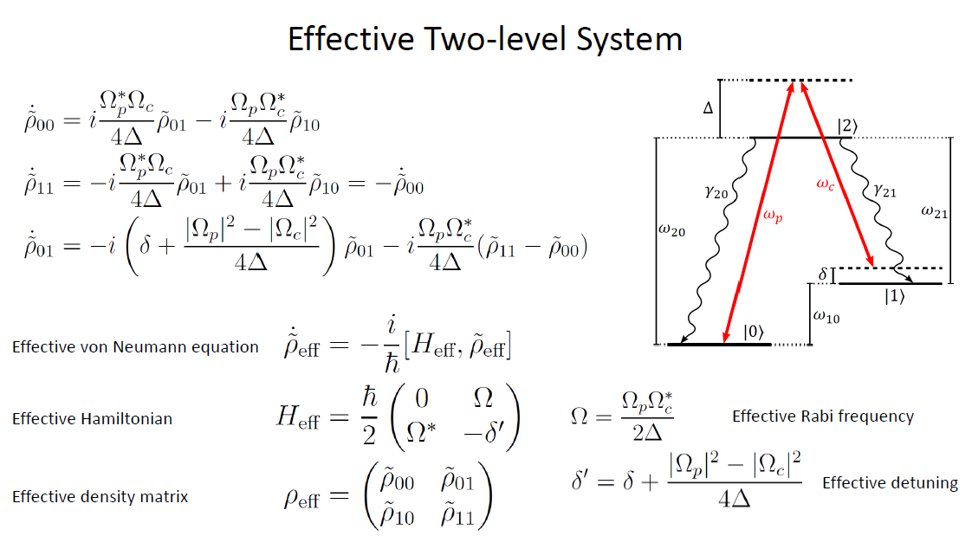
Raman Transition Frame Rotation

