Slide 1
RFSoC Meeting
RFSoC Procedure

Slide 2
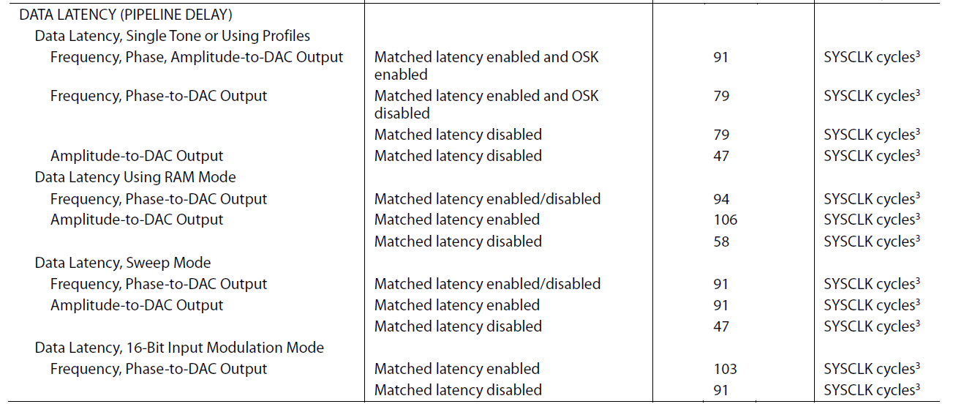
AD9910 Latency

Slide 3
Vivado Simulation for RFSoC...
i5-8400 (QuIQCL)
takes 90mins to start
i7-10700H
takes 30mins to start
-> Better CPU, faster simulation

