Slide 1
RFSoC Meeting
RFSoC Procedure

Slide 2
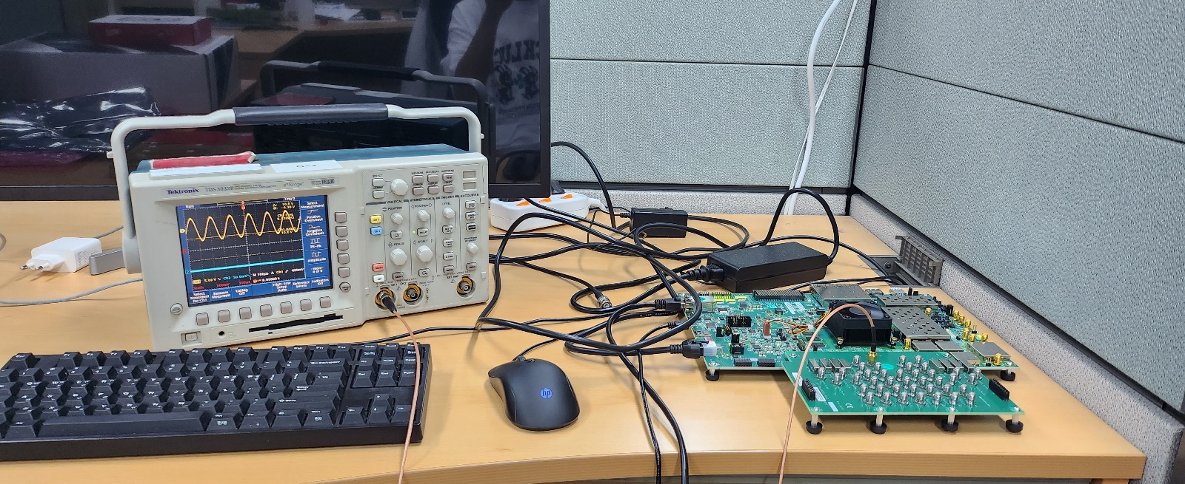
Simple DDS Experiment

Slide 3
Consideration
Notice that CPU is 64 bit based

Slide 4
Device Concepts
Exp.py
Exp.c
Exp.elf
TCP
RFSoC
While(True):
Get elf file
Do elf file

