Slide 1
RFSoC Meeting
RFSoC Procedure

Slide 2
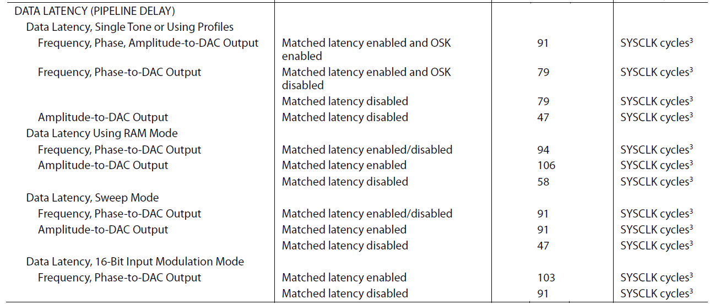
AD9910 Latency

Slide 3
Vivado Simulation for RFSoC...
i5-8400 (QuIQCL)
takes 90mins to start sim
i7-10700H
takes 30mins to start sim
-> Better CPU, faster simulation

Slide 4
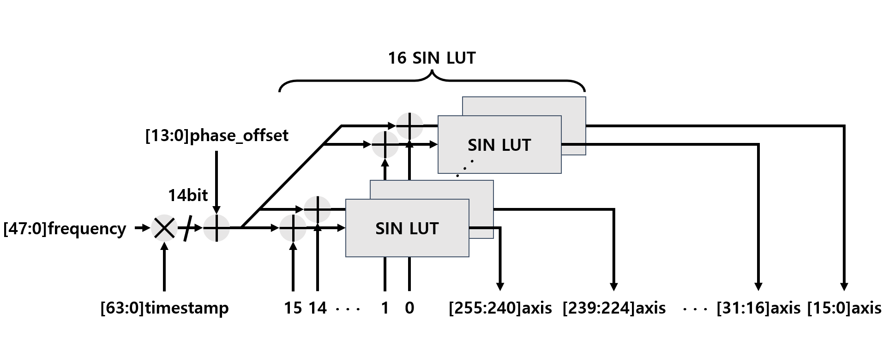
DDS Strucuture

Slide 5
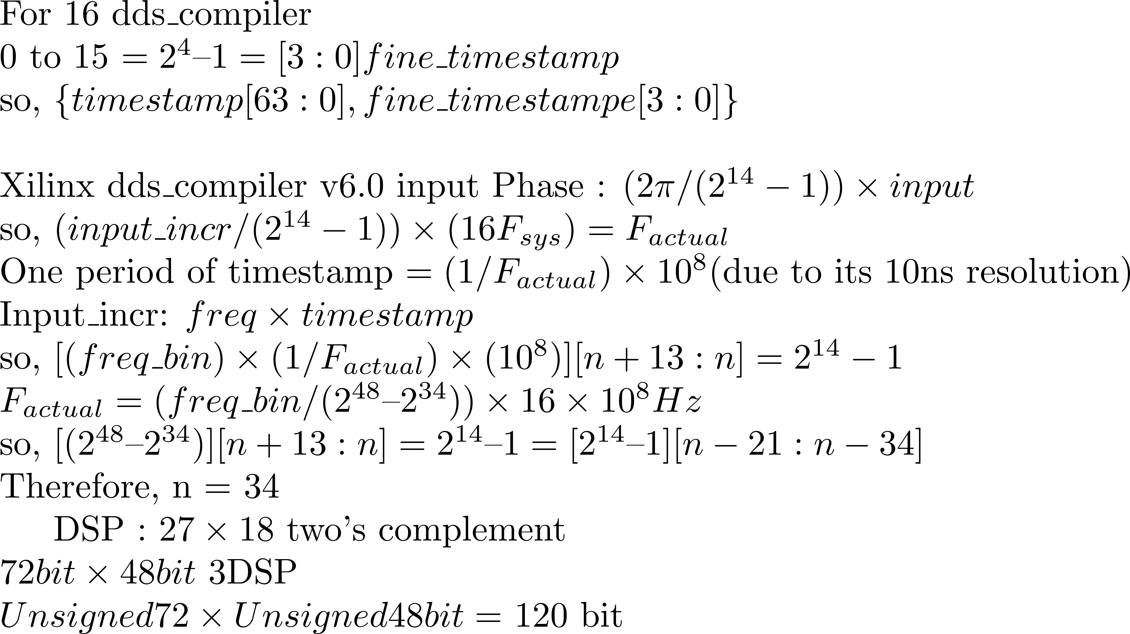
DDS in Verilog

Slide 6
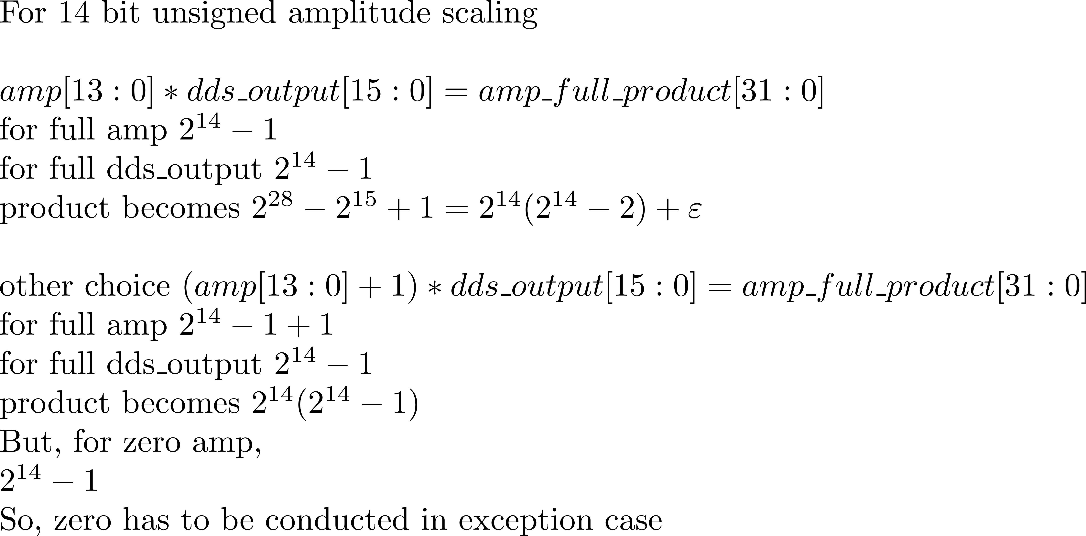
DDS in Verilog (2)

Slide 7
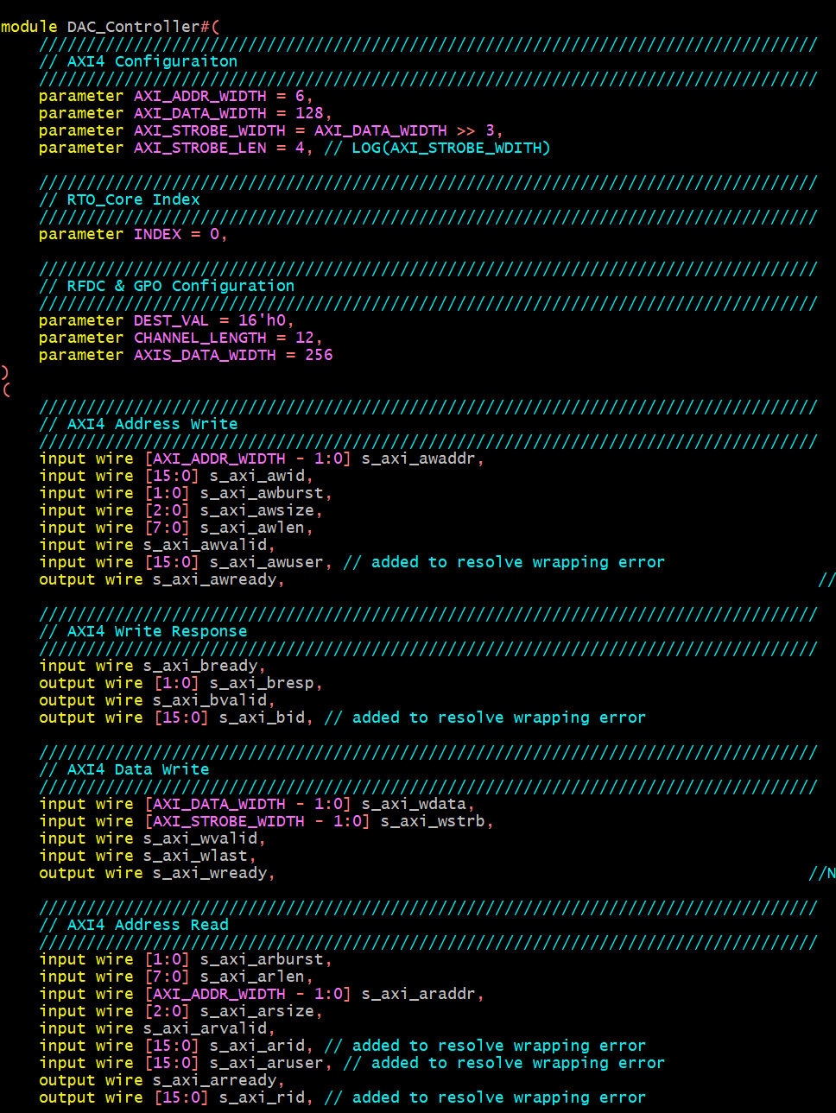
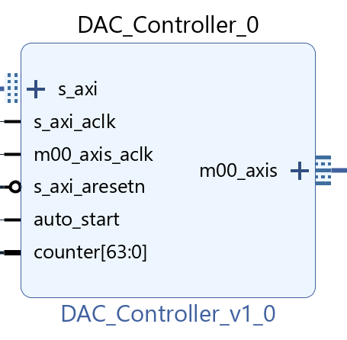
Vivado Custom IP

Slide 8
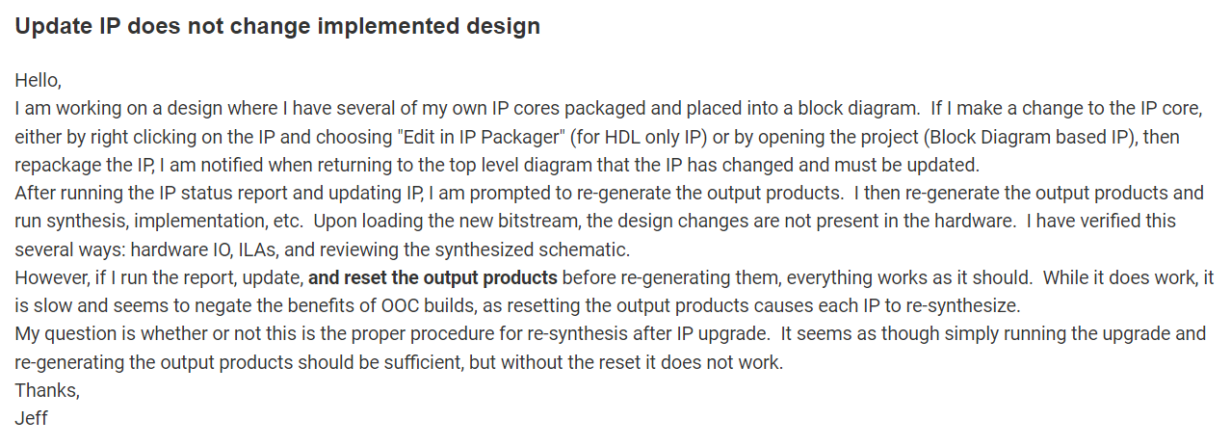
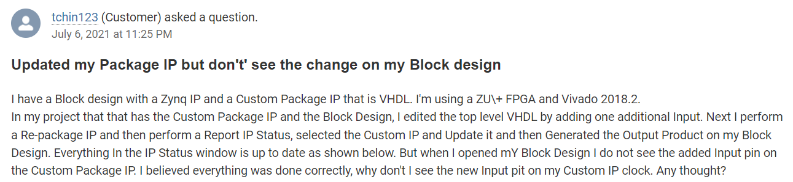
Vivado TCL
Custom IP update bug(?) in Vivado
https://support.xilinx.com/s/question/0D52E00006hpbx3SAA/update-ip-does-not-change-implemented-design?language=en_US
https://support.xilinx.com/s/question/0D52E00006hpRTFSA2/updated-my-package-ip-but-dont-see-the-change-on-my-block-design?language=en_US

Slide 9
Vivado TCL Control
/ip_src_dir
ip1.sv
ip2.sv
ip3.sv
/main_dir
ip.tcl
ip3.xdc
/prj_dir
/ip_out_dir
main.tcl
blk.bd
prj.xpr
ip.xic
ip.xml
ip.xpr

Slide 10
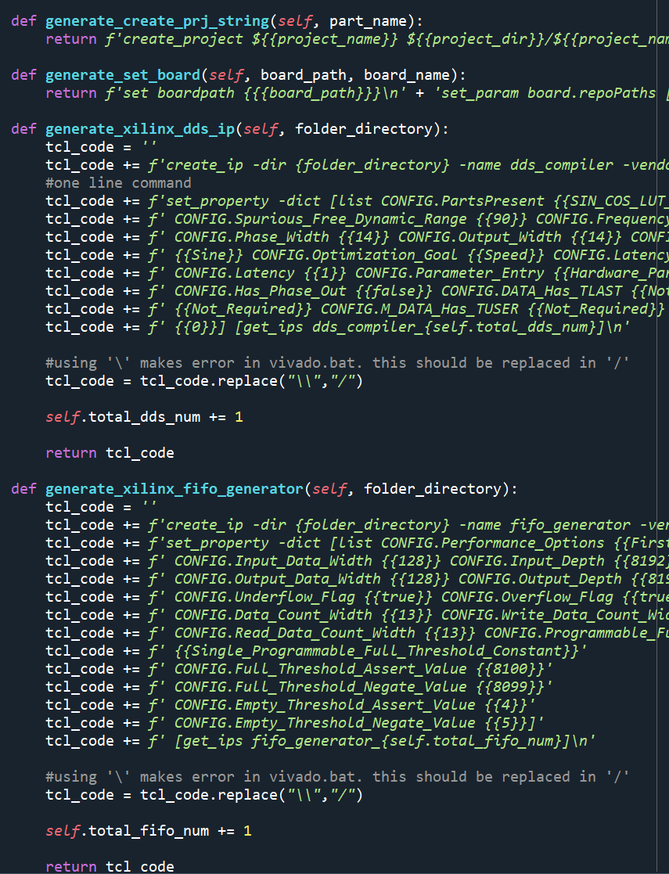

Custom IP Creation
/ip_src_dir
ip1.sv
ip2.sv
ip3.sv
ip.tcl
Call Vivado in python
/ip_out_dir
ip.xic
ip.xml
ip.xpr

Slide 11
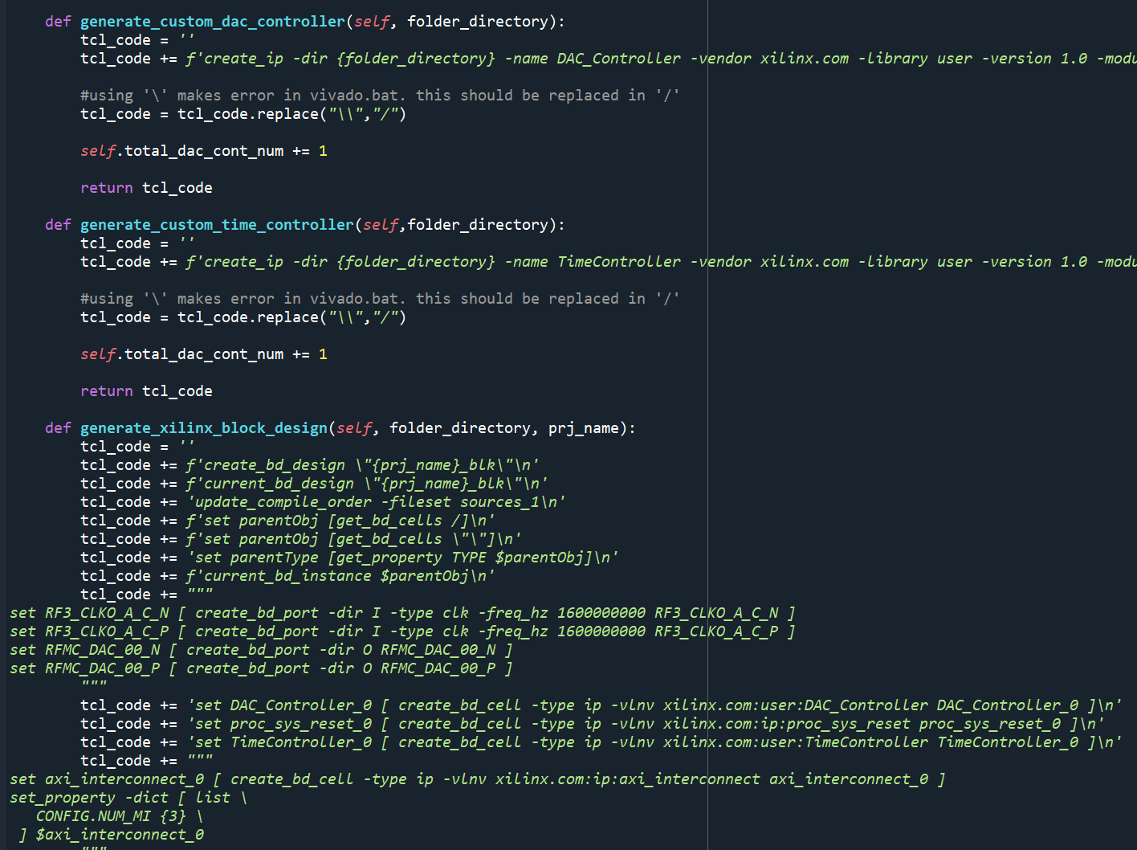
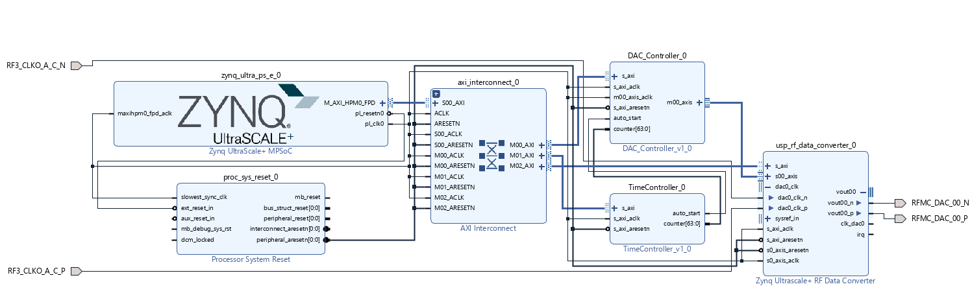
Block Design Creation
/main_dir
/ip_out_dir
ip3.xdc
ip.xic
ip.xml
ip.xpr
main.tcl
Call Vivado in python
/prj_dir
blk.bd
prj.xpr

Slide 12
Created Block Design Example

