Slide 1
RFSoC
20230310 Meeting

Slide 2
About RFSoC

Slide 3
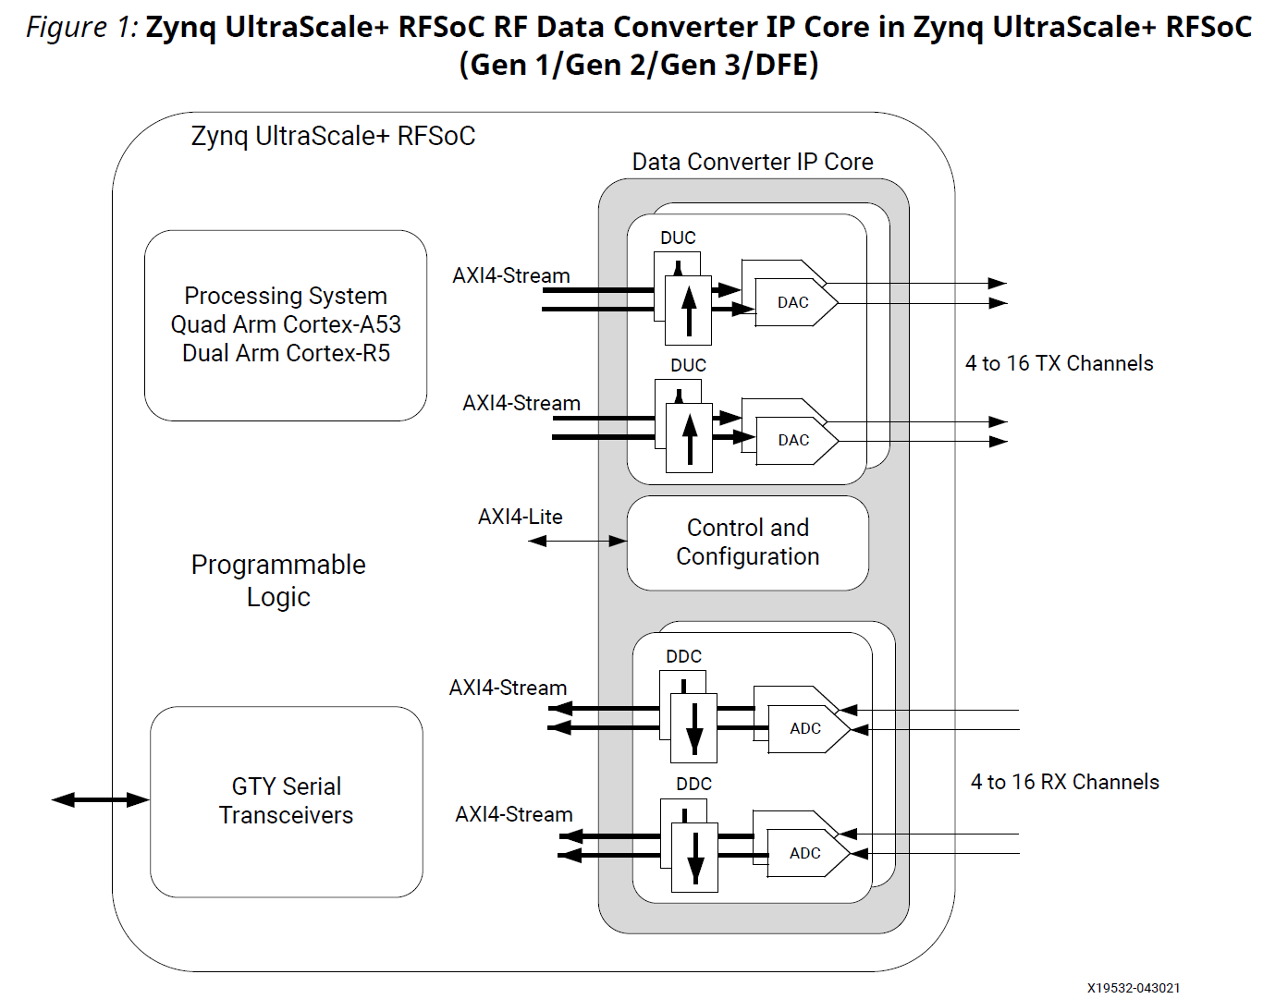
RFSoC Structure
8
8

Slide 4
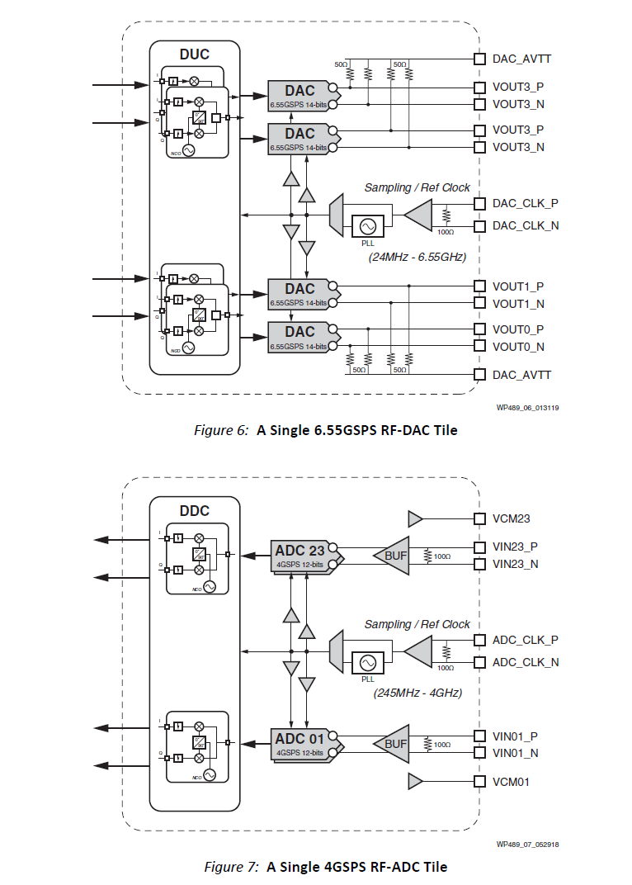
RFDC Structure

Slide 5
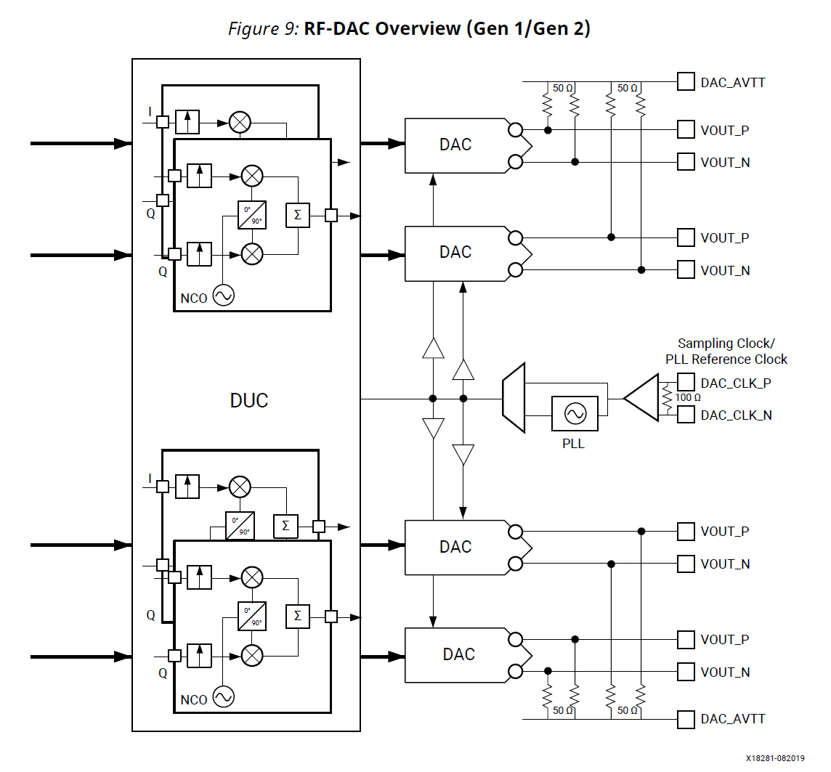
DAC Structure

Slide 6
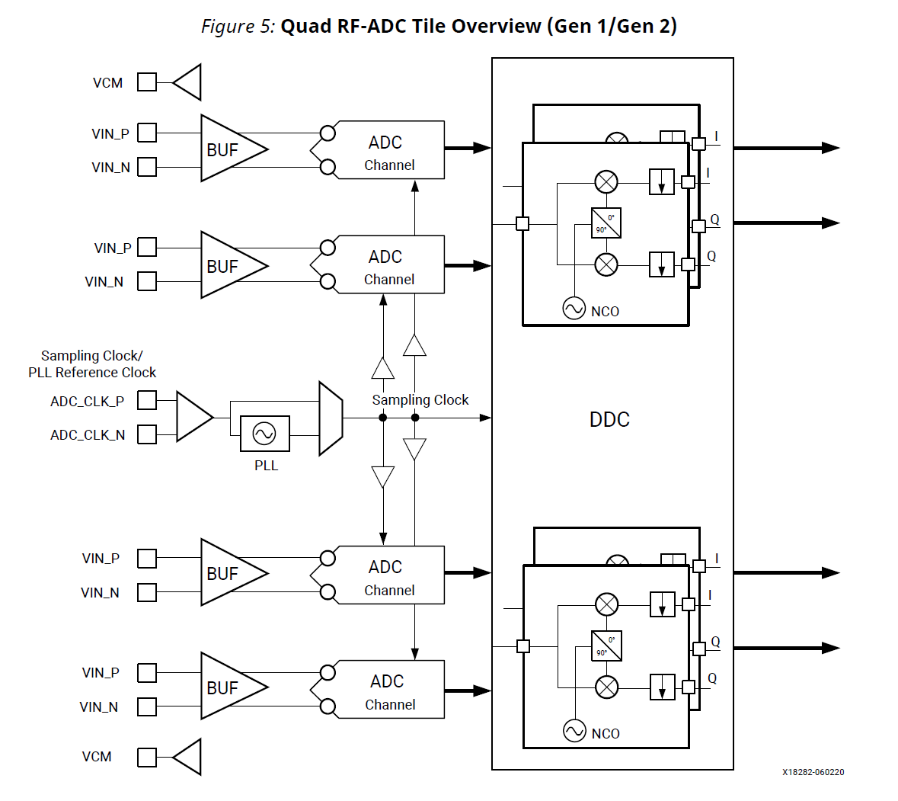
ADC Structure

Slide 7
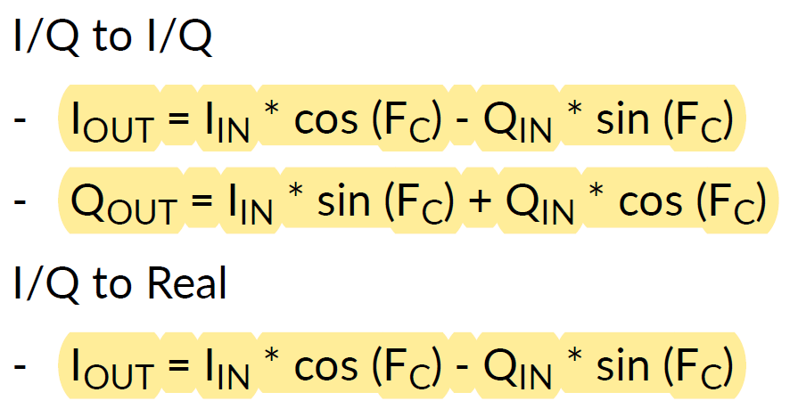
Output of RFDC
I = I_max -> 0x7FFF

Slide 8
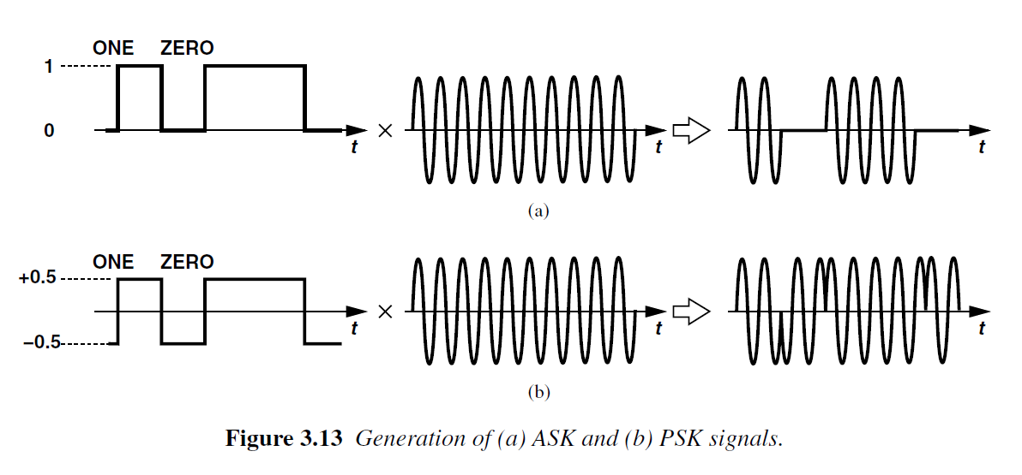
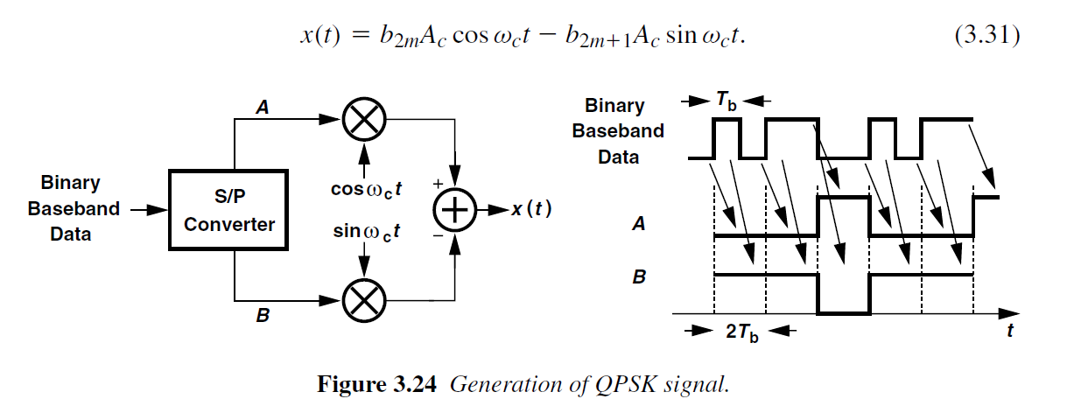
Wireless Communication(1)

Slide 9
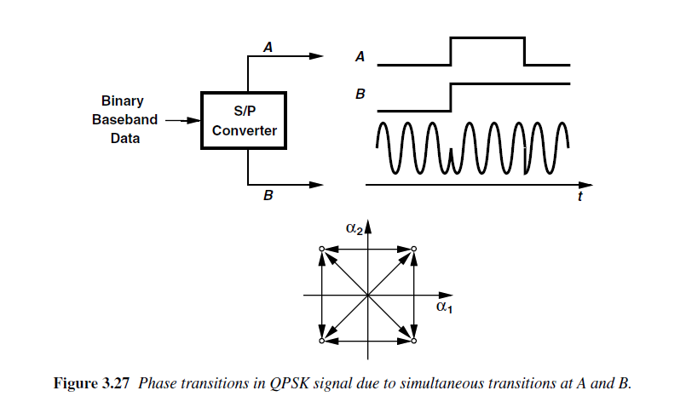
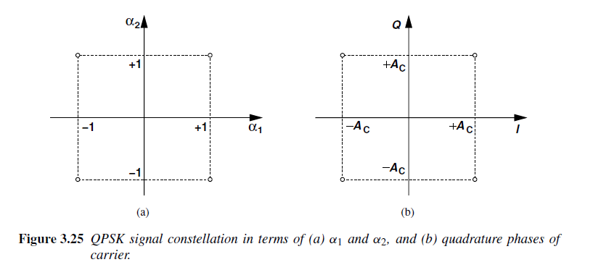
Wireless Communication(2)

Slide 10
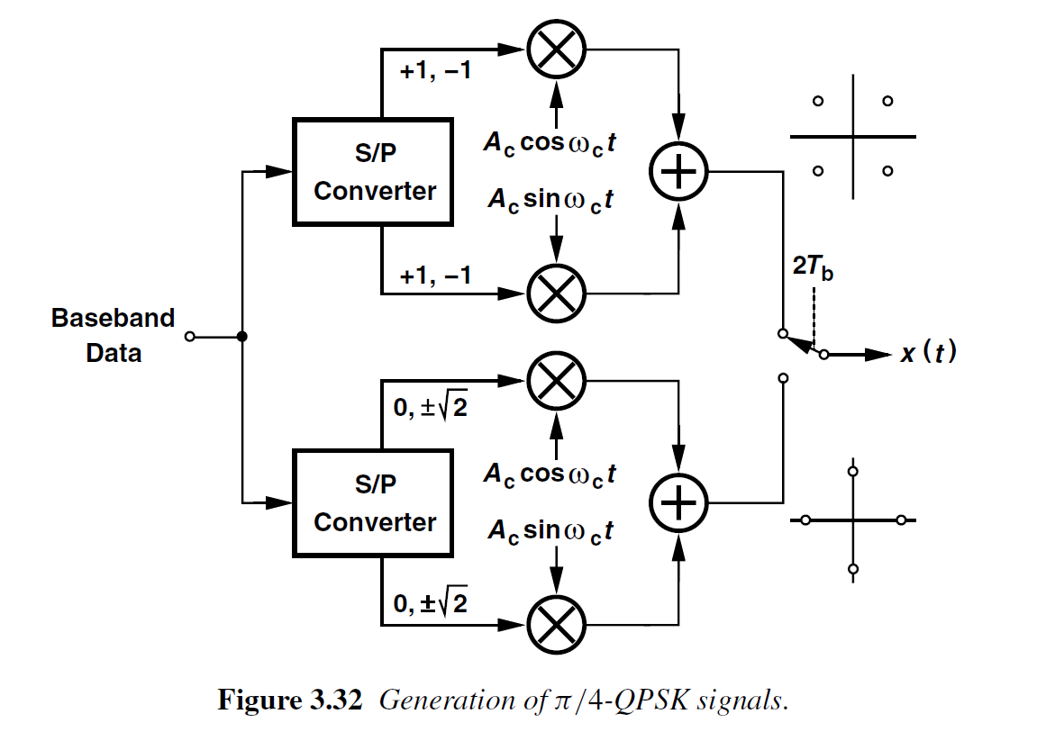
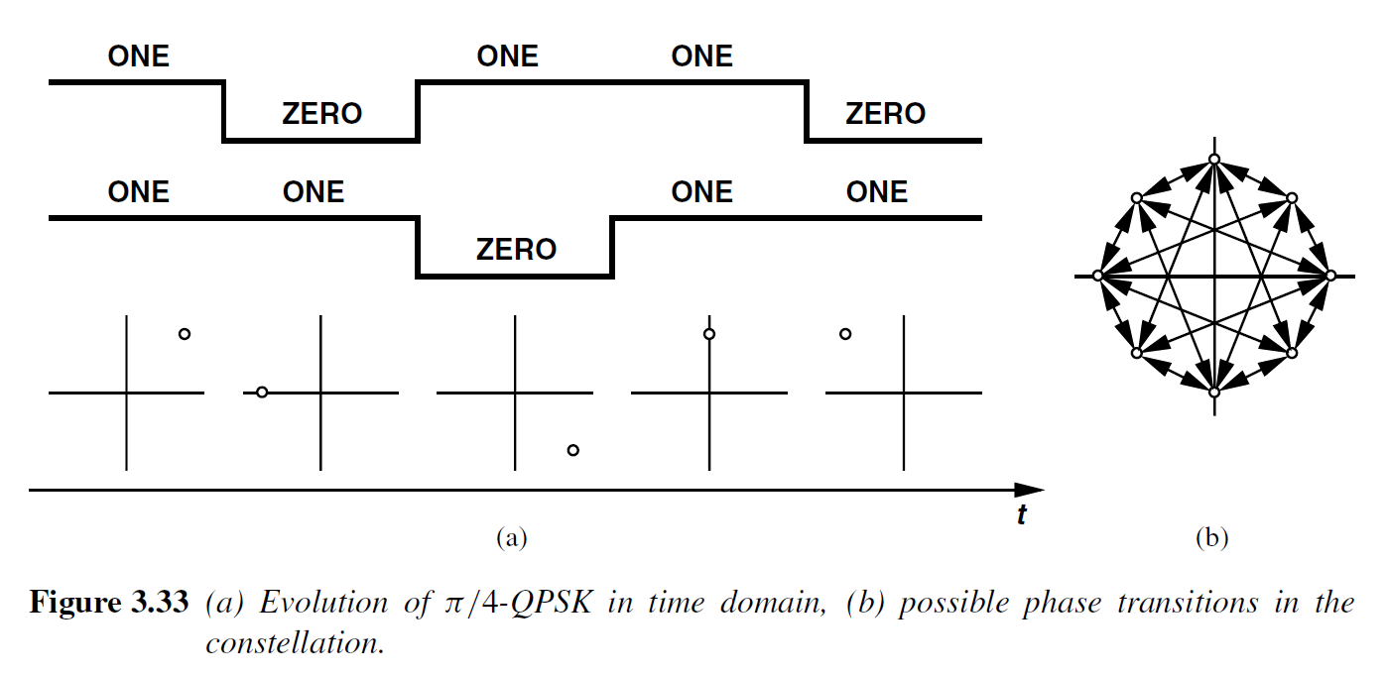
Wireless Communication(3)

Slide 11
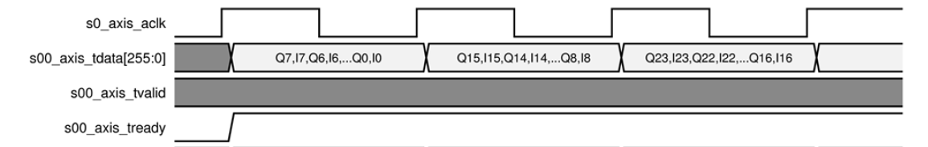
RFDC datapath
I value
s00_axis_tdata[255:0] <= 256'h0000 7fff 0000 7fff 0000 7fff 0000 7fff 0000 7fff 0000 7fff 0000 7fff 0000 7fff
Q value

Slide 12
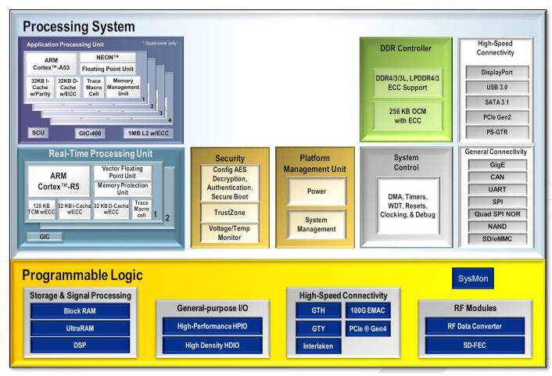
CPU Structure

Slide 13
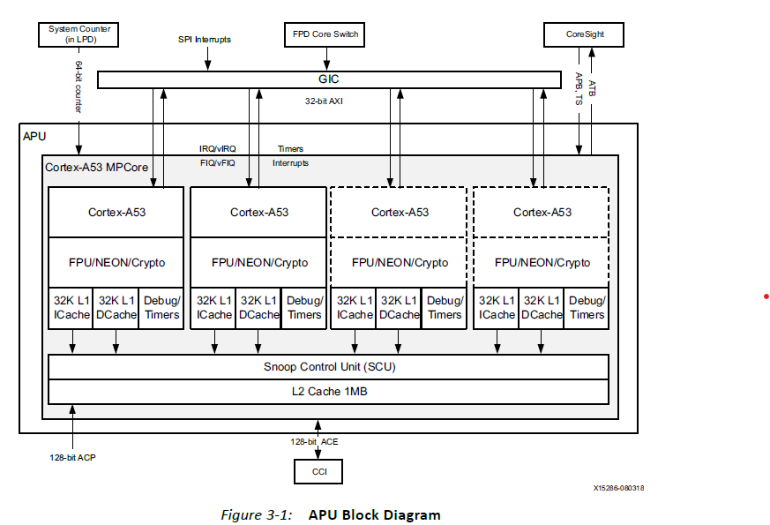
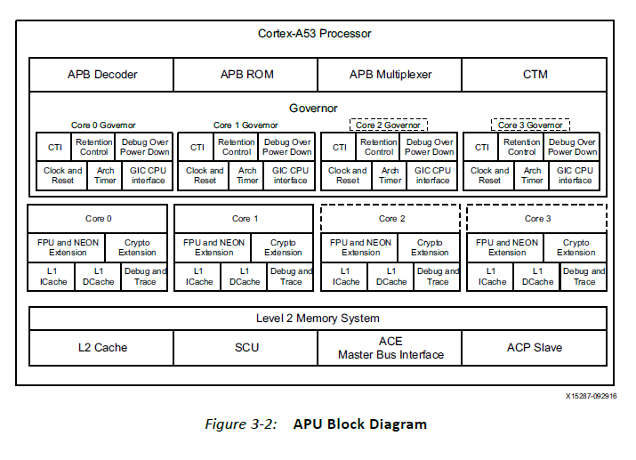
APU Structure

Slide 14
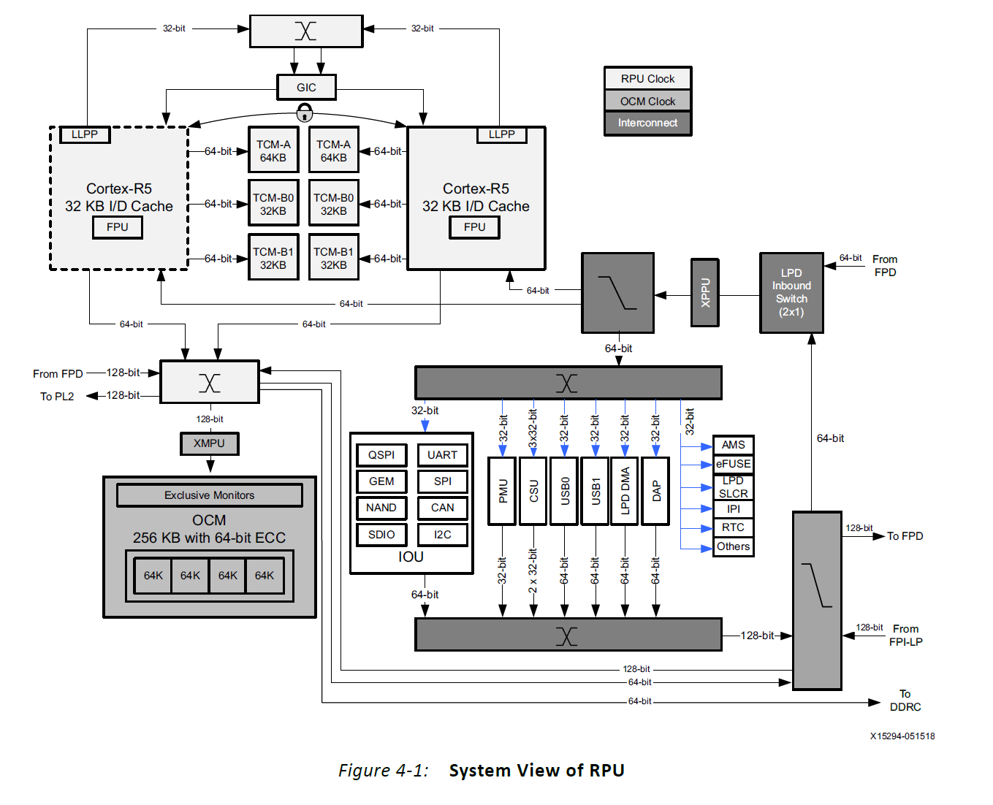
MPU Structure

Slide 15
About RFSoC OS(Firmware)

Slide 16
To apply feedback
wasting resource(DAC)
for waiting input
Task1
1
1
Core
Task2
Core
Task2
Task2
Task2
use DAC,ADC2
Task1
use DAC,ADC1
t=0 ns
t=t0
t=0 ns
t=t0
Task1
use DAC,ADC1
dac_output @ t = t0 > 0 ns
Task2
use DAC,ADC2
dac_output @ t = t0 > 0 ns
DAC1
DAC1
DAC2
DAC2
adc_input @ t = 0 ns
adc_input @ t = 0 ns
ADC1
ADC1
ADC2
ADC2

Slide 17
Necessity of DMA

Slide 18
Data transaction delay & bandwidth
DAC bandwidth : 1.6GHz(Max : 6.4GHz)
DAC input bit width : 256bit
Data transfer speed : 32bit (4byte) x 1.6GHz = 6.4GB/s w/o interpolation
32bit (4byte) x 0.2GHz = 800 MB/s w/ interpolation
-> can be accomplished with PCIe & SSD
-> data calculation from CPU would be better
AXIS frequency : 100MHz
AXIS max bit width : 128bit
CPU
DMA
DRAM
RFDC
CPU
CALC
DATA TRANSFER
CALC
DATA TRANSFER
CALC
DATA TRANSFER
CALC
CALC
CALC
DMA REQ
CALC
CALC
CALC
DMA REQ
AXI
WRITE
WRITE
WRITE
WRITE
WRITE
<without DMA>
<with DMA>
exact AXI data write duration should be checked

Slide 19
Development Environment & Usage

Slide 20
AD9910 delay, RFSoC delay should be compared

Slide 21
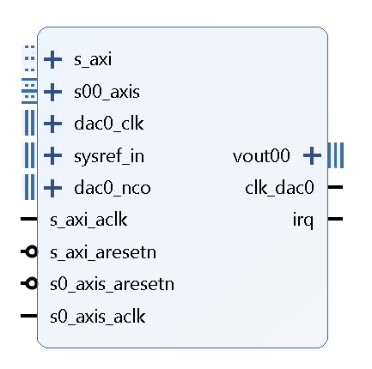
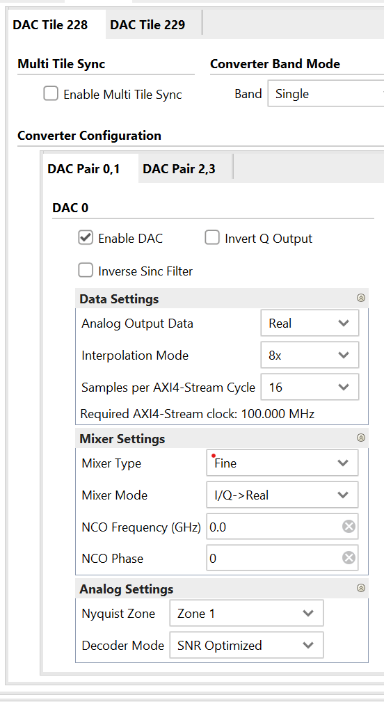
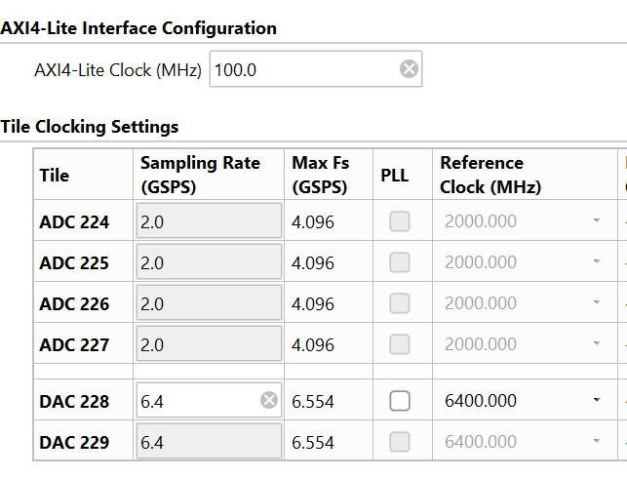
Simulation setting(1)
RFDC control using AXI4 lite interface
Connecting this pin to wire or register does not show simulation results
I/Q input using AXI4 stream interface
DAC clock
Clock for synchronization
(not used in here)
Real time mixer frequency control input
RFDC control clock
I/Q input clock

Slide 22
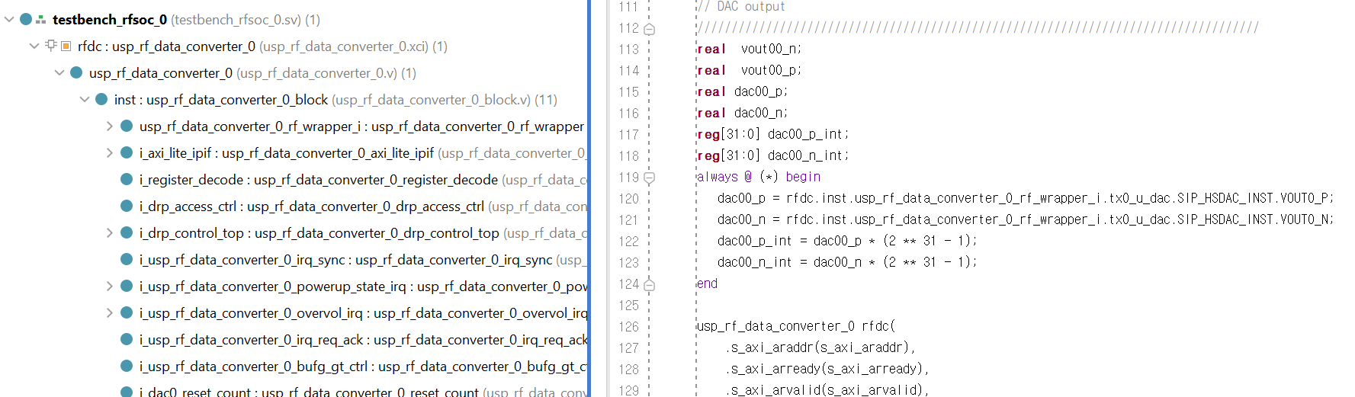
Simulation setting(2)
Simulation output is real type, and this should be assigned to real variable manually to see.
In addition real type does not show analog waveform, so this should be transformed to register type.

Slide 23
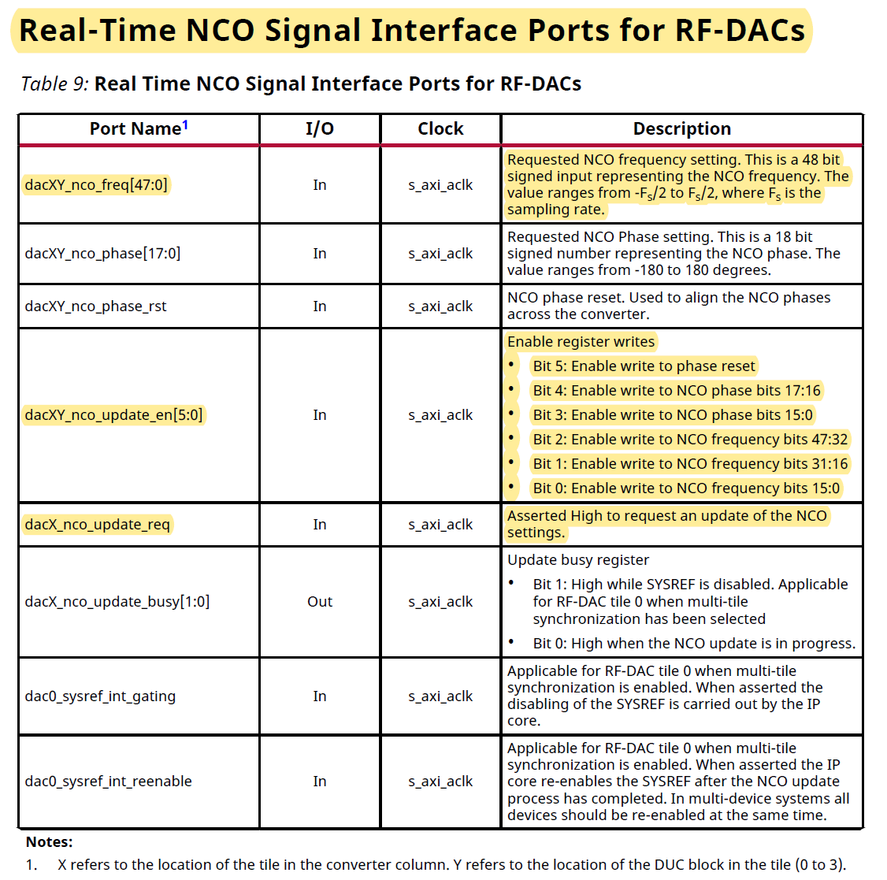
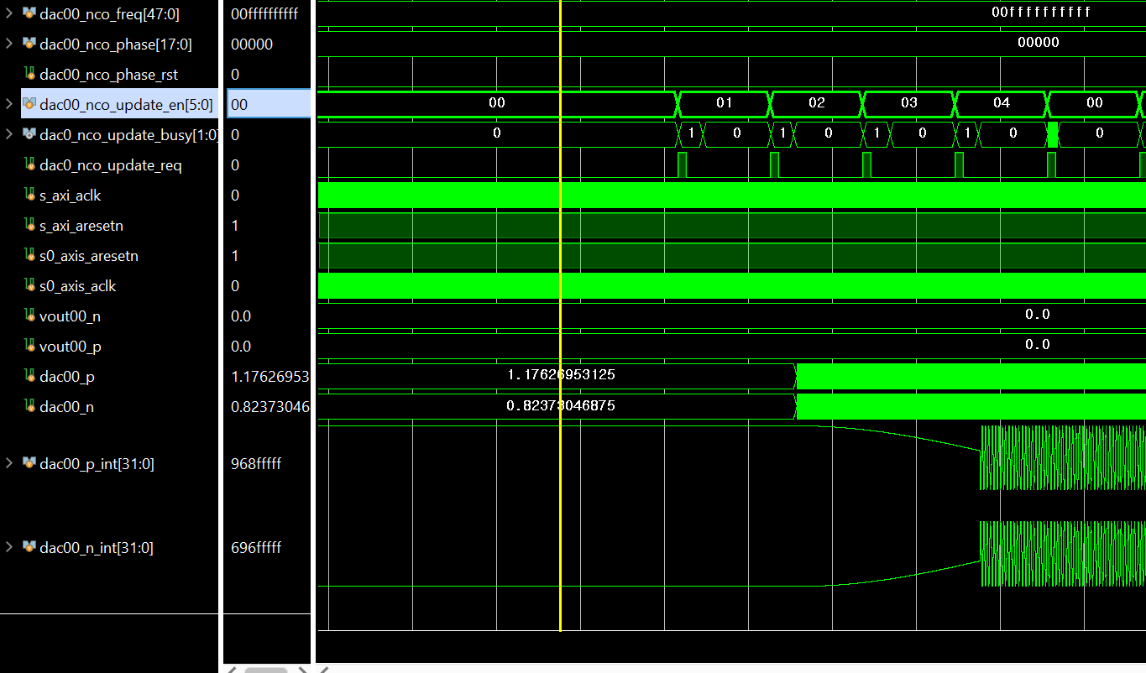
Mixer frequency input
dac00_nco_freq <= 48'h00ffffffffff
->mixer frequency ~= 6.4GHz * (2**40/2**64) = 25MHz

Slide 24
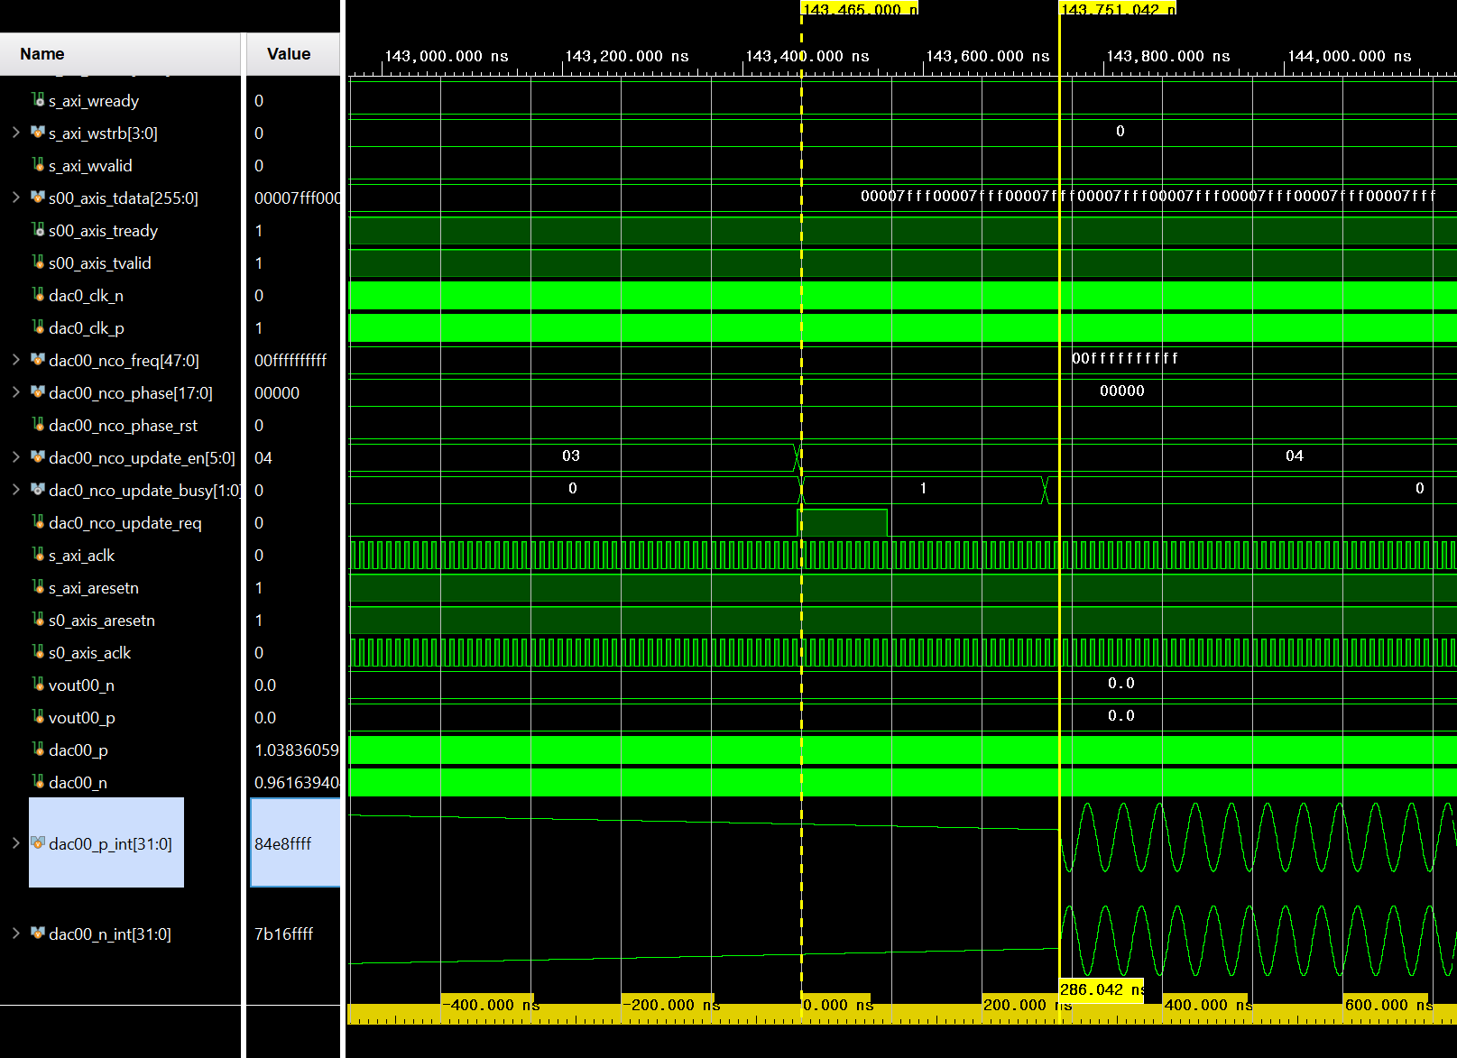
Frequency Update Delay
It takes almost ~300ns

Slide 25
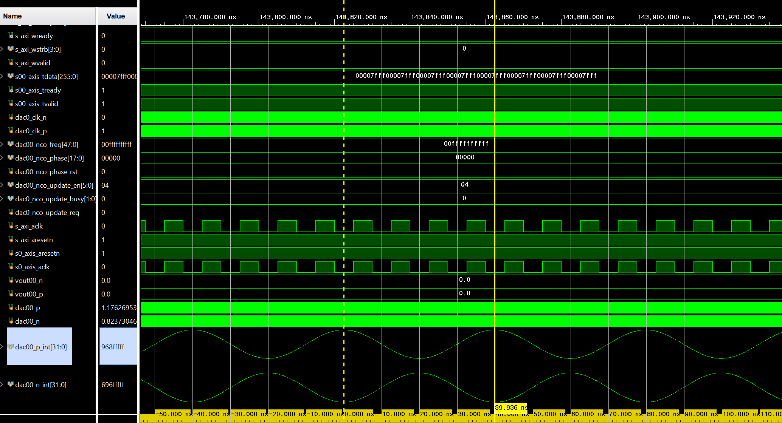
Result
Period ~= 40ns
-> consistent with our setting

Slide 26
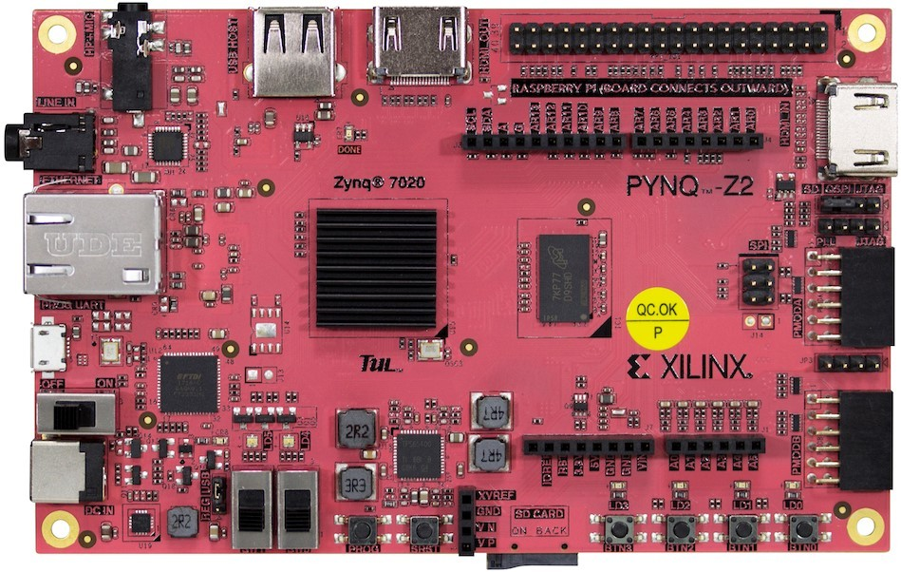
Zynq Study
PYNQ-Z2
- Python library available, but we donnot use
- Zynq-7020 chip
- Ethernet implementation
- PS-PL communication implementaion
- Real Time OS implementation
- Almost 200,000 won

