Slide 1
Mira Controller
Verdi, Oscilloscope, Chiller

Slide 2
System Diagram
TCP
serial
PORT:A
VerdiTCPServer_v1_00.py
raspberry pi
Verdi
PORT:B
ThermoTekTCPServer_v1_00.py
PC
router
raspberry pi
Chiller
PORT:C
DSO_X_3034A_TCPServer_v1_00.py
raspberry pi
Oscilloscope

Slide 3
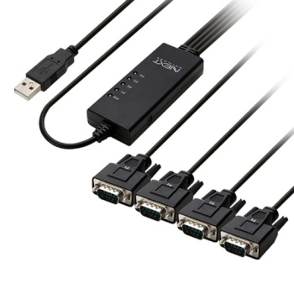
4port RS232
https://www.icbanq.com/P010954308?utm_source=google&utm_medium=cpc&utm_campaign=%EC%87%BC%ED%95%91_PerformanceMax&utm_id=%EC%87%BC%ED%95%91_PerformanceMax&utm_term=notset&utm_content=notset&gclid=CjwKCAjw9J2iBhBPEiwAErwpeeSgvx7I_TwXrB8KECZhIt8SdrB_Am4512MdUjQTT5VT9mKvROIviRoCK2QQAvD_BwE

