Slide 1
About DRAM
For RFSoC DRAM usement

Slide 2
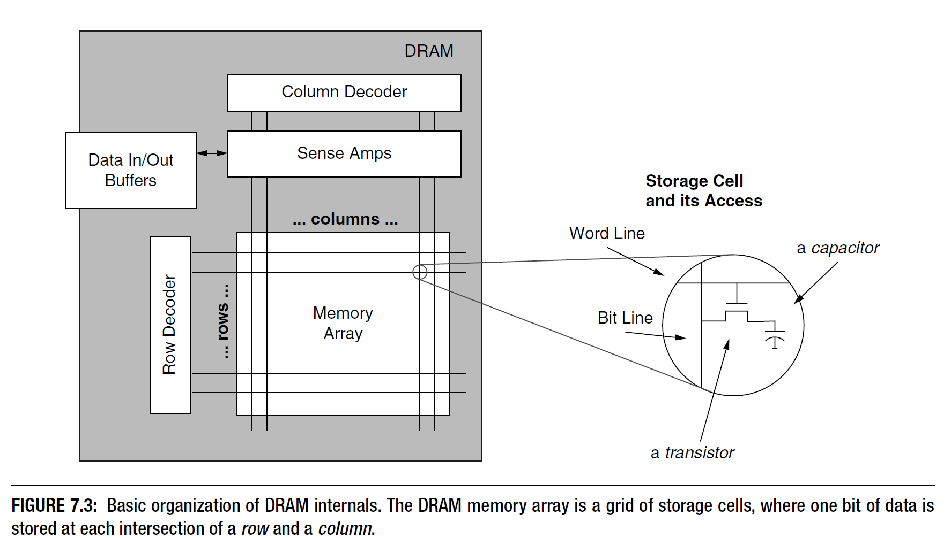
DRAM?

Slide 3
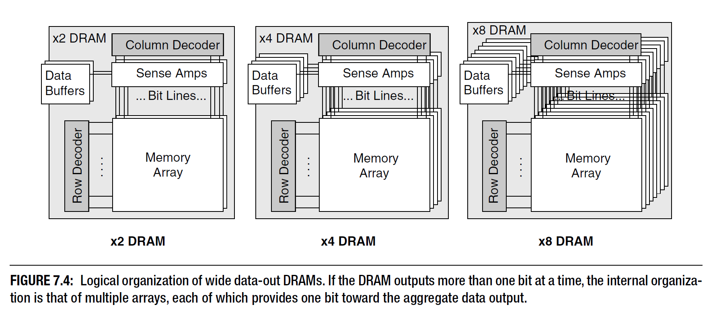
Memory Array vs Bank(1)

Slide 4
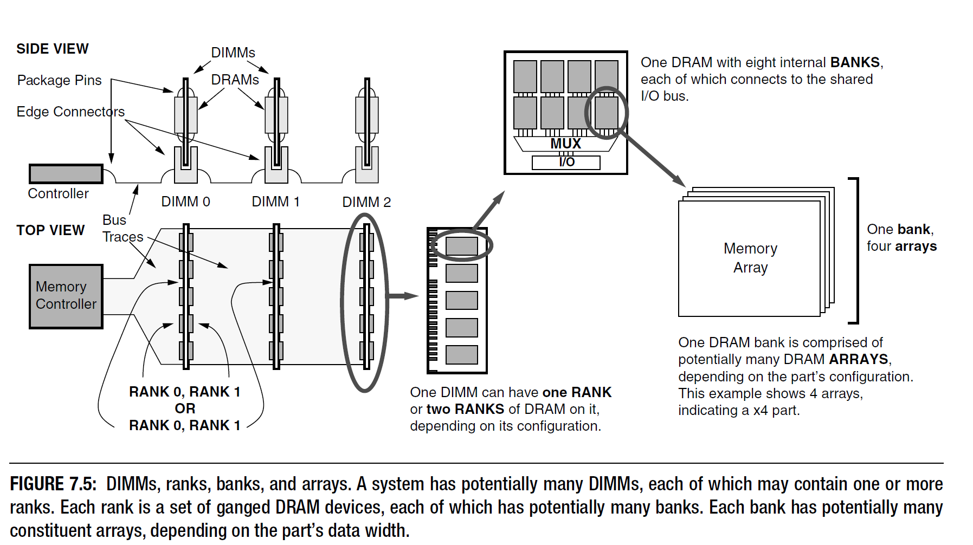
Memory Array vs Bank(2)

Slide 5
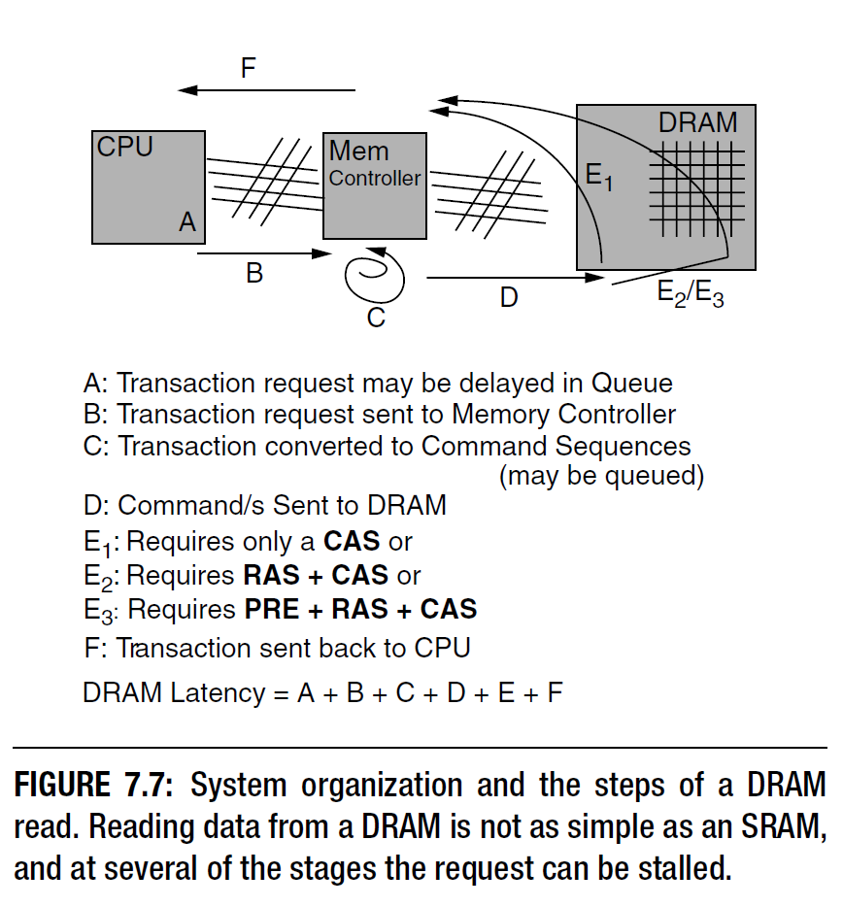
DRAM Control

Slide 6
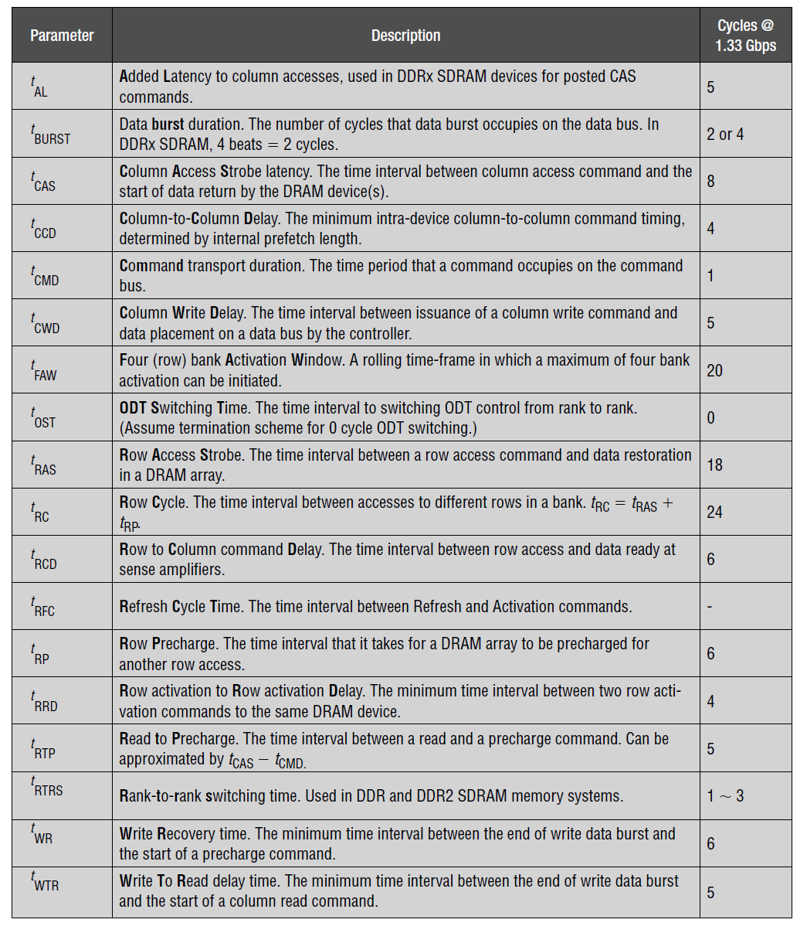
DRAM timing

