Slide 1
RFSoC Meeting
RFSoC Procedure

Slide 2
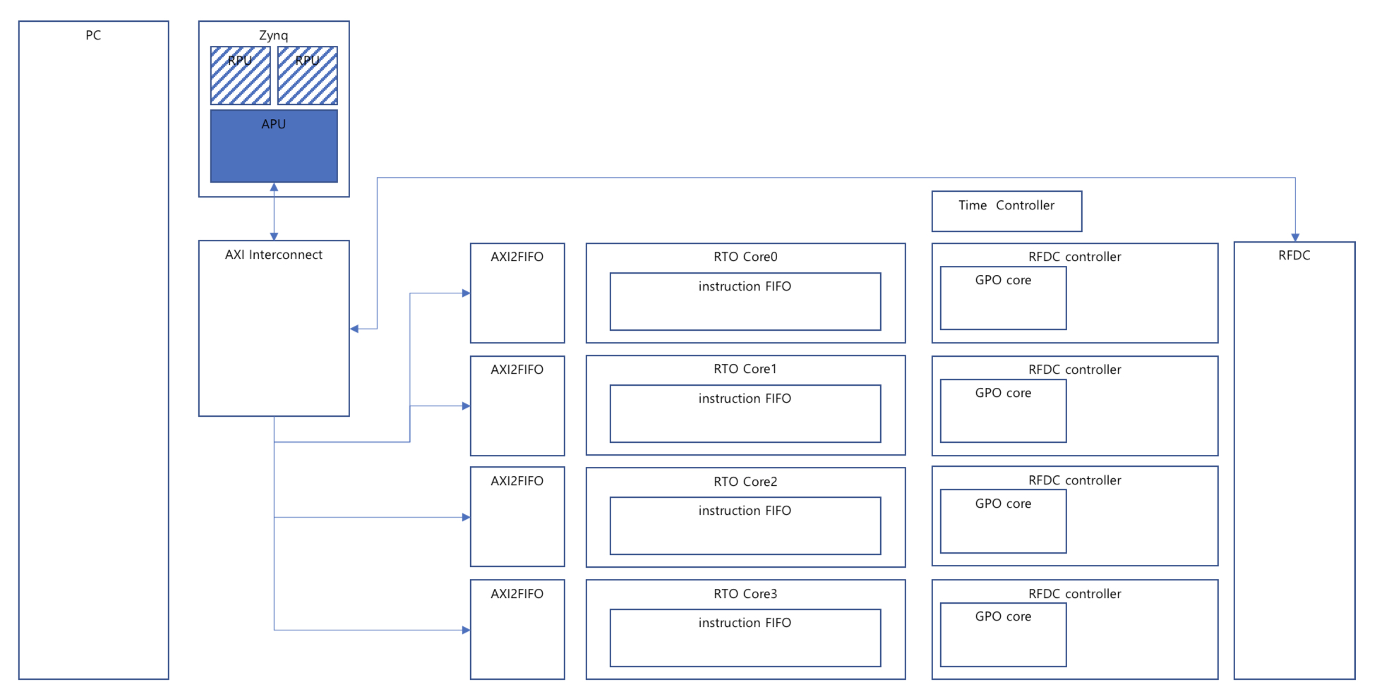
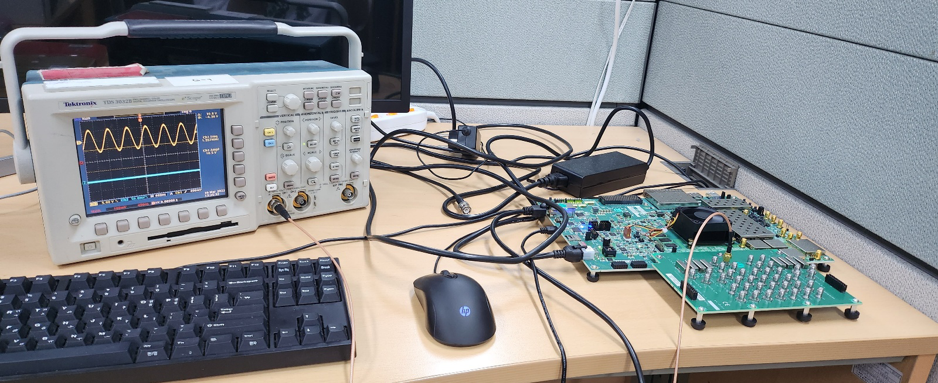
Programming Progress
-Signal Output Check Done
-TCP/IP is being studied(Using lwip)
-Spline Engine & LUT is considered -> After Paper Study

Slide 3
Consideration
-Using FreeRTOS?
-Is 128bit AXI interface natural for 64bit CPU?
-Spline Engine?
-FMC to BNC PCB

Slide 4
Device Concepts
PC
Exp.py
AST
Exp.c
Exp.elf
TCP
RFSoC
While(True):
Get elf file
Do elf file

Slide 5
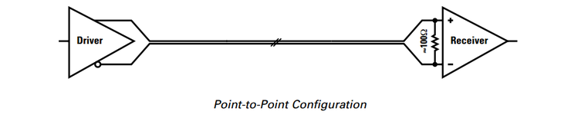
High Data Rate Isolator
-All requires LVDS

Slide 6
Simplified PMOD2BNC
-Withtout External Power
-3.3V to 5V
-Impedance Select

