Slide 1
RFSoC Meeting
RFSoC Procedure

Slide 2
Summary of Current Procedure
-AWG via ELF Done
-Instruction Cache Bug Fixed
-Malloc (BSS initialization) & Vector
-Cython
-Fastbranch Single Cycle CPU
-Spline Engine Study

Slide 3
1. AWG via ELF (128 bit write)
31 __attribute__((always_inline)) static void reg128_write(uint64_t addr, uint64_t upper_data, uint64_t lower_data)
32 {
33 volatile uint64_t * target_addr = (volatile uint64_t *)TARGET_ADDRESS;
34 volatile uint64_t * lower_addr = (volatile uint64_t *)LOWER_ADDRESS;
35 volatile uint64_t * upper_addr =(volatile uint64_t *) UPPER_ADDRESS;
36
37 *target_addr = addr;
38 *lower_addr = lower_data;
39 *upper_addr = upper_data;
40
41 __asm__ __volatile__(
42 "sub sp, sp, #32\n\t"
43 "str x0, [sp, #8]\n\t"
44 "str x1, [sp, #16]\n\t"
45 "str x2, [sp, #24]\n\t"
46 "ldr x0, [%0]\n\t"
47 "ldr x1, [%1]\n\t"
48 "ldr x2, [%2]\n\t"
49 "stp x1, x2, [x0]\n\t"
50 "ldr x0, [sp, #8]\n\t"
51 "ldr x1, [sp, #16]\n\t"
52 "ldr x2, [sp, #24]\n\t"
53 "add sp, sp, #32\n\t"
54 ://Target
55 : "r" (TARGET_ADDRESS), "r" (LOWER_ADDRESS), "r" (UPPER_ADDRESS)//Variable
56 ://Clover
57 );
58 }
3
2
X0
X1
X2
SP
X0
X1
X2
X
X
1234
5678
0x1000
SP+8
SP+16
SP+24
1
SP+32
0x0000
1234
0x0004
5678
4
0x1000
1234 5678

Slide 4
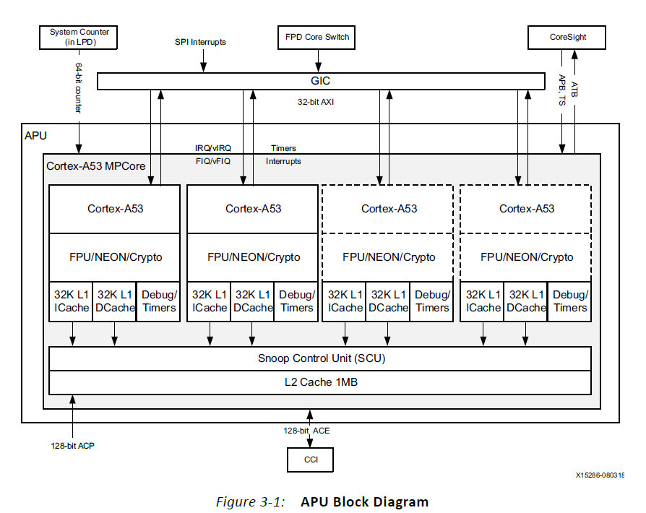
2. Instruction Cache Bug
ELF1
Run Well
RFSoC
ELF2
Run Fail
Run previous ELF instruction due to ICache

Slide 5
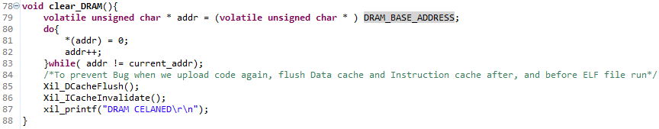
Instruction Cache Bug Fix

Slide 6
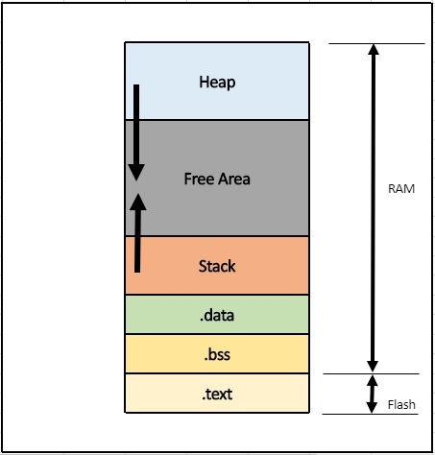
3. BSS(Block Started by Symbol) Section initialization
Initialized value (e.g. static int a = 10;)
Uninitialized value or Initialized to 0
(e.g. static int a; static int b = 0;)
▶Should be initialized to 0 manually

Slide 7
Startup.S
1 .file "startup.S"
2
3 .Lbss_end:
4 .quad __bss_end__
5
6 .Lbss_start:
7 .quad __bss_start__
8
9 .Lheap_end:
10 .quad _heap_end
11
12 .Lheap_start:
13 .quad _heap_start
14
15
16 .global _start
17 _start:
18 mov x0, #0
19 ldr x1,.Lbss_start /* calculate beginning of the BSS */
20 ldr x2,.Lbss_end /* calculate end of the BSS */
21
22 .Lloop_bss:
23 cmp x1,x2
24 bge .Lenclbss /* If no BSS, no clearing required */
25 str xzr, [x1], #8
26 b .Lloop_bss
27
28 .Lenclbss:
29 ldr x1,.Lheap_start /* calculate beginning of the BSS */
30 ldr x2,.Lheap_end /* calculate end of the BSS */
31
32 .Lloop_heap:
33 cmp x1,x2
34 bge .Lenclheap /* If no BSS, no clearing required */
35 str xzr, [x1], #8
36 b .Lloop_heap
36 b .Lloop_heap
37
38 .Lenclheap:
39 mov x0, #0
40 mov x1, #0
41 sub sp, sp, #16 /*Save return address to stack*/
42 str x30, [sp, #8]
43 bl main
44 ldr x30, [sp, #8]
45 add sp, sp, #16
46 ret
Entry Point
Initialized bss section to 0

Slide 8
linker.ld
1 _STACK_SIZE = DEFINED(_STACK_SIZE) ? _STACK_SIZE : 0xD0000;
2 _HEAP_SIZE = DEFINED(_HEAP_SIZE) ? _HEAP_SIZE : 0xD0000;
3 _DRAM_BASE_OFFSET = 0xf00000;
4 /* Define Memories in the system */
5
6 MEMORY
7 {
8 psu_ddr_0_MEM_0 : ORIGIN = _DRAM_BASE_OFFSET, LENGTH = 0x7FF00000
9 psu_ddr_1_MEM_0 : ORIGIN = 0x800000000, LENGTH = 0x80000000
10 psu_ocm_ram_0_MEM_0 : ORIGIN = 0xFFFC0000, LENGTH = 0x40000
11 psu_qspi_linear_0_MEM_0 : ORIGIN = 0xC0000000, LENGTH = 0x20000000
12 }
13
14 /* Specify the default entry point to the program */
15
16 ENTRY(_start)
Increased heap size to implement malloc
Change origin address to actual save address in RFSoC
Change entry point to “_start” label (Startup.S)

Slide 9
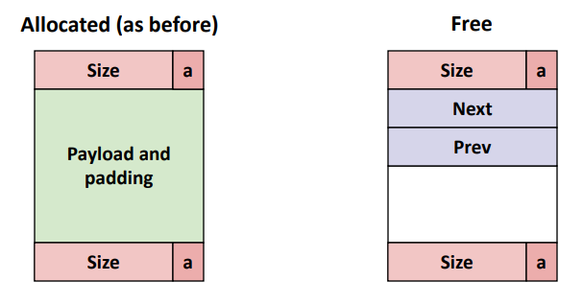
Malloc is complicate function
_sbrk.c
malloc.c (e.g. newlib)
7 #include <sys/types.h>
8 #include "xil_types.h"
9 #include "xil_printf.h"
10 extern u8 _heap_start[];
11 extern u8 _heap_end[];
12
13 static u8 *heap = NULL;
14 static u8 *HeapEndPtr = (u8 *)&_heap_end;
15
16 #ifdef __cplusplus
17 extern "C" {
18 __attribute__((weak)) caddr_t _sbrk ( s32 incr );
19 }
20 #endif
22 __attribute__((weak)) caddr_t _sbrk ( s32 incr )
23 {
24 u8 *prev_heap;
25 caddr_t Status;
26
27
28 if (heap == NULL) {
29 heap = (u8 *)&_heap_start;
30 }
31 prev_heap = heap;
32
33 if (((heap + incr) <= HeapEndPtr) && (prev_heap != NULL)) {
34 heap += incr;
35 Status = (caddr_t) ((void *)prev_heap);
36 } else {
37 Status = (caddr_t) -1;
38 }
39
40 return Status;
41 }
Time complexity depends on implementation of malloc.c
Increase Heap and Return Heap Address
https://github.com/Xilinx/newlib

Slide 10
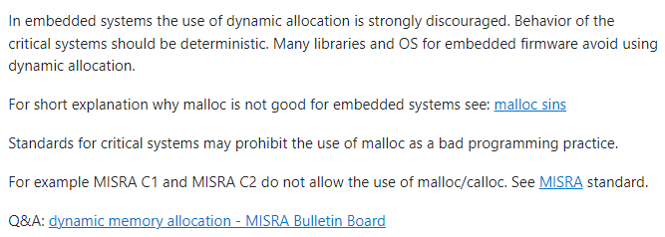
Malloc is discouraged in imbedded system
C++ vector and Python list are dynamic array (Vector requires additional libraries)
▶ Need to be avoided in our system (realtime system) until accurate structure is understood
+ Vector cannot be compiled
https://stackoverflow.com/questions/37812732/use-of-malloc-in-embedded-c

Slide 11
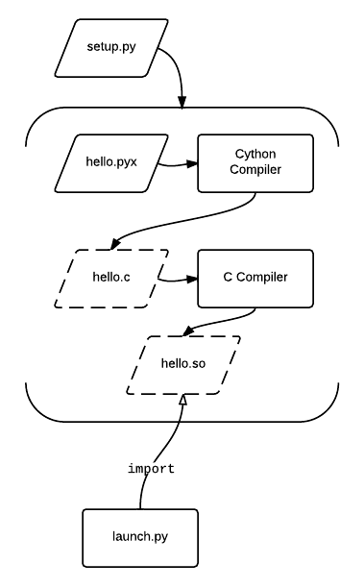
Cython
Compile failed
▶C++ library problem?

Slide 12
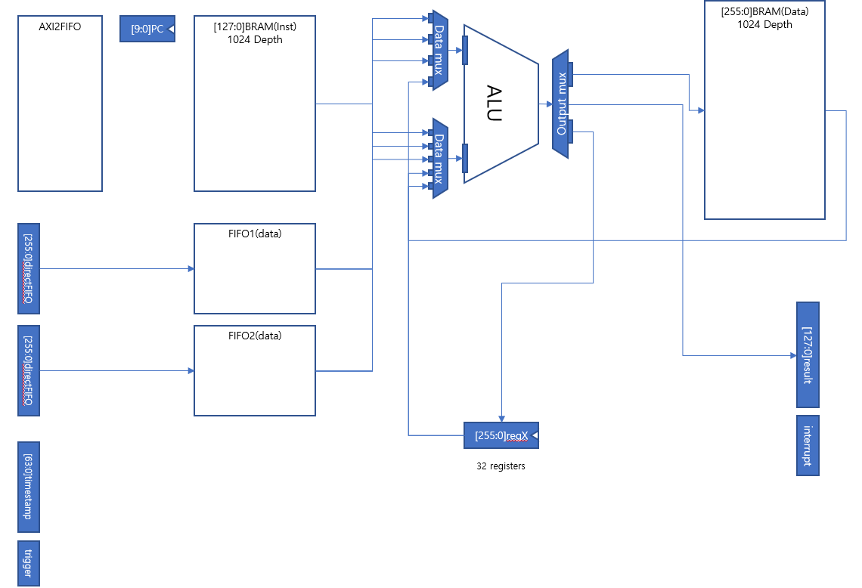
FastBranch CPU

Slide 13
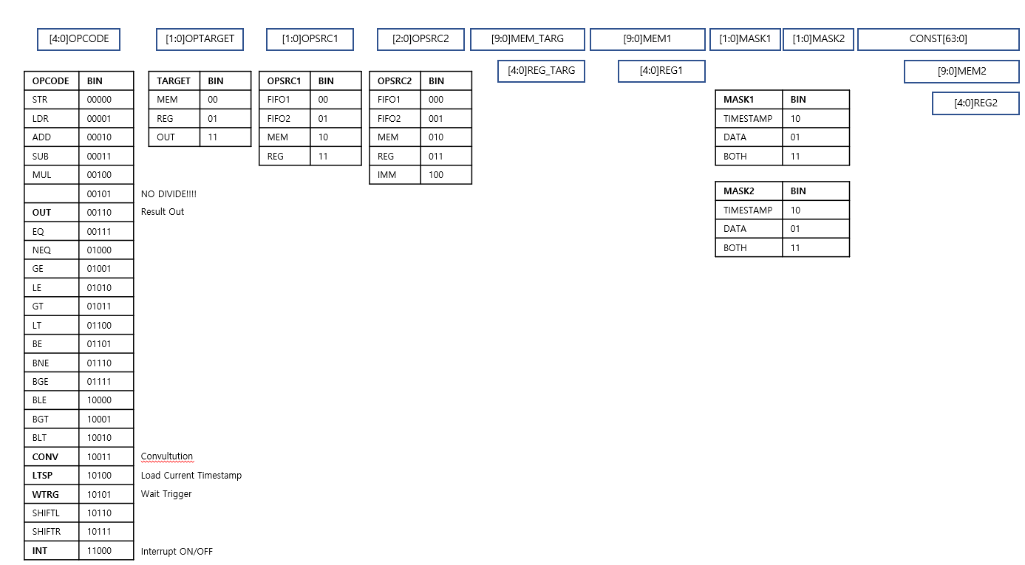
FastBranch CPU instruction

Slide 14
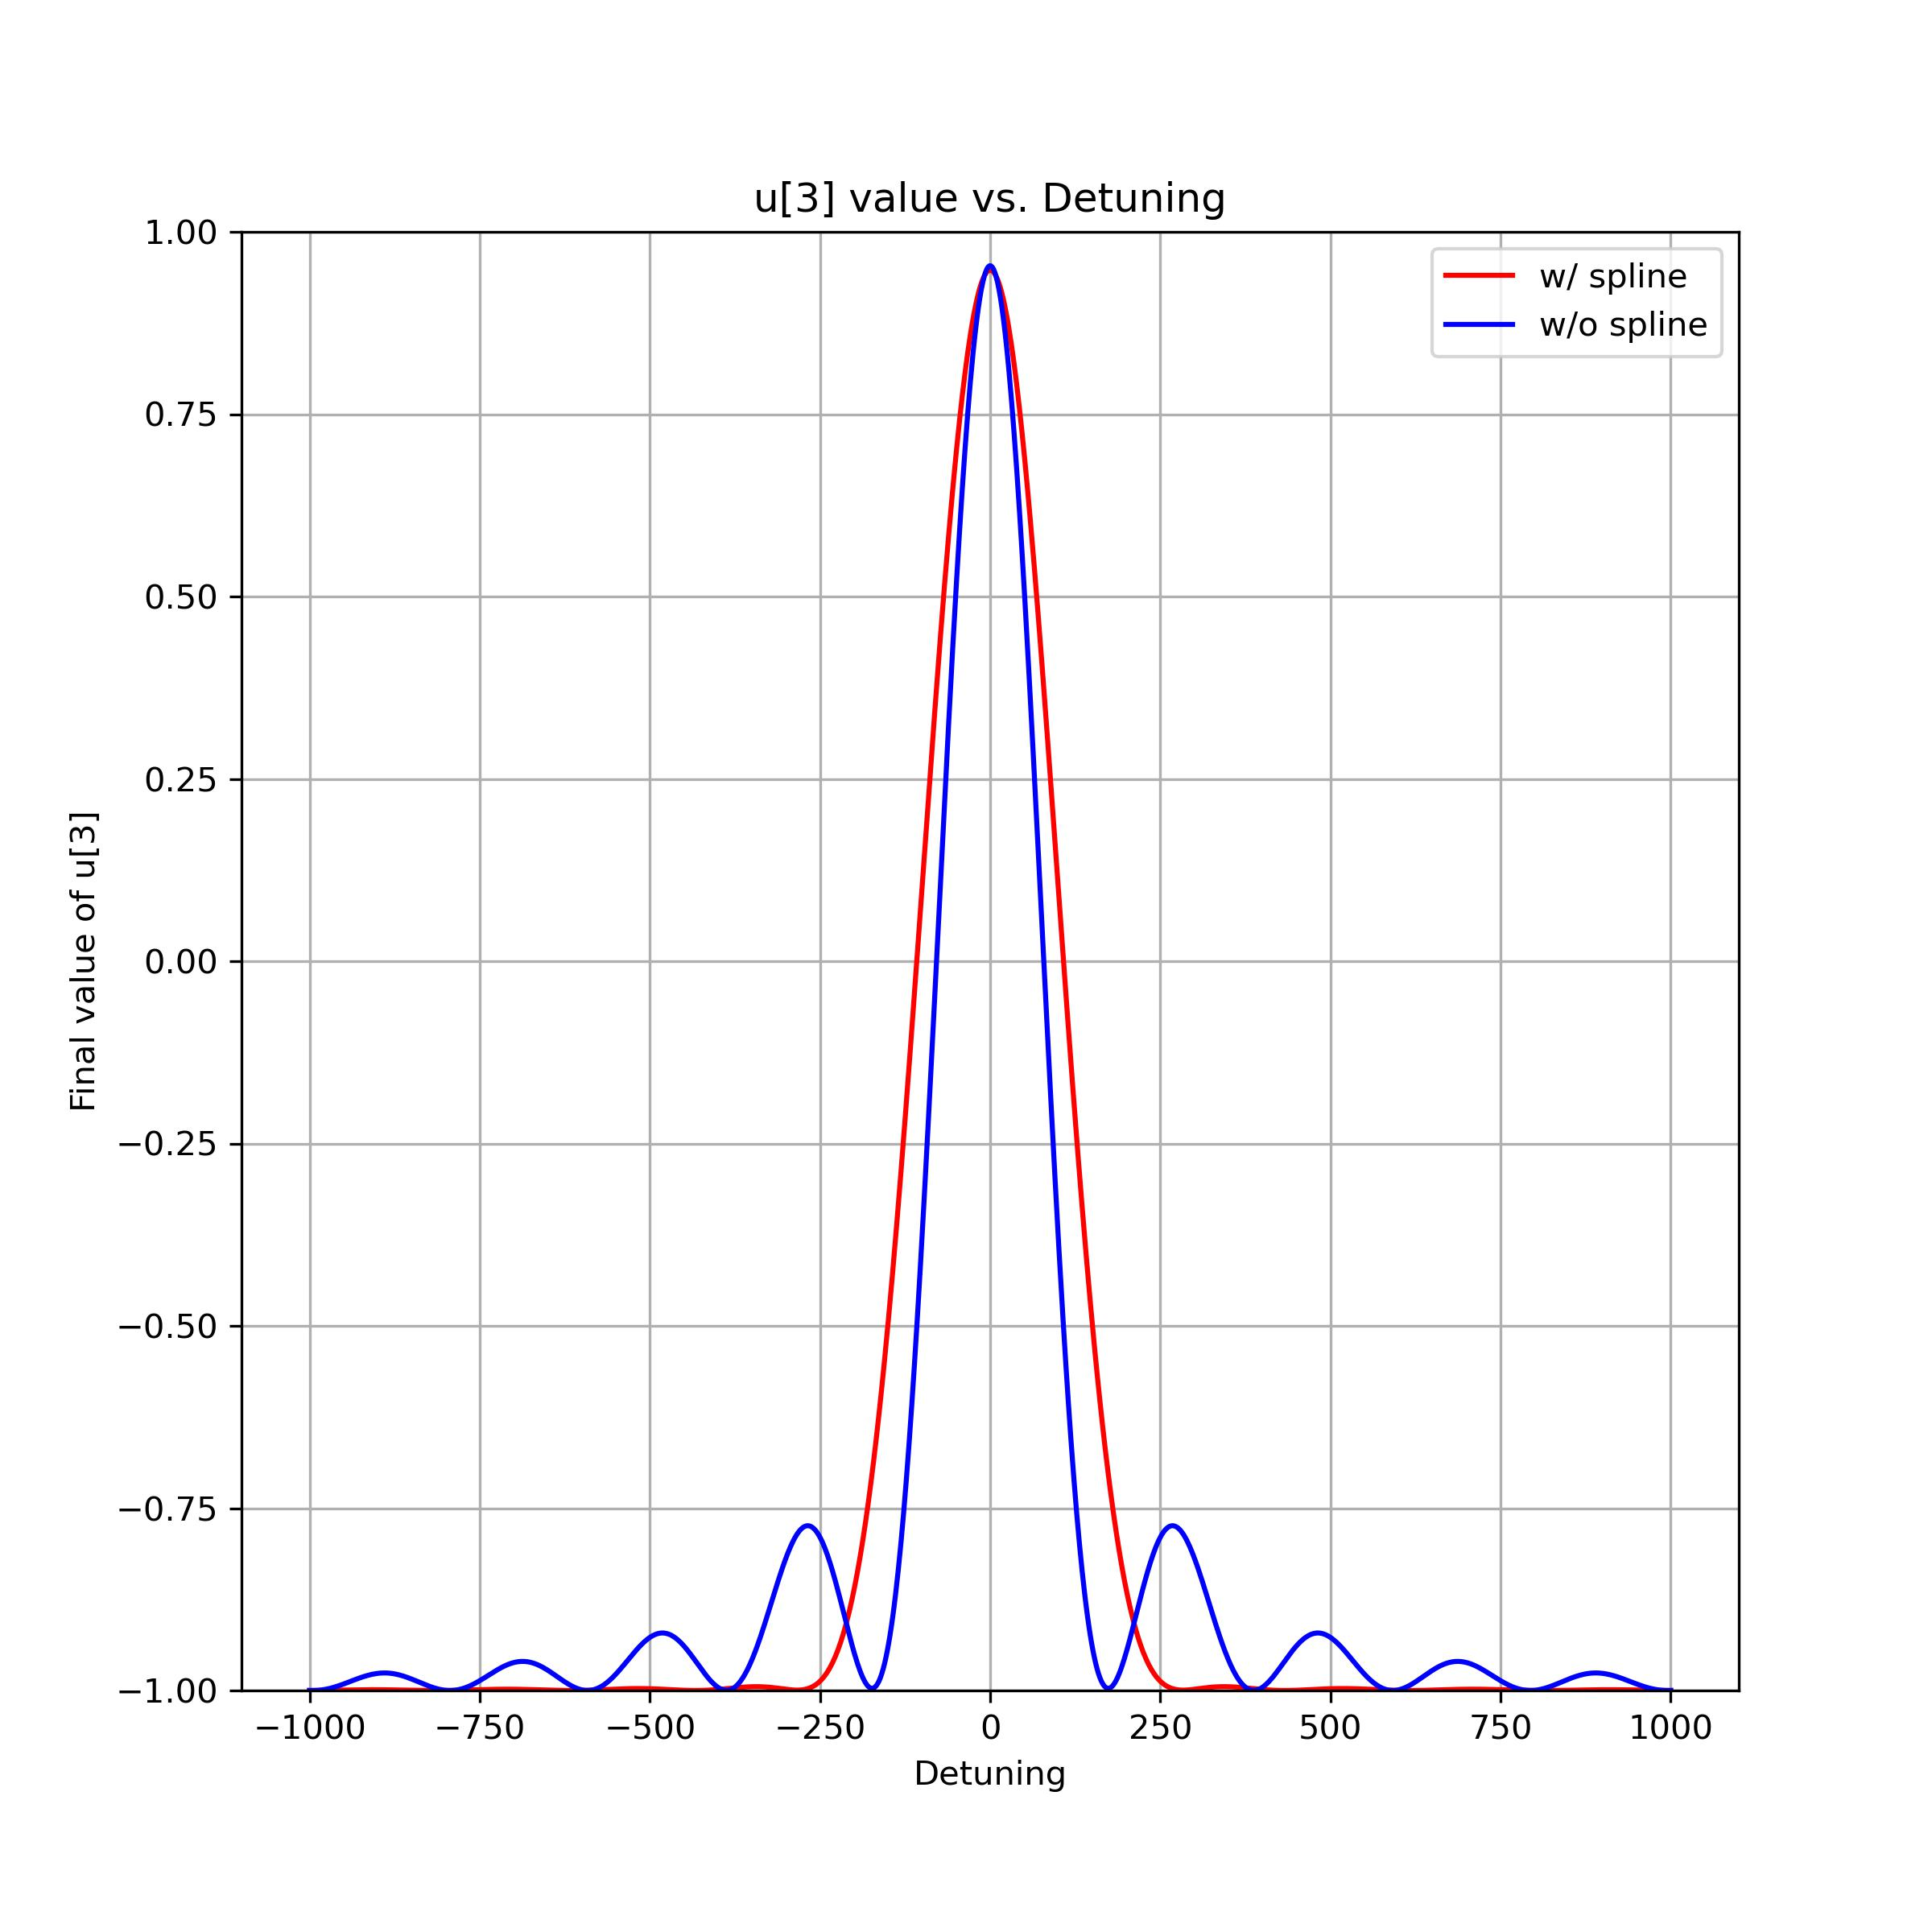
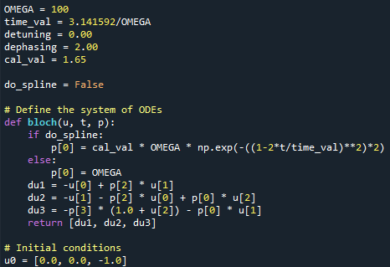
Spline Engine

