Slide 1
RFSoC Meeting
Compiler & PCB Procedure

Slide 2
Procedure Summary
-LLVM IR generator is on the work
-Circuit S parameter simulation done(wo capacitor)
-> why attenuator is necessary?
-Xilinx Chip Programming

Slide 3
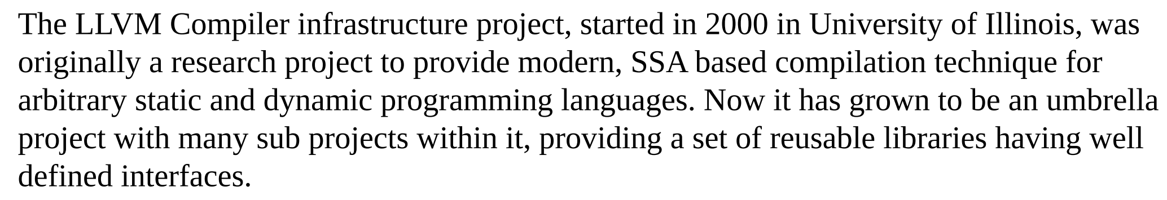
LLVM

Slide 4
LLVM IR
int a = 12;
int main(int b){
return a +b;
}
; ModuleID = "module"
target triple = "aarch64-none-unknown-elf"
target datalayout = "e-m:e-i8:8:32-i16:16:32-i64:64-i128:128-n32:64-S128"
define i64 @"main"()
{
entry:
%1 = alloca i64
store i64 %b, i64 * %1
%2 = load i64, i64 * @a
%3 = load i64, i64 * %1
%4 = add nsw i64 %2, %3
ret i64 %4
}
C Code
LLVM IR

Slide 5
Python AST
def foo(a : int, b:int , f:int) -> int:
c:int
goo_in = goo(1,2,3)
c = goo_in.mu() + 50
foo
FunctionDef
args
body
decorator
arg
arg
arg
a
b
c
AnnAssign
Assign
Return
target
c
annotation
Name
Call
int
goo_in
goo
args
Constant
Constant
Constant
1
2
3

Slide 6
Current Status
class goo:
def __init__(self, d:int, e:int, f:int)->int:
self.q:int
self.d:int
self.e:int
self.e = e
return
def mu(self):
self.m:int
self.m = 30 + (50+90)
return self.m
@kernel
def foo(a : int, b:int , f:int) -> int:
c:int
goo_in = goo(1,2,3)
c = goo_in.mu() + 50
return a + c
def main() -> int:
c:int
xil_printf('hello')
if c == 30 or c > 20:
c = 40
else:
c = 60
return 0
1 ; ModuleID = "module"
2 target triple = "aarch64-none-unknown-elf"
3 target datalayout = "e-m:e-i8:8:32-i16:16:32-i64:64-i128:128-n32:64-S128"
4
5 %"class.goo" = type {i64, i64, i64, i64}
6 declare void @"xil_printf"(i8* %".1", ...)
7
8 @".str0" = internal constant [6 x i8] c"hello\00"
9 define i64 @"class.goo.__init__"(%"class.goo"* %"self", i64 %"d", i64 %"e", i64 %"f")
10 {
11 entry:
12 %".6" = getelementptr inbounds %"class.goo", %"class.goo"* %"self", i32 0, i32 0
13 %".7" = getelementptr inbounds %"class.goo", %"class.goo"* %"self", i32 0, i32 1
14 %".8" = getelementptr inbounds %"class.goo", %"class.goo"* %"self", i32 0, i32 2
15 store i64 %"e", i64* %".8"
16 ret i64 0
17 }
18
19 define i64 @"class.goo.mu"(%"class.goo"* %"self")
20 {
21 entry:
22 %".3" = getelementptr inbounds %"class.goo", %"class.goo"* %"self", i32 0, i32 3
23 %".4" = add i64 50, 90
24 %".5" = add i64 30, %".4"
25 store i64 %".5", i64* %".3"
26 %".7" = load i64, i64* %".3"
27 ret i64 %".7"
28 }

Slide 7
Current Status
class goo:
def __init__(self, d:int, e:int, f:int)->int:
self.q:int
self.d:int
self.e:int
self.e = e
return
def mu(self):
self.m:int
self.m = 30 + (50+90)
return self.m
@kernel
def foo(a : int, b:int , f:int) -> int:
c:int
goo_in = goo(1,2,3)
c = goo_in.mu() + 50
return a + c
def main() -> int:
c:int
xil_printf('hello')
if c == 30 or c > 20:
c = 40
else:
c = 60
return 0
30 define i64 @"foo"(i64 %"a", i64 %"b", i64 %"f")
31 {
32 entry:
33 %"c" = alloca i64
34 %"goo_in" = alloca %"class.goo"
35 %".5" = call i64 @"class.goo.__init__"(%"class.goo"* %"goo_in", i64 1, i64 2, i64 3)
36 %".6" = call i64 @"class.goo.mu"(%"class.goo"* %"goo_in")
37 %".7" = add i64 %".6", 50
38 store i64 %".7", i64* %"c"
39 %"c.1" = load i64, i64* %"c"
40 %".9" = add i64 %"a", %"c.1"
41 ret i64 %".9"
42 }

Slide 8
Current Status
class goo:
def __init__(self, d:int, e:int, f:int)->int:
self.q:int
self.d:int
self.e:int
self.e = e
return
def mu(self):
self.m:int
self.m = 30 + (50+90)
return self.m
@kernel
def foo(a : int, b:int , f:int) -> int:
c:int
goo_in = goo(1,2,3)
c = goo_in.mu() + 50
return a + c
def main() -> int:
c:int
xil_printf('hello')
if c == 30 or c > 20:
c = 40
else:
c = 60
return 0
44 define i64 @"main"()
45 {
46 entry:
47 %"c" = alloca i64
48 %".2" = alloca i8*
49 %".3" = bitcast [6 x i8]* @".str0" to i8*
50 store i8* %".3", i8** %".2"
51 %".5" = load i8*, i8** %".2"
52 call void (i8*, ...) @"xil_printf"(i8* %".5")
53 %"c.1" = load i64, i64* %"c"
54 %".7" = icmp eq i64 %"c.1", 30
55 %"c.2" = load i64, i64* %"c"
56 %".8" = icmp sgt i64 %"c.2", 20
57 %".9" = or i1 %".7", %".8"
58 br i1 %".9", label %"then", label %"else"
59 then:
60 store i64 40, i64* %"c"
61 br label %"ifcont"
62 else:
63 store i64 60, i64* %"c"
64 br label %"ifcont"
65 ifcont:
66 ret i64 0
67 }

Slide 9
Run on RFSoC
>> C:\Program Files\LLVM\bin\clang.exe --target=aarch64-none-unknown-elf -mcpu=cortex-a53 -c -Wall -O2 output.ll -o "../C_Code/output/output.o"
>>
>> aarch64-none-elf-g++ -Wl,-T -Wl,../C_Code/linker/linker.ld -L../Xilinx_Include/bsplib/lib -o
"../C_Code/output/output.elf"
../C_Code/output/output.o
C:\Jeonghyun\GIT\Vivado_prj_manager\Compiler\C_Code\RFSoC_Driver/RFSoC_lib.a
../C_Code/init/startup.o
-Wl,--start-group,-lxil,-lgcc,-lc,-lstdc++,--end-group -Wl,
--start-group,-lxil,-lmetal,-lgcc,-lc,--end-group -Wl,
--start-group,-lxil,-llwip4,-lgcc,-lc,--end-group -Wl,
--start-group,-lxilpm,-lxil,-lgcc,-lc,--end-group -Wl,
--start-group,-lxil,-lgcc,-lc,-lmetal,--end-group
exp.py
python2llvm.py
exp.ll
Clang
exp.o
g++
exp.elf
RFSoC

Slide 10
PyObject
typedef struct {
Py_ssize_t ob_refcnt; /* object reference count */
PyTypeObject* ob_type; /* object type */
};

Slide 11
pseudo PyObject
%".2" = alloca i64
store i64 3, i64* %".2"
store i64 3, i64* %".2"
%".5" = getelementptr inbounds i64, i64* null, i64 1
%".6" = ptrtoint i64* %".5" to i64
%".7" = getelementptr inbounds %"class.PyObject", %"class.PyObject"* null, i64 1
%".8" = ptrtoint %"class.PyObject"* %".7" to i64
%".9" = call i8* (i64, ...) @"malloc"(i64 %".8")
%".10" = bitcast i8* %".9" to %"class.PyObject"*
%".11" = bitcast i64* %".2" to i8*
%"c" =
call %"class.PyObject"* @"class.PyObject.__init__"(%"class.PyObject"* %".10", i8* %".11", i64 1, i64 %".6")
define %"class.PyObject"* @"class.PyObject.__init__"(%"class.PyObject"* %"self", i8* %"value_addr", i64 %"size", i64 %"value_type")
{
entry:
%".6" = getelementptr inbounds %"class.PyObject", %"class.PyObject"* %"self", i32 0, i32 0
%".7" = getelementptr inbounds %"class.PyObject", %"class.PyObject"* %"self", i32 0, i32 1
%".8" = getelementptr inbounds %"class.PyObject", %"class.PyObject"* %"self", i32 0, i32 2
%".9" = getelementptr inbounds %"class.PyObject", %"class.PyObject"* %"self", i32 0, i32 3
store i64 1, i64* %".7"
store i64 %"size", i64* %".8"
store i64 %"value_type", i64* %".9"
%".13" = load i64, i64* %".8"
%".14" = call i8* (i64, ...) @"malloc"(i64 %".13")
br label %"loop"
prepare:
%".16" = alloca i64, i32 0
%".17" = load i64, i64* %".16"
%"condition" = icmp slt i64 %".17", %"size"
br i1 %"condition", label %"loop", label %"end"
loop:
%"victim.value" = alloca i8*
%".19" = load i64, i64* %".16"
%".20" = getelementptr i8, i8* %"value_addr", i64 %".19"
%".21" = load i64, i64* %".16"
%".22" = getelementptr i8, i8* %".14", i64 %".21"
%".23" = load i8, i8* %".20"
store i8 %".23", i8* %".22"
br label %"after_loop"
after_loop:
%".26" = load i64, i64* %".16"
%".27" = add i64 %".26", 1
store i64 %".27", i64* %".16"
%".29" = load i64, i64* %".16"
%".30" = icmp slt i64 %".29", %"size"
br i1 %".30", label %"loop", label %"end"
end:
ret %"class.PyObject"* %"self"
}
c = 3
variable
a
PyObject
val_addr
ref_num
size
type
val_addr
3

Slide 12
Circuit
Component | Cost[Won]
TCM2-33X | 5167
HMC545A | 8485
ERA-3SM+ | 3346
LFCG-1000+ | 7986
LPAM-40-01.0-S-08-2-K-TR | 40888
S11 ~ -(6+6)dB
12V from RFMC
regulator
Discrete Component
TCM2-33X+
LFCG-1000+
ERA-3SM+
7V
RFMC
SMA
output
LPF
PA
+23dB
(P1dB +13dBm)
Balanced Pi-pad
-3dB
balun
-10dB
RF SPDT
HMC545A

Slide 13
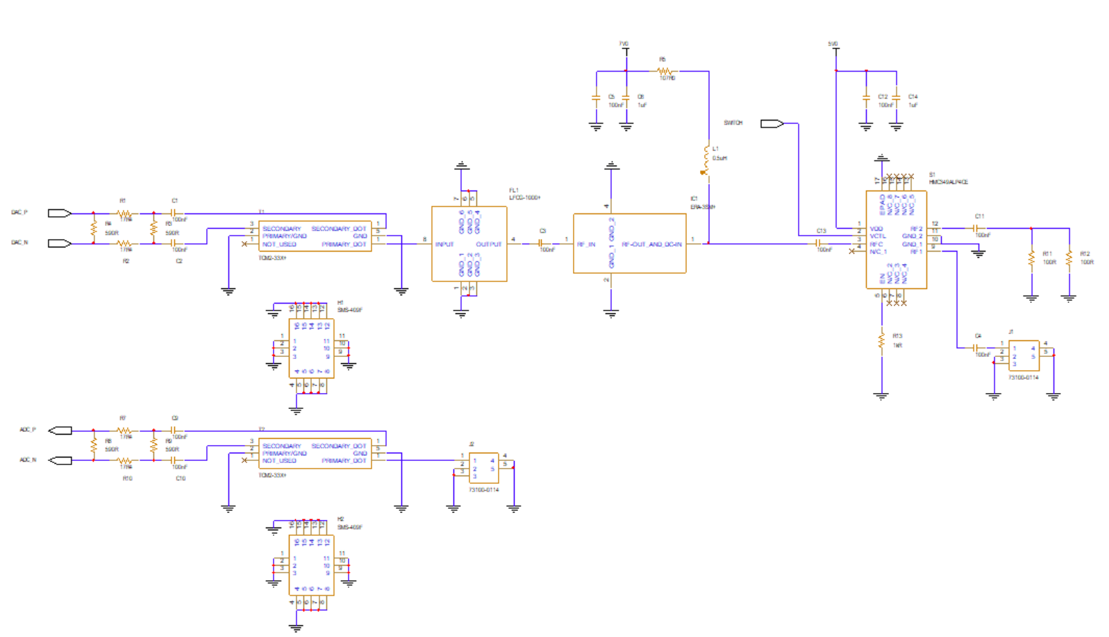
PCB design

Slide 14
Simulation Circuit
Port1
Port2
LPF
PA
+23dB
(P1dB +13dBm)
PI-pad
-3dB
balun
-10dB

Slide 15
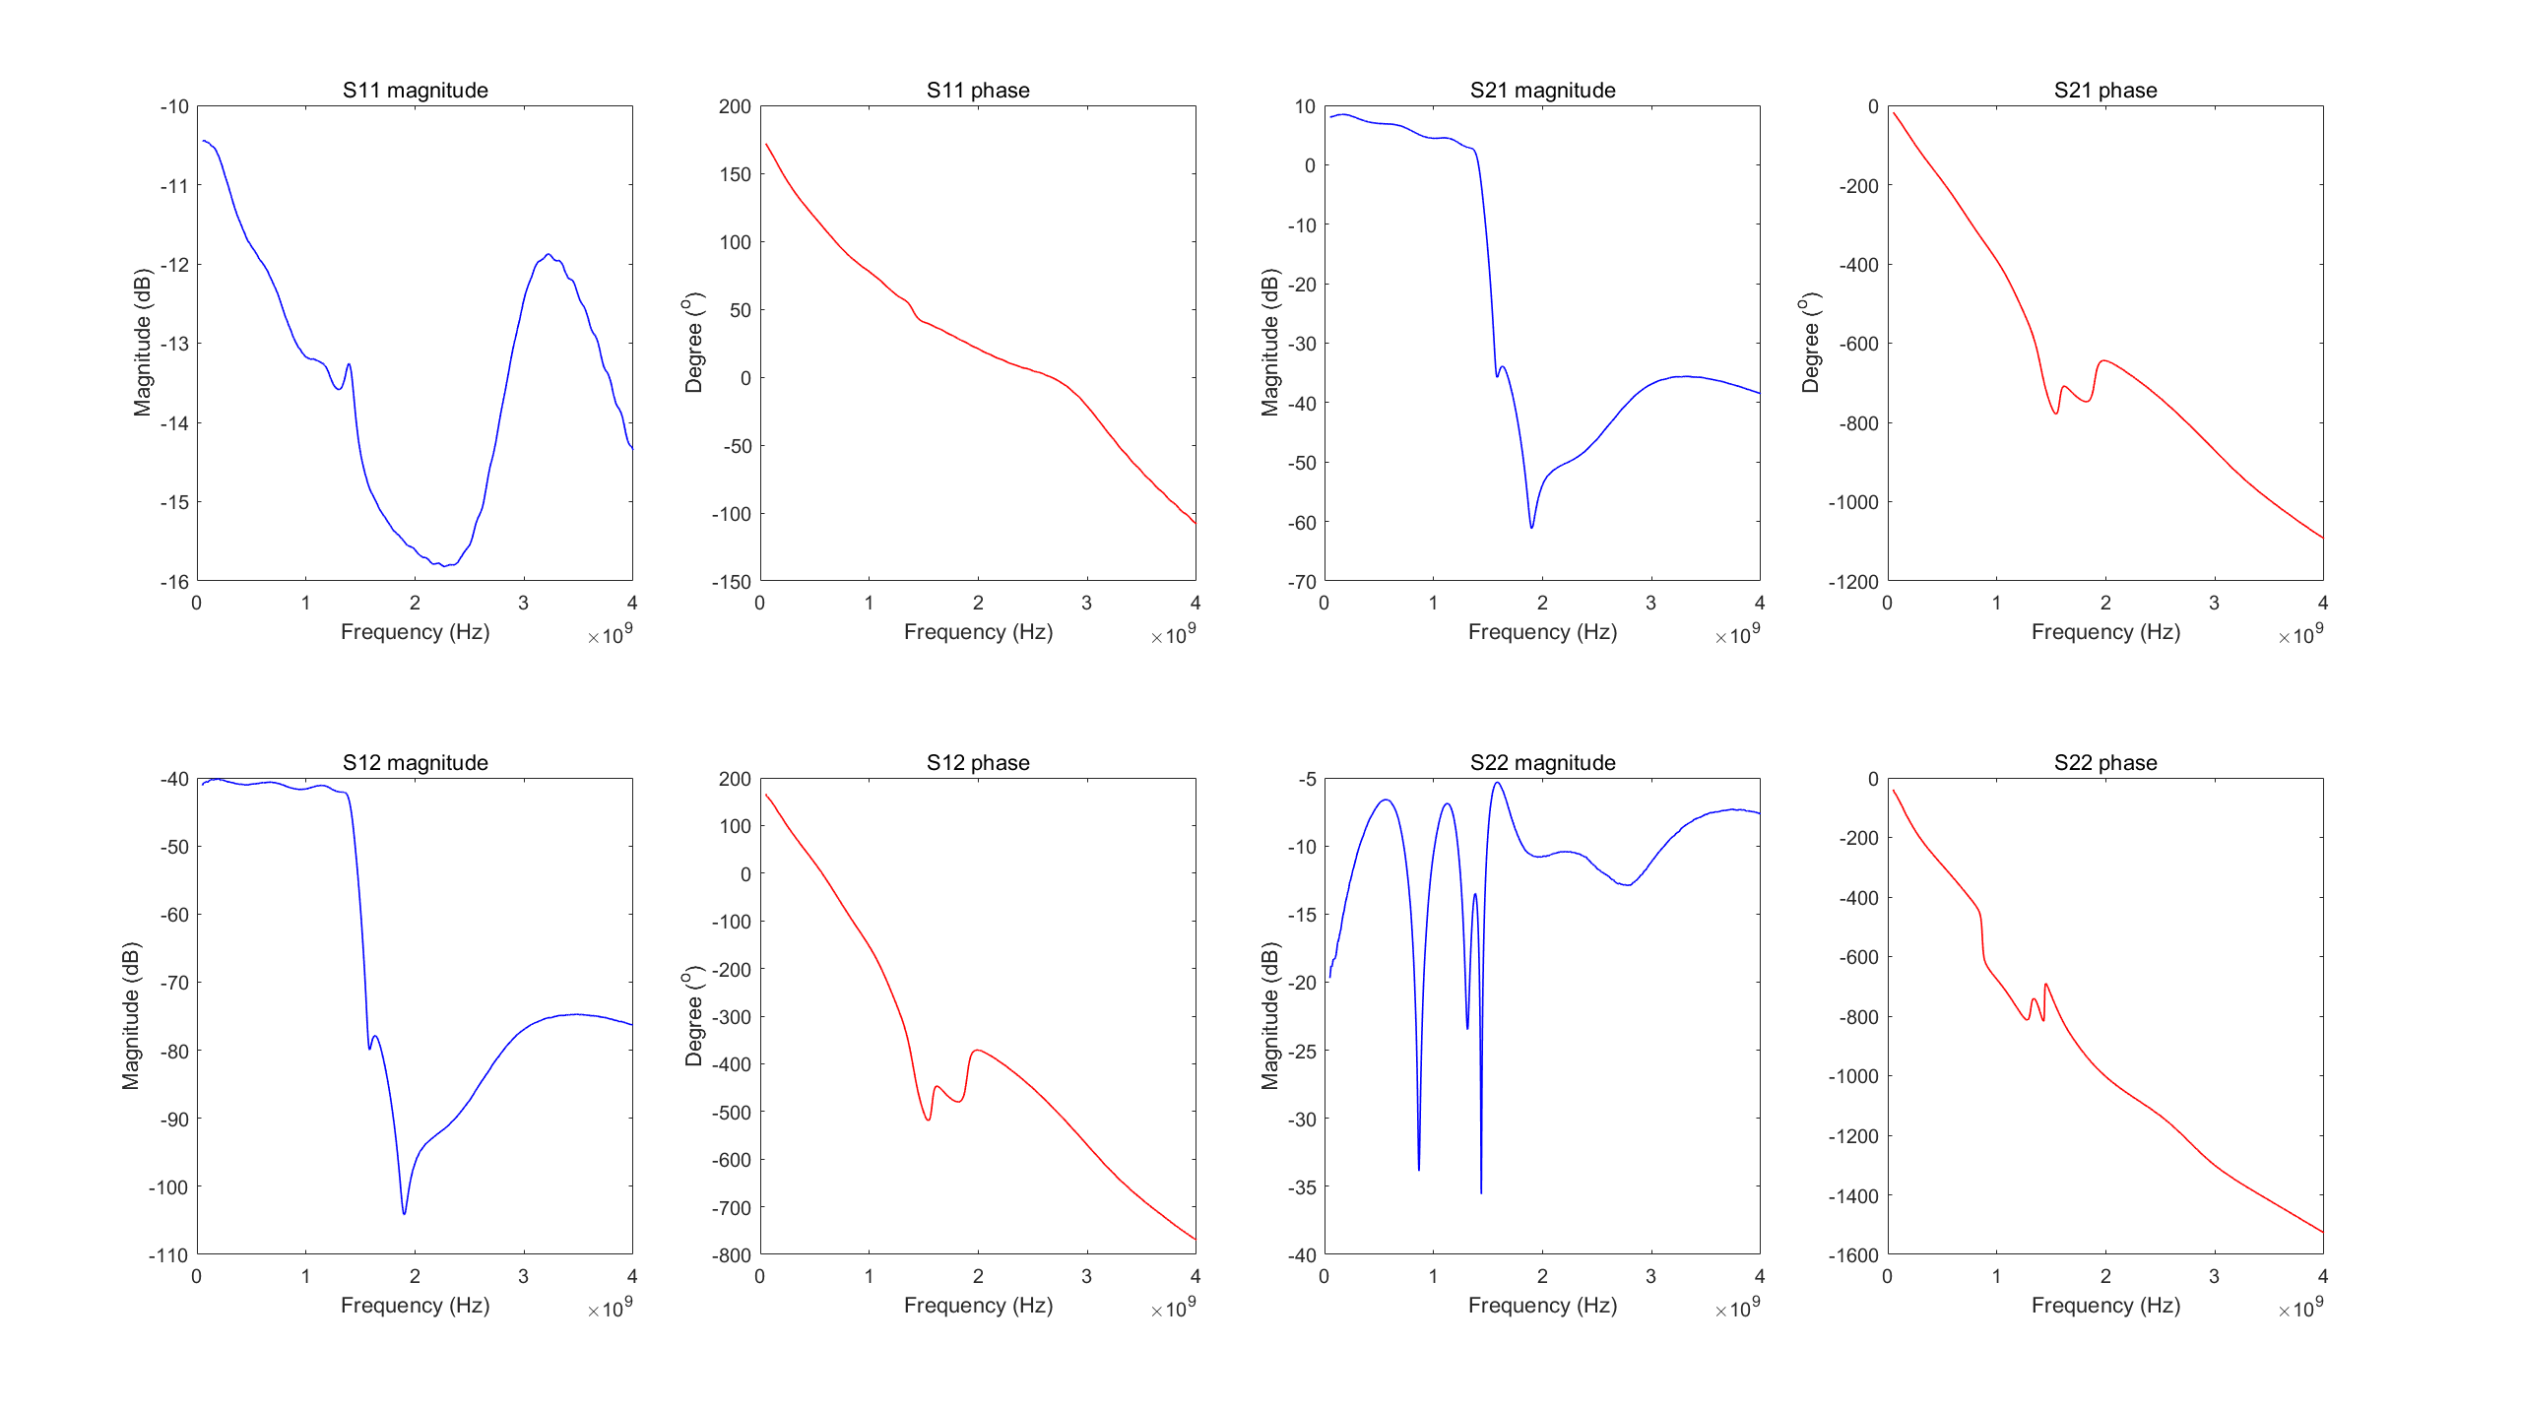
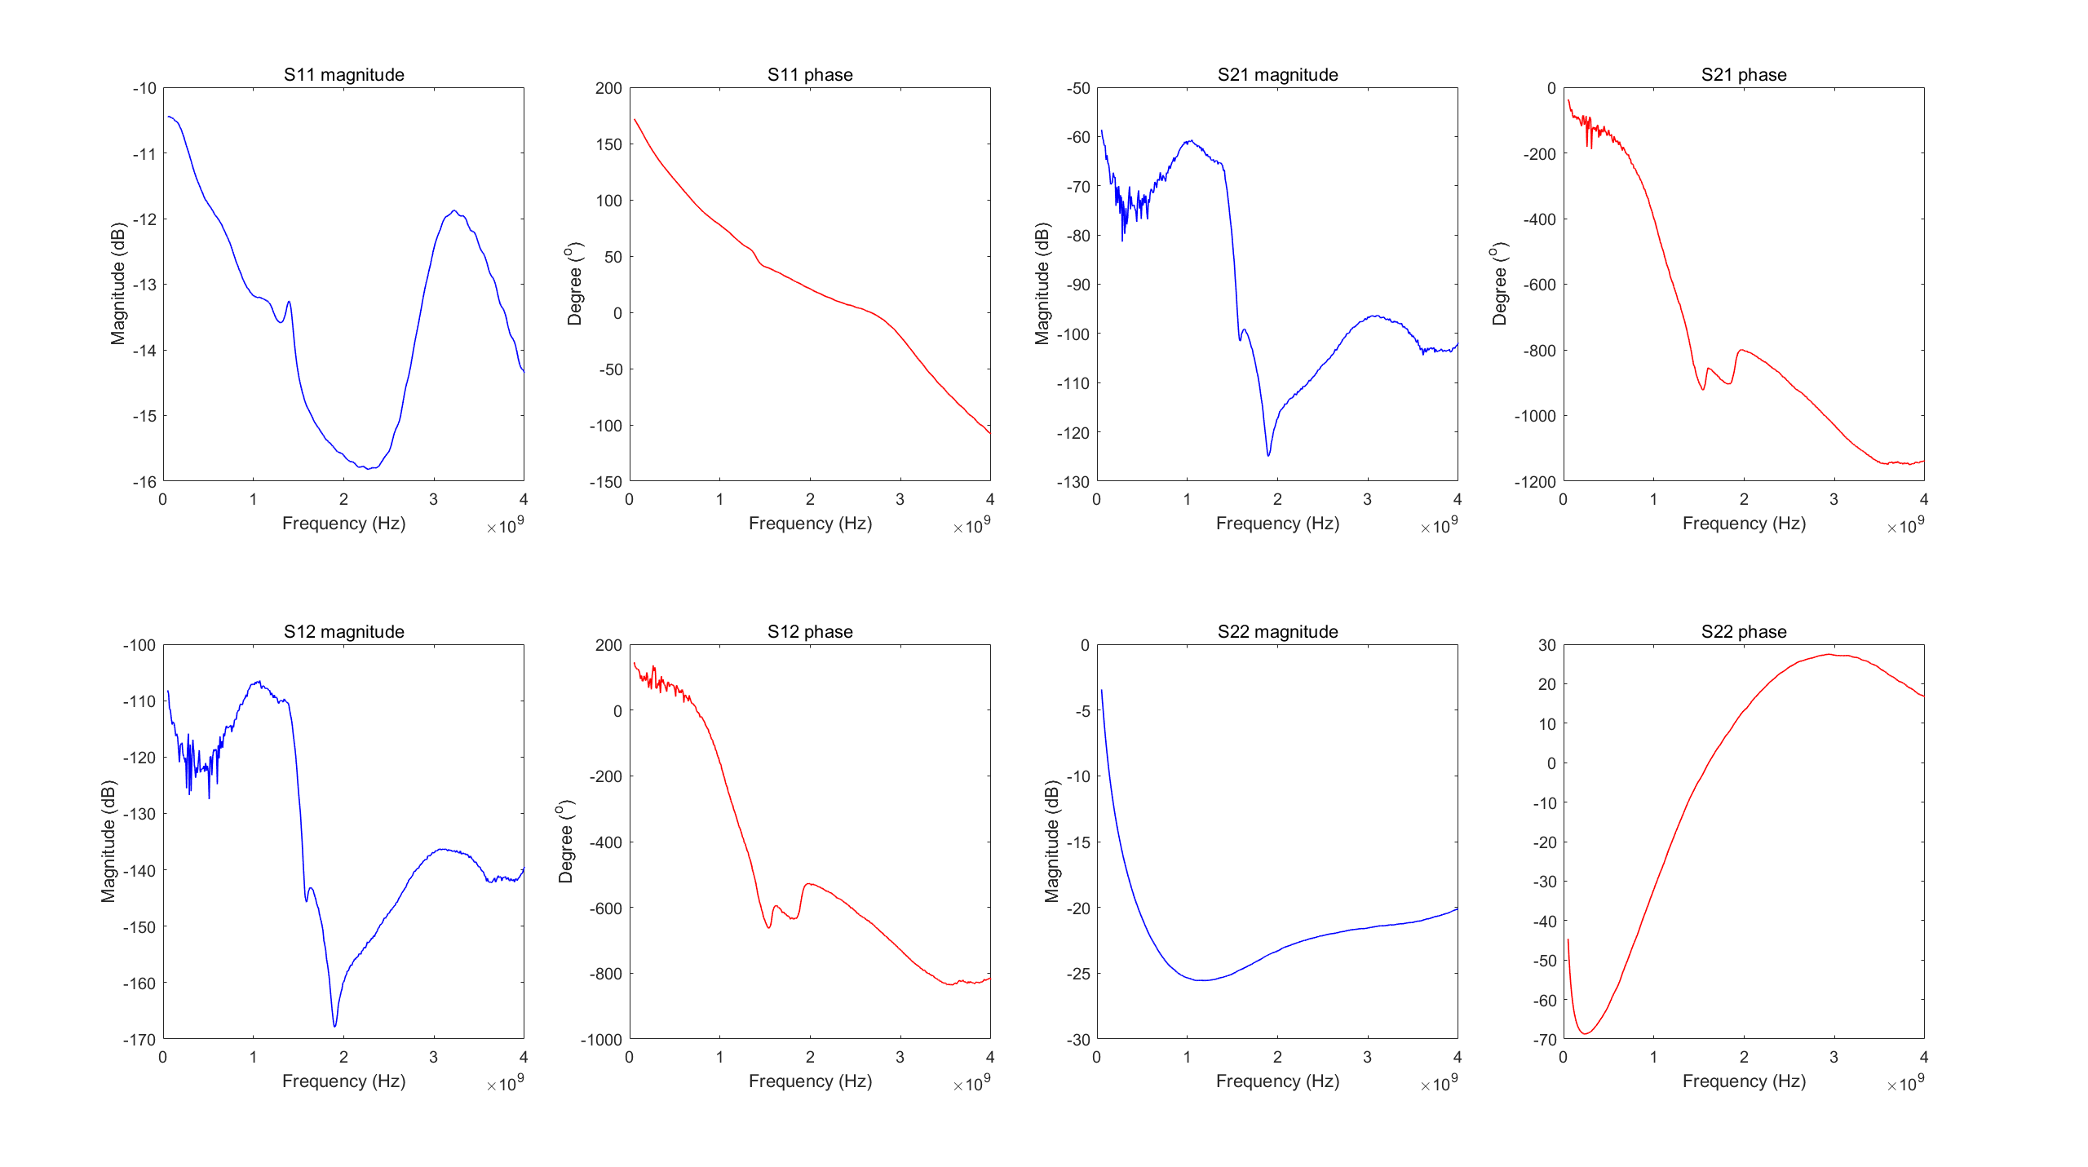
S parameter simulation
RF Switch On
RF Switch Off

Slide 16
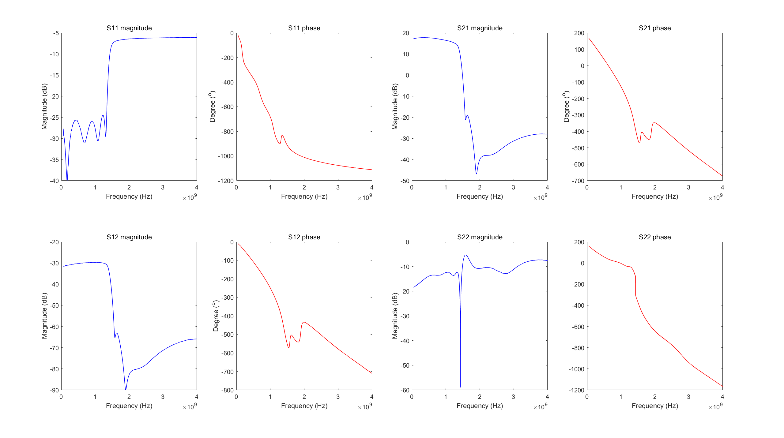
Effect from Baloon
with baloon
without baloon

Slide 17

Effect of Attenuator
with attenuator
without attenuator

Slide 18
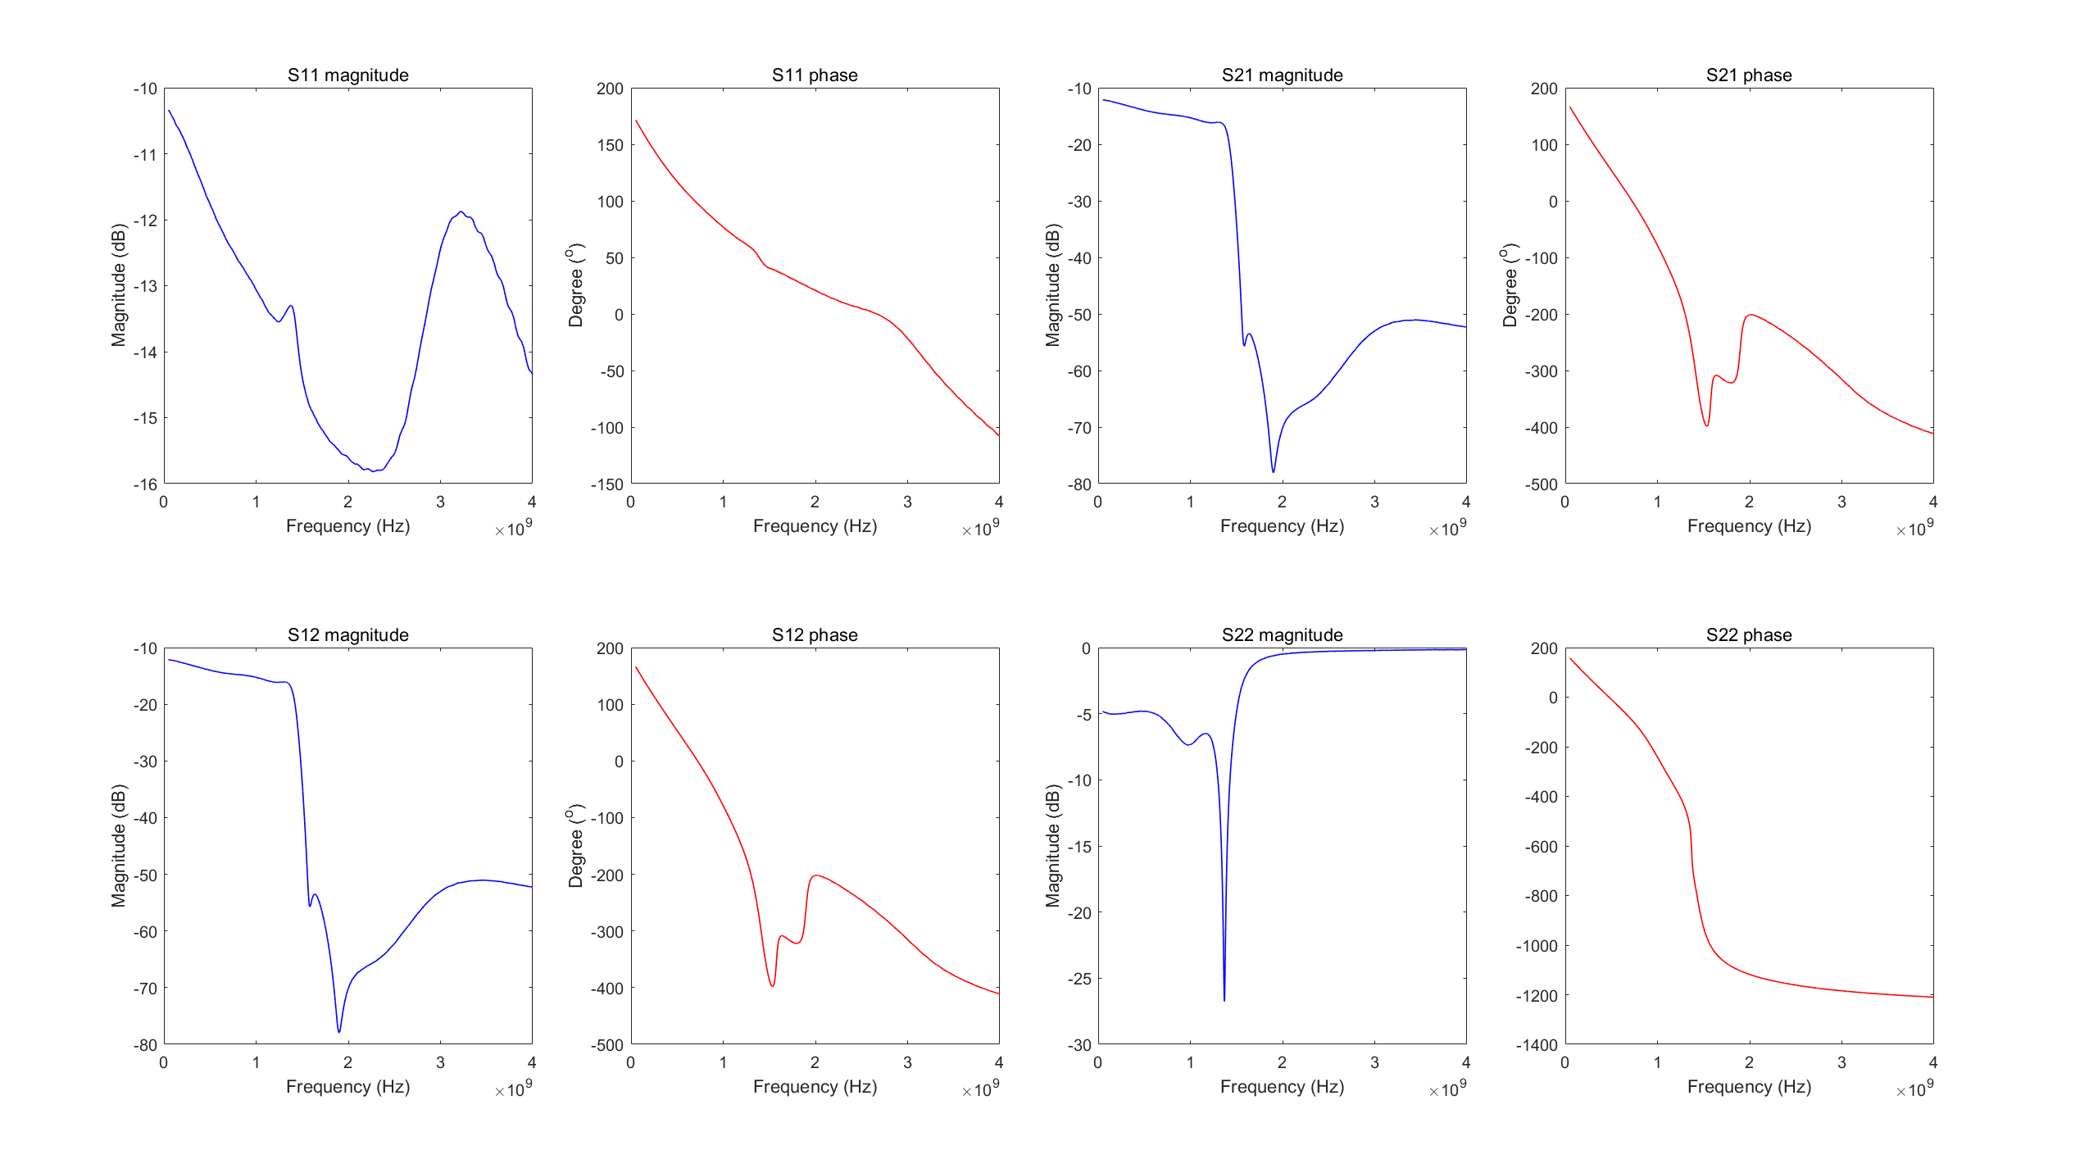
Before Amplifier
P1dB = 13dBm

Slide 19
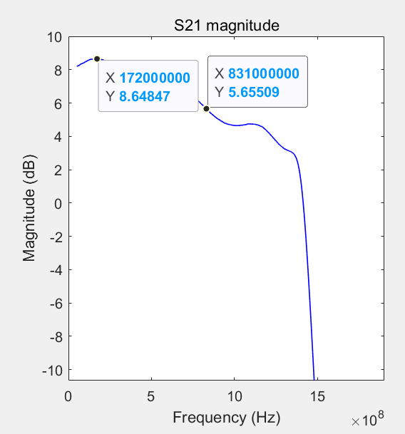
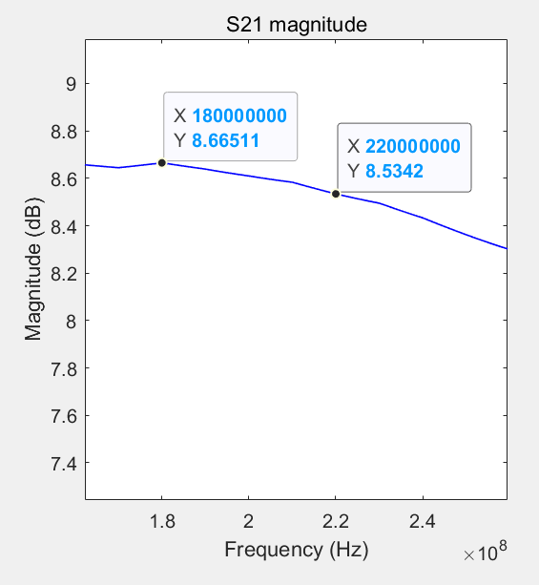
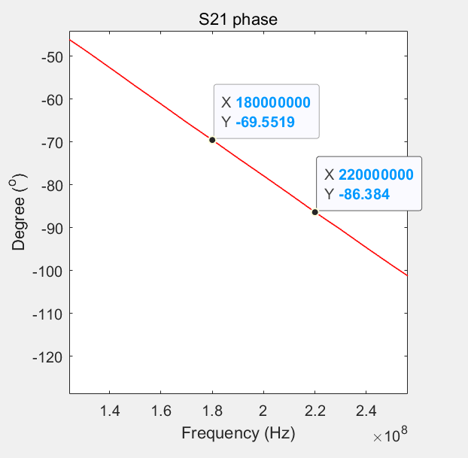
Near 200MHz

Slide 20
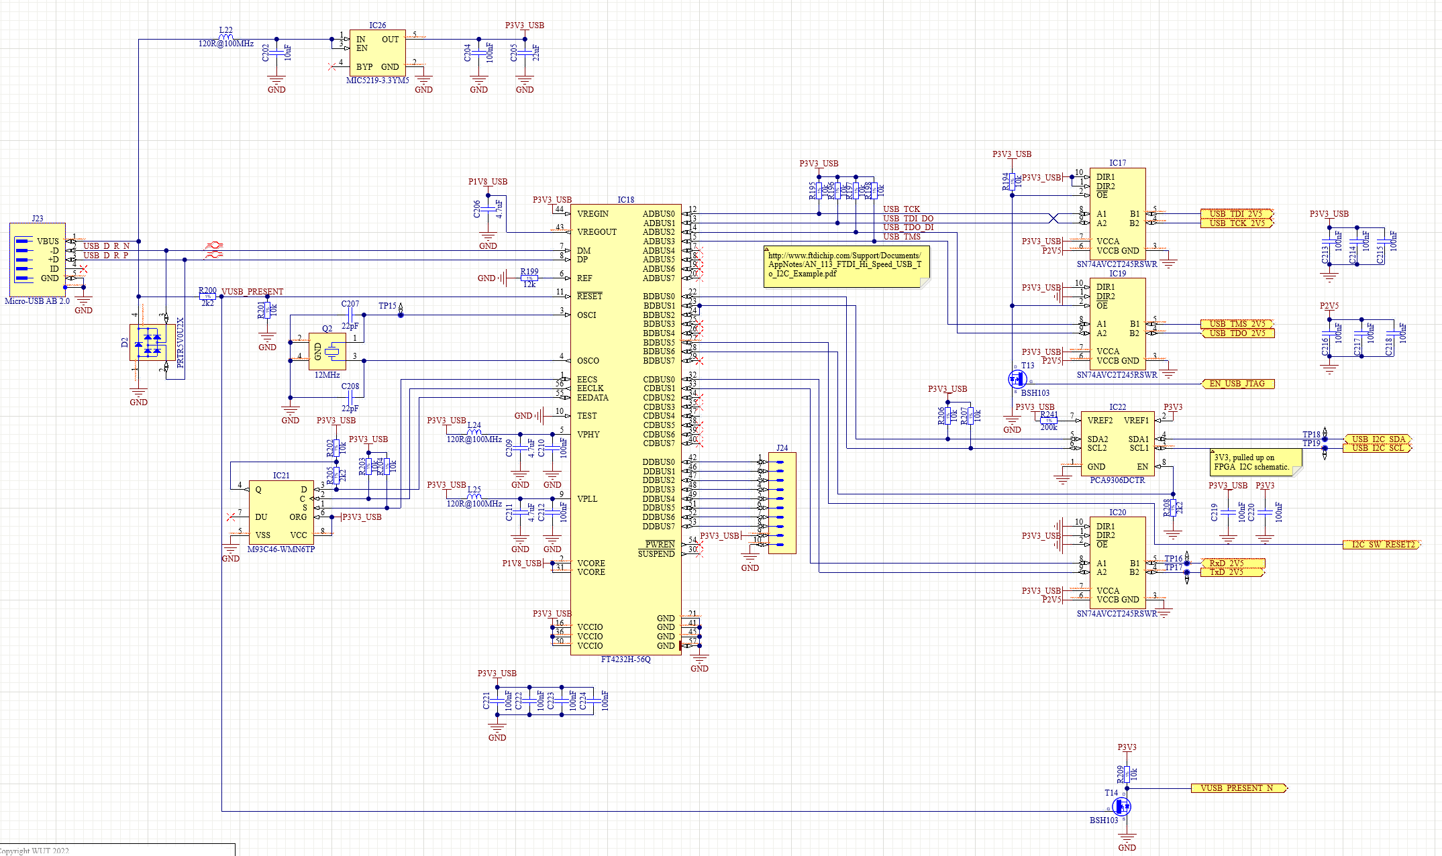
Xilinx Board Programming
FT4232H
FPGA
EEPROM

Slide 21
