Slide 1
RFSoC Design

Slide 2
rf_driver
seems to need improvement in fifo
RF_DataConverter
RFDC
controller
gpo_core
rto_core(rto_core)
DAC_out
AXI
AXI interconnect
Zynq
frequency
[63:0]gpo_out
counter_matched
timestamp_error
[127:0]error_data
IQ_in
busy
overflow_error
overrided
[127:0]rto_out
selected
[31:0]rd_data
busy_error
counter_matched
full
[127:0]gpo_in
empty
[63:0]override_value_input
auto_start
override_en_input
[31:0]wr_data
selected_input
reset
Ethernet
write
counter
[63:0]counter
cs
gpi_core
read
[31:0]din
[4:0]addr
[63:0]counter
data_ready
clk
write
[127:0]gpi_out
[15:0]dest
[4:0]addr
[127:0]timestamp_error_data
[127:0]overflow_error_data
DRAM
DMA Controller
read
[31:0]rd_data
rti_core()
cs
[127:0]rti_in
[127:0]timestamp_error_data
write
read
[4:0]addr
[31:0]rd_data
ADC_in
[63:0]counter
IQ_out

Slide 3
100MHz * 256 bit = 100MHz * 64 Byte/s = 6.4GB/s
->for 1ms, 6.4mB
->for 1us, 6.4kB

Slide 4
PC
Zynq
DMA controller
error_controller
RPU
RPU
APU
Time Controller
AXI Interconnect
AXI2FIFO
RTO Core0
RFDC controller
RFDC
instruction FIFO
GPO core
AXI2FIFO
RTO Core1
RFDC controller
instruction FIFO
GPO core
DRAM
1333MHz
AXI2FIFO
RTO Core2
RFDC controller
instruction FIFO
GPO core
AXI2FIFO
RTO Core3
RFDC controller
instruction FIFO
GPO core

Slide 5
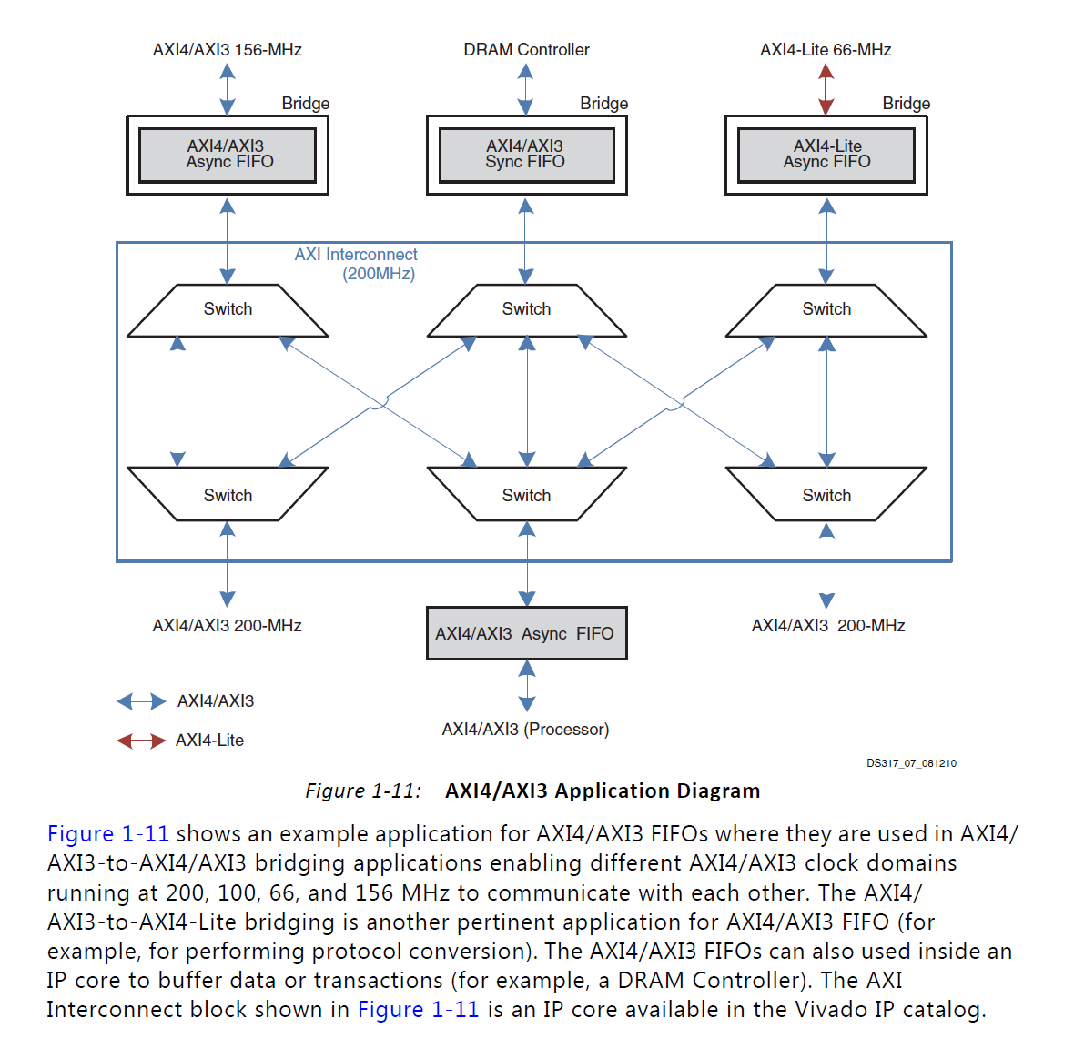

Slide 6
Instruction Decode
[15:0]dest
[15:0]control
[31:0]wr_data
[7:0]data_strobe
[1:0]fifo_mux_select
use_fifo
update
[3:0]mux_select

Slide 7
RFDC(only one DAC)
AXI_interconnect
RFDC controller
vout00_p
axi_s0_interface
axi_m0_interface
axi_s0_interface
axi_m0_interface
gpo_core(rfdc_control)
vout00_n
sysref_in_p
[63:0]gpo_out
axi_s1_interface
s00_axis_tdata[255:0]
[127:0]error_data
s00_axis_tready
sysref_in_p
busy
s00_axis_tvalid
overrided
clk_dac0
user_sysref_adc
selected
dac00_fast_shutdown
busy_error
s00_axis_tready
user_sysref_dac
dac00_pl_event
counter_matched
dac00_datapath_overflow
dac0_clk_p
dac00_nco_freq[47:0]
[127:0]gpo_in
dac0_nco_update_busy[1:0]
dac0_clk_n
dac00_nco_phase[17:0]
[63:0]override_value_input
s0_axis_aclk
dac00_nco_phase_rst
override_en_input
s0_axis_arestn
dac00_nco_update_en[5:0]
selected_input
s00_axis_tdata[255:0]
dac0_nco_update_req
s00_axis_tvalid
dac00_fast_shutdown
dac0_sysref_int_gaiting
dac00_pl_event
dac0_sysref_int_reenable
dac00_nco_freq[47:0]
dac00_nco_phase[17:0]
dac00_nco_phase_rst
dac00_nco_update_en[5:0]
dac0_nco_update_req
dac0_sysref_int_gaiting
dac0_sysref_int_reenable
sysref_in_p
CLK100MHz
sysref_in_n
dac0_clk_p
processot_reset
dac0_clk_n
aresetn

Slide 8
[15:0]dest
[15:0]control
[31:0]wr_data
axi_m0_interface
[7:0]data_strobe
[1:0]fifo_mux_select
use_fifo
update
[3:0]mux_select
s00_axis_tdata[255:0]
s00_axis_tdata[255:0]
[7:0]data_strobe
s00_axis_tvalid
dac00_fifo_en
gpo_core(gpo_dac_00)
dac00_fast_shutdown
s00_axis_tvalid
[1:0]dac00_ fifo_mux_select
[63:0]gpo_out
[127:0]error_data
dac00_pl_event
dac00_fast_shutdown
busy
[6:0]dac00_mux_select
overrided
dac00_nco_freq[47:0]
selected
dac00_pl_event
busy_error
dac00_nco_phase[17:0]
counter_matched
dac00_nco_phase_rst
dac00_nco_freq[47:0]
[47:0]gpo_00_buffer
dac00_nco_update_en[5:0]
DEMUX
[127:0]gpo_in
dac00_nco_phase[17:0]
[63:0]override_value_input
dac0_nco_update_req
[255:0]fifo_00_buffer
dac0_sysref_int_gaiting
dac00_nco_phase_rst
override_en_input
dac0_sysref_int_reenable
dac00_nco_update_en[5:0]
selected_input
dac0_nco_update_req
SYNC FIFO(fifo_dac_00)
dac0_sysref_int_gaiting
gpo0_selected_buffer
[255:0]data_out
clk
dac0_sysref_int_reenable
read
write
axi_decoder(axi_decoder_00)
empty
axi_m00_interface
[47:0]data_in
full
busy_error
axi_error
[255:0]data_in
selected
fifo0_underflow
fifo0_overflow
axi_error
busy_error
flush

Slide 9
[15:0]dest
[15:0]control
[31:0]wr_data
s00_axis_tdata[255:0]
[7:0]data_strobe
[1:0]fifo_mux_select
use_fifo
update
[3:0]mux_select
[7:0]data_strobe
dac00_fifo_en
gpo_core(gpo_dac_00)
0 1
[1:0]dac00_ fifo_mux_select
[63:0]gpo_out
[127:0]error_data
busy
[6:0]dac00_mux_select
overrided
selected
...
busy_error
[255:224]data
[223:192]data
[63:32]data
[31:0]data
counter_matched
[127:0]gpo_in
dac00_nco_freq[47:0]
[255:0]fifo_00_buffer
[63:0]override_value_input
override_en_input
selected_input
0 1
DEMUX
SYNC FIFO(fifo_dac_00)
[255:0]data_out
clk
[63:32]data
[31:0]data
read
DEMUX
write
dac00_nco_phase[17:0]
empty
full
DEMUX
[31:0]gpo_00_buffer
[255:0]data_in
1 0
flush

Slide 10
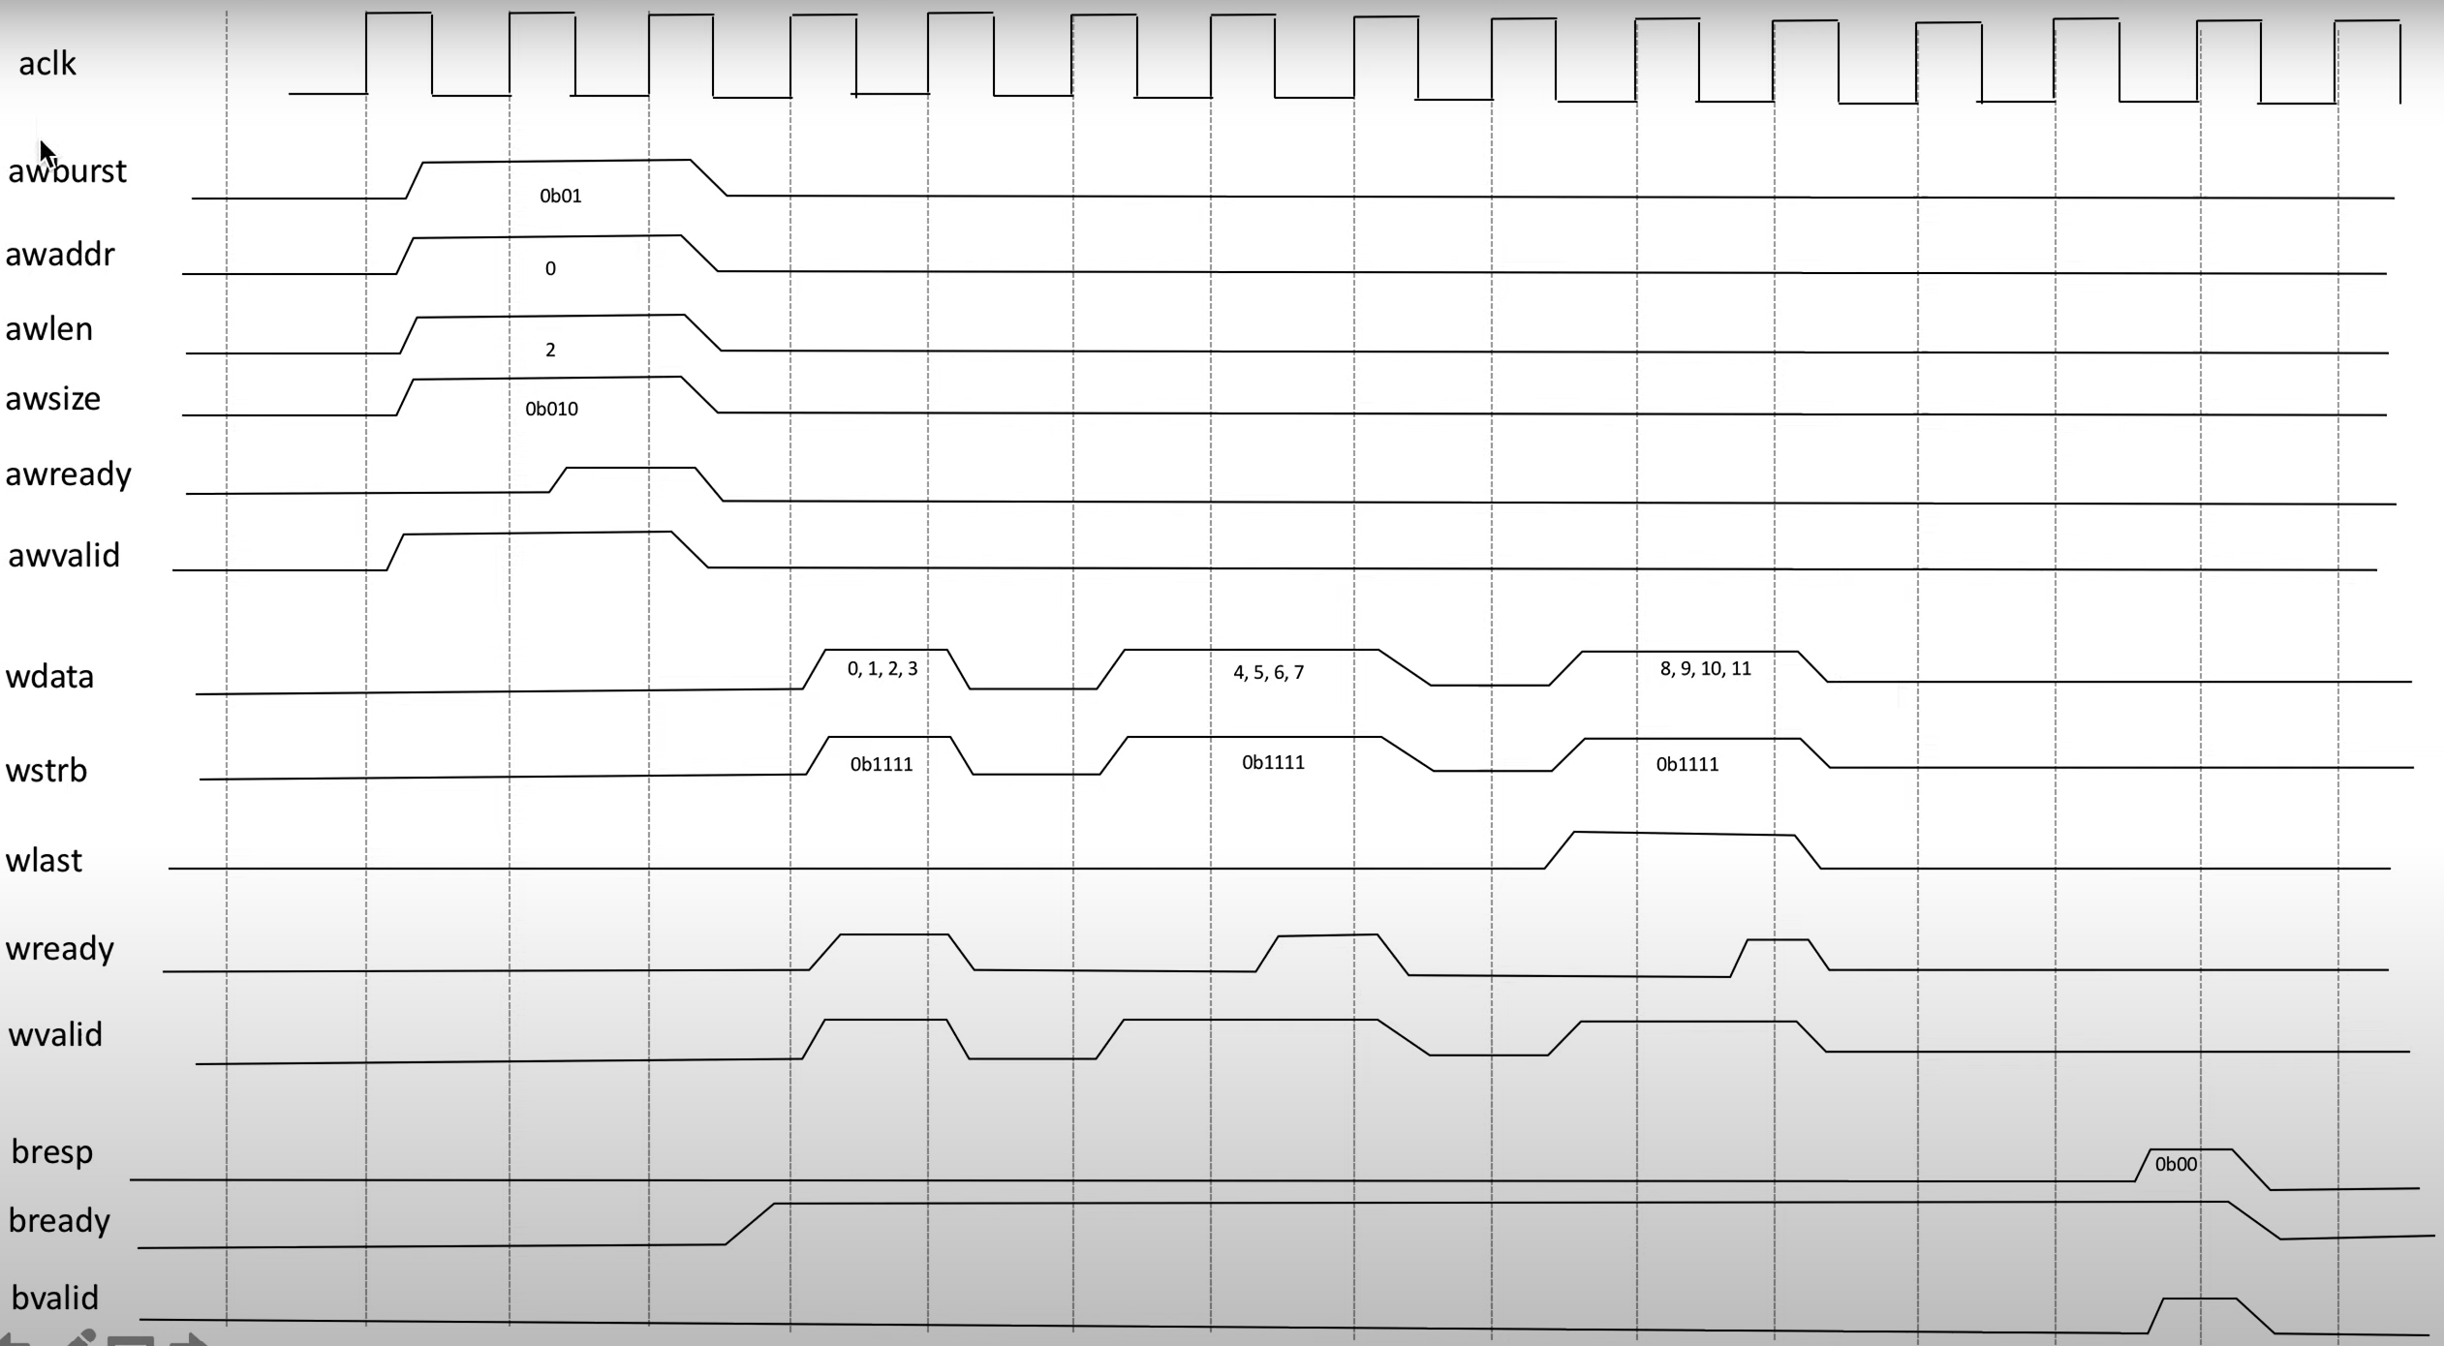

Slide 11
Solution1
Start()
#timestamp 0
Do Something()
Delay(1)
#timestamp 1
A = Measure()
Delay(1)
#timestamp 2
If( A == True )
Delay(2)
#timestamp 4
Do Something()
Else
Delay(5)
#timestamp 7
Do Something()
#back to timestamp 2
Do Something()
Delay(1)
#timestamp 3
Do Something()
Delay(2)
#timestamp 5
Do Something()
Delay(1)
#timestamp 6
Do Something()
End()
Zynq
RPU
Timestamp FIFO
Data bram
APU
timestamp | address
0000 | 0x0000
0001 | 0x0001
0002 | 0x0006
0003 | 0x0002
0004 | 0x0005
0005 | 0x0003
0006 | 0x0004
0007 | 0x0007
address | data
0x0000 | XXXX
0x0001 | XXXX
0x0002 | XXXX
0x0003 | XXXX
0x0004 | XXXX
0x0005 | NULL->XXXX
0x0006 | COND
0x0007 | XXXX->NULL
set data according to conditional statement
condition check
conditional statement interrupt

Slide 12
Solution2
Start()
#timestamp 0
Do Something()
Delay(1)
#timestamp 1
A = Measure()
Delay(1)
#timestamp 2
If( A == True )
Delay(2)
#timestamp 4
Do Something()
Else
Delay(5)
#timestamp 7
Do Something()
#back to timestamp 2
Do Something()
Delay(1)
#timestamp 3
Do Something()
Delay(2)
#timestamp 5
Do Something()
Delay(1)
#timestamp 6
Do Something()
End()
0 RTO DO_SOMETIHNG
1 RTO MEASURE
2 EQ A MES_VAL
2 IF A JMP TRUE:
7 RTO DO_SOMETHING
2 JMP FALSE:
TRUE:
4 RTO DO_SOMETIHNG
FALSE:
2 RTO DO_SOMETHING
3 RTO DO_SOMETHING
5 RTO DO_SOMETHING
6 RTO DO_SOMETHING
Zynq
Interpreter(in PC)
Just In Time Compilation(in Zynq)
RPU
APU

Slide 13
Solution3
Start()
#timestamp 0
Do Something()
Delay(1)
#timestamp 1
A = Measure()
Delay(1)
#timestamp 2
If( A == True )
Delay(2)
#timestamp 4
Do Something()
Else
Delay(5)
#timestamp 7
Do Something()
#back to timestamp 2
Do Something()
Delay(1)
#timestamp 3
Do Something()
Delay(2)
#timestamp 5
Do Something()
Delay(1)
#timestamp 6
Do Something()
End()
#define RTO_ADDRESS 0xF0000000
...
int main(){
uint32 *rto = RTO_ADDRESS;
uint32 *rti = RTI_ADDRESS;
uint32 *measure_done = MEASURE_DONE;
uint64 timestamp = 0;
...
*rto = timestamp | DO_SOMETHING;
*rto_push = 1;
while( rto_push_done == 0 ){
*rto_push = 0;
}
timestamp += 1;
*rto = timestamp | MEASURE;
while( rto_push_done == 0 ){
*rto_push = 0;
}
while(1){
if( measure_done ){
A = *rti;
break;
}
}
if( A == 1 ){
timestamp += 2;
*rto = timestamp | DO_SOMETHING;
while( rto_push_done == 0 ){
*rto_push = 0;
}
}
else{
...
}
...
}
address of memory mapped IO
Zynq
Interpreter(in PC)
From Python to C
Compile(using LLVM in PC) and send to Zynq
RPU
APU
variable
output data to FIFO through AXI
output signal to write FIFO through AXI
polling waiting for FIFO write done
RTO
RTI
polling waiting for FIFO read done
conditional statement implementation does not make problem

Slide 14
OS should be made to solve timestamp problem
e.g.
@1 DEVICE1()
@5 DEVICE1()
@3 DEVICE2()
->DEVICE2 timestamp error
Task1
@1 DEVICE1()
@5 DEVICE1()
Task2
@3 DEVICE2()
or user should not write code like this!

Slide 15
Solution4
Start()
#timestamp 0
Do Something()
Delay(1)
#timestamp 1
A = Measure()
Delay(1)
#timestamp 2
If( A == True )
#timestamp 2
Do Something()
Delay(1)
#timestamp 3
Do Something()
Delay(1)
#timestamp 4
Do Something()
Delay(1)
#timestamp 5
Do Something()
Delay(1)
#timestamp 6
Do Something()
Else
#timestamp 2
Do Something()
Delay(1)
#timestamp 3
Do Something()
Delay(1)
#timestamp 5
Do Something()
Delay(1)
#timestamp 6
Do Something()
Delay(1)
#timestamp 7
Do Something()
End()
#define RTO_ADDRESS 0xF0000000
...
int main(){
uint32 *rto = RTO_ADDRESS;
uint32 *rti = RTI_ADDRESS;
uint32 *measure_done = MEASURE_DONE;
uint64 timestamp = 0;
...
*rto = timestamp | DO_SOMETHING;
*rto_push = 1;
while( rto_push_done == 0 ){
*rto_push = 0;
}
timestamp += 1;
*rto = timestamp | MEASURE;
while( rto_push_done == 0 ){
*rto_push = 0;
}
while(1){
if( measure_done ){
A = *rti;
break;
}
}
if( A == 1 ){
timestamp += 2;
*rto = timestamp | DO_SOMETHING;
while( rto_push_done == 0 ){
*rto_push = 0;
}
}
else{
...
}
...
}
Start()
#timestamp 0
Do Something()
Delay(1)
#timestamp 1
A = Measure()
Delay(1)
#timestamp 2
If( A == True )
Delay(2)
#timestamp 4
Do Something()
Else
Delay(5)
#timestamp 7
Do Something()
#back to timestamp 2
Do Something()
Delay(1)
#timestamp 3
Do Something()
Delay(2)
#timestamp 5
Do Something()
Delay(1)
#timestamp 6
Do Something()
End()
Interpreter(in PC)
From Python to C
AT FUTURE

Slide 16
AXI Control with Timestamp
AXI Interconnect
Zynq
Interrupt Controller
Zynq
RPU
RPU
APU
A{U
RTO
RTO_AXI
GPO
AXI Interconnect
RFDC
RFDC

Slide 17
Pro1 How can we send data to RFDC?
Sol1 - Set eq y = f(t) at PC and send to Zynq to calculate it locally
Sol2 - Send data from PC at live
Pro2 How can we send data from DRAM to RFDC?
Sol1 - Set timing precisely before send data
Sol2 - Set starve signal->interrupt signal can be appear

Slide 18
GND | D15
GND | D14
GND | D13
GND | D12
GND | D11
GND | D10
GND | D9
GND | D8
GND | D7
GND | D6
GND | D5
GND | D4
GND | TXEN
GND | D3
GND | D2
GND | D1
GND | D0
GND | F1
GND | F0
AD9910
GND | PROF1[2]
GND | PROF1[1]
GND | PROF1[0]
GND | IOUPDATE1
GND | IOUPDATE2
GND | PROF2[0]
GND | PROF2[1]
GND | PROF[0]
GND | RESET1
GND | SDIO1
GND | SCLK1
GND | CSB1
GND | CSB2
GND | SCLK2
GND | SDIO2
GND | RESET2
OSK | DRCTL1 | DRHOLD1
GND | GND | GND
GND | PWRDWN1 | 3.3V
GND | PWRDWN2 | 3.3V
CLK
GND | D15
GND | D14
GND | D13
GND | D12
GND | D11
GND | D10
GND | D9
GND | D8
GND | D7
GND | D6
GND | D5
GND | D4
GND | TXEN
GND | D3
GND | D2
GND | D1
GND | D0
GND | F1
GND | F0
AD9910
OSK2 | DRCTL2 | DRHOLD2
GND | GND | GND

Slide 19
GND | D15
GND | D14
GND | D13
GND | D12
GND | D11
GND | D10
GND | D9
GND | D8
GND | D7
GND | D6
GND | D5
GND | D4
GND | TXEN
GND | D3
GND | D2
GND | D1
GND | D0
GND | F1
GND | F0
AD9910
GND | PROF1[2]
GND | PROF1[1]
GND | PROF1[0]
GND | IOUPDATE1
GND | IOUPDATE2
GND | PROF2[0]
GND | PROF2[1]
GND | PROF[0]
GND | RESET1
GND | SDIO1
GND | SCLK1
GND | CSB1
GND | CSB2
GND | SCLK2
GND | SDIO2
GND | RESET2
OSK | DRCTL1 | DRHOLD1
GND | GND | GND
GND | PWRDWN1 | 3.3V
GND | PWRDWN2 | 3.3V
CLK
GND | D15
GND | D14
GND | D13
GND | D12
GND | D11
GND | D10
GND | D9
GND | D8
GND | D7
GND | D6
GND | D5
GND | D4
GND | TXEN
GND | D3
GND | D2
GND | D1
GND | D0
GND | F1
GND | F0
AD9910
OSK2 | DRCTL2 | DRHOLD2
GND | GND | GND

