Slide 1
RFSoC
Introduction to RFSoC

Slide 2
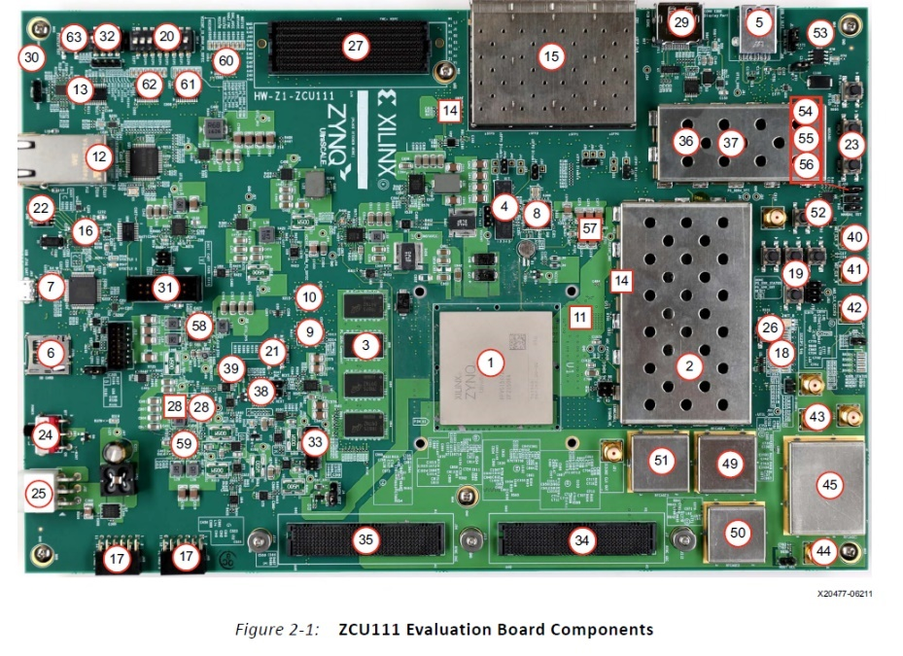
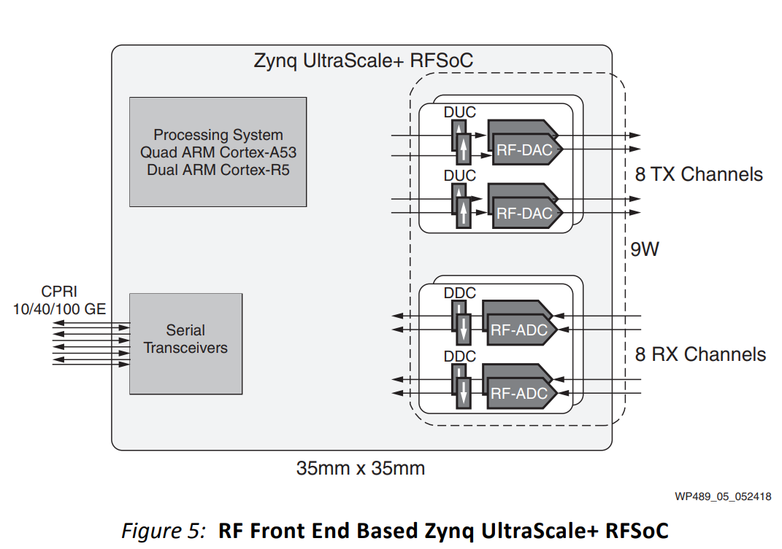
RFSoC?
XCZU28DR
ZCU111

Slide 3
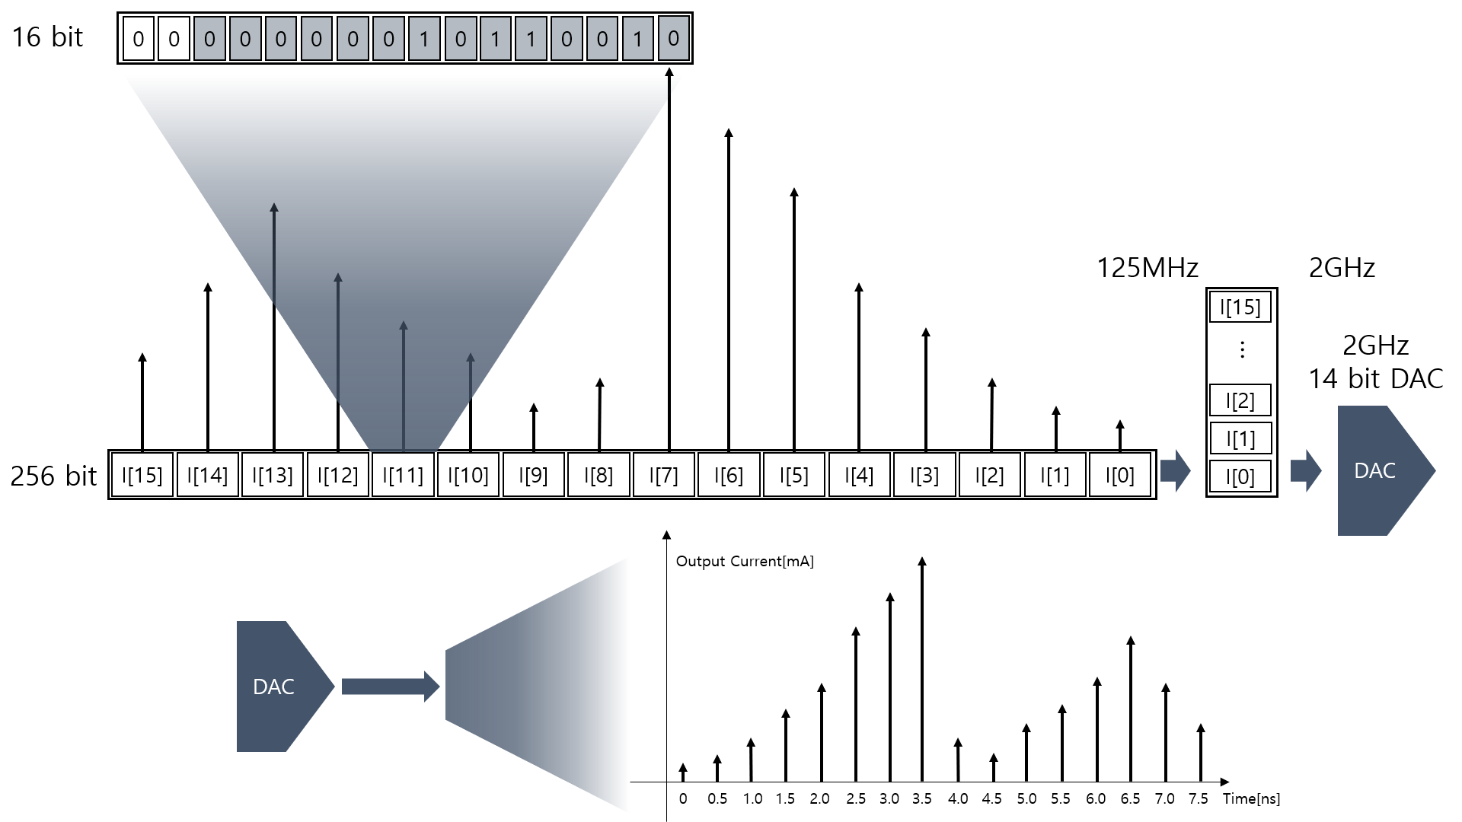
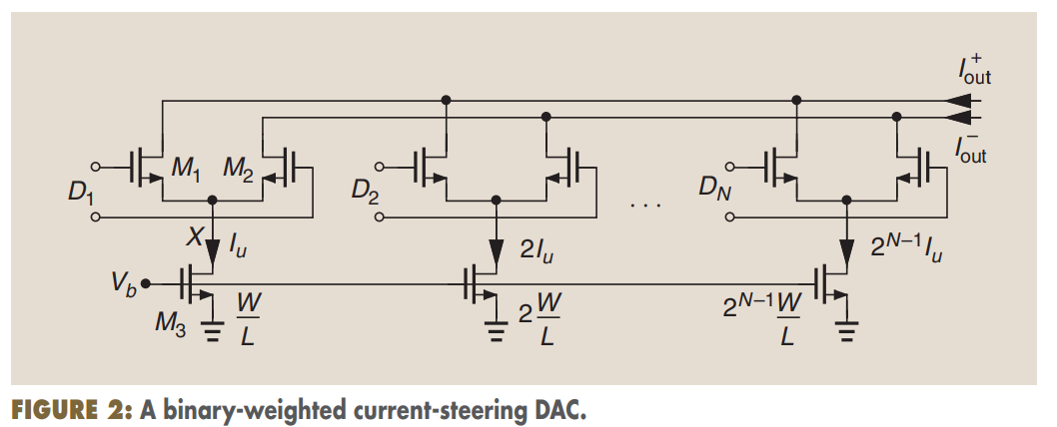
RFSoC DAC

