Slide 1
QuIQCL LabSeminar
Current RFSoC Procedure

Slide 2
Contents
About Compiler
RFSoC Structure
Internal Structure(Verilog + Firmware)

Slide 3

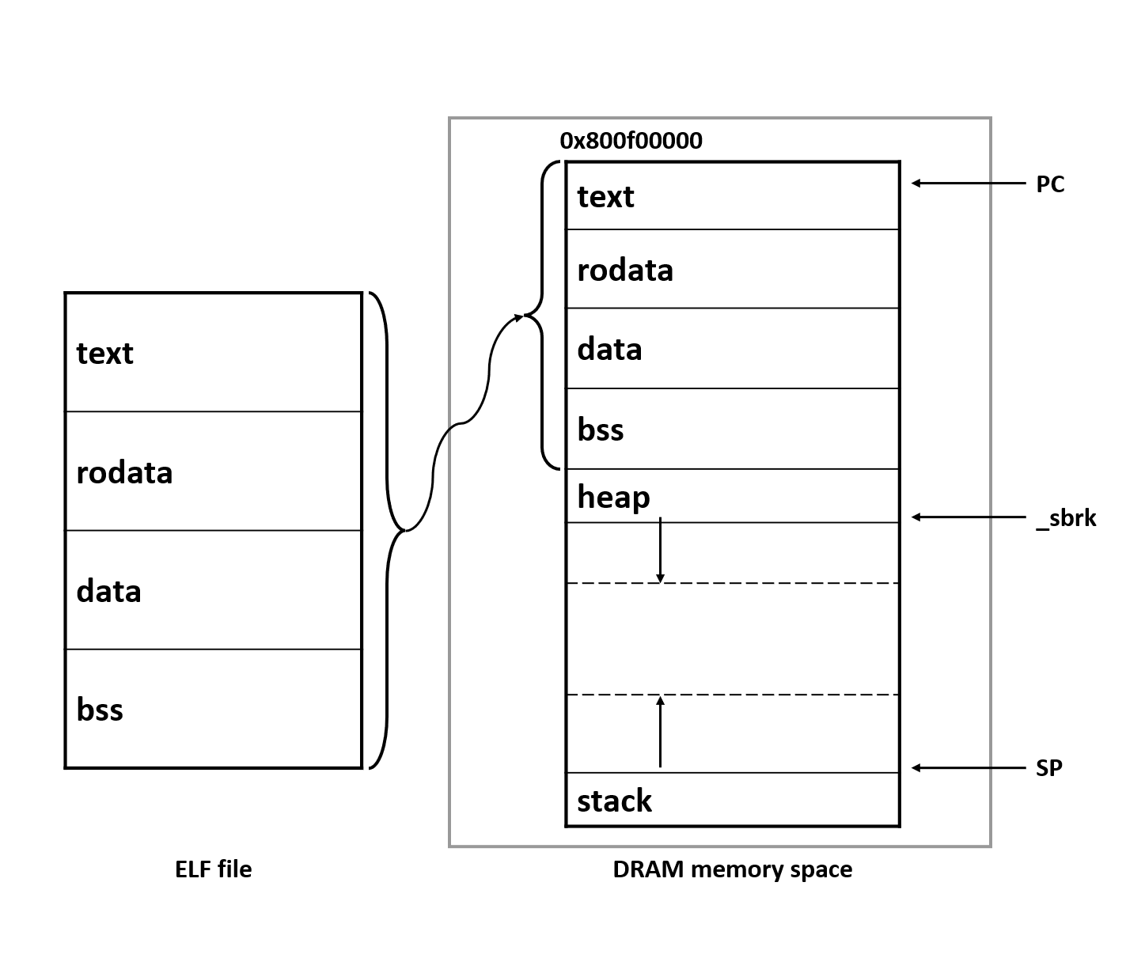
Compiler
exp.c
linker.ld
exp.elf
init.S
GNU
/xilinx_bsp
/rfsoc_driver

Slide 4
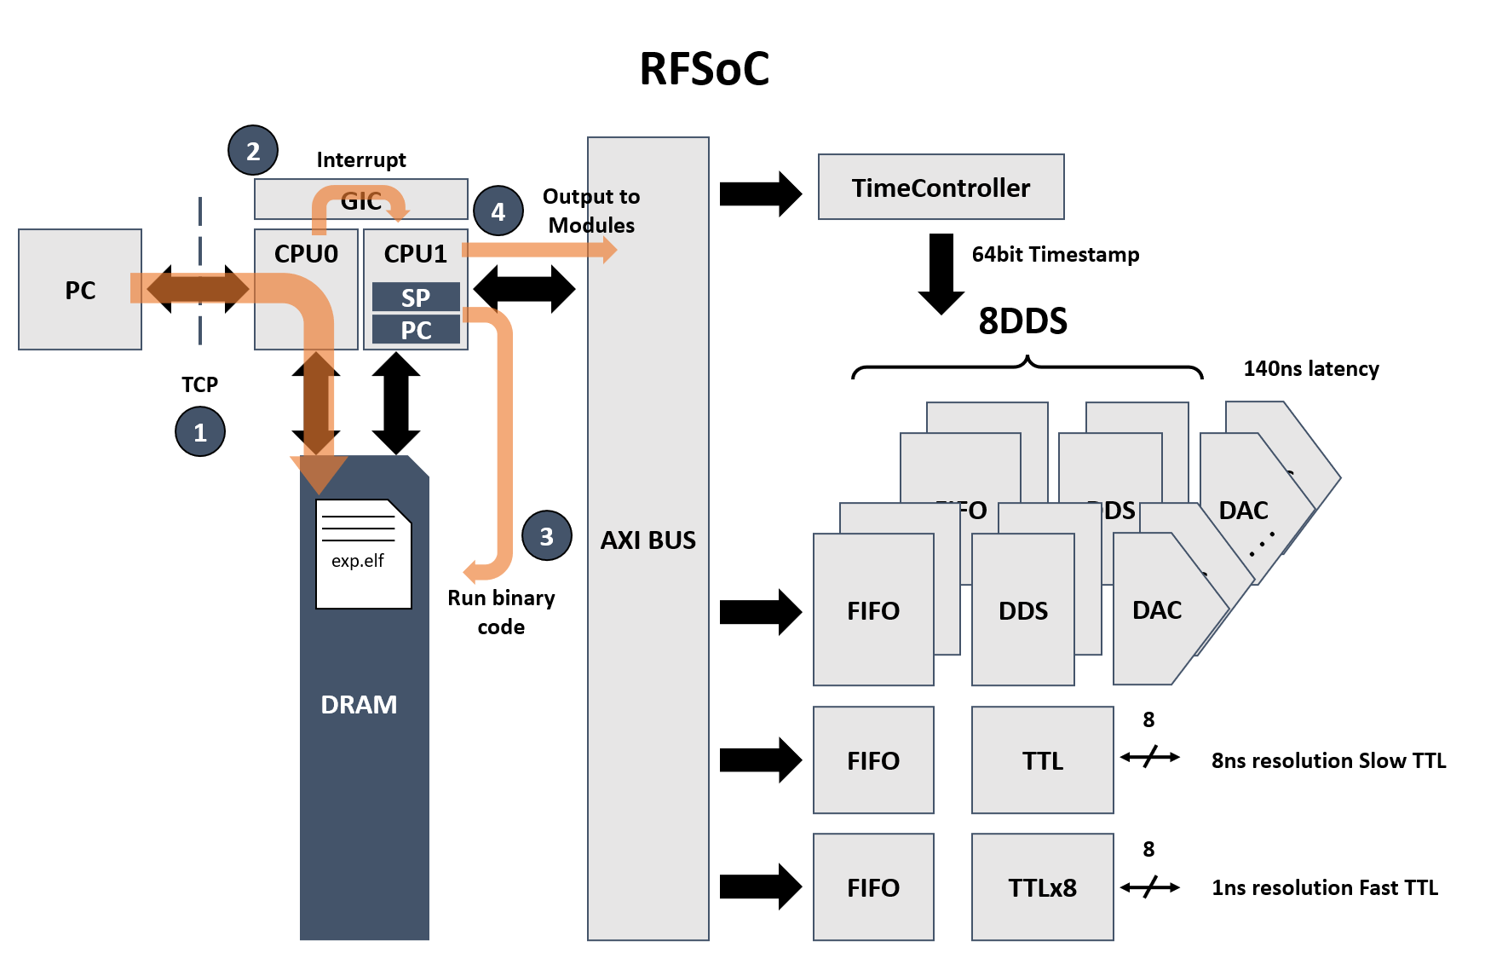
Current Structure

