Slide 1
RFSoC Design Simplified
V1_1
V1_0 Simple DDS
V1_1 Branch Controller, Edge Counter Concept Added
125MHz Bit gen done, TTLx8_out, RFDC_DDS Added

Slide 2
Design Procedure

Slide 3
Vivado
Base Code Creation
Dubugging
Firmware
Debugging
Experiment Code
Experiment

Slide 4
Vivado
Vitis
Firmware
Base Code Creation
Make TCL & Indexing
Debugging
On Chip Firmware
Debugging
Experiment Code
Compiler & Linker
Experiment

Slide 5
rf_driver
Version1
RF_DataConverter
RFDC
controller
gpo_core
rto_core_axi(rto_core)
DMA Controller
Interrupt Port
DAC_out
AXI
Zynq
frequency
[94:0]gpo_out
counter_matched
timestamp_error
210ns + 350ns
(For Soft Timing)
IQ_in
[94:0]error_data
overflow_error
DRAM
APU0
TCP
busy
overrided
[158:0]rto_out
[158:0]rd_data
1~100us
for APU<->RPU IPC case
selected
busy_error
full
FPD0
counter_matched
empty
AXI address set config
Interrupt and send DRAM address
[94:0]gpo_in
auto_start
3
AXI interconnect
[158:0]wr_data
AXI
RPU0
Deterministic
DMA Control
BTCM
RPU1
Branch Interrupt
selected_input
reset
write
counter
[63:0]timestamp
[63:0]data
[63:0]counter
For deterministic instruction
cs
Branch Result
(for time shift)
read
Possible to Interleaved access!
LPD0
EMIO[94:0]
clk
130ns + 250ns
(For Hard Timing)
100MHz Fixed
90ns / 280ns
(Exclusive Access for Conditional Inst)
[127:0]timestamp_error_data
[127:0]overflow_error_data
For fast conditional instruction
Config set data as a timestamp or not
EMIO Arbiter
nop_maker
rto_core_emio(rto_core)
FSM
2
[14:0]config
[15:0]dest
[63:0]data
EMIO
<30ns(target latency)
Branch Controller
rto_core_branch(rto_core)
FSM
1
ADC_in
BRANCH
Refresh < 100 cycles
Let’s look data sheet for more details…
IQ_out

Slide 6
rf_driver
Version2
RF_DataConverter
RFDC
controller
gpo_core
rto_core_axi(rto_core)
Refresh < 100 cycles
Let’s look data sheet for more details…
DMA Controller
Interrupt Port
DAC_out
AXI
Zynq
frequency
[127:0]gpo_out
counter_matched
timestamp_error
210ns + 350ns
(For Soft Timing)
IQ_in
[127:0]error_data
overflow_error
DRAM
busy
overrided
[127:0]rto_out
[127:0]rd_data
selected
busy_error
full
counter_matched
empty
AXI address set config
Interrupt and send DRAM address
[127:0]gpo_in
auto_start
2
AXI interconnect
[127:0]wr_data
AXI
RPU0
DMA Control
TCP
BTCM
RPU1
Branch Interrupt
Instruction Fetch
selected_input
reset
write
counter
[63:0]timestamp
[63:0]data
[63:0]counter
For deterministic instruction
cs
Branch Result
(for time shift)
read
Possible to Interleaved access!
LPD0
clk
130ns + 250ns
(For Hard Timing)
[127:0]timestamp_error_data
[127:0]overflow_error_data
rto_core_branch
branch_select
rto_core_branch
rto_core_branch
BRANCH_SEL
<30ns(target latency)
Branch Controller
rto_core_branch
1
ADC_in
IQ_out

Slide 7
PC
Zynq
Photon Counter
Edge Counter
APU0
Branch Controller
AXI2FIFO
RTO Core0
AXI2FIFO
RTO Core0
AXI2FIFO
BRAM
instruction FIFO
instruction FIFO
EMIO
RPU1
RPU0
RTI Core2
RTI Core2
Data FIFO
Data FIFO
LPD0
Global Phase
Time Controller
AXI Interconnect
AXI2FIFO
NOP Maker
RTO Core
RFDC controller
GateLUT
PulseLUT
RFDC
instruction FIFO
GPO core
Local Phase
DAC
BRAM
BRAM
AXI2FIFO
RTO Core
RFDC controller
GateLUT
PulseLUT
DAC
instruction FIFO
GPO core
Local Phase
BRAM
BRAM
AXI2FIFO
RTO Core
RFDC controller
Data FIFO
GPI core
ADC
RTI Core
Data FIFO
AXI2FIFO
RTO Core
RFDC controller
ADC
Data FIFO
GPI core
RTI Core
Data FIFO
AXI2FIFO
RTI Core
TTL_controller
TTL_pad
Data FIFO
GPI core

Slide 8
AXI BUS
TimeController
GIC
PC
CPU0
CPU1
64bit Timestamp
8DDS
TCP
140ns latency
FIFO
DDS
DAC
DRAM
FIFO
DDS
DAC
exp.elf
FIFO
DDS
DAC
. . .
FIFO
DDS
DAC
FIFO
TTL
8
8ns resolution Slow TTL
FIFO
TTLx8
8
1ns resolution Fast TTL

Slide 9
RFSoC
OSC
PLL1
PLL2
2
Interrupt
AXI BUS
GIC
Output to Modules
TimeController
4
PC
CPU0
CPU1
64bit Timestamp
SP
8DDS
PC
14 bit
140ns latency
TCP
1
FIFO
DDS
DAC
DRAM
FIFO
DDS
DAC
exp.elf
3
FIFO
DDS
DAC
. . .
FIFO
DDS
DAC
Run binary code
FIFO
TTL
8
8ns resolution Slow TTL
(single)
FIFO
TTLx8
8
1ns resolution Fast TTL
(diff)
FIFO
Edge
Counter
L->H Edge Sensitive Counter
FIFO
33(diff) + 38(single) IO pins

Slide 10
+1
Memory
PC
Code1
Code2
Code3
Code4
…
ALU
Data1
Data2
…
Heap
SP
Data1
Data2
…
Stack

Slide 11
ELF Execution Procedure

Slide 12
0x800f00000
text
rodata
data
bss
heap
stack
PC
text
rodata
data
bss
_sbrk
SP
ELF file
DRAM memory space

Slide 13
Branch Controller

Slide 14
AXI2FIFO
[9:0]PC
[127:0]BRAM(Inst)
1024 Depth
[255:0]BRAM(Data)
1024 Depth
Data mux
ALU
Output mux
Data mux
FIFO1(data)
[255:0]directFIFO
FIFO2(data)
[127:0]result
[255:0]directFIFO
[255:0]regX
interrupt
32 registers
[63:0]timestamp
trigger

Slide 15
[4:0]OPCODE
[1:0]OPTARGET
[1:0]OPSRC1
[2:0]OPSRC2
[9:0]MEM_TARG
[9:0]MEM1
[1:0]MASK1
[1:0]MASK2
CONST[63:0]
OPCODE | BIN
STR | 00000
LDR | 00001
ADD | 00010
SUB | 00011
MUL | 00100
 | 00101
OUT | 00110
EQ | 00111
NEQ | 01000
GE | 01001
LE | 01010
GT | 01011
LT | 01100
BE | 01101
BNE | 01110
BGE | 01111
BLE | 10000
BGT | 10001
BLT | 10010
CONV | 10011
LTSP | 10100
WTRG | 10101
SHIFTL | 10110
SHIFTR | 10111
INT | 11000
TARGET | BIN
MEM | 00
REG | 01
OUT | 11
OPSRC1 | BIN
FIFO1 | 00
FIFO2 | 01
MEM | 10
REG | 11
OPSRC2 | BIN
FIFO1 | 000
FIFO2 | 001
MEM | 010
REG | 011
IMM | 100
[4:0]REG_TARG
[4:0]REG1
[9:0]MEM2
MASK1 | BIN
TIMESTAMP | 10
DATA | 01
BOTH | 11
[4:0]REG2
NO DIVIDE!!!!
MASK2 | BIN
TIMESTAMP | 10
DATA | 01
BOTH | 11
Result Out
Convultution
Load Current Timestamp
Wait Trigger
Interrupt ON/OFF

Slide 16
Edge Counter

Slide 17
AXI2FIFO
RTO Core0
instruction FIFO
edge_only
RTI Core2
[63:0]edge_count
Data FIFO
duration
[63:0]photo_threshold_Y
ext_trigger
data_in
Comparator
[7:0]branch_cond
selected
trigger

Slide 18
48bit frequency(Phase)
Global Phase
16x6bit
32x128bit
256x128bit
6.4GS/s
AXI2FIFO
RTO Core0
RFDC controller
GateLUT
Pulse List
PulseLUT
RFDC
Gate Mode
instruction FIFO
GPO core
Local Phase
DDS Mode
See paper for spline engine…

Slide 19
RFDC_DDS

Slide 20
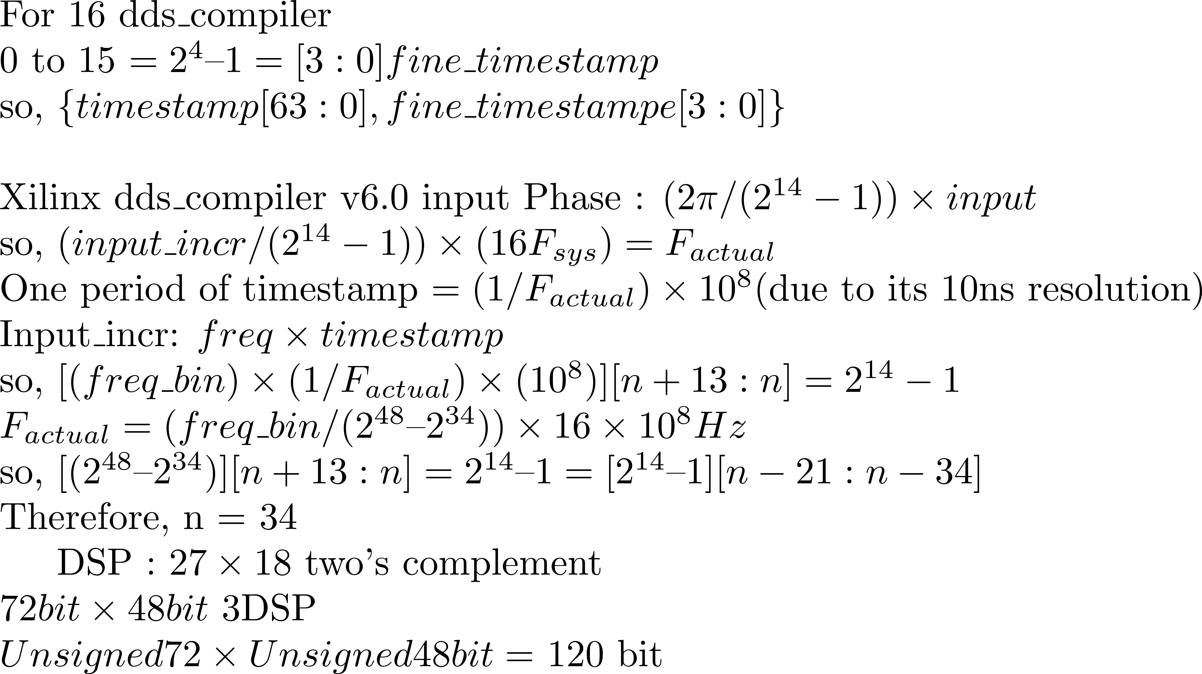

Slide 21
\documentclass{article}
\usepackage{amsmath}
\pagestyle{empty}
\begin{document}
\noindent For 16 dds\_compiler \\
0 to 15 $= 2^{4} – 1 = [3:0] fine\_timestamp$\\
so, $\{timestamp[63:0],fine\_timestampe[3:0]\}$\\
\noindent Xilinx dds\_compiler v6.0 input Phase : $(2\pi/(2^{14} - 1)) \times input$\\
so, $(input\_incr/(2^{14} - 1)) \times (16 F_{sys}) = F_{actual}$\\
One period of timestamp $= (1/F_{actual}) \times 10^{8} $(due to its 10ns resolution)\\
Input\_incr: $freq \times timestamp$\\
so, $[(freq\_bin) \times (1/F_{actual}) \times (10^{8}) ][n+13:n] = 2^{14} - 1$\\
$F_{actual} = (freq\_bin/(2^{48} – 2^{34})) \times 16 \times 10^{8} Hz$\\
so, $[(2^{48} – 2^{34})][n+13:n] = 2^{14} – 1
= [2^{14} – 1][n-21:n-34]$\\
Therefore, n = 34
DSP : $27 \times 18$ two’s complement\\
$72 bit \times 48 bit$ 3DSP\\
$Unsigned 72 \times Unsigned 48 bit = $ 120 bit
\end{document}

Slide 22
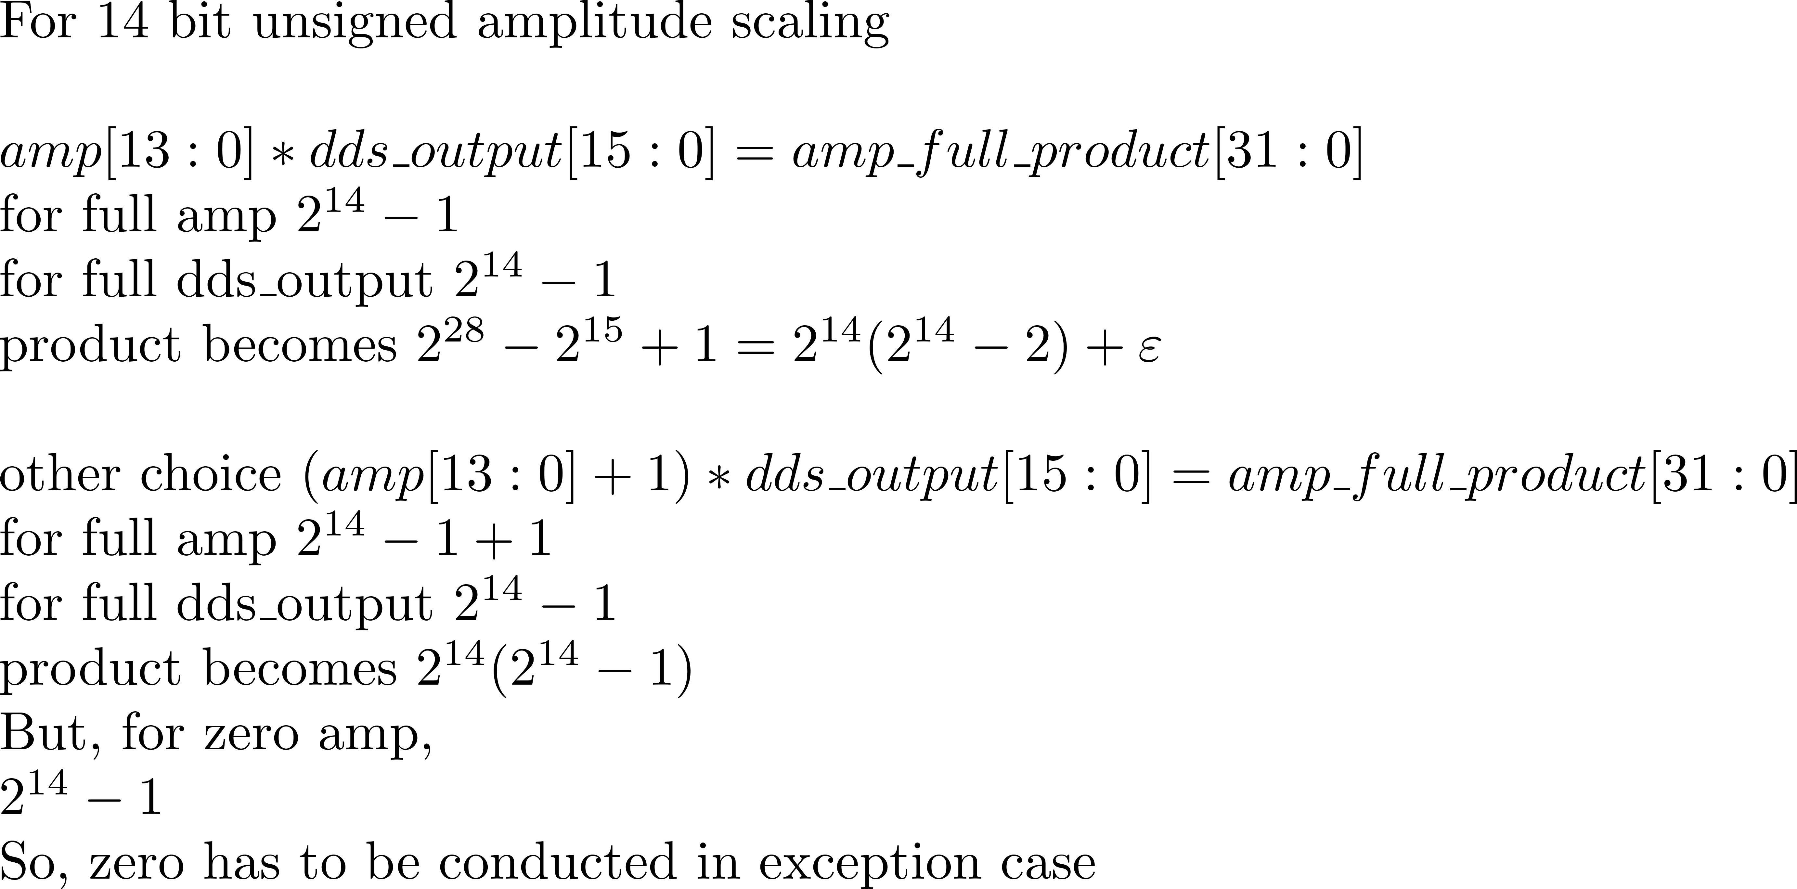

Slide 23
\noindent For 14 bit unsigned amplitude scaling\\
\noindent $amp[13:0] * dds\_output[15:0] = amp\_full\_product[31:0]$\\
for full amp $2^{14} - 1$\\
for full dds\_output $2^{14} - 1$\\
product becomes $2^{28} - 2^{15} + 1 = 2^{14}(2^{14} - 2) + \varepsilon$\\
\noindent other choice
$(amp[13:0]+1) * dds\_output[15:0] = amp\_full\_product[31:0]$\\
for full amp $2^{14} - 1 + 1$\\
for full dds\_output $2^{14} - 1$\\
product becomes $2^{14}(2^{14} - 1)$\\
But, for zero amp,\\
$2^{14} - 1$\\
So, zero has to be conducted in exception case

Slide 24
16 bit
0
0
0
0
0
0
0
0
1
0
1
1
0
0
1
0
125MHz
2GHz
I[15]
…
2GHz
14 bit DAC
I[2]
DAC
I[1]
256 bit
I[15]
I[14]
I[13]
I[12]
I[11]
I[10]
I[9]
I[8]
I[7]
I[6]
I[5]
I[4]
I[3]
I[2]
I[1]
I[0]
I[0]
Output Current[mA]
DAC
0
Time[ns]
0.5
1.0
1.5
2.0
2.5
3.0
5.0
3.5
5.5
4.0
6.0
4.5
6.5
7.0
7.5

Slide 25
[47:0]frequency
mux
[47:0]accumulated_phase
[63:0]timestamp
sync_en
[47:0]frequency
[47:0]frequency
[13:0]phase_offset
16 SIN LUT
14bit
SIN LUT
0
SIN LUT
1
. . .
. . .
14
SIN LUT
15
SIN LUT
. . .
[15:0]axis
[31:16]axis
Pipelined
Mul and Sum
[239:224]axis
[255:240]axis

Slide 26
[47:0]A
[47:0]B
[13:0]C
[47:0]D
[47:0]E
2bit carry out
propagation
[31:16]
[15:0]
[31:0]mul_stage1_31_0_0
[47:32]
[31:16]
[31:0]mul_stage1_47_16_0
[47:32]
[31:16]
[31:0]mul_stage1_47_16_1
[47:32]
[31:0]mul_stage1_63_32_0
[47:32]
[31:0]mul_stage1_63_32_1
[47:32]
[31:0]mul_stage1_63_32_2
[47:0]
[47:0]stage1_E_buffer
[16:0]
[16:0]stage1_C_buffer
[47:0]
[47:0]stage2_E_buffer
[47:32]
[31:16]
[15:0]
[47:0]
[47:0] full_mul_result

Slide 27
64 bit X 48 bit
16 bit X 14 bit
[13:0]phase_offset
[13:0]amp
14bit
SIN LUT
[47:0]frequency
REG
REG
[255:0]axis
[63:0]timestamp

Slide 28
DSP is 27 * 18 Multiplier
Pipelined Multiplication
[47:32]timestamp
[31:16]timestamp
[15:0]timestamp
[47:32]freq
[31:16]freq
[15:0]freq
[15:0]timestamp | [15:0]freq | [31:0]
[15:0]timestamp | [31:16]freq | [47:16]
[15:0]timestamp | [47:32]freq | [63:32]
[31:16]timestamp | [15:0]freq | [47:16]
[31:16]timestamp | [31:16]freq | [63:32]
[31:16]timestamp | [47:32]freq | [79:48] X
[47:32]timestamp | [15:0]freq | [63:32]
[47:32]timestamp | [31:16]freq | [79:48] X
[47:32]timestamp | [47:32]freq | [95:64] X

Slide 29
[47:32]timestamp
[31:16]timestamp
[15:0]timestamp
[47:32]freq
[31:16]freq
[15:0]freq
16 bit multiplication
[31:16]
[15:0]
[47:32]
[31:16]
DSP48E2 input
[47:32]
[31:16]
[63:48]
[47:32]
[63:48]
[47:32]
Carryout propagation
[63:48]
[47:32]
3 - 16bit addition
[47:32]
[47:32]
[47:32]
3 - 16bit addition
[47:34]

Slide 30
dest_sel[63:60]
data[59:0]
4’b0000
amp[13:0]
phase[13:0]
freq[47:16]
4’b0001
pads[11:0]
freq[47:0]
4’b0010
amp[13:0]
freq[47:2]
4’b0011
phase[13:0]
freq[47:2]
4’b0100
time_offset[59:0]
4’b0101
phase[45:0]
amp_offset[13:0]
4’b0110
Not defined
4’b0111
Not defined

Slide 31
dest_sel[63:60]
data[59:0]
4’b1000
amp[13:0]
phase[13:0]
freq[45:14]
4’b1001
amp[13:0]
phase[13:0]
freq[43:12]
4’b1010
amp[13:0]
phase[13:0]
freq[41:10]
4’b1011
amp[13:0]
phase[13:0]
freq[39:8]
4’b1100
amp[13:0]
phase[13:0]
freq[37:6]
4’b1101
amp[13:0]
phase[13:0]
freq[35:4]
4’b1110
amp[13:0]
phase[13:0]
freq[33:2]
4’b1111
amp[13:0]
phase[13:0]
freq[31:0]

Slide 32
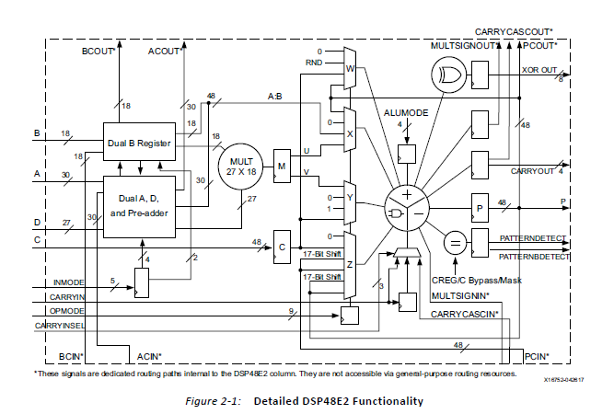

Slide 33
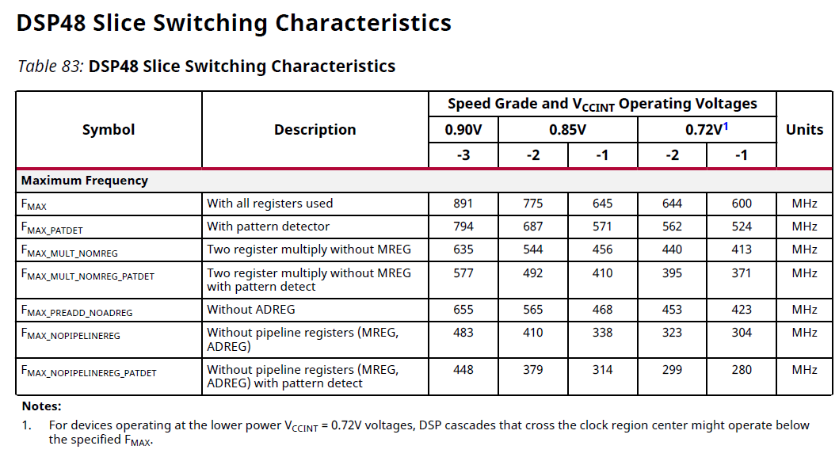

Slide 34
TTLx8

Slide 35
Ver1
last_bit
FIFO_0
selected_0
MUX
FIFO_1
selected_1
MUX
FIFO_2
selected_2
MUX
FIFO_3
selected_3
MUX
FIFO_4
selected_4
MUX
FIFO_5
selected_5
MUX
FIFO_6
selected_6
MUX
FIFO_7
selected_7
MUX
[7]
[6]
[5]
[4]
[3]
[2]
[1]
[0]
Two high Overhead

Slide 36
Ver2
1
+
MUX
1
[9:0]output_top
[9:0]input_top
+
MUX
[63:0]counter
BRAM
[63:0]last_input_timestamp
>
[9:0]addr
[9:0]addr
rd_en
[63:0] input_timestamp
[127:0]data
[7:0] input_timestamp
=
threshold
1
1
>
+
full
-
MUX
[9:0]total_num
BRAM has fixed latency in read(2 Cycle)

Slide 37
Ver3->Work well
1
FIFO
full
[63:0]data
[63:0]data
+
full
rd_en
MUX
1
[9:0]output_top
[9:0]input_top
MUX
[63:0]counter
ADJ_FIFO
[63:0]last_input_timestamp
[9:0]addr
[9:0]addr
rd_en
[63:0] input_timestamp
[7:0]data
=

Slide 38
pads[55:0]
Out7
Out6
Out5
Out4
Out3
Out2
Out1
Out0

Slide 39
Out7[7:0]
Out6[7:0]
Out5[7:0]
Out4[7:0]
Out3[7:0]
Out2[7:0]
Out1[7:0]
Out0[7:0]
OSERDES_0
OBUFDS_0
OSERDES_1
OBUFDS_1
OSERDES_2
OBUFDS_2
OSERDES_3
OBUFDS_3
OSERDES_4
OBUFDS_4
0
0
0
0
1
1
1
1
OSERDES_5
OBUFDS_5
[7:0]input
output
input
output_p
output_n
OSERDES_6
OBUFDS_6
0ns
4ns
8ns
OSERDES_7
OBUFDS_7

Slide 42
AXI Buffer
Buffer added to resolve timing problem

Slide 43
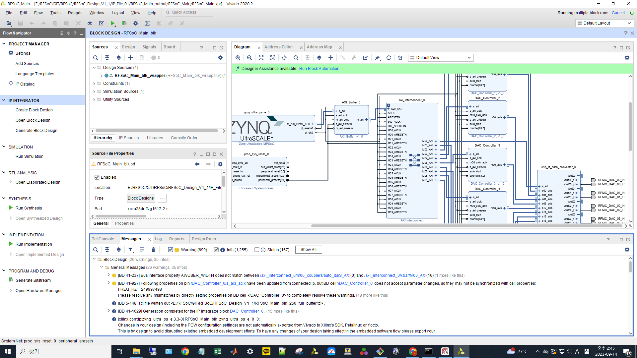
AXI buffer
Make Malfuction when buffer is implemented in this way!!

Slide 44
etc

Slide 45
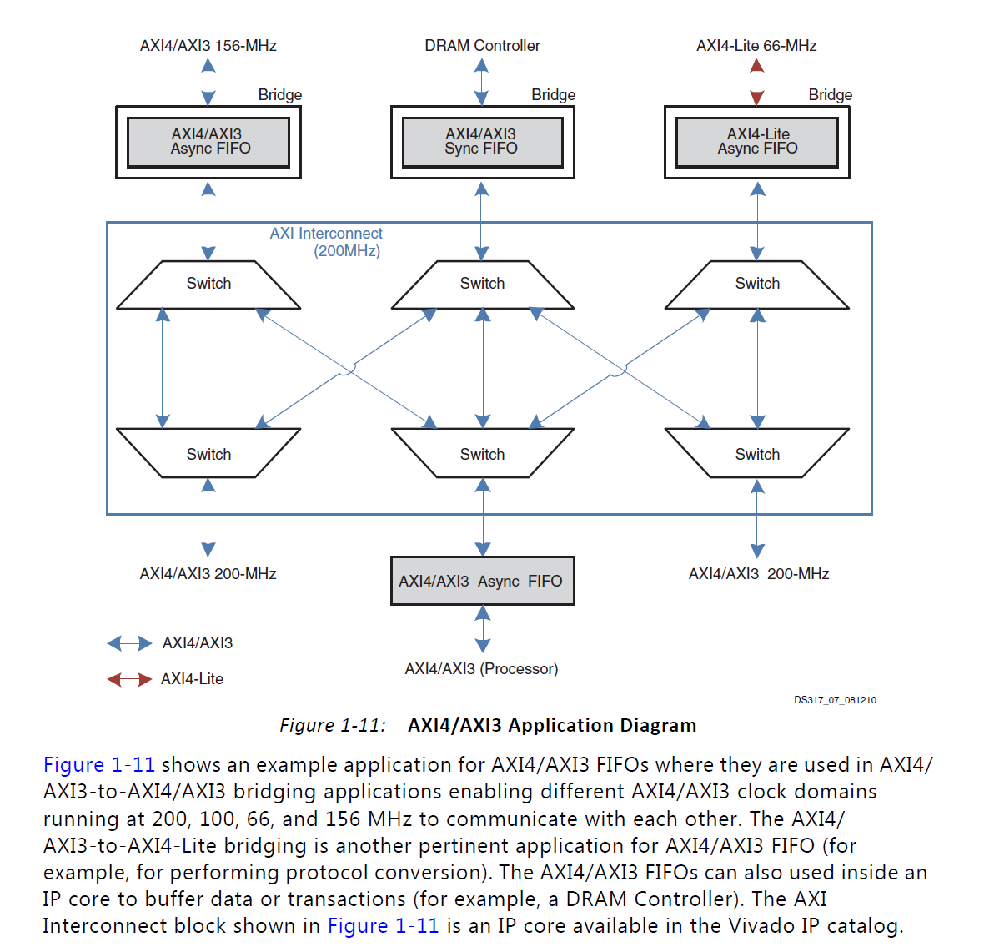

Slide 46
Distributor
Write
s_axi_awaddr
[17:0]data
s_axi_arvalid
s_axi_awaddr[17:0]
s_axi_awvalid
rto_core
AXI FSM
s_axi_bready
s_axi_rready
0x000
write_fifo
s_axi_wdata[127:0]
0x004
flush_fifo
s_axi_wstrb[15:0]
s_axi_wvalid
s_axi_awlen[7:0]
s_axi_aresetn
s_axi_aclk
s_axi_awsize[2:0]
rti_core
0x000
read_fifo
Read
0x004
flush_fifo
s_axi_arready
s_axi_awready
s_axi_bresp[1:0]
s_axi_bvalid
s_axi_rdata[127:0]
s_axi_rresp[1:0]
s_axi_rvalid
s_axi_wready

Slide 47
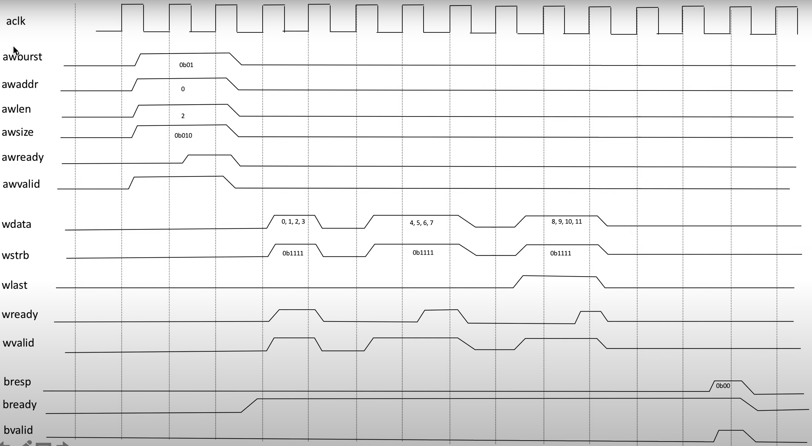

Slide 48
Instruction Decode
[15:0]dest
[15:0]control
[31:0]wr_data
[7:0]data_strobe
[1:0]fifo_mux_select
use_fifo
update
[3:0]mux_select

Slide 49
RFDC(only one DAC)
AXI_interconnect
RFDC controller
vout00_p
axi_s0_interface
axi_m0_interface
axi_s0_interface
gpo_core(rfdc_control)
vout00_n
sysref_in_p
[63:0]gpo_out
s00_axis_tdata[255:0]
[127:0]error_data
s00_axis_tready
sysref_in_p
busy
clk_dac0
user_sysref_adc
s00_axis_tvalid
overrided
selected
s00_axis_tready
user_sysref_dac
dac00_fast_shutdown
busy_error
dac00_datapath_overflow
dac0_clk_p
dac00_pl_event
counter_matched
dac0_nco_update_busy[1:0]
dac0_clk_n
dac00_nco_freq[47:0]
[127:0]gpo_in
s0_axis_aclk
dac00_nco_phase[17:0]
[63:0]override_value_input
s0_axis_arestn
dac00_nco_phase_rst
override_en_input
s00_axis_tdata[255:0]
dac00_nco_update_en[5:0]
selected_input
s00_axis_tvalid
dac0_nco_update_req
dac00_fast_shutdown
dac0_sysref_int_gaiting
dac00_pl_event
dac0_sysref_int_reenable
dac00_nco_freq[47:0]
dac00_nco_phase[17:0]
dac00_nco_phase_rst
dac00_nco_update_en[5:0]
dac0_nco_update_req
dac0_sysref_int_gaiting
dac0_sysref_int_reenable
sysref_in_p
CLK100MHz
sysref_in_n
processot_reset
dac0_clk_p
aresetn
dac0_clk_n

Slide 50
[15:0]dest
[15:0]control
[31:0]wr_data
axi_m0_interface
[7:0]data_strobe
[1:0]fifo_mux_select
use_fifo
update
[3:0]mux_select
s00_axis_tdata[255:0]
s00_axis_tdata[255:0]
[7:0]data_strobe
s00_axis_tvalid
s00_axis_tvalid
gpo_core(gpo_dac_00)
dac00_fast_shutdown
[63:0]gpo_out
dac00_pl_event
dac00_fast_shutdown
[127:0]error_data
busy
dac00_nco_freq[47:0]
[3:0]dac00_mux_select
overrided
selected
dac00_nco_phase[17:0]
dac00_pl_event
busy_error
dac00_nco_phase_rst
dac00_nco_freq[47:0]
[47:0]gpo_00_buffer
counter_matched
dac00_nco_update_en[5:0]
dac00_nco_phase[17:0]
DEMUX
[127:0]gpo_in
dac0_nco_update_req
[63:0]override_value_input
dac0_sysref_int_gaiting
dac00_nco_phase_rst
override_en_input
dac0_sysref_int_reenable
dac00_nco_update_en[5:0]
selected_input
dac0_nco_update_req
gpo0_selected_buffer
dac0_sysref_int_gaiting
dac0_sysref_int_reenable

Slide 51
[15:0]dest
[15:0]control
[31:0]wr_data
s00_axis_tdata[255:0]
[7:0]data_strobe
[1:0]fifo_mux_select
use_fifo
update
[3:0]mux_select
[7:0]data_strobe
gpo_core(gpo_dac_00)
[63:0]gpo_out
[127:0]error_data
busy
[3:0]dac00_mux_select
overrided
selected
...
busy_error
[255:224]data
[223:192]data
[63:32]data
[31:0]data
counter_matched
[127:0]gpo_in
dac00_nco_freq[47:0]
[63:0]override_value_input
override_en_input
selected_input
SYNC FIFO(fifo_dac_00)
[255:0]data_out
clk
[63:32]data
[31:0]data
read
DEMUX
write
dac00_nco_phase[17:0]
empty
full
DEMUX
[31:0]gpo_00_buffer
[255:0]data_in
flush

Slide 52
Solution3
Start()
#timestamp 0
Do Something()
Delay(1)
#timestamp 1
A = Measure()
Delay(1)
#timestamp 2
If( A == True )
Delay(2)
#timestamp 4
Do Something()
Else
Delay(5)
#timestamp 7
Do Something()
#back to timestamp 2
Do Something()
Delay(1)
#timestamp 3
Do Something()
Delay(2)
#timestamp 5
Do Something()
Delay(1)
#timestamp 6
Do Something()
End()
#define RTO_ADDRESS 0xF0000000
...
int main(){
uint32 *rto = RTO_ADDRESS;
uint32 *rti = RTI_ADDRESS;
uint32 *measure_done = MEASURE_DONE;
uint64 timestamp = 0;
...
*rto = timestamp | DO_SOMETHING;
*rto_push = 1;
while( rto_push_done == 0 ){
*rto_push = 0;
}
timestamp += 1;
*rto = timestamp | MEASURE;
while( rto_push_done == 0 ){
*rto_push = 0;
}
while(1){
if( measure_done ){
A = *rti;
break;
}
}
if( A == 1 ){
timestamp += 2;
*rto = timestamp | DO_SOMETHING;
while( rto_push_done == 0 ){
*rto_push = 0;
}
}
else{
...
}
...
}
address of memory mapped IO
Interpreter(in PC)
From Python to C
Compile(using LLVM in PC) and send to Zynq
Zynq
RPU
APU
variable
output data to FIFO through AXI
output signal to write FIFO through AXI
polling waiting for FIFO write done
RTO
RTI
polling waiting for FIFO read done
conditional statement implementation does not make problem

Slide 53
OS should be made to solve timestamp problem
e.g.
@1 DEVICE1()
@5 DEVICE1()
@3 DEVICE2()
->DEVICE2 timestamp error
Task1
@1 DEVICE1()
@5 DEVICE1()
Task2
@3 DEVICE2()
or user should not write code like this!

Slide 54
Solution4
Start()
#timestamp 0
Do Something()
Delay(1)
#timestamp 1
A = Measure()
Delay(1)
#timestamp 2
If( A == True )
#timestamp 2
Do Something()
Delay(1)
#timestamp 3
Do Something()
Delay(1)
#timestamp 4
Do Something()
Delay(1)
#timestamp 5
Do Something()
Delay(1)
#timestamp 6
Do Something()
Else
#timestamp 2
Do Something()
Delay(1)
#timestamp 3
Do Something()
Delay(1)
#timestamp 5
Do Something()
Delay(1)
#timestamp 6
Do Something()
Delay(1)
#timestamp 7
Do Something()
End()
#define RTO_ADDRESS 0xF0000000
...
int main(){
uint32 *rto = RTO_ADDRESS;
uint32 *rti = RTI_ADDRESS;
uint32 *measure_done = MEASURE_DONE;
uint64 timestamp = 0;
...
*rto = timestamp | DO_SOMETHING;
*rto_push = 1;
while( rto_push_done == 0 ){
*rto_push = 0;
}
timestamp += 1;
*rto = timestamp | MEASURE;
while( rto_push_done == 0 ){
*rto_push = 0;
}
while(1){
if( measure_done ){
A = *rti;
break;
}
}
if( A == 1 ){
timestamp += 2;
*rto = timestamp | DO_SOMETHING;
while( rto_push_done == 0 ){
*rto_push = 0;
}
}
else{
...
}
...
}
Start()
#timestamp 0
Do Something()
Delay(1)
#timestamp 1
A = Measure()
Delay(1)
#timestamp 2
If( A == True )
Delay(2)
#timestamp 4
Do Something()
Else
Delay(5)
#timestamp 7
Do Something()
#back to timestamp 2
Do Something()
Delay(1)
#timestamp 3
Do Something()
Delay(2)
#timestamp 5
Do Something()
Delay(1)
#timestamp 6
Do Something()
End()
Interpreter(in PC)
From Python to C
AT FUTURE

Slide 55
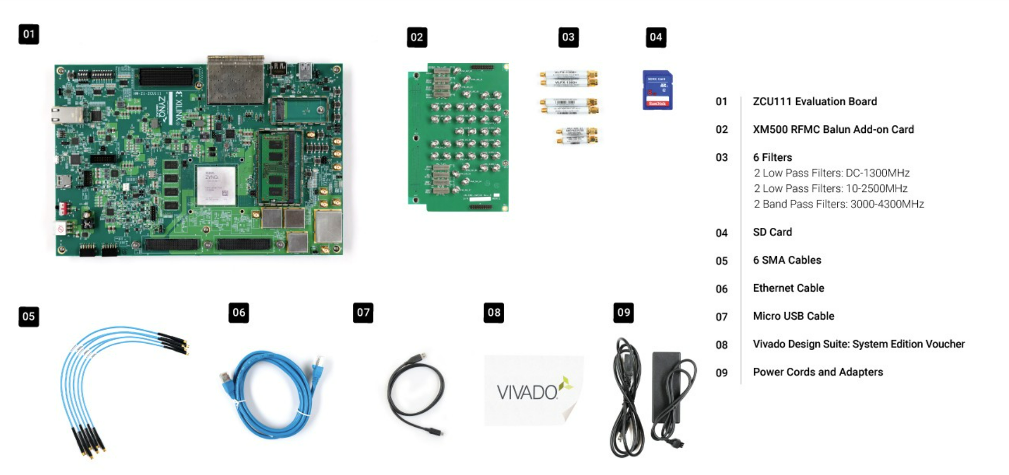
License for ZCU111(Vivado Design Suite)
Only 5 times of changing seat are allowed!!!

