Slide 1
In-order execution nails every weak memory behavior
RC11 is good enough w/o performance overhead!
Chung-Kil Hur Seoul National University
@The Future of Weak Memory 2024
In collaboration with
Sunghwan Lee, Minki Cho, Roy Margalit, Ori Lahav.
Notes:
Good morning, my name is Sung-Hwan Lee and today I will present our work on developing an in-order relaxed memory model with a minimal performance overhead.

Slide 2
Weak Memory Behaviors
Observable Weak Behaviors due to
Compiler Optimizations
Hardware Optimizations
Can be captured by
Four kinds of reorderings
RR reordering
WR reordering
WW reordering
RW reordering (a.k.a. Load Buffering)
Notes:
Then, the natural question would be: can we model all relaxed behaviors with in-order executions?
To do so, we may use other mechanisms that allow us to model relaxed behaviors while keeping the execution of the program in-order.
For example, store buffers or thread views.
[▶] Unfortunately, even with these mechanisms, the answer is no. And that’s why efficient memory models use ooo executions.
[▶] So, an in-order model should restrict some relaxed behaviors, and thus, these models have performance overheads.

Slide 3

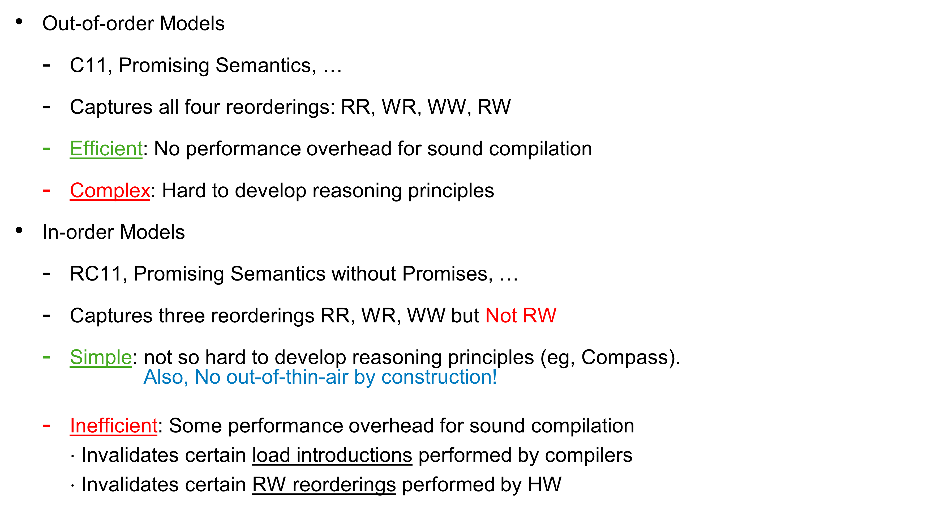
Weak Memory Models
View: RR,WR,WW Promise: RW
Out-of-order Models
C11, Promising Semantics, …
Captures all four reorderings: RR, WR, WW, RW
Efficient: No performance overhead for sound compilation
Complex: Hard to develop reasoning principles
In-order Models
RC11, Promising Semantics without Promises, …
Captures three reorderings RR, WR, WW but Not RW
Simple: not so hard to develop reasoning principles (eg, Compass). Also, No out-of-thin-air by construction!
Inefficient: Some performance overhead for sound compilation $⋅$ Invalidates certain load introductions performed by compilers $⋅$ Invalidates certain RW reorderings performed by HW
__________
___
______
_________
_____
_______
______
____
________
{
my function
{
unknown
context code
out-of-order
execution
Notes:
Then, the natural question would be: can we model all relaxed behaviors with in-order executions?
To do so, we may use other mechanisms that allow us to model relaxed behaviors while keeping the execution of the program in-order.
For example, store buffers or thread views.
[▶] Unfortunately, even with these mechanisms, the answer is no. And that’s why efficient memory models use ooo executions.
[▶] So, an in-order model should restrict some relaxed behaviors, and thus, these models have performance overheads.

Slide 4

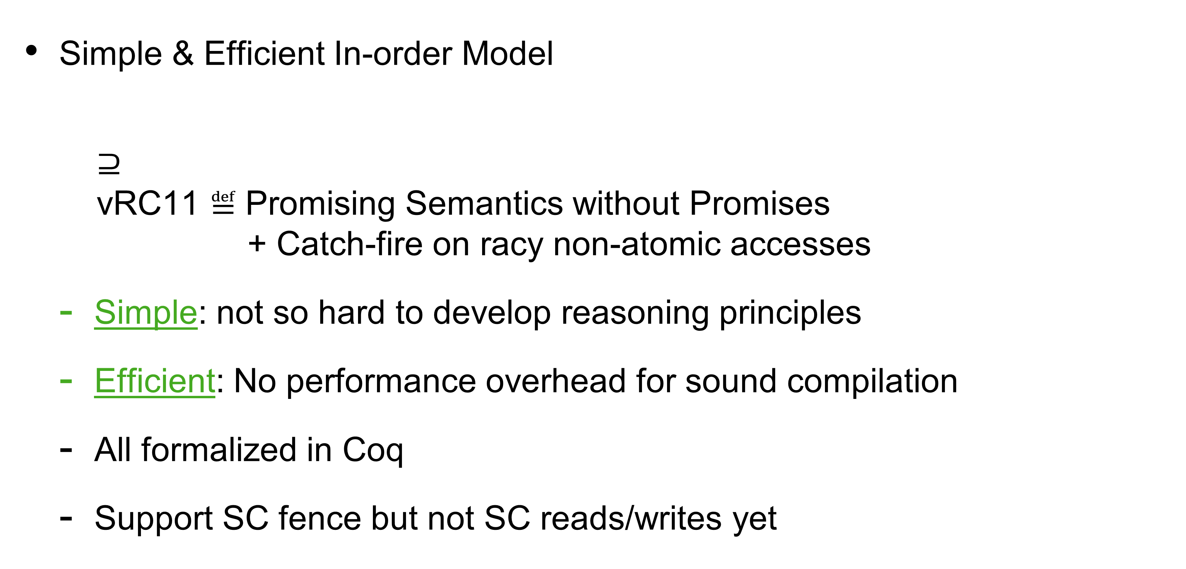
Positive Results [PLDI’23]
Simple & Efficient In-order Model
$⊇$ vRC11 $≝$Promising Semantics without Promises + Catch-fire on racy non-atomic accesses
Simple: not so hard to develop reasoning principles
Efficient: No performance overhead for sound compilation
All formalized in Coq
Support SC fence but not SC reads/writes yet
RC11
Lifted the performance overhead
Notes:
Then, the natural question would be: can we model all relaxed behaviors with in-order executions?
To do so, we may use other mechanisms that allow us to model relaxed behaviors while keeping the execution of the program in-order.
For example, store buffers or thread views.
[▶] Unfortunately, even with these mechanisms, the answer is no. And that’s why efficient memory models use ooo executions.
[▶] So, an in-order model should restrict some relaxed behaviors, and thus, these models have performance overheads.

Slide 5
Problems & Solutions
Notes:
Then, the natural question would be: can we model all relaxed behaviors with in-order executions?
To do so, we may use other mechanisms that allow us to model relaxed behaviors while keeping the execution of the program in-order.
For example, store buffers or thread views.
[▶] Unfortunately, even with these mechanisms, the answer is no. And that’s why efficient memory models use ooo executions.
[▶] So, an in-order model should restrict some relaxed behaviors, and thus, these models have performance overheads.

Slide 6

Problems with (v)RC11
RR,WR,WW,RW
Load introduction
(v)RC11
RR,WR,WW
RW
Non-atomic:
In-order (Race-Free)
Atomic:
In-order
OK
Problem 1
Insert fake branches after rlx reads
- to prevent RW reorderings
HW
Out-of-order
Problem 2
Notes:
All in all, we developed an in-order memory model with only negligible overhead.
[▶] We provided an in-order source model for programmers based on the promise-free fragment of the promising semantics.
[▶] This model can be efficiently compiled to hardware only with negligible performance overhead.
The IR model allows ooo executions for NA writes, and it is based on the promising semantics.
[▶] We also provided a simple sequential model for compiler writers by applying the result of our paper at the last PLDI.
Specifically, we proved that [▶] a compiler optimization correct under the sequential model [▶] is also correct under the IR model.
Therefore, programmers as well as compiler writers do not need to understand the complex IR model.
In the paper, you can find more details about the source and IR models and formal results on them.
This is the end of my talk, and thank you for listening.
Compiler writers’ intention is to optimize non-atomic code as if sequential program.
We actually proved this intuition by proving that all optimizations correct under a sequential machine is also correct under our IR model.
I am not aware of any optimization performed by compilers and unsound in the sequential model.
So we can say that the IR model supports all compiler optimizations performed by current compilers.

Slide 7
Our Solution to The Problems
(v)RC11
Non-atomic:
In-order (Race-Free)
Atomic:
In-order
RR,WR,WW,RW
Load introduction
vRC11 +promises on na
RR,WR,WW
RW
Non-atomic:
Out-of-order
Atomic:
In-order
OK
OK
Insert fake branches after rlx reads
Insert RW fences before rlx writes
HW
Out-of-order
OK (Why?)
Notes:
All in all, we developed an in-order memory model with only negligible overhead.
[▶] We provided an in-order source model for programmers based on the promise-free fragment of the promising semantics.
[▶] This model can be efficiently compiled to hardware only with negligible performance overhead.
The IR model allows ooo executions for NA writes, and it is based on the promising semantics.
[▶] We also provided a simple sequential model for compiler writers by applying the result of our paper at the last PLDI.
Specifically, we proved that [▶] a compiler optimization correct under the sequential model [▶] is also correct under the IR model.
Therefore, programmers as well as compiler writers do not need to understand the complex IR model.
In the paper, you can find more details about the source and IR models and formal results on them.
This is the end of my talk, and thank you for listening.
Compiler writers’ intention is to optimize non-atomic code as if sequential program.
We actually proved this intuition by proving that all optimizations correct under a sequential machine is also correct under our IR model.
I am not aware of any optimization performed by compilers and unsound in the sequential model.
So we can say that the IR model supports all compiler optimizations performed by current compilers.

Slide 8
Observations on RW reordering in HW
Notes:
Then, the natural question would be: can we model all relaxed behaviors with in-order executions?
To do so, we may use other mechanisms that allow us to model relaxed behaviors while keeping the execution of the program in-order.
For example, store buffers or thread views.
[▶] Unfortunately, even with these mechanisms, the answer is no. And that’s why efficient memory models use ooo executions.
[▶] So, an in-order model should restrict some relaxed behaviors, and thus, these models have performance overheads.

Slide 9
Impact of Restricting RW Reordering
Response from Arm engineers:
Only small performance benefit of load-store reordering
Observable on Arm/Power implementations
Performance impact in hardware
Reorderings
load-load
store-load
store-store
Most CPUs
Significant
load-store
Few Arm CPUs
Small
Notes:
Now, we need to understand the performance impact of restricting load-store reordering.
Among the four kinds of reorderings, three of them are observed on most CPU implementations of Arm and Power, while load-store reordering is only observed on few Arm CPUs.
[▶] This is because the performance impact of three reorderings in hardware is significant while the impact of load-store reordering is small.
In fact, [▶] we consulted Arm engineers and learned why the performance benefit of load-store reordering is so small.

Slide 10



Why So Small Benefits?
A CPU core
Other cores
In progress
Store buffer
...
commit
…
…
Y = 1
a = X
Y = 1
PC
Two approaches to commit time
PC
Treated as completed before the load’s completion in its own core
Forbid commit before the load’s completion
Load-store reordering: invisible to other cores
PC
...
PC
most CPUs
Allow commit before the load’s completion
Load-store reordering: visible to other cores
CPU design: increased complexity
Performance benefit: only when buffer is full
few Arm CPUs
Notes:
To see why, suppose that a CPU core is about to execute a store Y=1 and the previous load from X is still in progress because it is taking a long time.
Now, [▶] when the store is executed, it is first moved to a core-local store buffer.
Then, [▶] in the perspective of its own core, the store Y=1 can be treated as completed before the completion of the previous load.
Therefore, the core may execute the [▶▶] later instructions, and the store in the buffer will not block any further execution.
At some point, [▶] the store will be committed and become visible to other cores.
[▶] There are two approaches to when to commit a store.
Specifically, we can either forbid or allow the commit before the completion of the previous load.
First, if we forbid the early commit, [▶] load-store reordering is not visible to other cores.
[▶] This is what actually happens on most CPUs where load-store reordering is never observed.
On the other hand, we may allow the early commit, and then, [▶] load-store reordering becomes visible to other cores.
[▶] This makes the CPU design more complex, but [▶] the early commit has no performance benefit unless the buffer is full.
That’s why the benefit of load-store reordering is small and [▶] only few CPUs perform it.
I also note that hardware engineers do not evaluate performance impact of in-core optimizations on concurrent executions.

Slide 11


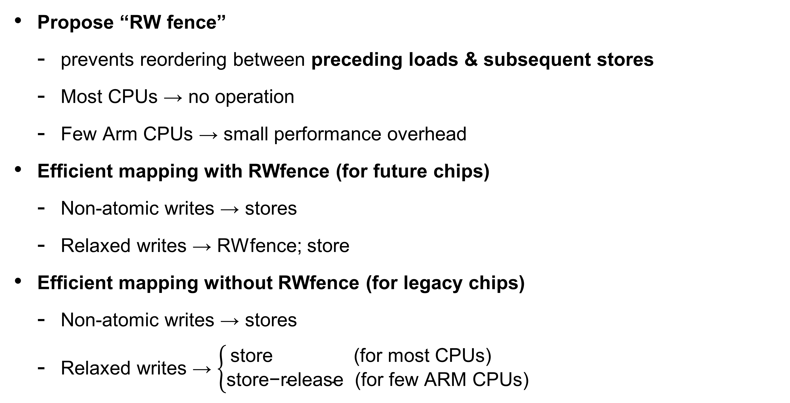
Our Solution for Efficient Mapping
Propose “RW fence”
prevents reordering between preceding loads & subsequent stores
Most CPUs → no operation
Few Arm CPUs → small performance overhead
Efficient mapping with RWfence (for future chips)
Non-atomic writes → stores
Relaxed writes → RWfence; store
Efficient mapping without RWfence (for legacy chips)
Non-atomic writes → stores
Relaxed writes → $\left\{\begin{aligned}\text{store} \text{ (}\text{for} \text{most} \text{CPUs}\text{)} \\ \text{store}\text{−}\text{release} \text{(}\text{for} \text{few} \text{ARM} \text{CPUs}\text{)}\end{aligned}\right.$
No or negligible
performance overhead
Notes:
Accordingly, for efficient compilation of an in-order model, we propose strong store instructions that prevent reordering only with previous loads.
On most CPUs that do not reorder load and store, a strong store has no performance overhead.
Even on few CPUs that *do* reorder load and store, a strong store can be implemented only with a small performance overhead.
[▶] Then, we can use strong store for compiling relaxed writes.
Crucially, since non-atomic writes are still compiled to plain hardware stores, strong stores are only rarely used. [▶] Therefore, the performance overhead is negligible, if any.

Slide 12
Conclusion
Notes:
Then, the natural question would be: can we model all relaxed behaviors with in-order executions?
To do so, we may use other mechanisms that allow us to model relaxed behaviors while keeping the execution of the program in-order.
For example, store buffers or thread views.
[▶] Unfortunately, even with these mechanisms, the answer is no. And that’s why efficient memory models use ooo executions.
[▶] So, an in-order model should restrict some relaxed behaviors, and thus, these models have performance overheads.

Slide 13
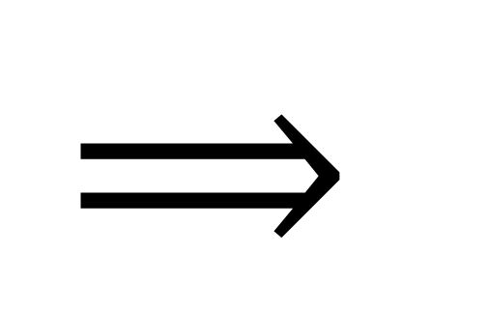
Final Results (All formalized in Coq)
Simple model
for programmers
(v)RC11
Non-atomic:
In-order (Race-Free)
Atomic:
In-order
$$⟹$$
Opt.
Opt.
vRC11 +promises on na
SEQ[PLDI’22]
Single-threaded model
Non-atomic:
Out-of-order
Atomic:
In-order
HW
Insert RW fences
Simple model
for compiler writers
Out-of-order
Notes:
All in all, we developed an in-order memory model with only negligible overhead.
[▶] We provided an in-order source model for programmers based on the promise-free fragment of the promising semantics.
[▶] This model can be efficiently compiled to hardware only with negligible performance overhead.
The IR model allows ooo executions for NA writes, and it is based on the promising semantics.
[▶] We also provided a simple sequential model for compiler writers by applying the result of our paper at the last PLDI.
Specifically, we proved that [▶] a compiler optimization correct under the sequential model [▶] is also correct under the IR model.
Therefore, programmers as well as compiler writers do not need to understand the complex IR model.
In the paper, you can find more details about the source and IR models and formal results on them.
This is the end of my talk, and thank you for listening.
Compiler writers’ intention is to optimize non-atomic code as if sequential program.
We actually proved this intuition by proving that all optimizations correct under a sequential machine is also correct under our IR model.
I am not aware of any optimization performed by compilers and unsound in the sequential model.
So we can say that the IR model supports all compiler optimizations performed by current compilers.

Slide 14
Future Work
Support Dynamic Allocation
Work in Progress
Interesting Challenges (all resolved now)
Develop CompCertWM
Plan to start in a year
Expect to reuse existing proofs (thanks to the SEQ approach)
Add SC reads/writes
Notes:
Accordingly, for efficient compilation of an in-order model, we propose strong store instructions that prevent reordering only with previous loads.
On most CPUs that do not reorder load and store, a strong store has no performance overhead.
Even on few CPUs that *do* reorder load and store, a strong store can be implemented only with a small performance overhead.
[▶] Then, we can use strong store for compiling relaxed writes.
Crucially, since non-atomic writes are still compiled to plain hardware stores, strong stores are only rarely used. [▶] Therefore, the performance overhead is negligible, if any.

Slide 15
Discussion
(v)RC11 as C standard?
How about GPUs?
Notes:
Then, the natural question would be: can we model all relaxed behaviors with in-order executions?
To do so, we may use other mechanisms that allow us to model relaxed behaviors while keeping the execution of the program in-order.
For example, store buffers or thread views.
[▶] Unfortunately, even with these mechanisms, the answer is no. And that’s why efficient memory models use ooo executions.
[▶] So, an in-order model should restrict some relaxed behaviors, and thus, these models have performance overheads.

