Slide 1


@ SejoonLee | SHUBH PMC

Slide 2

@ SejoonLee | SHUBH PMC

Slide 3
@ SejoonLee | SHUBH PMC

Slide 4




@ SejoonLee | SHUBH PMC

Slide 5
@ SejoonLee | SHUBH PMC

Slide 6


Slide 8
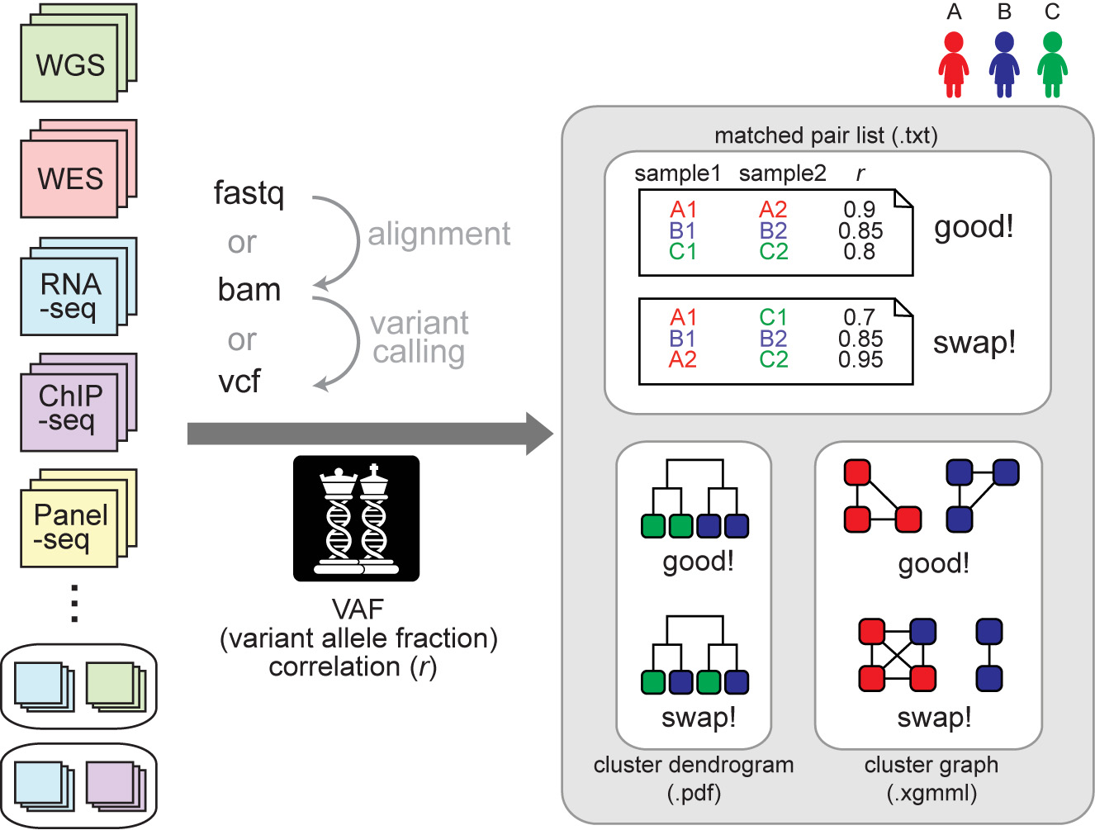

Slide 9
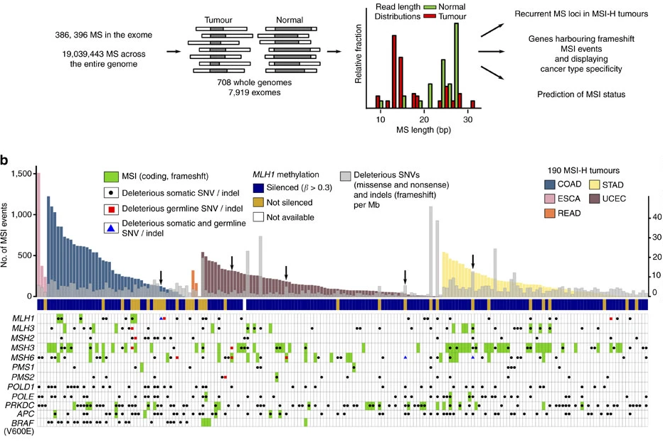

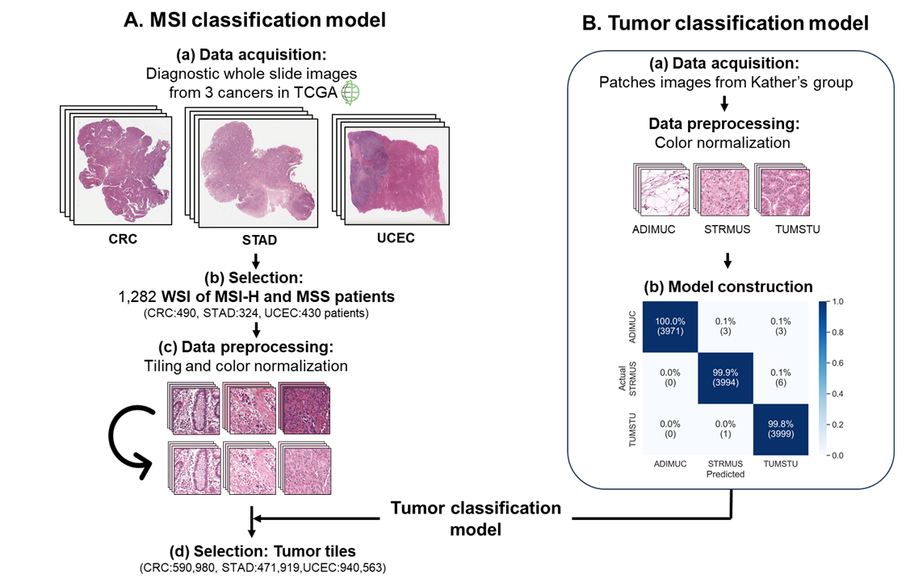
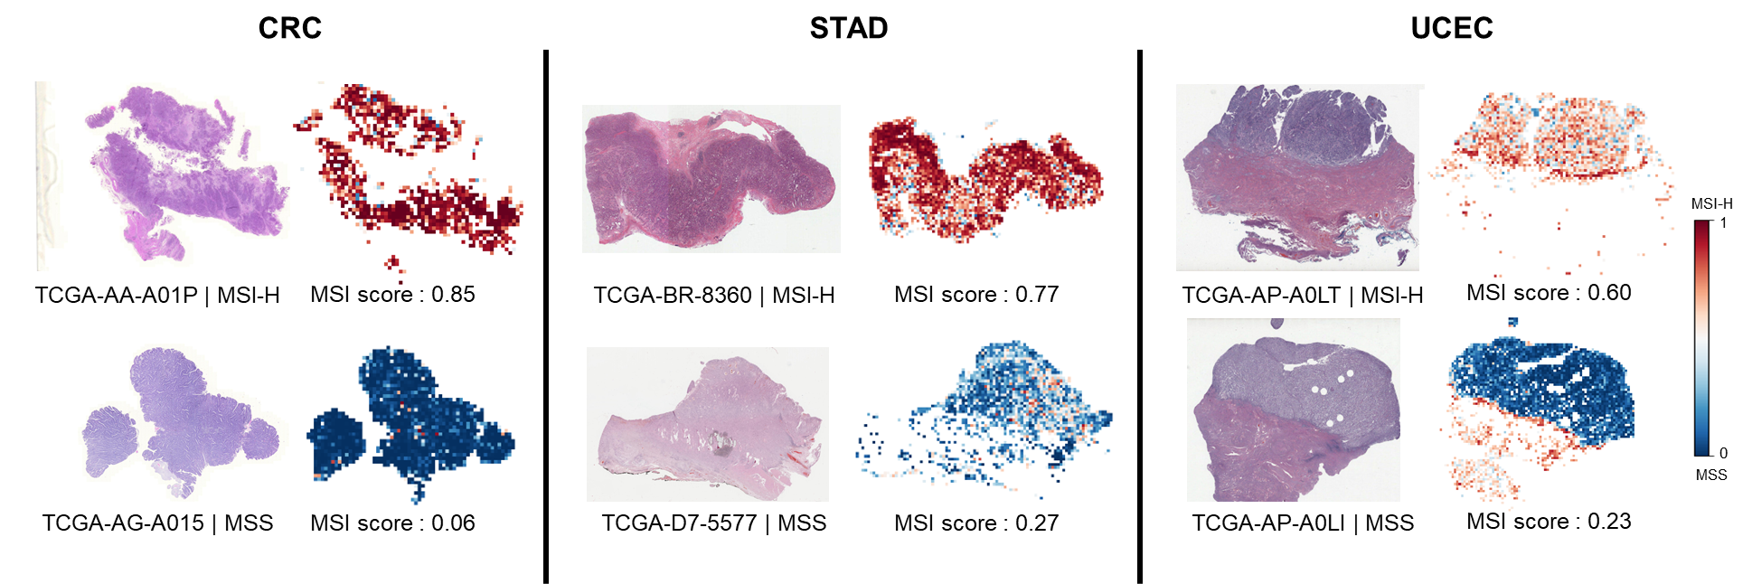
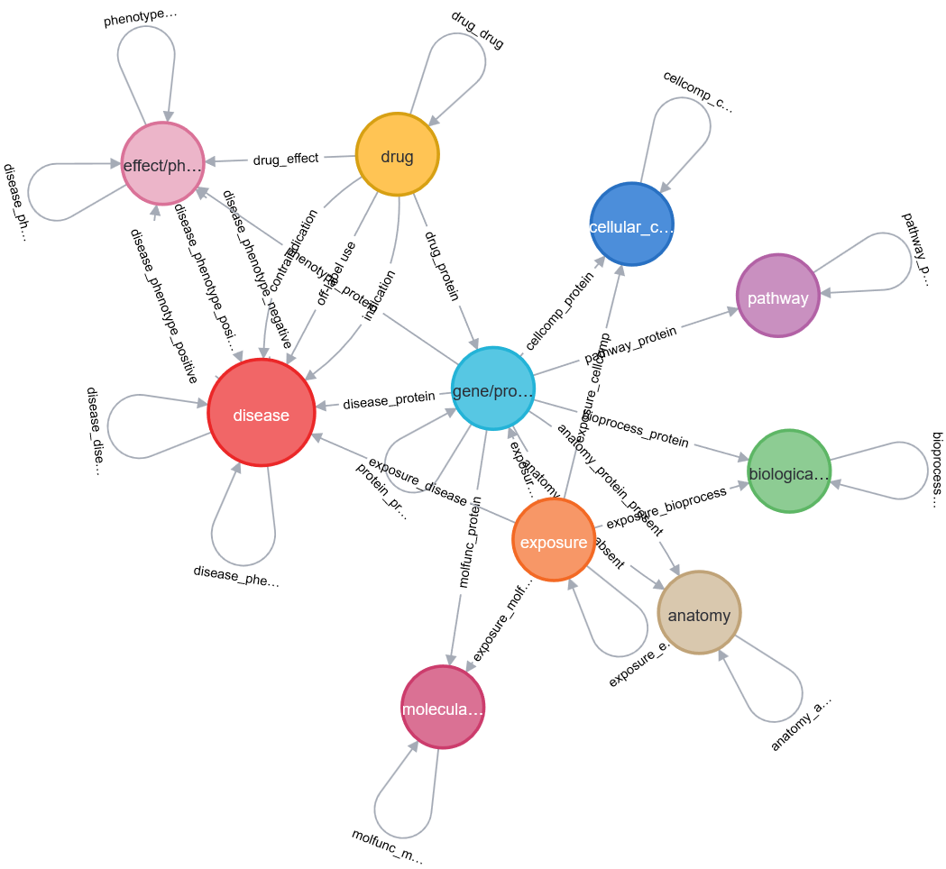
COAD
READ
Cancer type
UCEC
Genomic region
True Positive Rate
True Positive Rate
COAD
3’UTR
READ
STAD
5’UTR
CDS
0
40000
80000
120000
3’UTR (AUC = 0.98)
3’UTR (AUC = 0.93)
5’UTR (AUC = 0.96)
5’UTR (AUC = 0.90)
The number of invariable MS
CDS (AUC = 0.76)
CDS (AUC = 0.80)
STAD
UCEC
COAD
READ
16278
3643
3026
1664
956
3181
1405
1091
7885
63218
True Positive Rate
True Positive Rate
STAD
798
3859
UCEC
5645
25461
3’UTR (AUC = 0.87)
3’UTR (AUC = 0.95)
17051
5’UTR (AUC = 0.75)
5’UTR (AUC = 0.96)
CDS (AUC = 0.73)
CDS (AUC = 0.77)
The number of invariable MS
False Positive Rate
False Positive Rate

Slide 10
@ SejoonLee | SHUBH PMC

Slide 11



Slide 12

@ SejoonLee | SHUBH PMC

Slide 13

@ SejoonLee | SHUBH PMC

Slide 14


Slide 15
C
B
I
linical
io
nformatics

Slide 16

C
B
I

Slide 18

@ SejoonLee | SHUBH PMC

Slide 19



