Slide 1

Agricultural Data Platform
Modern Cloud-Native Architecture for ARE Directorate
Head of Data Engineering Technical Assessment – November 2025
Author: Emmanuel Nwosu

Slide 2

Executive Summary
Transform ARE’s data capabilities with a modern cloud-native platform.
Replace fragile legacy systems with a unified, governed Data Platform.
Enable timely, accurate analytics for £600M+ in annual payments.
Ingest and analyse data from 200K+ IoT sensors across 50K farms.
Embed GDPR-compliant governance and auditable data lineage from day one.

Slide 3

Target Platform Architecture
Data Sources: IoT sensors, legacy systems, spreadsheets, external APIs.
Ingestion: Event Hubs for streaming, Data Factory for batch, API Management and Functions for APIs.
Lakehouse: Bronze (raw), Silver (cleansed), Gold (curated) on Delta Lake.
Consumers: Synapse (SQL & Spark), Power BI, ML workloads, and downstream APIs.
Governance & Security: Purview, Key Vault, RBAC, data lineage, and compliance controls.

Slide 4

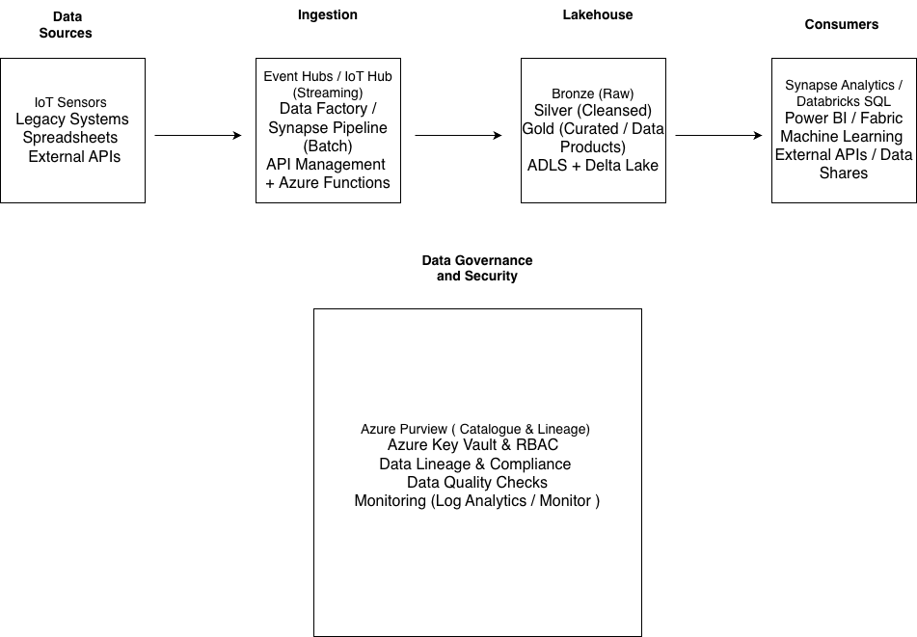

Slide 5

Core Design Principles
Scalability: Auto-scaling compute to handle seasonal and event-driven peaks.
Security: Zero-trust model with encryption at rest and in transit.
Interoperability: API-first design to integrate internal and external services.
Governance: Built-in lineage, cataloguing, and GDPR-compliant data access.
Cost Efficiency: Serverless and consumption-based patterns where appropriate.

Slide 6

Technology Stack (Azure-Aligned)
Cloud & Storage: Microsoft Azure, Data Lake Storage Gen2, Delta Lake format.
Processing: Azure Databricks (batch & streaming), Azure Functions for microservices.
Integration: Event Hubs, Data Factory, API Management, Logic Apps (where needed).
Analytics: Azure Synapse, Power BI for self-service and executive reporting.
Governance & Security: Microsoft Purview, Azure AD / RBAC, Key Vault, Policy.

Slide 7

Example Data Product: Farm Soil Health
Data Quality: Duplicate detection, timestamp standardisation, type coercion.
Business Rules: Configurable moisture thresholds and consecutive-day alert rules.
Analytics: Daily soil moisture and temperature metrics per farm/region/crop.
Alerts: Automated identification of at-risk farms and CRITICAL vs WARNING severity.
Lineage & Observability: Pipeline metadata, dashboards, and audit-ready outputs.

Slide 8

Delivery Approach
Phase 1 – Foundation (Months 1–3): Core Azure landing zone, DevOps/DataOps, governance framework.
Phase 2 – Migration (Months 4–9): Onboard priority systems, build core pipelines and quality gates.
Phase 3 – Scale & Optimise (Months 10–12): Production hardening, ML use-cases, cost optimisation.
Ways of Working: Agile delivery, product-centric data teams, CI/CD for data pipelines.

Slide 9

Role of Head of Data Engineering
Technical Leadership: Define reference architectures, standards (IaC, DataOps, quality).
Team Development: Build and coach a multidisciplinary engineering team (data, platform, ML).
Stakeholder Partnership: Align platform roadmap with ARE priorities—payments, climate, compliance.
Platform Ownership: Own reliability (SLOs/SLIs), security posture, and platform cost efficiency.
Continuous Improvement: Embed feedback loops, engineering metrics, and knowledge sharing.

