Slide 1
SWPP 2026 FALL TEAM 05
FrameLESS
Read the same event across sources.
An Android app that puts original passages beside the claims they address.
Seoyoung Do Junseo Heo Jinsol Lee Seungmin Kim
Notes:
TALK TRACK
A reader starts with one Korean news article. FrameLESS looks for reports of the same event and shows the passages that address claims in the chosen article. We do not issue an article-wide truth or political-bias verdict.
SOURCES AND STATUS
Project requirements: https://github.com/snuhcs-course/swpp-2026-project-team-05/wiki/Requirements-and-Specifications

Slide 2
The comparison gap
A reader opens several reports.
Finding the matching passages is still manual.
NAVER News
Ground News
FrameLESS
Find more articles
See coverage across outlets
Inspect passages linked to a claim
02
Notes:
TALK TRACK
Our Iteration 1 review considered NAVER News for discovery. Ground News describes story-level coverage and outlet context in its own material. FrameLESS focuses on passages tied to the reader-selected article. This slide is positioning, not a claim that other products never show source text.
SOURCES AND STATUS
FrameLESS competitive review: https://github.com/snuhcs-course/swpp-2026-project-team-05/wiki/Requirements-and-Specifications
Ground News product description: https://help.ground.news/en/articles/485057

Slide 3
From URL to source
01
Paste an article URL
The app checks the link.
02
Find the same event
The server screens related reporting.
03
Compare a claim
Each result keeps its source and quoted passage.
04
Open the source
The reader checks the original page.
03
Notes:
TALK TRACK
Follow one action per stage. The output is a way to inspect reporting differences, not a fact-check label. Public article pages can block extraction, so missing and recoverable error states matter.
SOURCES AND STATUS
Product flow: https://github.com/snuhcs-course/swpp-2026-project-team-05/wiki/Requirements-and-Specifications
Integrated client and API are in draft PR #10; live v2 is not yet verified.

Slide 4
Iteration 1 baseline
Working
Unclear
Article URL input
Same-event retrieval
Linked claim comparisons
Iteration 1 API
Claims found only in other articles
Silence versus failed extraction
Too little coverage for a comparison
The first pipeline gave us a baseline for a more explicit rubric.
04
Notes:
TALK TRACK
Iteration 1 delivered an end-to-end app and a deployed backend. Its limitations made us separate true absence from an unavailable or incomplete comparison. The old demo video is historical and must be labeled Iteration 1 if used.
SOURCES AND STATUS
Iteration 1 design: https://github.com/snuhcs-course/swpp-2026-project-team-05/wiki/Design-Documentation
Iteration 1 video: https://github.com/snuhcs-course/swpp-2026-project-team-05/blob/iteration-1-demo/docs/demo/iteration-1-demo.mp4

Slide 5
Two kinds of comparison
I1–I5
A–G
Information
Expression
Which claim appears? Where? Who is quoted? What context or outlook is added?
How does reporter wording differ from wording used by another outlet?
Insufficient evidence stays unrated. No article-wide score.
05
Notes:
TALK TRACK
The adopted rubric is I1–I5 for information and A–G for reporter expression. It distinguishes not found, uncertain, and unscored; a low expression value is not absolute neutrality. Seoyoung’s proposed question grouping P3 is not presented as a shipped feature.
SOURCES AND STATUS
Rubric implementation: server/analysis/v2/rubric_analysis.py
Team discussion: https://swpp2026fall.slack.com/archives/C0C56TCMKU6/p1792113199423159

Slide 6
System architecture
01
02
03
04
Android
Django API
NAVER + Gemini
Evidence JSON
URL and result screens
Validation and orchestration
Related reports and structured analysis
Quotes, links, relation, status
API keys stay on the server. The current production deployment is still Iteration 1 code.
06
Notes:
TALK TRACK
The Android client sends an article URL to Django. The server fetches article text, searches through NAVER API HUB, calls Gemini, and returns source-linked JSON. The existing Vercel production deployment is from October 5 and does not demonstrate the integrated v2 path.
SOURCES AND STATUS
Architecture history: https://github.com/snuhcs-course/swpp-2026-project-team-05/wiki/Design-Documentation
Current contract: server/views.py and server/analysis/v2_adapter.py

Slide 7
Keeping evidence attached
A quote has to keep its article.
The v2 pipeline and Android UI used different result structures. A loose mapping could show a valid quote under the wrong source.
article_index
source_url + quote
relation + speaker
Which article?
Where is the passage?
What does it mean, and who said it?
07
Notes:
TALK TRACK
The adapter preserves stable article and claim IDs, a literal source passage and URL, relation and speaker attribution, and partial or unavailable states. Offline tests and a synthetic-response emulator run check the contract and screen path. These checks do not establish the semantic quality or availability of a real model run. Consult the testing draft for revision-specific results.
SOURCES AND STATUS
Adapter: server/analysis/v2_adapter.py
Testing draft: docs/testing-documentation-iter2.md

Slide 8
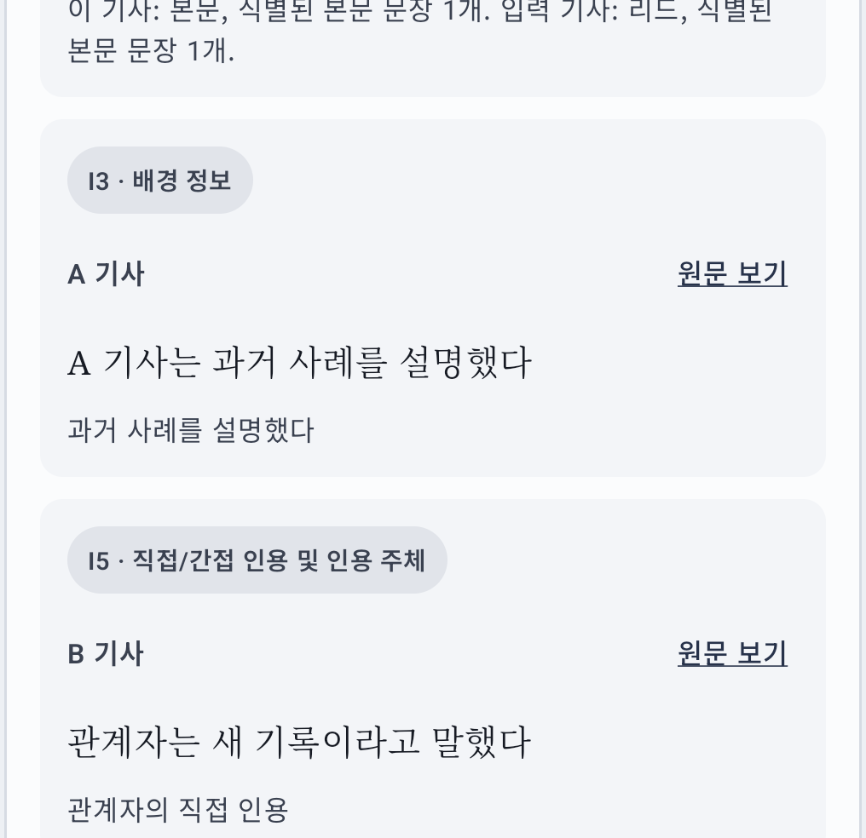
Current UI preview
Synthetic response
A quote, its source link, and rubric details.
Live NAVER/Gemini walkthrough and source review are still pending.
08
Notes:
TALK TRACK
The screenshot came from an emulator using a mocked HTTP response. It demonstrates screen navigation and rendering, not a live Gemini or NAVER result. Replace or supplement this slide with a recorded run of the exact configured backend and APK. If live v2 is not ready, show the historical Iteration 1 clip as such.
SOURCES AND STATUS
Synthetic screen: docs/testing-assets/android-synthetic-rubric.png
Live sign-off checklist: docs/midterm-presentation-outline.md

Slide 9
Team and integration status
Seoyoung Do
Comparison rubric
Junseo Heo
v2 analysis pipeline
Jinsol Lee
Android result screens
Seungmin Kim
API integration, tests, demo
Draft PR #10 connects the parts. Offline tests pass; live v2 remains to be checked.
09
Notes:
TALK TRACK
The team assignment came from Slack. Jinsol’s UI and Junseo’s pipeline are connected through Django in draft PR #10; it is not merged into main. Update this slide with final PR status, revision, and live outcome before presenting.
SOURCES AND STATUS
Team roles: https://swpp2026fall.slack.com/archives/C0C56TCMKU6/p1791896799209629
Integration PR: https://github.com/snuhcs-course/swpp-2026-project-team-05/pull/10

Slide 10
Before we call it a demo
01
Run v2 on a public article
Record status, analysis ID, and time.
02
Read the cited passages
Check event, claim relation, quote, and speaker.
03
Record the Android flow
Use that backend and APK; show the source page.
10
Notes:
TALK TRACK
These are the three remaining gates. A health endpoint only checks that credential values exist, not that the services respond. The real run needs source review, timing, and a device recording. The demo branch and Iteration 2 package follow those checks.
SOURCES AND STATUS
Iteration 2 submission notice: https://swpp2026fall.slack.com/archives/C0BUL8N1864/p1791763218720289
Test gaps: docs/testing-documentation-iter2.md

Slide 11
AI in the workflow
AI drafted a first pass.
Review caught a relation mismatch.
Code checks
People still need to check
IDs, quote spans, source links, failure states
Same-event selection and the meaning of each comparison
11
Notes:
TALK TRACK
In this integration, AI assisted with adapter and test drafting. Final review found that a claim relation could be withheld in the comparison card but asserted in the I1 card. We fixed both to show a withheld judgment and added regression tests. A passing fixture test does not prove that Gemini’s interpretation is fair. This is an account of the current integration work; ask each teammate for a real AI-use example before speaking for the whole team.
SOURCES AND STATUS
Current contract: server/analysis/v2_adapter.py
AI collaboration Wiki: https://github.com/snuhcs-course/swpp-2026-project-team-05/wiki/AI-Collaboration-Report

