Slide 1
Alongside passionate support of
Greenberger-Horne-Zeilinger State
Team SSQRT

Slide 2
Problem Statements
Build and run a GHZ state on an Real Quantum Hardware
Apply Readout Error Mitigation
Implement Quantum Communication Scheme
1
Improve GHZ circuit with Pulse-level Calibration
Optimize Pulse Parameters
2
Perform Zero-noise Extrapolation
Calibrate DRAG pulse and Rotary term
3

Slide 3
Problem Statements
Build and run a GHZ state on an Real Quantum Hardware
Apply Readout Error Mitigation
Implement Quantum Communication Scheme
1

Slide 4
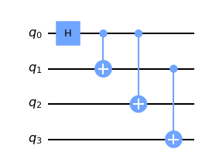
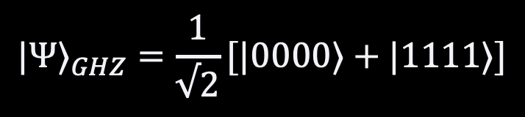
How to make a GHZ state
$${|Ψ⟩}_{GHZ}=\frac{1}{√2}[|0000⟩+|1111⟩]$$
Four-qubit GHZ State

Slide 5
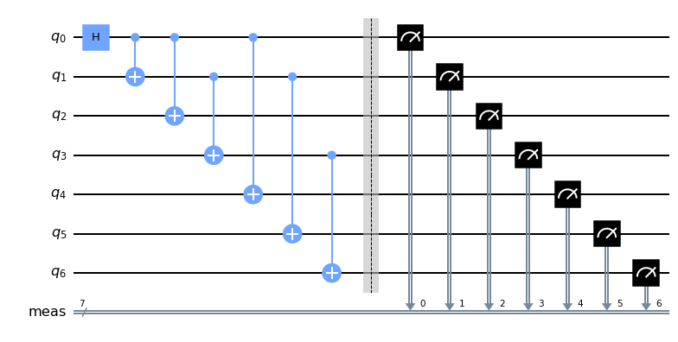

How to make a GHZ state
$${|Ψ⟩}_{GHZ}=\frac{1}{√2}[|0000⟩+|1111⟩]$$
Four-qubit GHZ State including Two-qubit Repetition Code

Slide 6
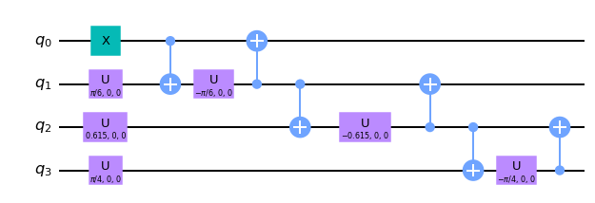
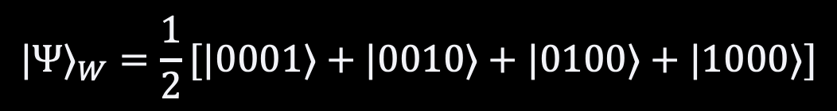
W state
$${|Ψ⟩}_{W}=\frac{1}{2}[|0001⟩+|0010⟩+|0100⟩+|1000⟩]$$
Four-qubit W State

Slide 7
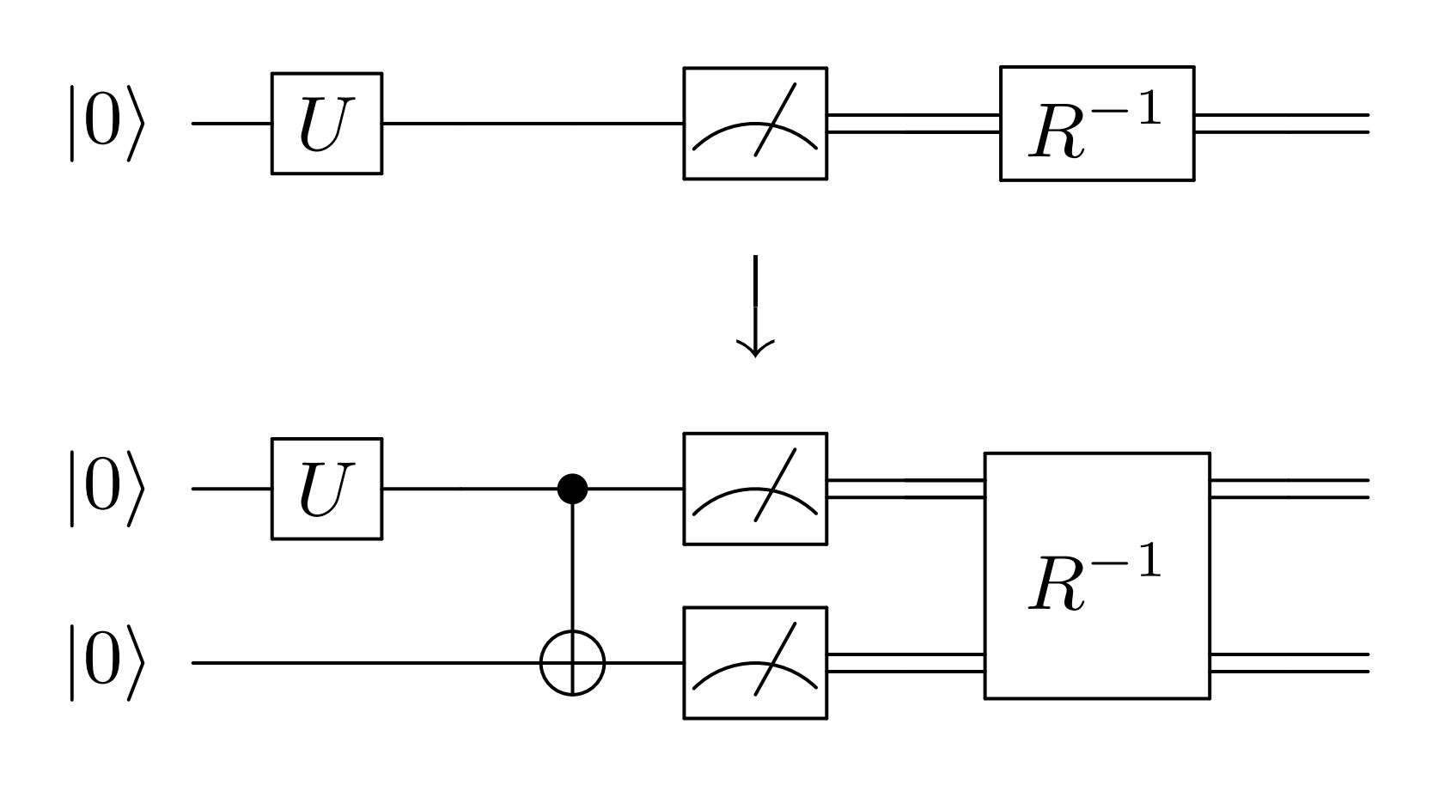
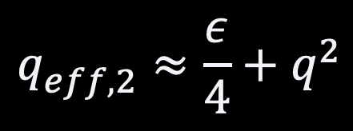
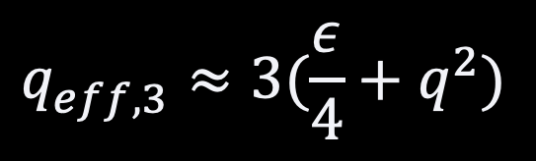
Readout Error Mitigation
Bit flip Readout Error Probability
$$q_{eff,2}^{}≈\frac{ε}{4}+q^{2}$$
Two-qubit readout error detection
$$q_{eff,3}^{}≈3(\frac{ε}{4}+q^{2})$$
Readout Error Mitigation Scheme using CNOT gate
Three-qubit readout error correction
R. Hicks et. al, “Active Readout Error Mitigation,” University of California, Berkeley, 2022.

Slide 8
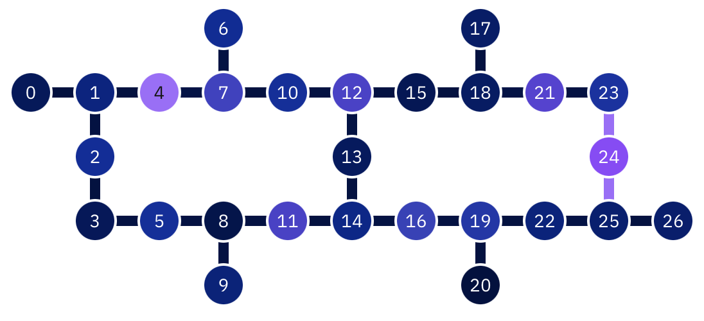
IBM Canberra
Falcon r6 Processor
27 Qubits

Slide 9
Optimal Qubit Layout Algorithm

Slide 10
Optimal Qubit Layout Algorithm
Optimal Qubit Layout Algorithm
Find all possible sets of four connected qubits
<
Find sets of qubits capable of three CNOT connections
<
If a qubit is subject to two CNOT possibilities,
compare the error probabilities of the two cases
<
Compare among the finalists for the optimal result

Slide 11
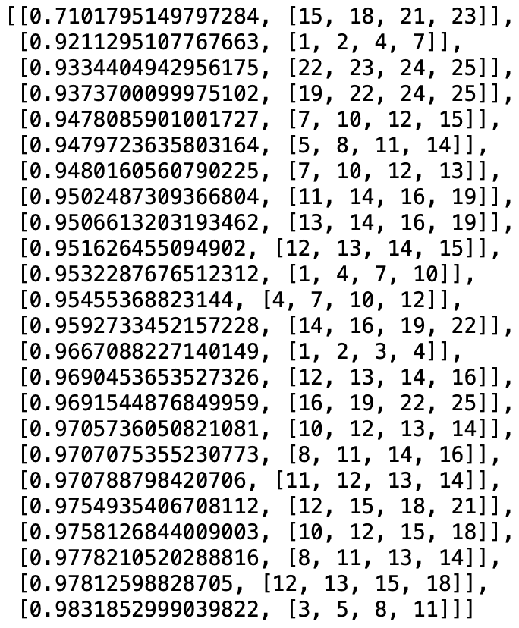
Optimal Qubit Layout Algorithm
Fidelity
Qubit Set

Slide 12

Before Correction
After Correction
Post-Measurement Treatment
Two Best Sets
0.96481
0.88822
0.99978
0.99846
Response Matrix
Two Worst Sets
Local Error Approximation
0.70727
0.54980
0.99152
0.98054
$$R≅R_{1}⨂R_{2}⨂R_{3}⨂R_{4}$$

Slide 13
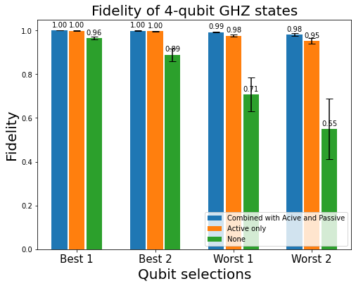
Before Correction
After Correction
Post-Measurement Treatment
Two Best Sets
0.96481
0.88822
0.99978
0.99846
Two Worst Sets
0.70727
0.54980
0.99152
0.98054

Slide 14
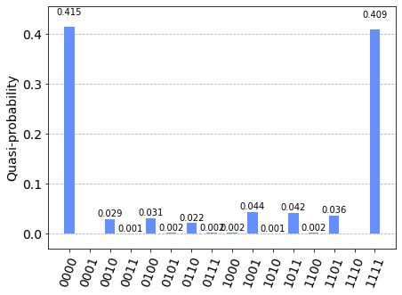
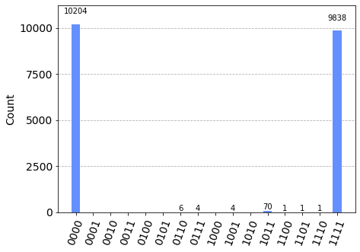
Comparison with IBM Runtime Sampler
IBM Runtime Sampler (Resilience Level 1)
Active & Passive Readout Error Mitigation

Slide 15
One-Hop Bidirectional Quantum Transportation
GHZ
Not a Bidirectional Channel!
Two independent path of channel each consuming one GHZ pair
$$\left(α | 0\right\rangle +β|1⟩)⊗\frac{\left|000\right\rangle +\left|111\right\rangle }{\sqrt{2}}=\frac{α\left|0000\right\rangle +α\left|0111\right\rangle +β\left|1000\right\rangle +β\left|1111\right\rangle }{\sqrt{2}}$$

Slide 16
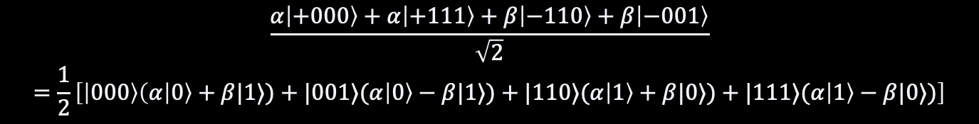
One-Hop Bidirectional Quantum Transportation
GHZ
GHZ⁻¹
$$\frac{α\left|+000\right\rangle +α\left|+111\right\rangle +β\left|−110\right\rangle +β\left|−001\right\rangle }{\sqrt{2}}=\frac{1}{2}\left[\left|000\right\rangle \left(α | 0\right\rangle +β|1⟩)+|001⟩(α\left|0\right\rangle −β|1⟩)+|110⟩(α\left|1\right\rangle +β|0⟩)+|111⟩(α\left|1\right\rangle −β|0⟩)\right]$$

Slide 17
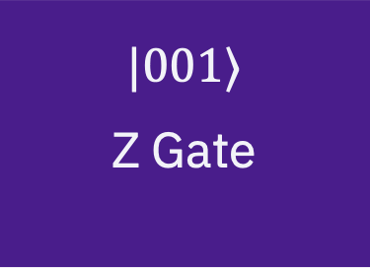
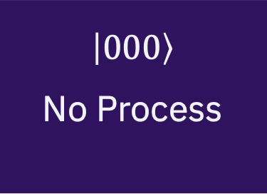
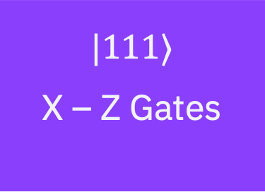
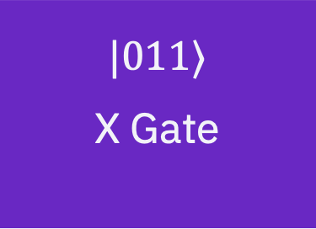
One-Hop Bidirectional Quantum Transportation
GHZ
measured
GHZ⁻¹
$$\frac{\left|000\right\rangle \left(α | 0\right\rangle +β|1⟩)+|001⟩(α\left|0\right\rangle −β|1⟩)+|110⟩(α\left|1\right\rangle +β|0⟩)+|111⟩(α\left|1\right\rangle −β|0⟩)}{2}$$
$$\left|000\right\rangle$$
No Process
$$|001⟩$$
Z Gate
$$|011⟩$$
X Gate
$$|111⟩$$
X – Z Gates

Slide 18
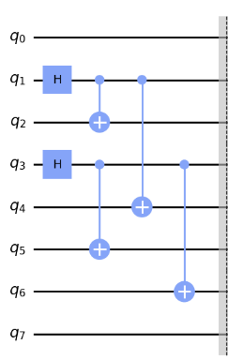
Procedures
1 Prepare GHZ States
1
2
3
4
5
6
0
7

Slide 19
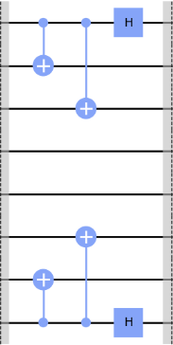
Procedures
2 Transfer Information to the Next Qubit with GHZ⁻¹ Gate
1
2
3
4
5
6
0
7

Slide 20
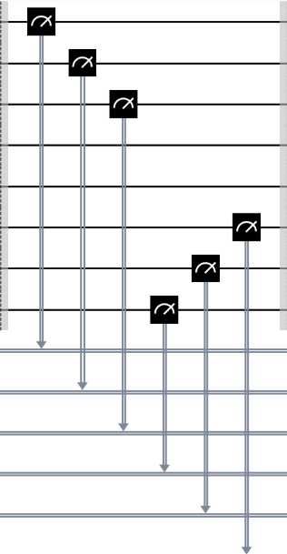
Procedures
3 Measurement: Transfer the Entire Information
4
3

Slide 21
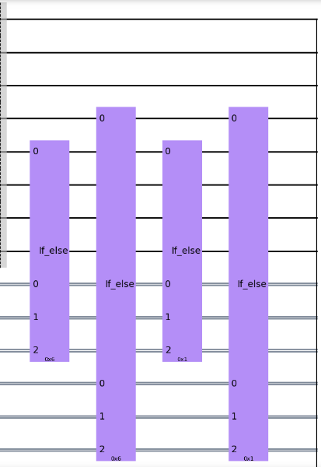
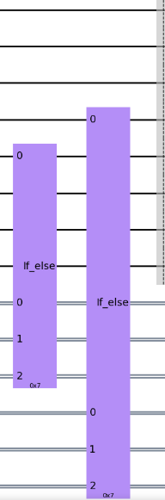
Procedures
4 Post-Processing
4
3

Slide 22


Multi-Hop
$$ψ_{A}$$
$$ψ_{B}$$

Slide 23





Multi-Hop
$A_{1}, B_{1}$ :one of $I,X,Z,ZX$
$${A_{1}ψ}_{A}$$
$$A_{1}$$
$$B_{1}$$
$${B_{1}ψ}_{B}$$

Slide 24

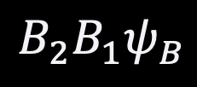
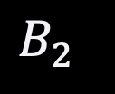
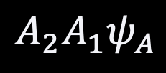


Multi-Hop
$A_{1}, B_{1},A_{2}, B_{2}$:one of $I,X,Z,ZX$
$${{A_{2}A}_{1}ψ}_{A}$$
$$A_{2}$$
$$B_{1}$$
$$A_{1}$$
$$B_{2}$$
$${{B_{2}B}_{1}ψ}_{B}$$

Slide 25
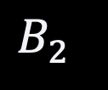
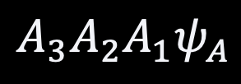




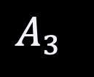
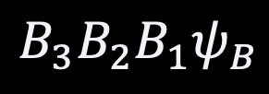
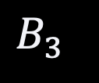
Multi-Hop
$A_{1}, B_{1},A_{2}, B_{2},A_{3}, B_{3}$:one of $I,X,Z,ZX$
$${{{A_{3}A}_{2}A}_{1}ψ}_{A}$$
$$A_{2}$$
$$A_{3}$$
$$A_{1}$$
$$B_{1}$$
$$B_{3}$$
$$B_{2}$$
$${{{B_{3}B}_{2}B}_{1}ψ}_{B}$$

Slide 26
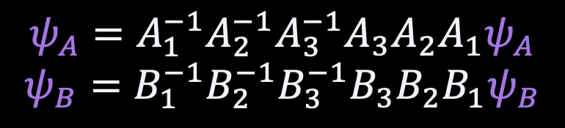
Multi-Hop
$A_{1}, B_{1},A_{2}, B_{2},A_{3}, B_{3}$:one of $I,X,Z,ZX$
$$ψ_{A}=A_{1}^{−1}A_{2}^{−1}A_{3}^{−1}A_{3}A_{2}A_{1}ψ_{A}$$
$$ψ_{B}=B_{1}^{−1}B_{2}^{−1}B_{3}^{−1}B_{3}B_{2}B_{1}ψ_{B}$$
ch = Multinode(0, 25, [([1, 2, 4], [3, 5, 6]),
([7, 8, 10], [9, 11, 12]),
([13, 14, 16], [15, 17, 18]),
([19, 20, 22], [21, 23, 24])],
[(2, 3), (4, 5), (1, 0), (6, 7)])

Slide 27
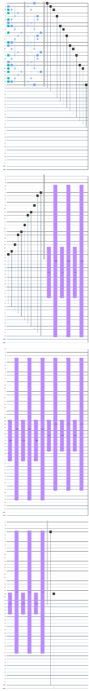
Multi-Hop
3-Hop Circuit, 27 qubits

Slide 28
Problem Statements
Improve GHZ circuit with Pulse-level Calibration
Optimize Pulse Parameters
2

Slide 29
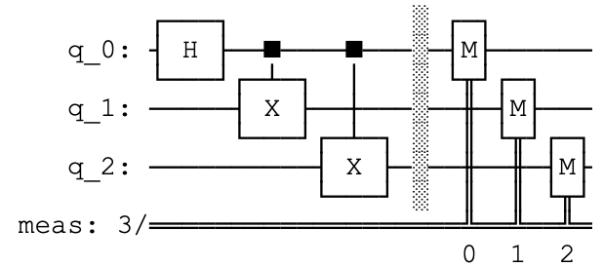
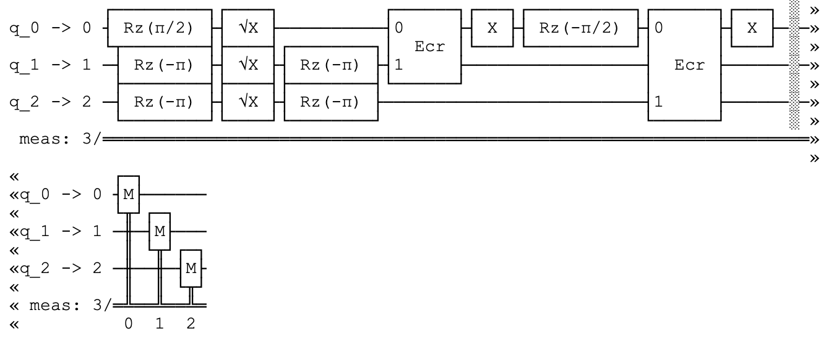
Single Qubit Calibration
Calibrated 3-qubit GHZ Gate
3-qubit GHZ Gate Abstraction

Slide 30
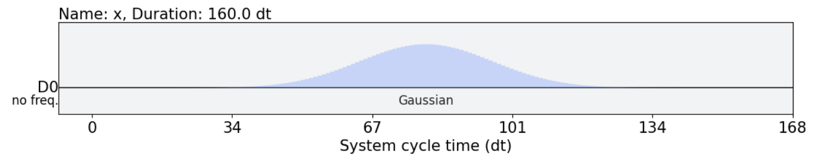
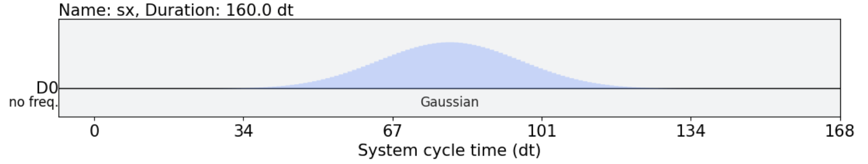
Single Qubit Calibration
X Gate
SX Gate

Slide 31
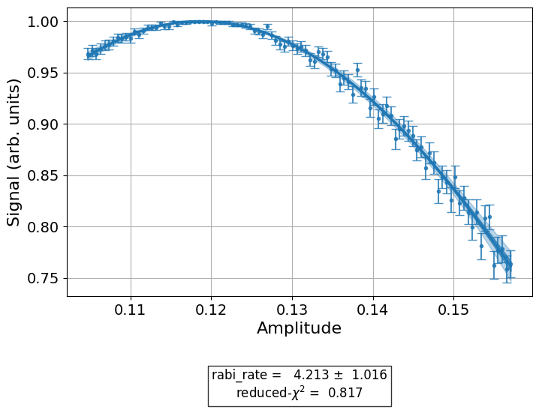
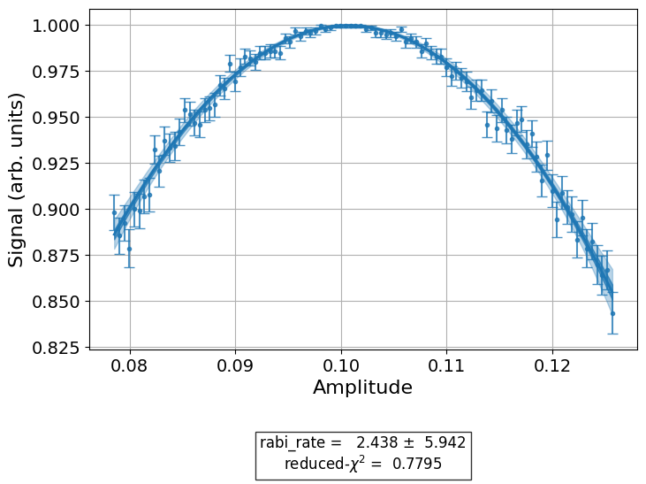
Single Qubit Calibration
Amplitude Optimization
Qubit 1
Qubit 2

Slide 32
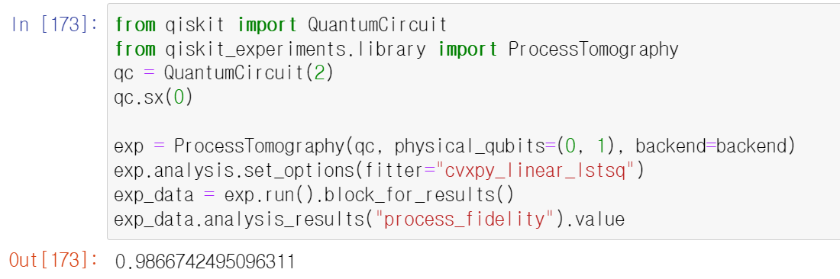
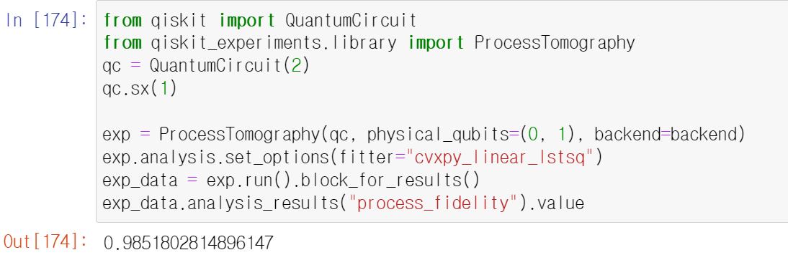
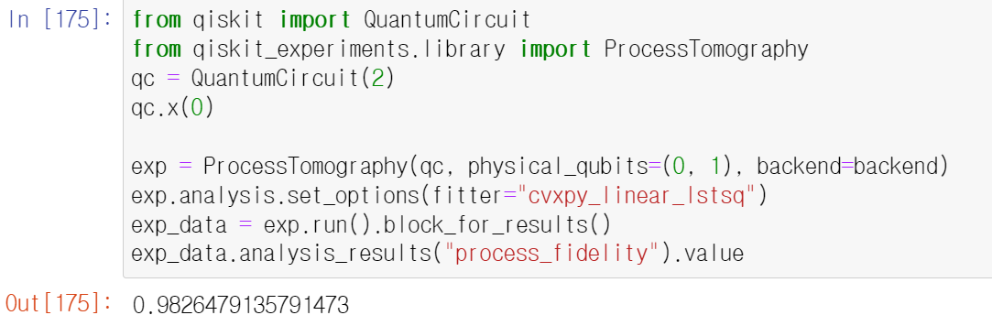
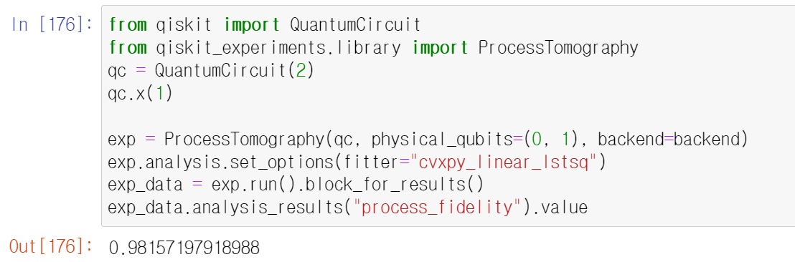
Single Qubit Calibration
SX Gate Optimal Values
X Gate Optimal Values

Slide 33
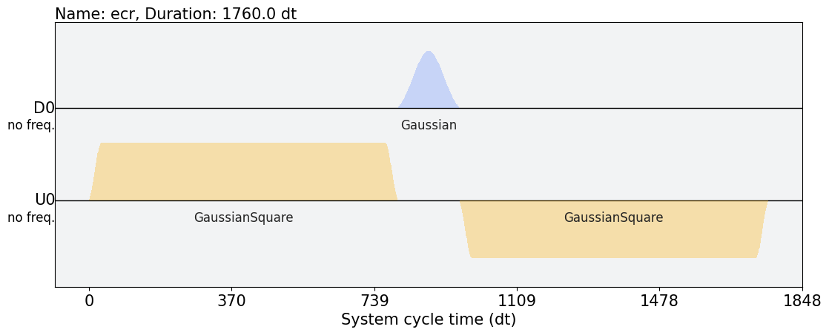
Cross Resonance Pulse Calibration

Slide 34
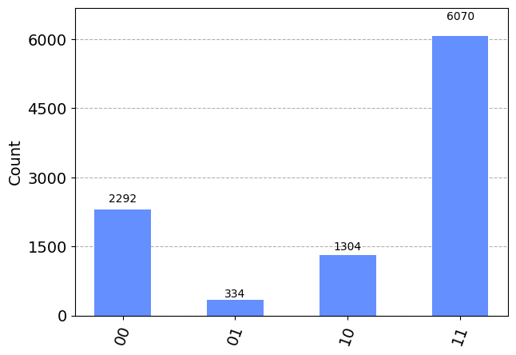
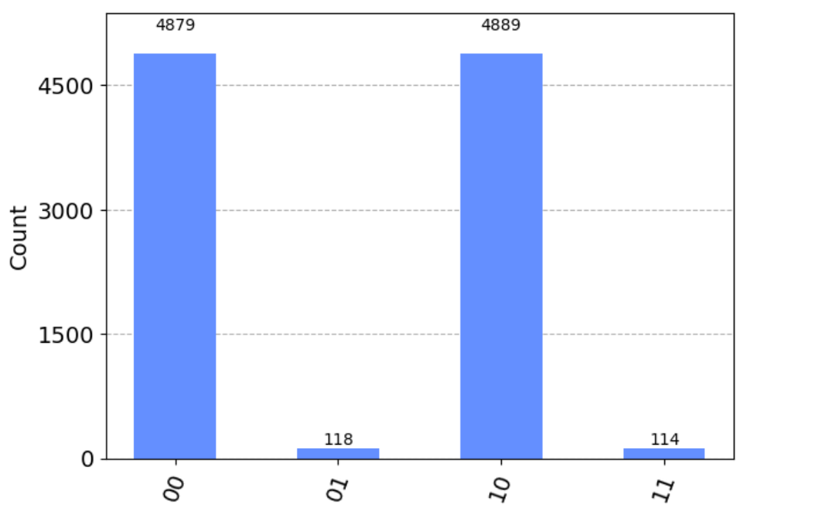
Cross Resonance Pulse Calibration
Poor Calibration
Optimized Calibration

Slide 35
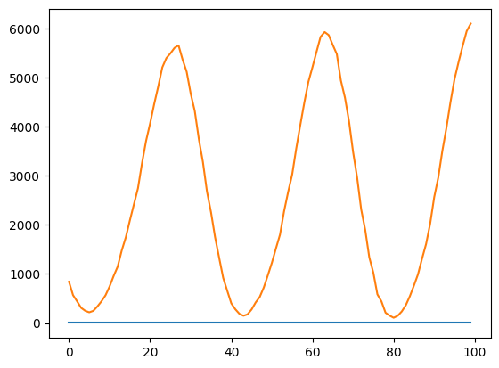
Cross Resonance Pulse Calibration
Count
Amplitude
CNOT Gate Calibration by Optimizing Amplitude
J. Jang, et. al

Slide 36
Problem Statements
Zero-noise Extrapolation
DRAG pulse and Rotary term
3

Slide 37
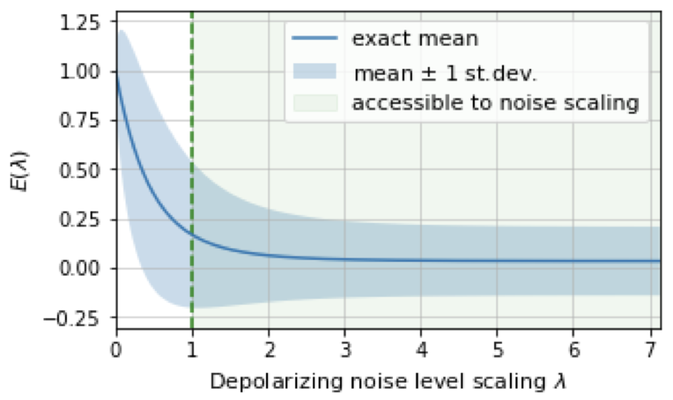
Zero-Noise Extrapolation
Leakage
T. Girugica-Tiron, et. al, ”Digital Zero noise extrapolation for quantum error mitigation,” Stanford University, 2021.

Slide 38
Pulse Calibration: DRAG
$$DRAG\left(x, x_{0},A, σ, β\right)=A\exp\left(−\frac{{\left(x−x_{0}\right)}^{2}}{2σ^{2}}\right)+iβ\frac{d}{dx}[A\exp\left(−\frac{{\left(x−x_{0}\right)}^{2}}{2σ^{2}}\right)]$$
Leakage
Limits Leakage to higher energy levels

Slide 39
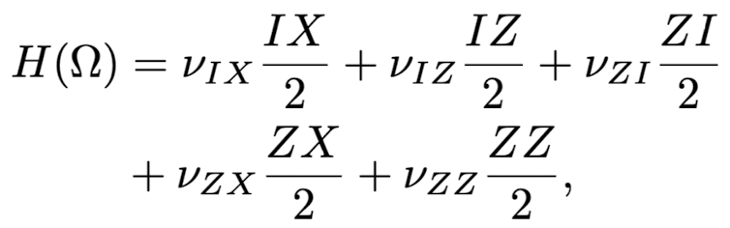

Pulse Calibration: Rotary Term
$$H=∑\{ω_{j}b_{j}^{†}b_{j}+\frac{δ_{j}}{2}b_{j}^{†}b_{j}\left(b_{j}^{†}b_{j}−I\right)\}+J \left(b_{0}^{†}b_{1}+b_{1}^{†}b_{0}\right)+Ωcos\left(ω_{d}t+φ_{c}\right)(b_{0}^{†}+b_{0})$$
Block-Diagonalization
Echoed Cross-Resonance Gate
$$ZX_{π/2}=XI∙ZX_{−π/4}∙XI∙ZX_{π/4}$$

